Slide 1
Molecular Biology Primer

Slide 2
Starting 19th century…
Cellular biology:
Cell as a fundamental building block
1850s+:
``DNA’’ was discovered by Friedrich Miescher and Richard Altmann
Mendel’s experiments with garden pea plants
Laws of inheritance, ``Alleles”, ``genotype’’ vs. ``Phenotype’’
1909: Wilhelm Johannsen coined the word ``gene’’
Still….. Proteins were thought to be the primary genetic materials… but..

Slide 3
Avery’s Experiment

Slide 4
What does a gene produce?
Gene → … ?... → Protein

Slide 5
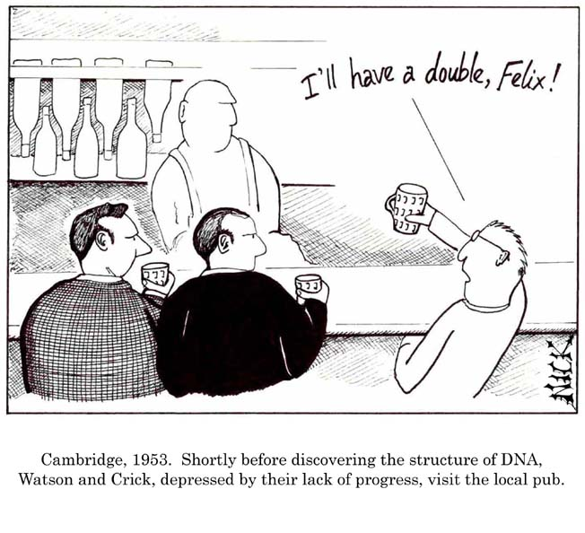
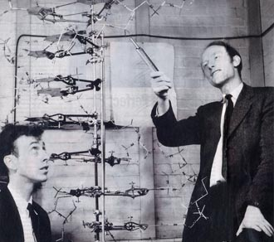
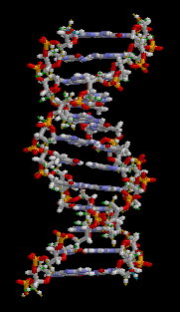
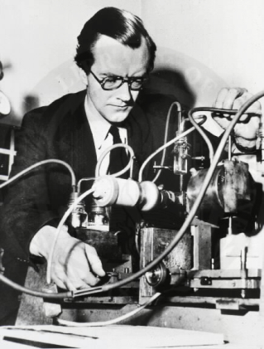
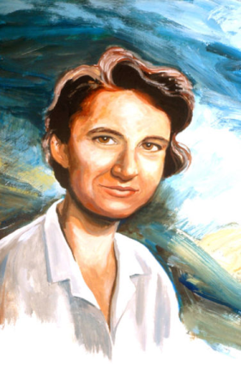
DNA: Birth of Molecular Biology (1953)
J.D.Watson
F. Crick
@Cavendish Lab, Cambridge
M.H.F.Wilkins
R. Franklin
@King’s College, London
Notes:
But before that, here are a few biology basics
Each cell contains a nucleus
The hereditary material is encoded in the form of DNA molecules within the nucleus
DNA is a double stranded molecule – and each strand is a sequence of nucleotides labeled A,C,G,T
The two strands are related by a property called reverse complementation – ie., if we know the sequence of one strand we can deduce the sequence of the other
The DNA molecules in a cell are collectively referred to as the genome
Genes are contiguous stretches along the genome which encode the recipe to produce protein molecules
Proteins are the fundamental functional units of a cell

Slide 6
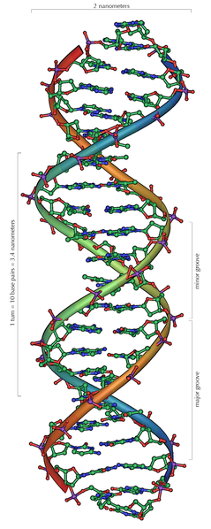
DNA: A Double Helix
Phosphate
Group
Nitrogenous
Base
A,C,G,T
Adenine
Cytosine
Guanine
Thymine
Double Helix in 3D
Sugar
3’
5’
A
T
Complementary Base Pairing Rule:
G
C
A ← → T
C
G
C ← → G
G
C
Reverse Complement:
A
T
5’
3’
AGCGACTG
TCGCTGAC
C
G
A
3’
5’
T
Strand#2
Strand#1
G
C
5’
3’
Each position is a “base pair”

Slide 7
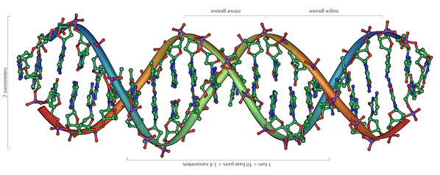
A little convention for convenience
Let us use a straight line from now on to represent a DNA strand (or equivalently, its sequence)
“Top strand” or “Watson strand”
5’
3’
3’
5’
“Bottom strand” or “Crick strand”

Slide 8
Genome
The collection of all DNA in a cell
Every organism has its own genome
The human genome:
Humans have 23 pairs of chromosomes
Each chromosome is one long DNA molecule (hence, also a DNA sequence)
The ”human genome” = 23 x 2 DNA sequences = approximately 3 billion base pairs (haploid copy)
Genomes are of varied size and complexity
Fig source: https://www.edinformatics.com/
Then, what are “genes”?

Slide 9
Genes are coding parts of a genome
Genes are internally made of exons (coding segments) and introns (non-coding segments)
Exon_1
Intron_1
Exon_2
Intron_2
Exon_3
RNA (a)
Spliced Variants of RNA transcripts
Exon_1
Exon_2
Exon_3
Exon_1
Exon_3
RNA (b)
…
Each gene can code for one or more RNA product (via alternative splicing)

Slide 10
Central Dogma: DNA ➔ RNA ➔ Protein

Slide 11
The Central Dogma & Biological Data
Genomic DNA containing gene segments
Transcribed molecules
(RNA molecules)
Translated products (protein molecules)
Protein structures
Slide adapted from: http://www.sanbi.ac.za/training-2/undergraduate-training/

Slide 12
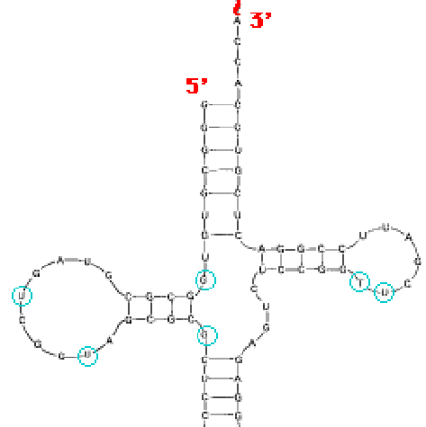
DNA RNA
Spot the difference!
Phosphate
Group
Nitrogenous
Base
A,C,G,T
Adenine
Cytosine
Guanine
Thymine
Phosphate
Group
Nitrogenous
Base
A,C,G,U
Adenine
Cytosine
Guanine
Uracil
Sugar
3’
Sugar
5’
A
T
A
G
C
G
C
G
C
G
C
G
A
T
A
C
G
C
T
A
RNA types:
tRNA
mRNA
rRNA
U
G
Strand#2
Strand#1
C
G
5’
3’
Double stranded
Single Stranded

Slide 13
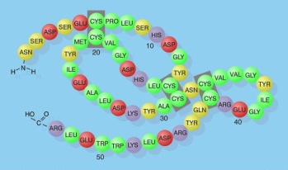
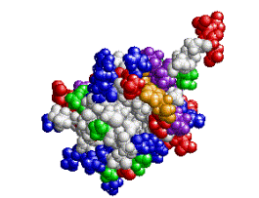
Proteins
Like a DNA and a RNA molecule is a chain of nucleotides {A,C,G,T/U}, a protein molecule is a ``chain of amino acids” (aka, peptide chain)
There are 20 amino acids
Next question:
How does a gene encode the information to produce a protein molecule?

Slide 14
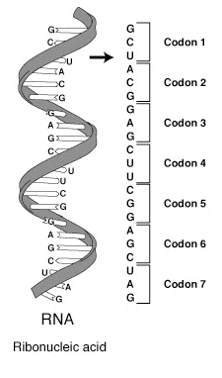
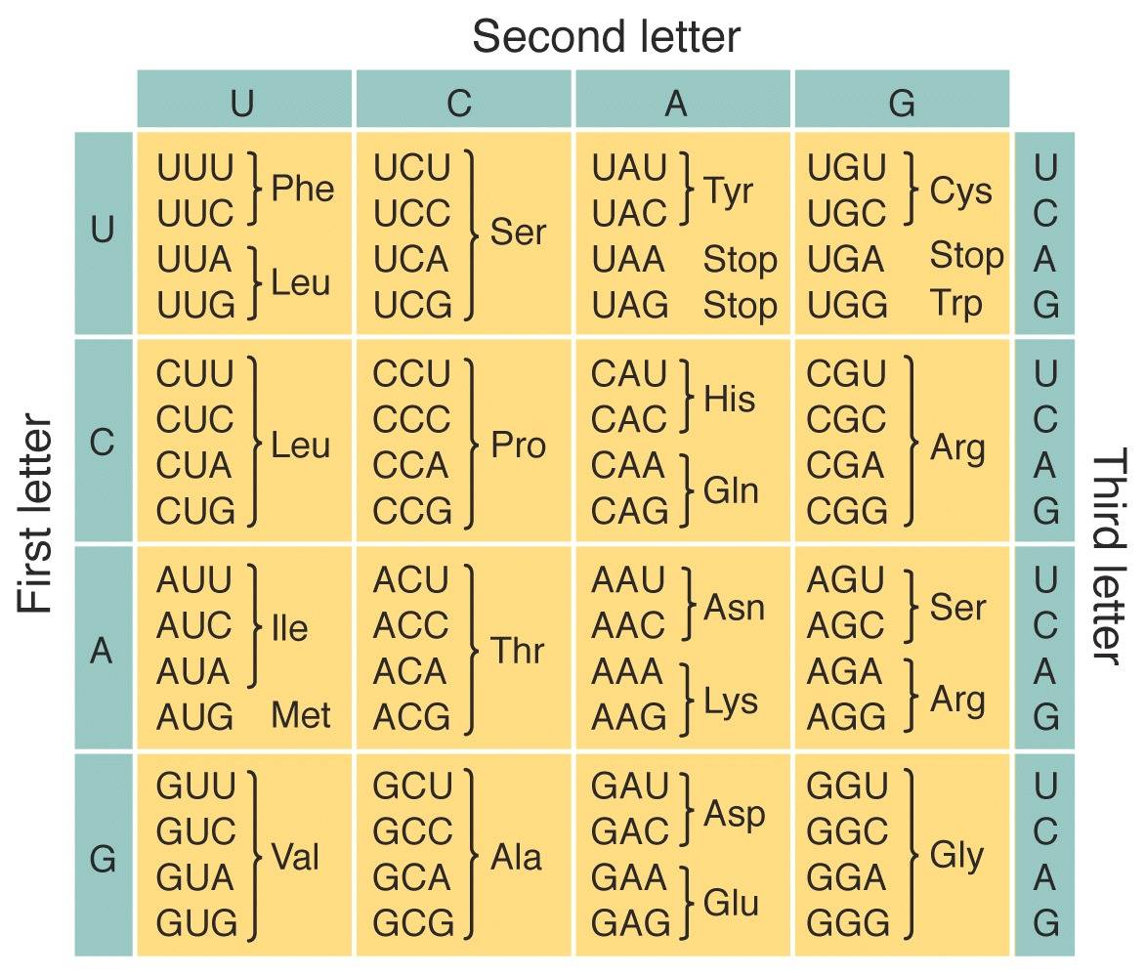
Genetic Code: Khorana, Holley and Nirenberg, 1968
Combinatorial Logic:
4² < 20 < 4³
➔ Hence 3 nucleotides in a codon

Slide 15
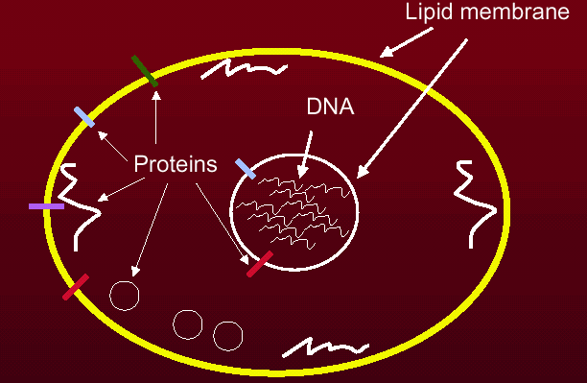
Information Flow During Protein Synthesis
Gene
3’
5’
DNA
5’
e₁
e₂
e₃
e₄
e₅
3’
Transcription
One gene can code for many proteins! (alternative splicing in eukaryotes)
mRNA
e₁
e₂
e₄
+ tRNA
Translation
Protein
Folding
Coding (exons)
Stable
Structure
Non-Coding (introns)
Nuclear genome

Slide 16
Genetic imperfections
Mutations are changes (edits) on the genome
Point mutations (single character edits) are referred to as “single nucleotide polymorphisms” (SNPs)
Point mutations can possibly change the protein product

Slide 17
Genetic imperfections
If a point mutation is in the coding part of a gene, it is one of the three kinds:
Synonymous: doesn’t change the amino acid product e.g., a codon changes from … CCA… ➔ … CCC… both yield Proline (as the amino acid product)

Slide 18
Genetic imperfections
A case of early Stargardt (tunnel vision) Gene: ABCA4
Missense: changes the amino acid product using a substituted amino acid
Nonsense: truncates the protein product because of a premature stop codon
Protein truncates
Fig. source: Genomic quirks

Slide 19
Genetic imperfections
A case of heart failure Gene: DSP
Frameshift errors: happens when the deletion (or insertion) of a nucleotide could result in shifting of the open reading frame (used in transcription)
Fig. source: Genomic quirks

Slide 20
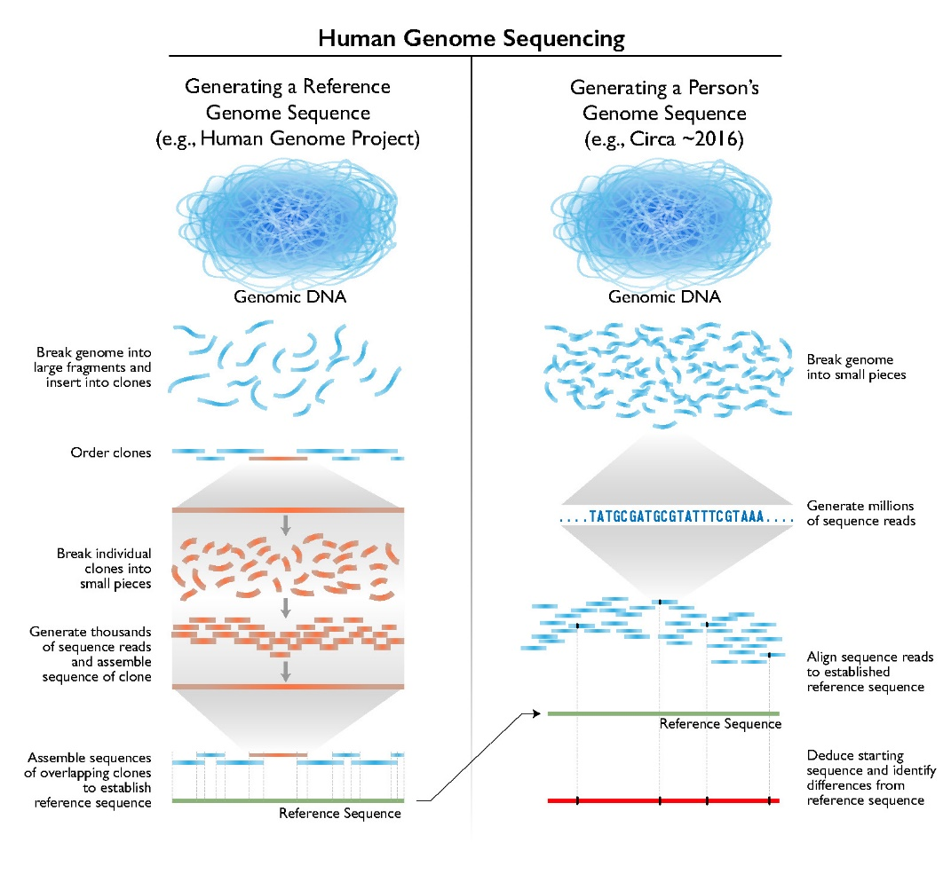
Sequencing a genome
Sequencing is the process of spelling out the characters (bases) of the genome
It is possible to sequence only fragments of DNA.
The lengths of the fragments (aka. “reads”) vary based on technology:
From 100bp (“short reads”)
To 20Kbp (“long reads”)
The original draft of the human genome (~3 billion bp) was sequenced for billion$ (circa. 2000)
You can now sequence your genome in under $1K
https://www.genome.gov/

Slide 21
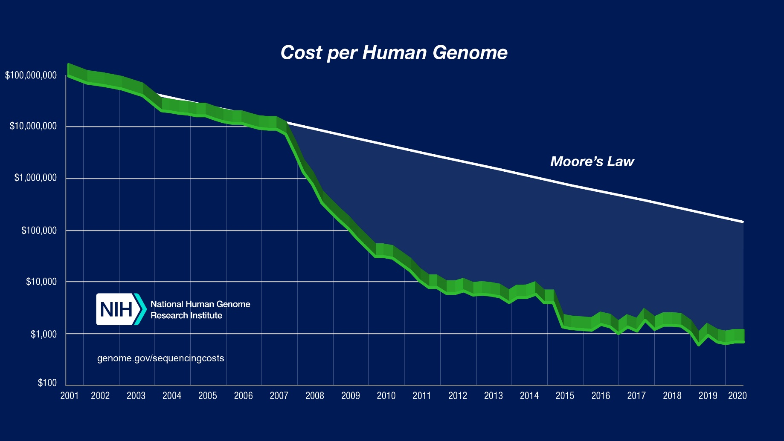
Cost to sequence a genome

Slide 22
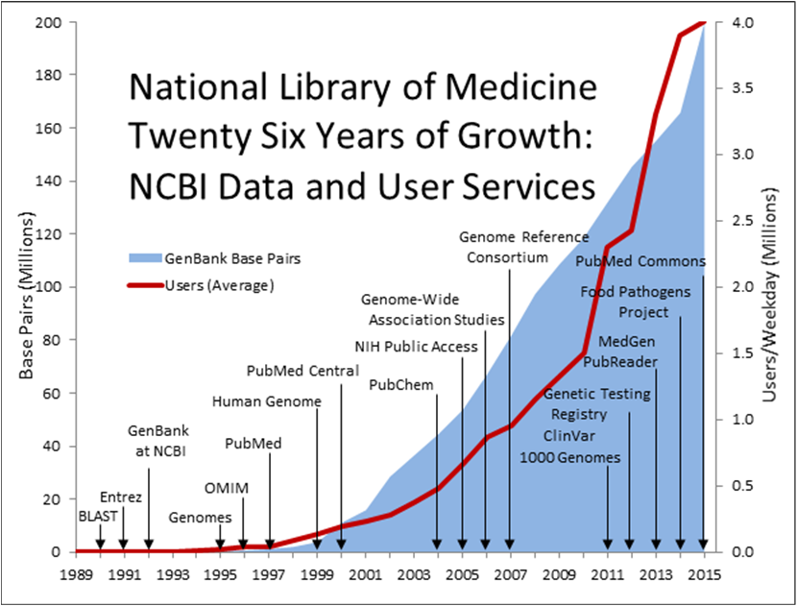
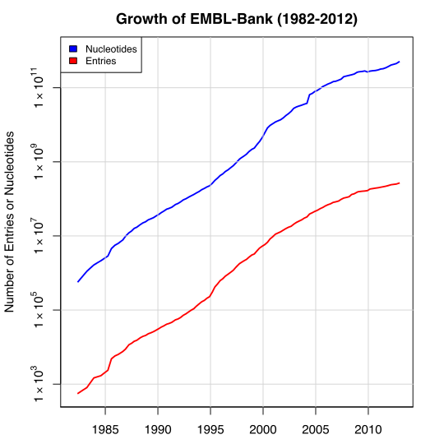
Genomic databases
“An annotated collection of all publicly available nucleotide and amino acid sequences.”
Source: NCBI GenBank, EMBL websites
https://www.nlm.nih.gov/about/2017CJ.html

Slide 23
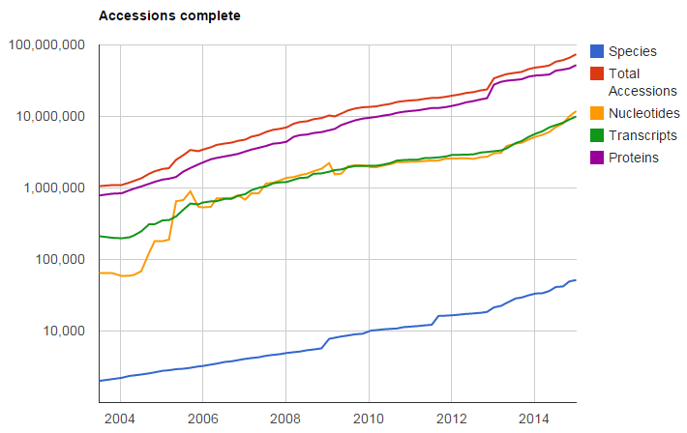
NCBI RefSeq database
“A comprehensive, integrated, non-redundant, well-annotated set of reference sequences including genomic, transcript, and protein.”
~600GB of data
http://www.ncbi.nlm.nih.gov/refseq/

Slide 24
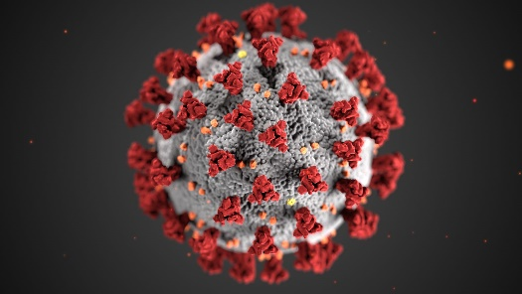
COVID-19 genome strains
COVID-19 Genome:
RNA virus
Approximately 30Kbp genome size
No. strains recorded till date (Jan’21): 4,046
Diversity of the genome (across strains) by nucleotides:
Diversity of the genome (across strains) by Amino Acid product:
https://nextstrain.org/ncov/global

Slide 25
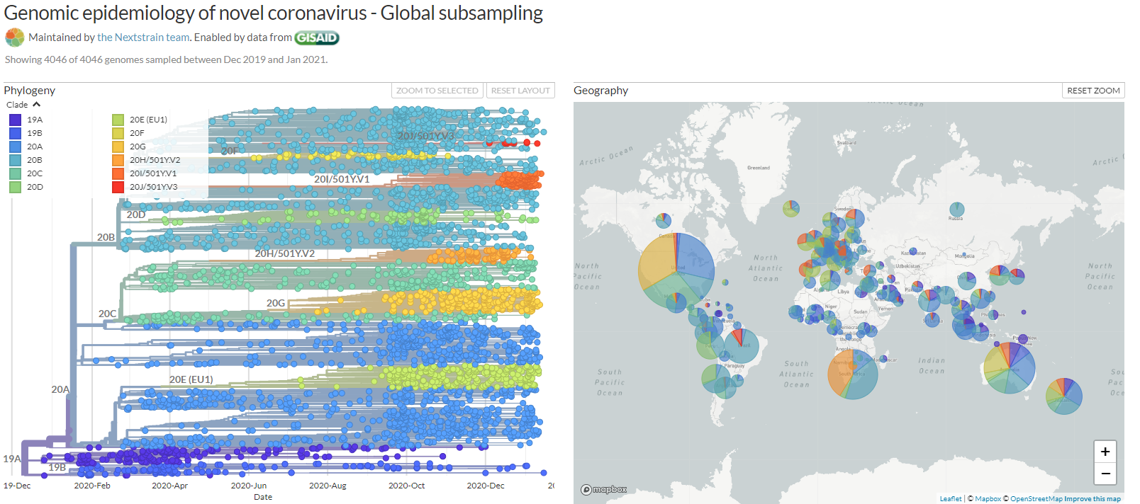
COVID-19 genome strain evolution
https://nextstrain.org/ncov/global

Slide 26
Several Questions Leading Up to Today’s Computational Biology and Bioinformatics
What are the nucleotides in a DNA molecule? (problem of sequencing)
What DNAs make up the genome of a species? (problem of genome sequencing, genome assembly)
What are the genes within a genome? (gene identification/discovery)
What protein and RNA products does a gene produce? (annotation)
What is the native 3D structure of a protein and how does it get there? (protein folding, structure prediction) Similar questions can be asked of RNAs too.

Slide 27
Several Questions ….
Are there non-protein coding genes? (pseudo-genes)
Under what conditions does a gene express itself, and are there genes that are more active than others under experimental conditions? (gene expression analysis, microarrays)
Are there a subset of genes that co-operate, and does a gene’s activity get affected by others? (gene regulatory networks)
How do genes look and behave in closely related species? What distinguishes them? (gene and species evolution)
What is the ``TREE OF LIFE’’? (phylogenetic tree reconstruction)
How does a protein know where to go next within a cellular complex? (localization, signal peptide prediction)
AND MANY MORE ….

Slide 28
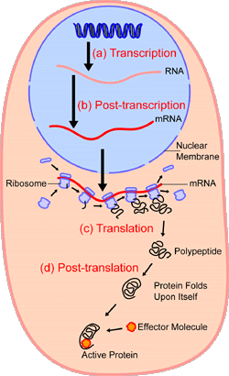
Computational Biology & Bioinformatics: Problem Areas
Structure
Sequence Discovery
Gene structure prediction
RNA structure prediction
Protein structure prediction
Genome
Gene
Regulatory elements
RNA products
Proteins
DNA
Evolutionary Studies
Tree of life
Speciation
Function
Gene to protein annotation
Gene expression analysis
Microarray experiments
RNA interference
Metabolic networks/pathway
Population Genetics
Haplotype analysis
Nucleotide polymorphism

Slide 29
Computational Biology and Bioinformatics
A rapidly evolving field
Technology – biological and computational
Capabilities
Concepts
Knowledge and Science
A plethora of grand challenge questions
An Ante-disciplinary Science?
An interesting read:
``Antedisciplinary’’ Science, Sean R. Eddy, PLoS Computational Biology, 1(1):e6

Slide 30
Referred Slide Materials, Acknowledgments, and Web Resources
``DNA From the Beginning” (http://www.dnaftb.org), Dolan DNA Learning Center, Cold Spring Harbor Laboratory
Stanford University, CS 262: Computational Genomics
NCBI website
Wikipedia
J.D. Watson, The Double Helix: A personal account of the discovery of the structure of DNA

