Slide 1
(14-1) Exception Handling in C++ D & D Chapter 17
Instructor - Andrew S. O’Fallon
CptS 122 (April 15, 2024)
Washington State University

Slide 2
Key Concepts
Exceptions
Exception handling
try block
catch handler
Keyword throw
Fault-tolerant programs

Slide 3
What is an Exception?
A signal that a problem has occurred during program execution that requires special processing
Exceptions should only occur during “exceptional” circumstances
C++ provides a mechanism for handling exceptions so that programs don’t just “crash” or stop executing, without a chance to recover

Slide 4
What is Exception Handling?
A process for detecting and resolving exceptions
C++ exception handling is built on three keywords
try
catch
throw

Slide 5
When to Use Exception Handling?
Exception handling processes synchronous errors, which occur when a statement in the program executes
Exception handling does not process asynchronous events that may happen independent of program flow

Slide 6
try Block
Contains code that might generate an exception

Slide 7
catch Handler
Executes as a result of an exception
The correct handler is “activated” when a match occurs between the type of exception thrown and type of parameter for the handler
An exception parameter should always be declared as a reference to the type of exception in the handler

Slide 8
Keyword throw
When an unexpected circumstance occurs an exception is generated by keyword throw

Slide 9
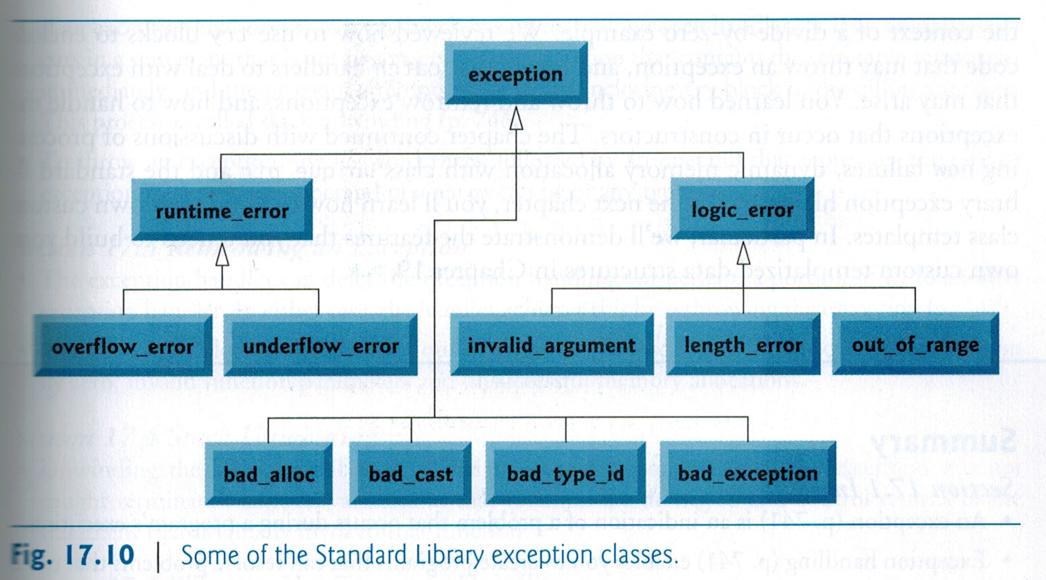
Standard Library Exception Classes and Hierarchy (I)
p. 775, Deitel & Deitel, C++ How To Program, 10th Ed.

Slide 10
Standard Library Exception Classes and Hierarchy (II)
We can write classes, which are derived from the standard library exception classes (Note: the standard exception classes are located in <stdexcept>)
class DivideByZeroException : public runtime_error

Slide 11
Dividing-by-zero Example
Provided in class

Slide 12
Fault-tolerant Programs
Programs that can satisfy most, if not all requirements, even if faults or exceptions occur
These programs handle faults or exceptions gracefully, which provides a level of robustness

Slide 13
Summary
Exception handling provides a mechanism for building robust and fault-tolerant programs

Slide 14
References
P.J. Deitel & H.M. Deitel, C++ How to Program (10th Ed.), Pearson Education , Inc., 2017.
J.R. Hanly & E.B. Koffman, Problem Solving and Program Design in C (7th Ed.), Addison-Wesley, 2013

