Slide 1
(14-3) More with UML
Instructor - Andrew O’Fallon
CptS 122
Washington State University

Slide 2
UML as a Model
UML is a notational syntax for expressing Object Oriented models
Merges Booch, Rumbaugh, and Jacobson
Not a methodology (although the Unified Process is)
UML Models can (should be) an important source for test

Slide 3
Relationships in UML Models
Relationships in models can show a dependency between two instances
The example shows a relationship such that a student takes 0 to many classes; We might question the many (limiting it to some max value) but we can definitely look for tests about this relationship
Class
Student
takes
0..*
Built in relationships have a corresponding generic test requirements that can be identified by applying a relational test strategy to each UML diagram

Slide 4
General Purpose Elements of UML
Organize diagrams
Express details

Slide 5
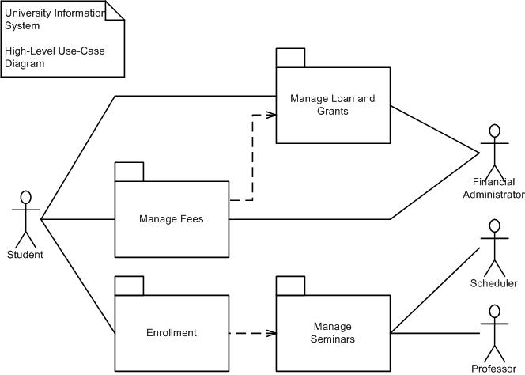
Packages and Package Diagrams
Package
A group of UML diagrams and diagram elements of any kind, including other packages
A package diagram shows the organization of packages

Slide 6
Expressions, Constraints, Comments, and NOTES
Expression ➔ a string from an executable language that can be evaluated to produce a result
Constraints ➔ a predicate expression on an element
Comments ➔ a natural language constraint
A note is a box with a dog eared corner. It may or may not be connected to a diagram element. It contains a textual description or explanation.

Slide 7
Use Case Models (1)
Query weather&snow forecast
<<include>>
Book room
Enter personal info
Visitor
Book SB course
<<include>>
<<extend>> (Enter kid’s age)
Cancel course
Book kids’ SB course
Cancel room

Slide 8
Use Case Models (2)
Use Case: Book SB course
Precond: -
Main flow:
Visitor enters date
Include (Enter personal info)
(Enter kid’s age)
Store reservation
Confirm reservation to Visitor
Exceptional flow:
If number of course participants for specified date > 8, then tell visitor so and let him choose another date

Slide 9
Use Case Models (3)
Use Case: Book kids’ SB course
Precond: SB course is for a kid
Main flow:
Enter kid’s age
Store reservation
Confirm reservation to Visitor
Exceptional flow:
If course for specified date is adult course, then tell visitor so and let him choose another date
Exceptional flow:
If course for specified date is kids’ course, and the specified age is outside the course’s age range, then tell visitor so and let him choose another date

Slide 10
Use Case
An abstraction of the system to model behavior to external interaction
Accomplish important tasks from the user’s point of view
Represent system requirements
Functional
Allocation to classes
Object interaction and interfacing
User interfaces
User documentation

Slide 11
Class Diagram
Central for OO modeling
Shows static structure of the system
Types of objects
Static relationships
Association (e.g.: a company has many employees)
Generalization (subtypes) (e.g.: an employee is a kind of person)
Dependencies (Aggregation) (e.g.: a company is using trucks to ship products)

Slide 12
Class
Set of objects
Defines
Name
Attributes (optional: type optional: initial value)
Operations
Task
startDate: Date = default
endDate: Date
name
setStartDate (d : Date)
setEndDate (d : Date)
getDuration () : Date

Slide 13
Class diagram example
Actuator
association
startUp( )
shutDown( )
generalization
Light
Heater
Cooler
Temperature
off( )
1
1
on( )
aggregation
0..*
1
1
1
Environmental Controller
SystemLog
define_climate( )
display( )
terminate_climate( )
recordEvent( )

Slide 14
Sequence Diagrams
Shows object interactions arranged in time sequence
It focuses on
Objects (and classes)
Message exchange to carry out the scenarios functionality
The objects are organized in an horizontal line and the events in a vertical time line

Slide 15
Notation Example (simple version)
Messages point from client to supplier
: Professor
CourseManager
Math 101 - Section
1 : CourseOffering
Add professor (Professor)
Lifeline
Message

Slide 16
Sequence Diagram: Larger Example
course form :
CourseForm
theManager :
CurriculumManager
: Registrar
Object
creation
1 : set course info
2 : process
3 : add course
aCourse :
Course
4 : <<create>>

Slide 17
Sequence Diagrams: More Details
an Order
an Order
an Order
a Stock Item
Self delegation
Entry window
Line
1: prepare()
2: * prepare()
3: check()
4: [check = true]
remove()
5: needsToReorder()
Iteration
Condition
6: [needsToReorder = true]
<<create>>
a Reorder
Item
Asynchronous
Message
Activation
Return arrow

Slide 18
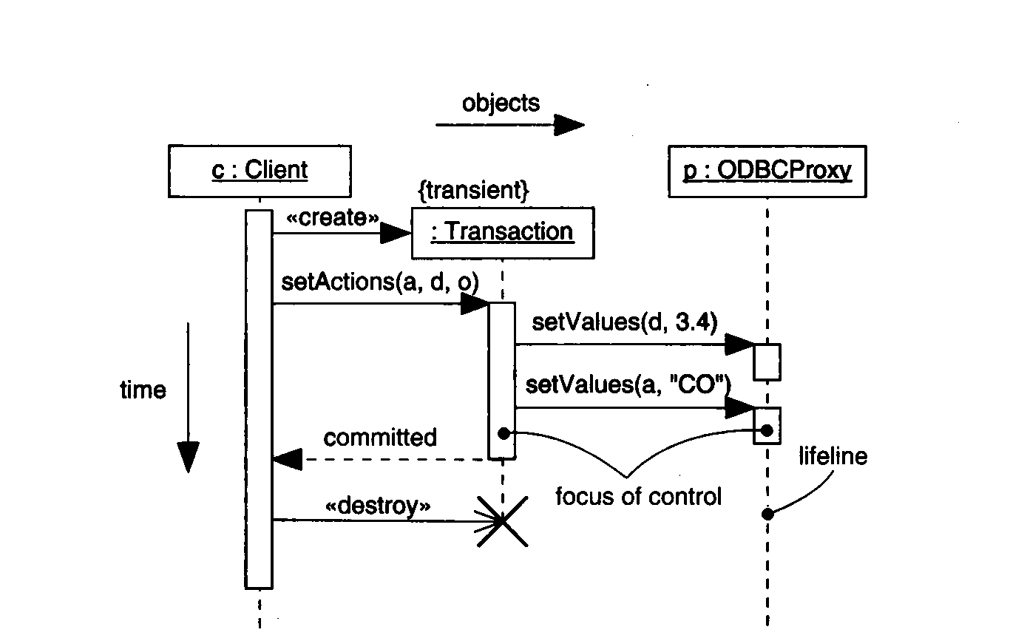
Example of a Transaction
From: G. Booch, J.Rumbaugh, I. Jacobson: The Unified Modeling Language User Guide.
Addison Wesley, 1999, fig 18-2 page 247
Notes:
In this examples all the new features of UML 1.3 are shown with reference to interaction diagram...

Slide 19
Content of Sequence Diagrams
Objects
They exchange messages among each other
Messages
Synchronous: “call events,” denoted by the full arrow; Duration of synchronization should be indicated by activation bar or return arrow
Asynchronous: “signals,” denoted by a half arrow
There are also «create» and «destroy» messages

Slide 20
Asynchronous messages
Do not block the caller
Can do 3 things:
Create a new thread
Create a new object
Communicate with a thread that is already running

Slide 21
References
Robert V. Binder, Testing Object-Oriented Systems: Models, Patterns, and Tools, Addison-Wesley, 2000.

Slide 22
Collaborators
Jack Hagemeister

