Slide 1
(9-3) Efficiency of Algorithms D & D Chapter 20
Instructor - Andrew S. O’Fallon
CptS 122 (March 8, 2024)
Washington State University

Slide 2
Analysis of Algorithms (1)
In general, we want…
to determine central unit of work by considering the operations applied in the algorithm
to express unit of work as function of size of input data: How quickly does amount of work grow as size of input grows?
classify algorithms according to how their running time and/or space requirements grow as input size grows
For example, recall Sequential Search algorithm
Get list of n names to search, and target name to search for
Examine each name in sequence
If all names have been examined, set found to false and stop
If name equals target, set found to true and stop
If name not equal to target, advance to next name
Main unit of work: comparisons
Analysis
In best case, one comparison must be made (target is first item in list)
In worst case, n comparisons must be made (target not found; all items examined)
In average case n/2 comparisons must be made

Slide 3
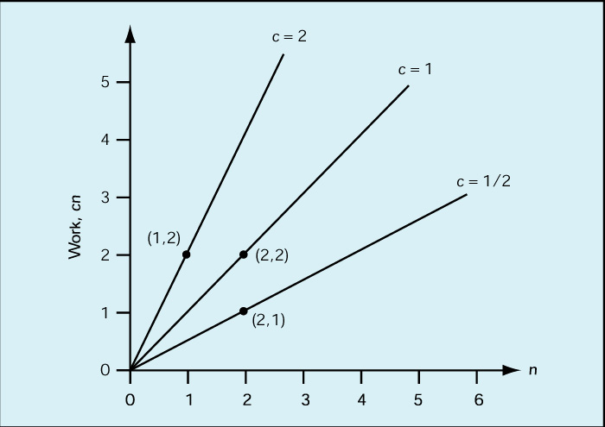
Analysis of Algorithms (2)
Order of magnitude analysis (“Big-O”)
Constant factors do not change shape of graph!

Slide 4
Analysis of Algorithms (3)
Order of magnitude (“Big-O”) (cont.)
Any algorithm whose work can be expressed as c * n where c is a constant and n is the input size is said to be “order of magnitude n”, or O(n)
Likewise, any algorithm whose work varies as a constant times the square of the input size is said to be “order of magnitude n-squared”, or O(n²)

Slide 5
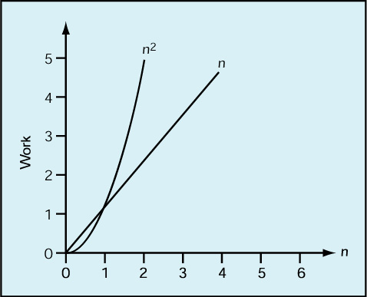
Analysis of Algorithms (4)
Order of magnitude (“Big-O”) (cont.)
O(n²) always gets bigger than O(n) eventually!

Slide 6
Analysis of Algorithms (5)
Big-O Analysis of Sequential Search
Best case: O(1)
Worst case: O(n)
Average case: O(n/2) = O(n)

Slide 7
Analysis of Algorithms (6)
Recall Selection Sort…
Input: a list of numbers
Output: a list of the same numbers in ascending order
Method:
Set marker that divides “unsorted” and “sorted” sections of list to the end of the list
While the unsorted section of the list is not empty
Find largest value in “unsorted” section of list
Swap with last value in “unsorted” section of list
Move marker left one position

Slide 8
Analysis of Algorithms (7)
Selection Sort (cont.)
Big-O Analysis
Units of work: comparisons and exchanges
In all cases, we need n + (n - 1) + … + 1 comparisons = [n * (n – 1)]/2 comparisons = 1/2n² – 1/2n comparisons = O(n²) comparisons
In best case, items are already in order, so 0 exchanges needed: O(n²) comparisons + 0 exchanges = O(n²)
In worst case, items are in reverse order, so n exchanges needed: O(n²) comparisons + n exchanges = O(n²)

Slide 9
Analysis of Algorithms (8)
Selection Sort (cont.)
Space Analysis
Major space requirement is list of numbers (n)
Other space requirements:
Extra memory location needed for marker between sorted and unsorted list
Extra memory location needed to store LargestSoFar used to find largest item in unsorted list
Extra memory location needed to exchange two values (why?)
Overall, space requirement is proportional to n.

Slide 10
Analysis of Algorithms (9)
Recall Binary Search…
Input: a list of n sorted values and a target value
Output: True if target value exists in list and location of target value, false otherwise
Method:
Set startindex to 1 and endindex to n
Set found to false
While found is false and startindex is less than or equal to endindex
Set mid to midpoint between startindex and endindex
If target = item at mid then set found to true
If target < item then set endindex to mid – 1
If target > item then set to startindex to mid + 1 pointSet marker that divides “unsorted” and “sorted” sections of list to the end of the list
If found = true then print “Target found at location mid”
Else print “Sorry, target value could not be found.”

Slide 11
Analysis of Algorithms (10)
Binary Search (cont.)
Big-O Analysis
Unit of work: comparisons
Best case
target value is at first midpoint
O(1) comparisons
Worst case
target value is not found
list is cut in half until it is reduced to a list of size 0 (startindex is greater than or equal to endindex)
How many times can the list be cut in half? The number of times a number n is divisible by another number m is defined to be the logb(a), so the answer is log₂(n) = O(lg n)

Slide 12
Analysis of Algorithms (11)
 |  | n
Order |  |  | 10 | 50 | 100 | 1000
lg n |  |  | 0.0003 sec | 0.0006 sec | 0.0007 sec | 0.001 sec
n |  |  | 0.001 sec | 0.005 sec | 0.01 sec | 0.1 sec
n² |  |  | 0.01 sec | 0.25 sec | 1 sec | 1.67 min
2^{n} |  |  | 0.1024 sec | 3570 yrs | 4 * 1016 centuries | Too big to compute

Slide 13
Summary of Orders of Magnitude
O(lg n) = flying
O(n) = driving
O(n²) = walking
O(n³) = crawling
O(n⁴) = barely moving
O(n⁵) = no visible progress
O(2^{n}) = forget it, it will never happen

Slide 14
References
P.J. Deitel & H.M. Deitel, C++ How to Program (9th Ed.), Pearson Education , Inc., 2014.
J.R. Hanly & E.B. Koffman, Problem Solving and Program Design in C (7th Ed.), Addison-Wesley, 2013

Slide 15
Collaborators
Chris Hundhausen

