Slide 1
http://cheezburger.com/58645249

Slide 2
Last Week
Function Approximation
Neural Networks
Linear
Tile Coding
IFSA

Slide 3
CMAC
http://incompleteideas.net/rlai.cs.ualberta.ca/RLAI/RLtoolkit/tilecoding.html
http://incompleteideas.net/rlai.cs.ualberta.ca/RLAI/RLtoolkit/tiles.html

Slide 4
(Code excerpts from Peter Stone: Keepaway)
void CMAC::loadTiles()
{
int tilingsPerGroup = TILINGS_PER_GROUP; /* num tilings per tiling group */
numTilings = 0;
/* These are the 'tiling groups' -- play here with representations */
/* One tiling for each state variable */
for ( int v = 0; v < getNumFeatures(); v++ ) {
for ( int a = 0; a < getNumActions(); a++ ) {
GetTiles1( &(tiles[ a ][ numTilings ]), tilingsPerGroup, colTab,
state[ v ] / getResolution( v ), a , v );
}
numTilings += tilingsPerGroup;
}
if ( numTilings > RL_MAX_NUM_TILINGS )
cerr << "TOO MANY TILINGS! " << numTilings << endl;
}

Slide 5
double CMAC::computeQ( int action )
{
double q = 0;
for ( int j = 0; j < numTilings; j++ ) {
q += weights[ tiles[ action ][ j ] ];
}
return q;
}
int SarsaAgent::selectAction()
{
int action; // Epsilon-greedy
if ( drand48() < epsilon) {
action = range_rand( getNumActions() ); //explore
}
else{
action = argmaxQ(); //exploit
}
return action;
}

Slide 6
int SarsaAgent::startEpisode( double state[] )
{
FA->decayTraces( 0 );
FA->setState( state );
for ( int a = 0; a < getNumActions(); a++ ) {
Q[ a ] = FA->computeQ( a );
}
lastAction = selectAction();
FA->updateTraces( lastAction );
return lastAction;
}
void SarsaAgent::endEpisode( double reward ){
double delta = reward - Q[ lastAction ];
FA->updateWeights( delta, alpha );
lastAction = -1;
}

Slide 7
int SarsaAgent::step( double reward, double state[] )
{
double delta = reward - Q[ lastAction ];
FA->setState( state );
for ( int a = 0; a < getNumActions(); a++ ) {
Q[ a ] = FA->computeQ( a );
}
lastAction = selectAction();
delta += Q[ lastAction ];
FA->updateWeights( delta, alpha );
// need to redo because weights changed
Q[ lastAction ] = FA->computeQ( lastAction ));
FA->decayTraces( gamma * lambda );
for ( int a = 0; a < getNumActions(); a++ ) { //clear other than F[a]
if ( a != lastAction ) {
FA->clearTraces( a );
}
}
FA->updateTraces( lastAction ); //replace/set traces F[a]
return lastAction;
}

Slide 9
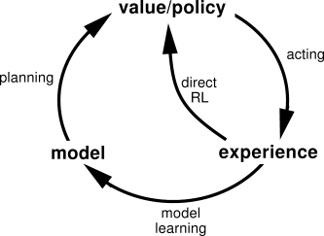
Learning: Uses experience
Planning: Use simulated experience

Slide 10
The book says “The unified view we present in this chapter is that all state-space planning methods share a common structure“ and the “common structure means that many ideas and algorithms can be transferred between planning and learning”. Can I get more detailed examples of applications support this argument?

Slide 11
Models
A model lets the agent predict how the environment responds to its actions
Distribution model: description of all possibilities and their probabilities
p(s’, r | s, a) for all s, a, s’, r
Sample model, aka simulation model
Produces sample experiences for given s,a
Allows reset / exploring starts
Often easier to obtain

Slide 12
Models
How would we learn to estimate them?
Discrete state space
Continuous state space

Slide 13
Planning
State space planning: search of state space
Plan-space planning: search of plans
Genetic Algorithms
Partial-order planning
Dynamic programming: have a model
Model-based RL (aka Model-learning RL) : learn a model

Slide 14
Random-sample on-step tabular Q-planning

Slide 15
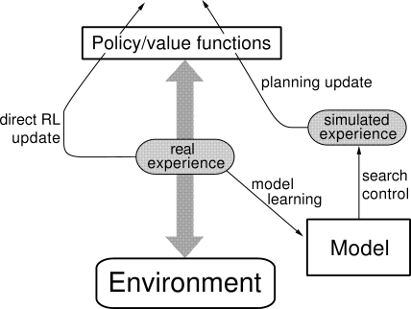
Dyna
Search Control
Direct simulated experience
Planning, acting, model learning, direct RL in parallel!

Slide 16
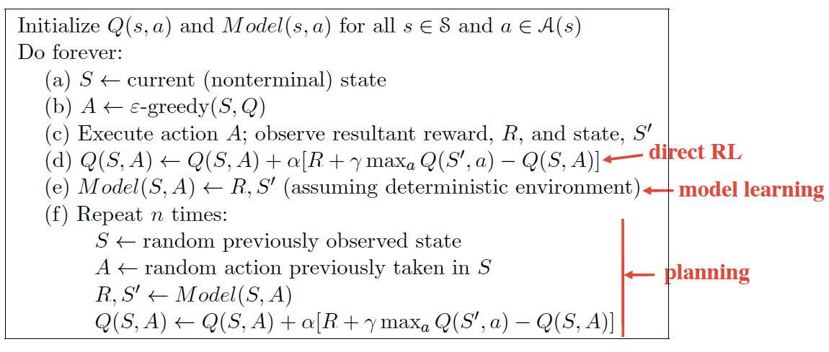
Dyna-Q

Slide 17
Collect Data
Generate Model
Plan over model
…
Profit!

Slide 18
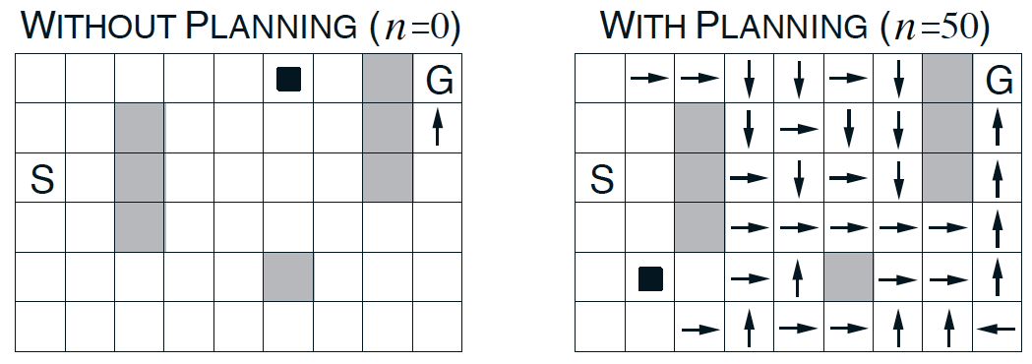
Without planning: each episode adds only one additional step to the policy, and so only one step (the last) has been learned so far.
With planning: only one step is learned during the first episode, but here during the second episode an extensive policy has been developed that by the episode's end will reach almost back to the start state.

Slide 19
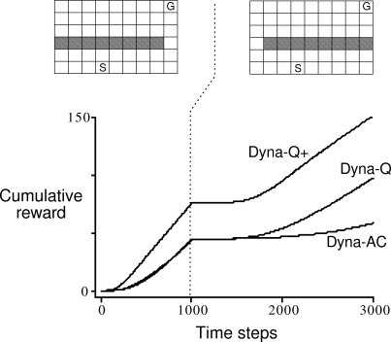
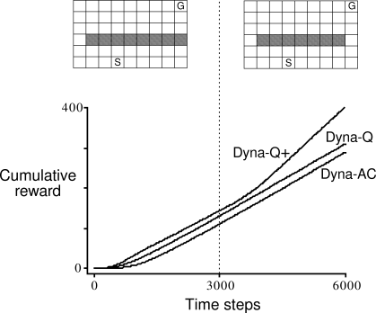
Dyna-Q+ is Dyna-Q with exploration bonus (shaping reward) :
Notes:
Dyna-Q+: r + \kappa \sqrt n (can encourage planning to get over to untried states)

Slide 20
Dyna-Q+ is Dyna-Q with exploration bonus
Why is Dyna-Q+ much better on left, but only slightly better on right?
Notes:
Dyna-Q+: r + \kappa \sqrt n (can encourage planning to get over to untried states)

Slide 21
Dyna-Q+ is Dyna-Q with exploration bonus
Why is Dyna-Q+ much better on left, but only slightly better on right?
Model is “optimistic”
Think pessimistic vs. optimistic initialization
Notes:
Dyna-Q+: r + \kappa \sqrt n (can encourage planning to get over to untried states)

Slide 22
Prioritized Sweeping
Priority Queue over s,a pairs whose estimated value would change non-trivially
When processed, effect on predecessor pairs is computed and added
Other ideas:
Change in policy?
Continuous state space?
“All animals are equal, but some are more equal than others.”
George Orwell, Animal Farm

Slide 23
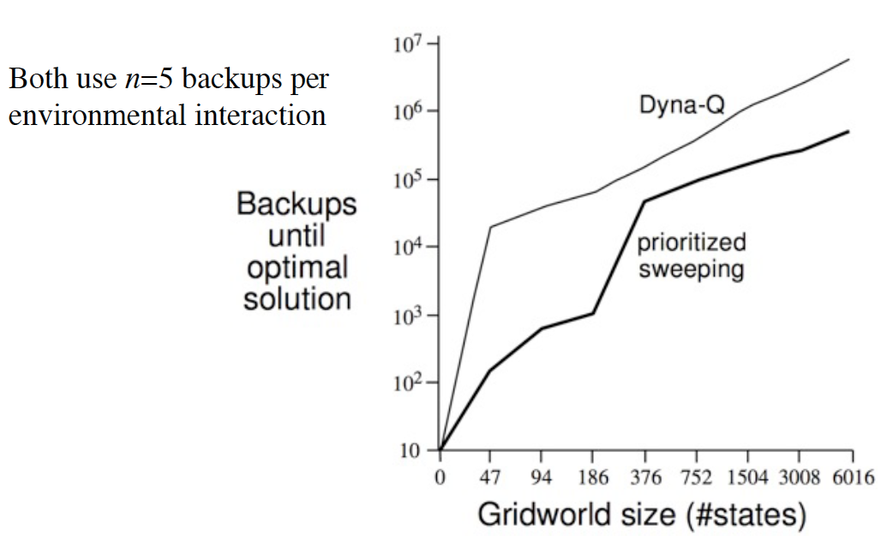
Prioritized Sweeping vs. Dyna-Q

Slide 24
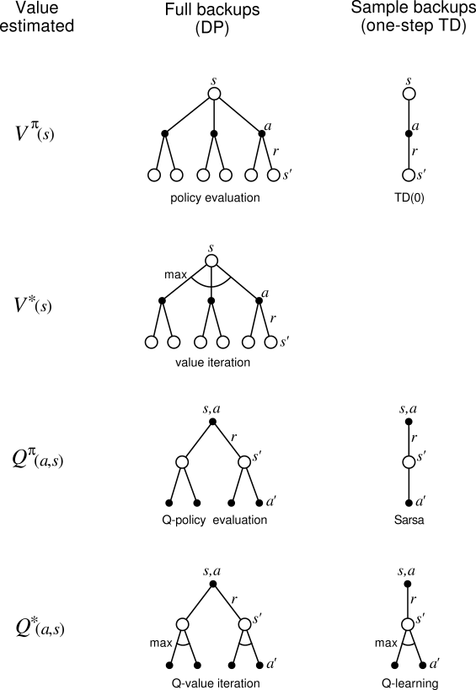

Slide 25
Trajectory sampling: perform backups along simulated trajectories
Samples from on-policy distribution
May be able to (usefully) ignore large parts of state space

Slide 26
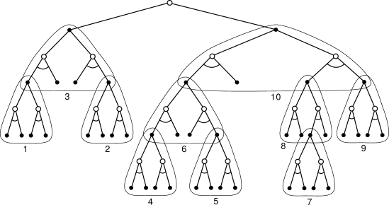
How to backup
Full vs. Sample
Deep vs. Shallow
Heuristic Search

