Slide 1
Choosing a good λ?
Sarsa(λ) looks all the way to the end of the episode in its backup?
On-line vs. Off-line updating (vs. On-Policy vs. Off-Policy)
Forward vs. Backward views

Slide 2
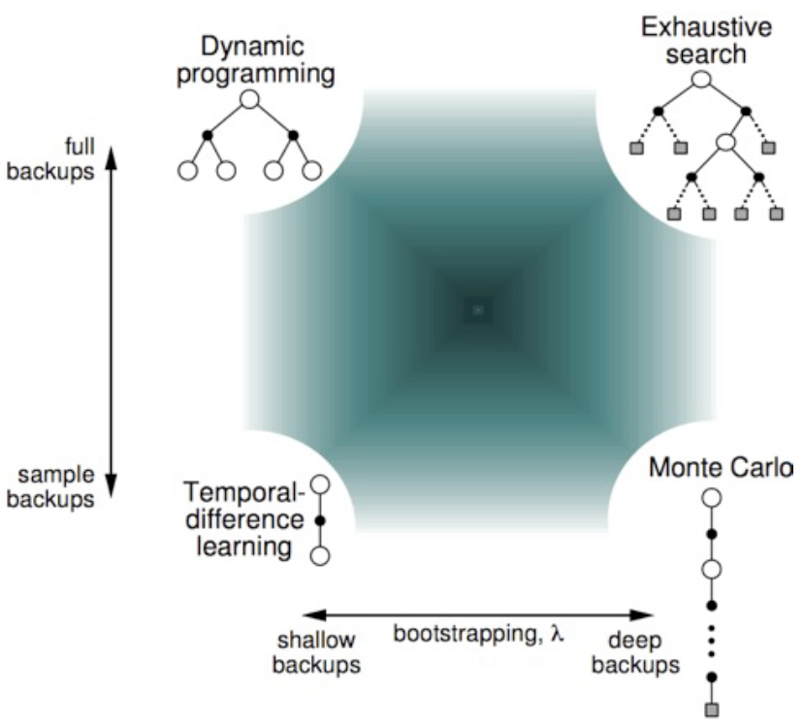
Unified View

Slide 3
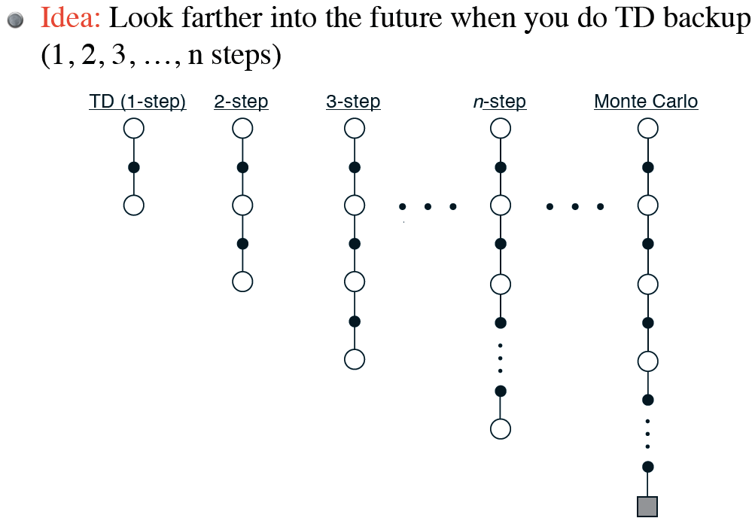
N-step TD Prediction

Slide 4
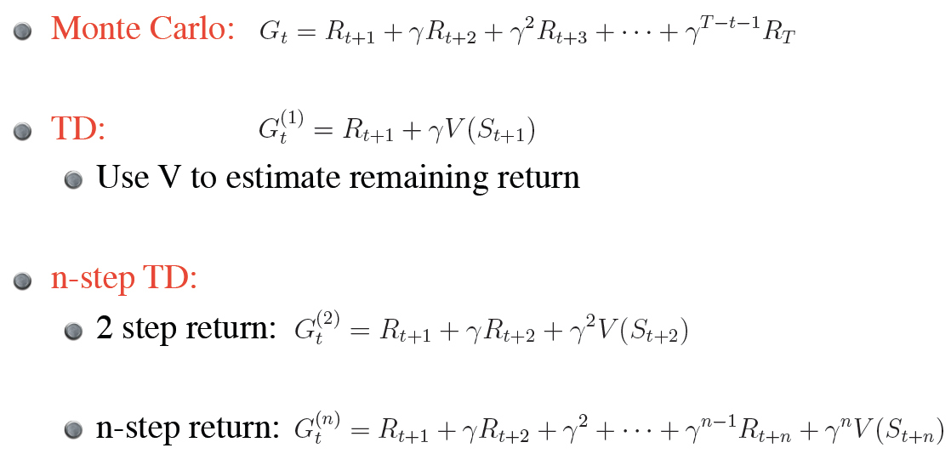

Slide 5
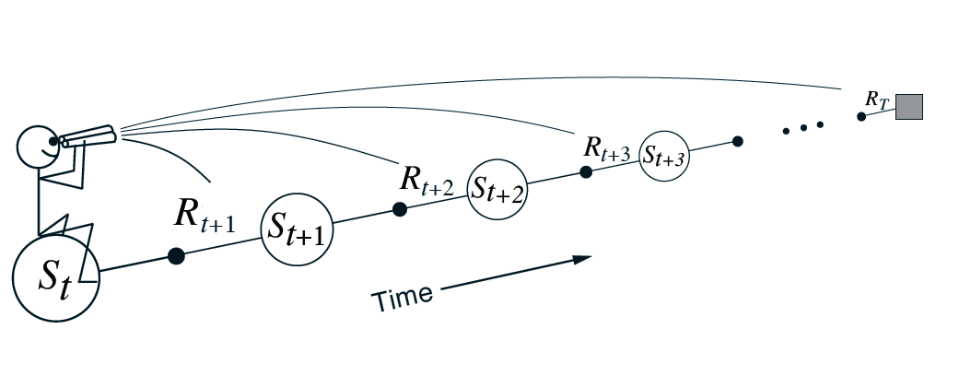
Forward View

Slide 6
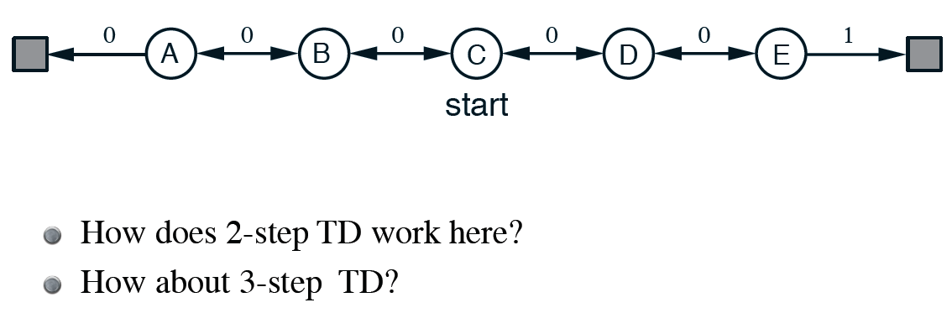
Random Walk

Slide 7
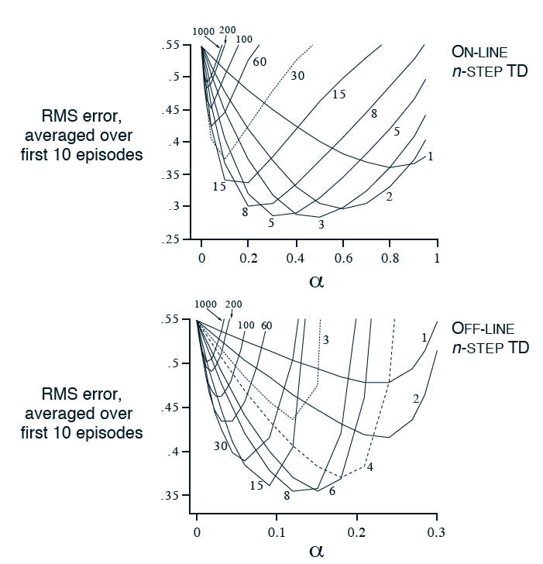
19-state random walk

Slide 8
n-step method is simple version of TD(λ)
Example: backup average of 2-step and 4-step returns

Slide 9
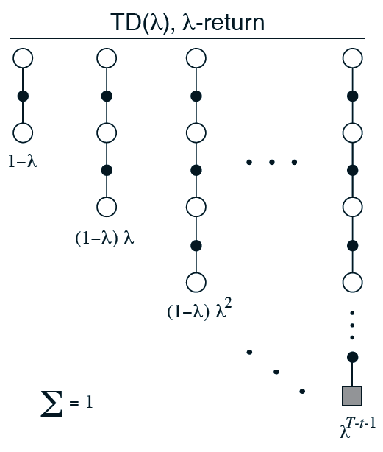
Forward View, TD(λ)
Weigh all n-step return backups by λ^{n-1}
(time since visitation)
λ-return:
Backup using λ-return:

Slide 10
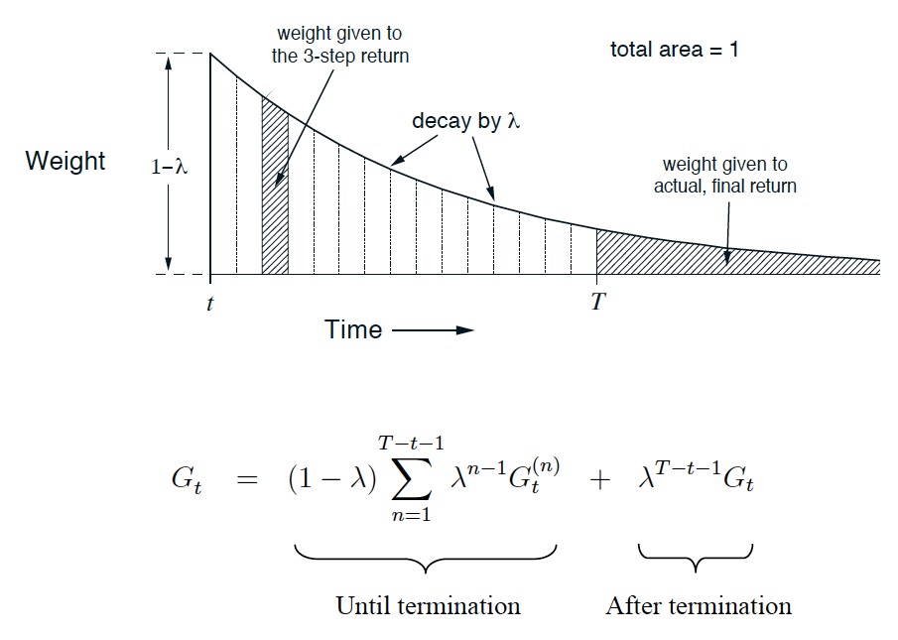
Weighting of λ-return

Slide 11
Relationship with TD(0) and MC

Slide 12
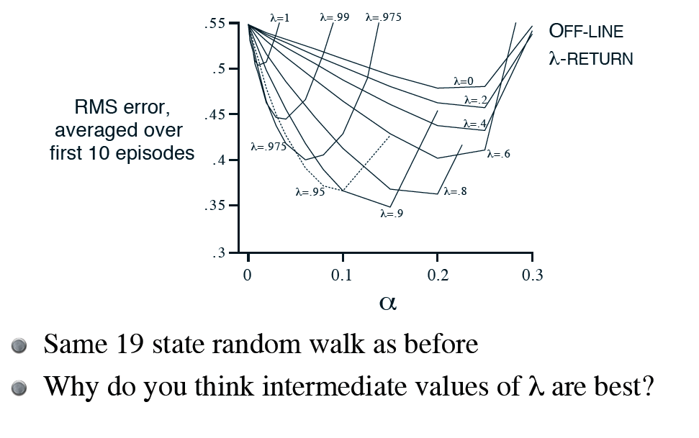

Slide 13
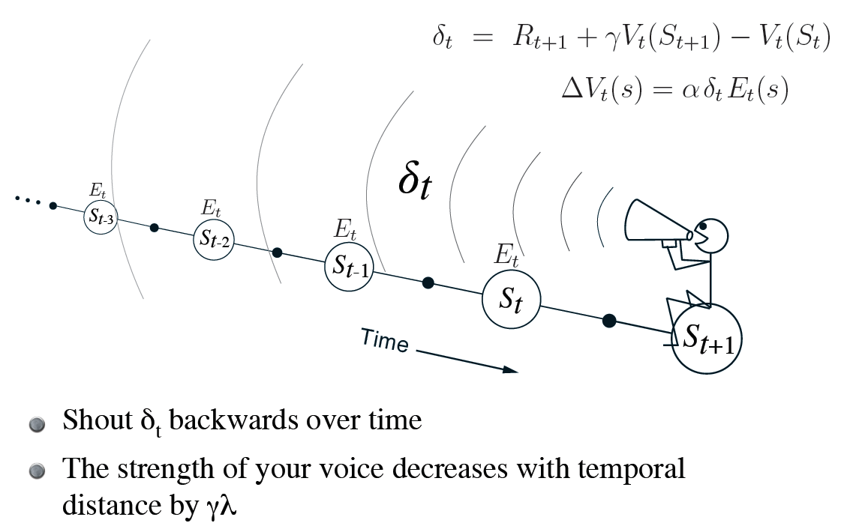
Backward View

Slide 14
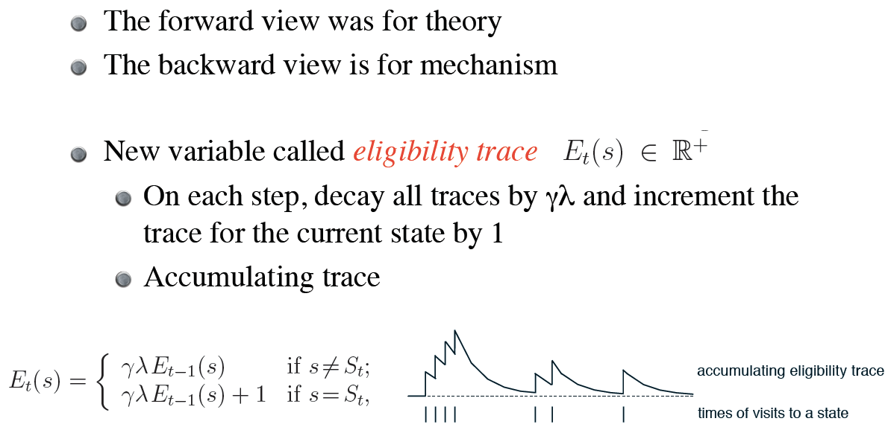
Book shows forward and backward views are actually equivalent

Slide 15
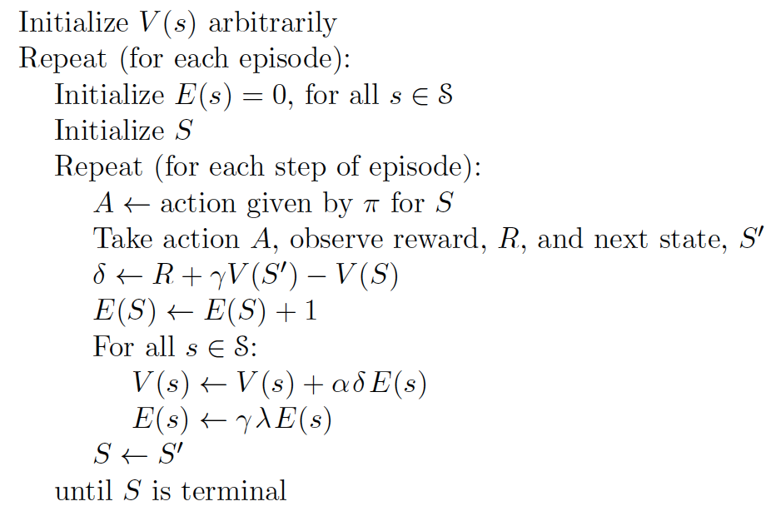
On-line, Tabular TD(λ)

Slide 16
Update rule:
As before, λ = 0 means TD(0)
Now, when λ = 1, you get MC, but
Can apply to continuing tasks
Works incrementally and on-line!

Slide 17
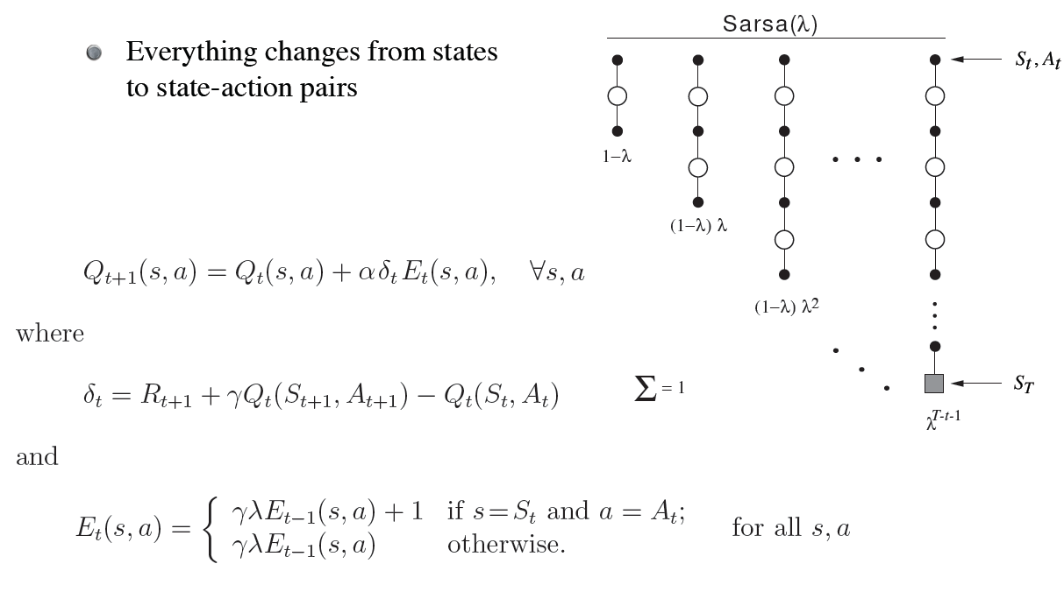
Control: Sarsa(λ)

Slide 18
Gridworld Example

Slide 19
Watkin’s Q(λ)
Why isn’t Q-learning as easy as Sarsa?

Slide 20
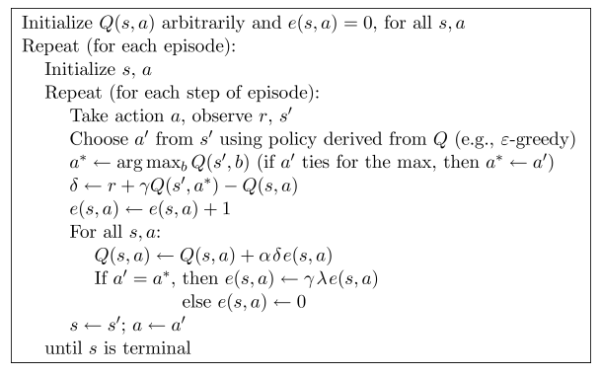
Watkin’s Q(λ)
Why isn’t Q-learning as easy as Sarsa?

