Slide 1
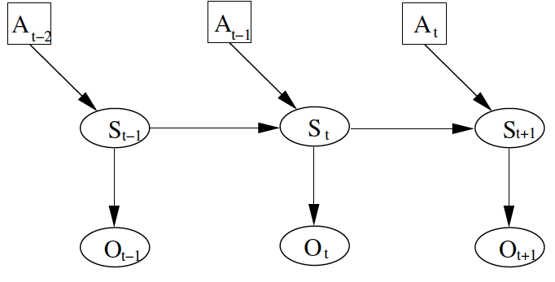
General approach:
A: action
S: pose
O: observation
Position at time t depends on position previous position and action, and current observation

Slide 2
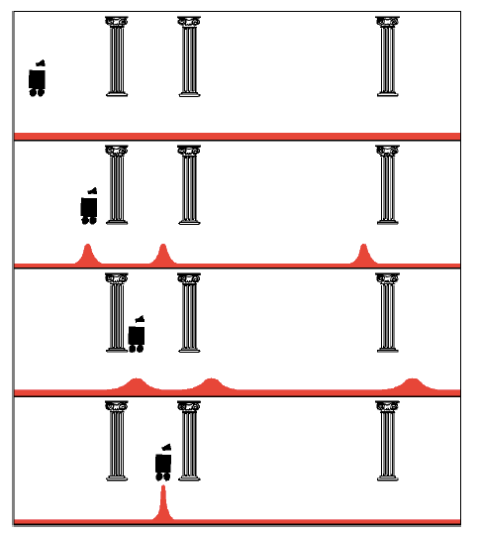
Uniform Prior
Observation: see pillar
Action: move right
Observation: see pillar

Slide 3
Example
P(z|open) = 0.6 P(z|¬open) = 0.3
P(open) = P(¬open) = 0.5
P(open | z) = ?

Slide 4
Example
P(z|open) = 0.6 P(z|¬open) = 0.3
P(open) = P(¬open) = 0.5
$z$ raises the probability that the door is open.

Slide 5
Example: 2nd Measurement
P(z₂|open) = 0.5 P(z₂|¬open) = 0.6
P(open|z₁)=2/3
$z2$lowers the probability that the door is open.

Slide 6
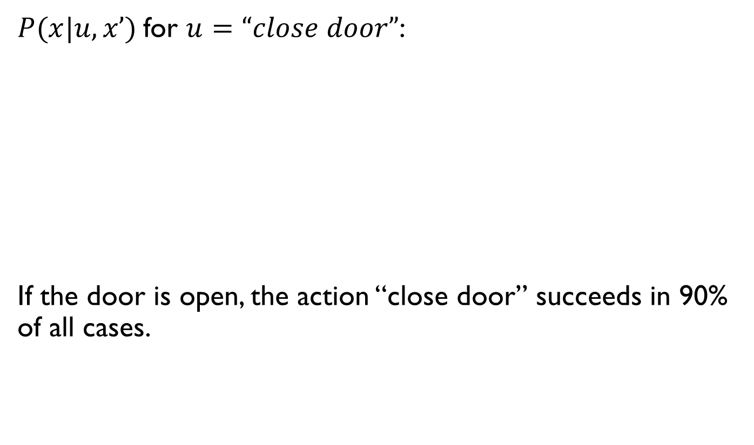
for :
If the door is open, the action “close door” succeeds in 90% of all cases.

Slide 7
Example: The Resulting Belief

Slide 8
Example: The Resulting Belief
OK… but then what’s the chance that it’s still open?

Slide 9
Example: The Resulting Belief

Slide 10
Summary
Bayes rule allows us to compute probabilities that are hard to assess otherwise.
Under the Markov assumption, recursive Bayesian updating can be used to efficiently combine evidence.

Slide 11


Example

Slide 12
Example
P(s)
s

Slide 13
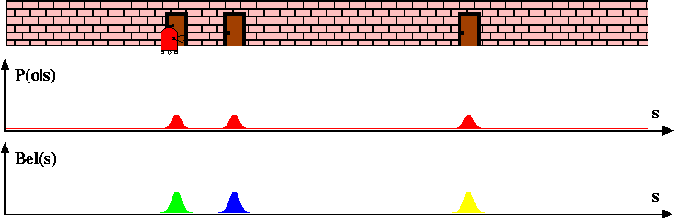
Example

Slide 14
Example
How does the probability distribution change if the robot now senses a wall?

Slide 15

Example 2
0.2 | 0.2 | 0.2 | 0.2 | 0.2

Slide 16
Example 2
0.2 | 0.2 | 0.2 | 0.2 | 0.2
Probability should go down.
Robot senses yellow.
Probability should go up.

Slide 17
Example 2
0.2 | 0.2 | 0.2 | 0.2 | 0.2
States that match observation
  Multiply prior by 0.6
States that don’t match observation
  Multiply prior by 0.2
Robot senses yellow.
0.04 | 0.12 | 0.12 | 0.04 | 0.04

Slide 18
Example 2
0.04 | 0.12 | 0.12 | 0.04 | 0.04
Sums to 0.36
!
Normalize (divide by total)
The probability distribution no longer sums to 1!
.111 | .333 | .333 | .111 | .111

Slide 19
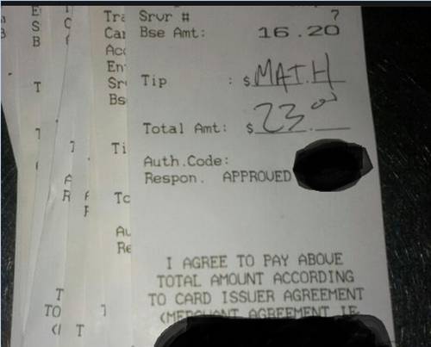
Nondeterministic Robot Motion
.111 | .333 | .333 | .111 | .111
R
The robot can now move Left and Right.

Slide 20
Nondeterministic Robot Motion
.111 | .333 | .333 | .111 | .111
R
The robot can now move Left and Right.
When executing “move x steps to right” or left:
.8: move x steps
.1: move x-1 steps
.1: move x+1 steps

Slide 21
Nondeterministic Robot Motion
0 | 1 | 0 | 0 | 0
Right 2
When executing “move x steps to right”:
.8: move x steps
.1: move x-1 steps
.1: move x+1 steps
The robot can now move Left and Right.
0 | 0 | 0.1 | 0.8 | 0.1

Slide 22
Nondeterministic Robot Motion
0 | 0.5 | 0 | 0.5 | 0
Right 2
When executing “move x steps to right”:
.8: move x steps
.1: move x-1 steps
.1: move x+1 steps
The robot can now move Left and Right.
0.4 | 0.05 | 0.05 | 0.4 | (0.05+0.05) 0.1

Slide 23
Nondeterministic Robot Motion
0 | 0.5 | 0 | 0.5 | 0
What is the probability distribution after 1000 moves?

Slide 24
Example

Slide 25
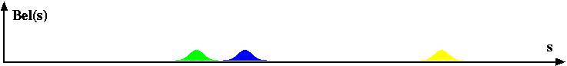
Example
Right

Slide 26
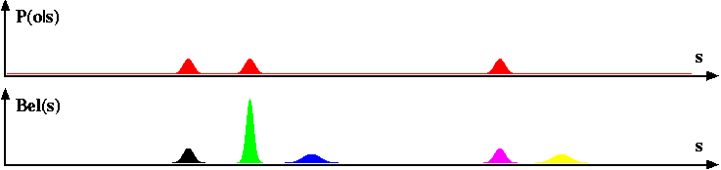
Example

Slide 27
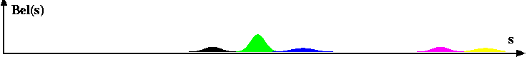
Example
Right

Slide 28
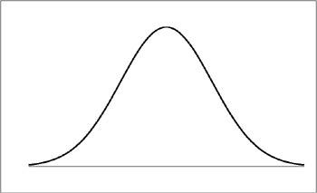
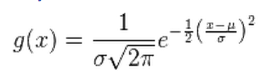
Kalman Filter Model
σ²
Area under the curve sums to $1$
$$μ$$
Gaussian
(in $1D$ for now)

Slide 29
Kalman Filter
Gain Information
Lose
Information
Sense
Move
Gaussian:
μ, σ²
Bayes Rule
(Multiplication)
Convolution
(Addition)
Initial Belief

Slide 30
Measurement Example
μ, σ²
v, r²
Prior Position Estimate $(μ,σ^{2})$
Measurement Estimate $(ν, r^{2})$

Slide 31
Measurement Example
μ, σ²
v, r²
Prior Position Estimate $(μ,σ^{2})$
Measurement Estimate $(ν, r^{2})$
Where is the new mean $μ′$?

Slide 32
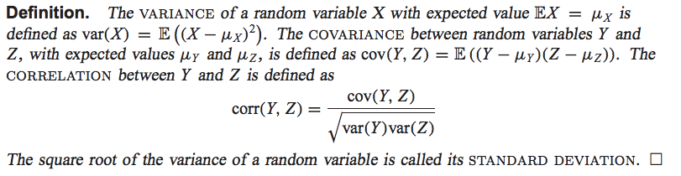
Measurement Example
μ, σ²
v, r²
Prior Position Estimate $(μ,σ^{2})$
Measurement Estimate $(ν, r^{2})$
What is the new covarance $σ^{2}′$?
σ²’?

Slide 33
Measurement Example
μ, σ²
v, r²
Prior Position Estimate $(μ,σ^{2})$
Measurement Estimate $(ν, r^{2})$
New Estimate $(μ^{′},σ^{2}′)$
μ', σ²’
To calculate, go through and multiply the two Gaussians and renormalize to sum to 1
Also, the multiplication of two Gaussian random variables is itself a Gaussian

Slide 34
Multiplying Two Gaussians
μ, σ²
v, r²
Prior Position Estimate $(μ,σ^{2})$
Measurement Estimate $(ν, r^{2})$
(ignoring constant term in front)
To find mean, maximize function (i.e., take derivative)
4. Set equal to 0 and solve for x
… something similar for the variance:
(ignoring the constant term in front)
To find the mean, need to maximize this function (i.e. take derivative)
Set equal to and solve for
…something similar for the variance

Slide 35
Another point of view…
μ, σ²
v, r²
Prior Position Estimate $(μ,σ^{2})$
Measurement Estimate $(ν, r^{2})$
New Estimate $(μ^{′},σ^{2}′)$
: p(x)
: p(z|x)
: p(x|z)
μ', σ²’

Slide 36
Example
Prior Position Estimate $(10,4)$
Measurement Estimate $(12, 4)$

Slide 37
Example
Prior Position Estimate $(10,4)$
Measurement Estimate $(12, 4)$
Notes:
Sigma2 = 16*16 / (16+16) = 256/32 = 8 -> 2.83
u=(10*16+12*16)/(16+16))=(160+192)/32)=11

Slide 38
Example
Prior Position Estimate $(10,8)$
Measurement Estimate $(13, 2)$
μ’=12.4
σ²’=1.6

Slide 39
Kalman Filter
Lose
Information
Sense
Move
Gaussian:
μ, σ²
Convolution
(Addition)
Initial Belief

Slide 40
Motion Update
For motion
Model of motion noise
u, r²
μ’=μ+u
σ²’=σ²+r²

Slide 41
Motion Update
For motion
Prior Position Estimate $(8,4)$
M$ovement Estimate (10, 6)$
Model of motion noise
u, r²
μ’=μ+u
σ²’=σ²+r²

Slide 42
Motion Update
For motion
Prior Position Estimate $(8,4)$
M$ovement Estimate (10, 6)$
Model of motion noise
u, r²
μ’=μ+u=18
σ²’=σ²+r²=10

Slide 43
Kalman Filter
μ’=μ+u
σ²’=σ²+r²
Sense
Move
Gaussian:
μ, σ²
Initial Belief

Slide 44
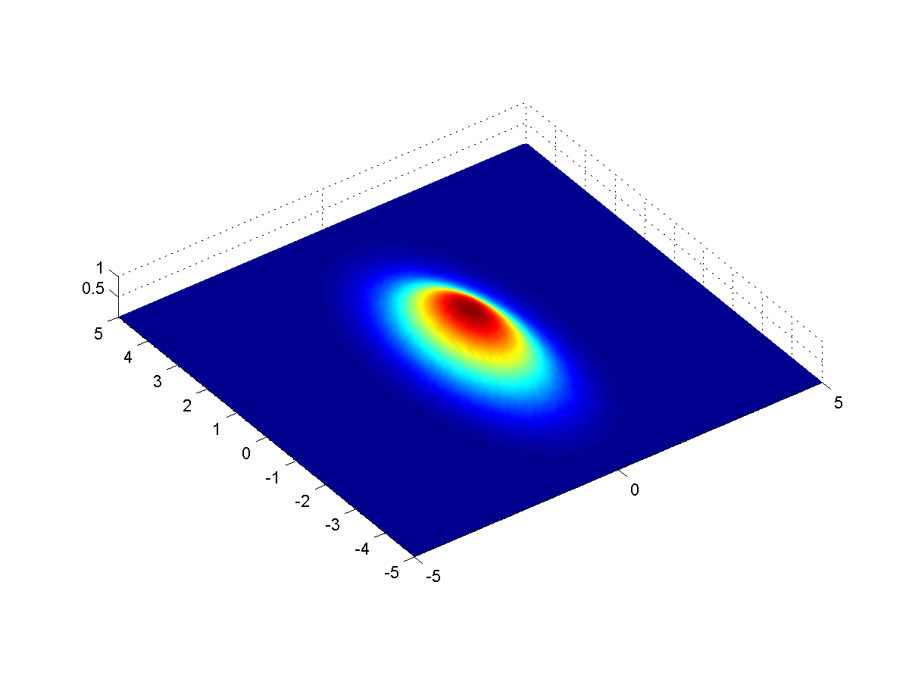
Kalman Filter in Multiple Dimensions
2D Gaussian

Slide 45

Implementing a Kalman Filter example
VERY simple model of robot movement:
What information do our sensors give us?

Slide 46
Implementing a Kalman Filter example
F
H
H = [1 0]

Slide 47
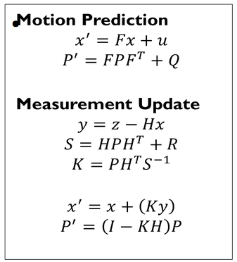
Implementing a Kalman Filter
Estimate
P’ uncertainty covariance
F state transition matrix
u motion vector
F motion noise
Measurement
measurement function
measurement noise
identity matrix

Slide 48
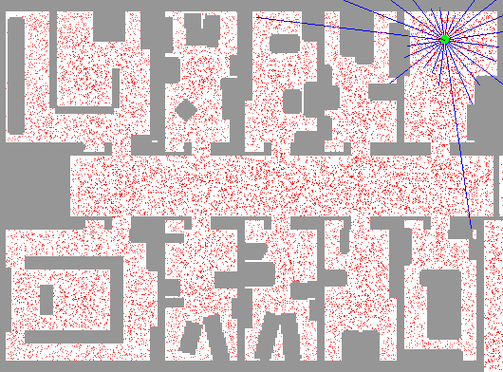
Particle Filter Localization (using sonar)
http://www.cs.washington.edu/ai/Mobile_Robotics//mcl/animations/global-floor-start.gif

Slide 49
Particles
Each particle is a guess about where the robot might be
x
y
θ

Slide 50


Robot Motion
move each particle according to the rules of motion
+
add random noise
$n$ particles
$n$ particles

Slide 51
Incorporating Sensing

Slide 52
Incorporating Sensing
Difference between the
actual measurement
and the
estimated measurement
Importance weight

Slide 53
Importance weight python code
def Gaussian(self, mu, sigma, x):
# calculates the probability of x for 1-dim Gaussian with mean mu and var. sigma
return exp(- ((mu - x) ** 2) / (sigma ** 2) / 2.0) / sqrt(2.0 * pi * (sigma ** 2))
def measurement_prob(self, measurement):
# calculates how likely a measurement should be
prob = 1.0;
for i in range(len(landmarks)):
dist = sqrt((self.x - landmarks[i][0]) ** 2 + (self.y - landmarks[i][1]) ** 2)
prob *= self.Gaussian(dist, self.sense_noise, measurement[i])
return prob
def get_weights(self):
w = []
for i in range(N): #for each particle
w.append(p[i].measurement_prob(Z)) #set it’s weight to p(measurement Z)
return w

Slide 54
Importance weight pseudocode
Calculate the probability of a sensor measurement for a particle:
prob = 1.0;
for each landmark
d = Euclidean distance to landmark
prob *= Gaussian probability of obtaining a reading at
distance d for this landmark from this particle
return prob

Slide 55
Incorporating Sensing

Slide 56
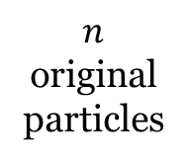
Resampling
$n$ original particles
Importance Weight
0.2
0.6
0.2
0.8
0.8
0.2
Sum is 2.8

Slide 57
Resampling
$n$ original particles
Importance Weight | Normalized Probability
0.2 | 0.07
0.6 | 0.21
0.2 | 0.07
0.8 | 0.29
0.8 | 0.29
0.2 | 0.07
Sum is 2.8

Slide 58

Resampling
$n$ original particles
Importance Weight | Normalized Probability
0.2 | 0.07
0.6 | 0.21
0.2 | 0.07
0.8 | 0.29
0.8 | 0.29
0.2 | 0.07
Sample n new particles from previous set
Each particle chosen with probability p, with replacement
Sum is 2.8

Slide 59
Resampling
Is it possible that one of the particles is never chosen?
Yes!
Is it possible that one of the particles is chosen more than once?
Yes!
$n$ original particles
Importance Weight | Normalized Probability
0.2 | 0.07
0.6 | 0.21
0.2 | 0.07
0.8 | 0.29
0.8 | 0.29
0.2 | 0.07
Sample n new particles from previous set
Each particle chosen with probability p, with replacement
Sum is 2.8

Slide 60
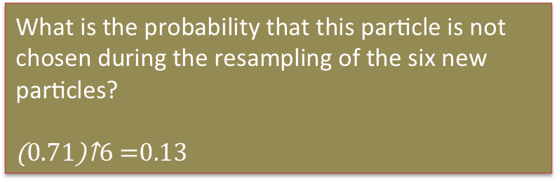
Resampling
What is the probability that this particle is not chosen during the resampling of the six new particles?
$${\left(0.71\right)}^{6}=0.13$$
$n$ original particles
Importance Weight | Normalized Probability
0.2 | 0.07
0.6 | 0.21
0.2 | 0.07
0.8 | 0.29
0.8 | 0.29
0.2 | 0.07
Sample n new particles from previous set
Each particle chosen with probability p, with replacement
Sum is 2.8
Notes:
.71 ^ 6 = 12.8%

Slide 61
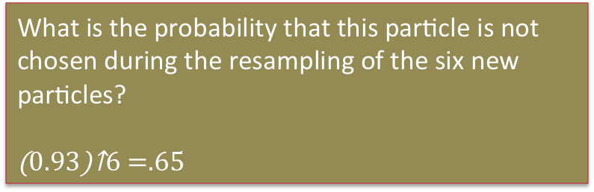
Resampling
What is the probability that this particle is not chosen during the resampling of the six new particles?
$${\left(0.93\right)}^{6}=.65$$
$n$ original particles
Importance Weight | Normalized Probability
0.2 | 0.07
0.6 | 0.21
0.2 | 0.07
0.8 | 0.29
0.8 | 0.29
0.2 | 0.07
Sample n new particles from previous set
Each particle chosen with probability p, with replacement
Sum is 2.8

Slide 62
Question
What happens if there are no particles near the correct robot location?

Slide 63
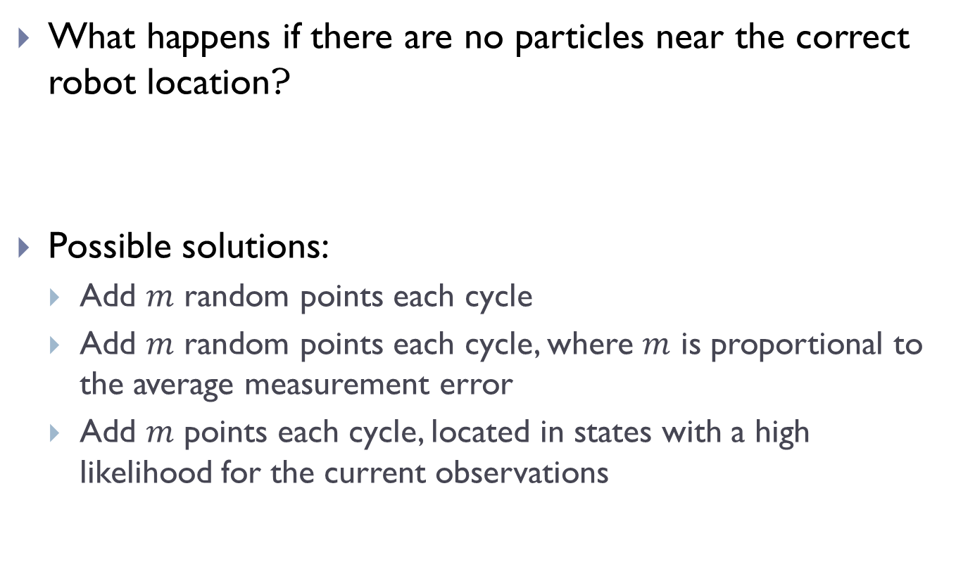
Question
What happens if there are no particles near the correct robot location?
Possible solutions:
  Add random points each cycle
  Add random points each cycle, where is proportional to the average measurement error
  Add points each cycle, located in states with a high likelihood for the current observations

Slide 64
Summary
Kalman Filter
  Continuous
  Unimodal
  Harder to implement
  More efficient
  Requires a good starting guess of robot location
Particle Filter
  Continuous
  Multimodal
  Easier to implement
  Less efficient
  Does not require an accurate prior estimate

