Slide 1
gradientDescent.py
def gradientDescent(x, y, theta, alpha, m, numIterations):
xTrans = x.transpose()
replaceMe = .0001
for i in range(0, numIterations):
hypothesis = np.dot(x, theta)
loss = hypothesis - y
# Want the mean squared error here. Only use
# for debugging to make sure we're progressing
cost = np.sum(replaceMe) / (m)
if i % 9999 == 0:
print i, cost
# avg gradient per example
gradient = np.dot(xTrans, replaceMe) / m
# update
theta = theta * replaceMe
return theta

Slide 2
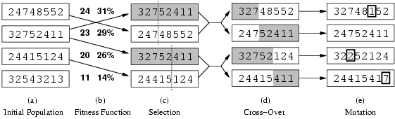

Genetic algorithms

Slide 3
Fitness function
Population, lots of parameters
Types of problems can solve
  http://nn.cs.utexas.edu/pages/research/rocket/
  http://nerogame.org/
Co-evolution
  http://www.cs.utexas.edu/users/nn/pages/research/neatdemo.html
  http://www.cs.utexas.edu/users/nn/pages/research/robotmovies/clip7.gif

Slide 4
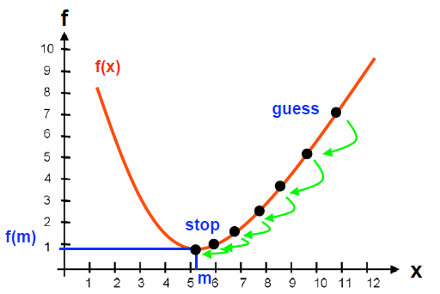
CptS 580: Reinforcement Learning
Graduate
or
Undergradate && (CptS 350 || Matt’s permission)
How can an agent learn to act in an environment?
No absolute truth
Trial and Error

Slide 5
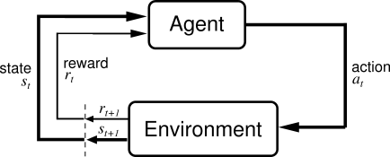
http://sarvagyavaish.github.io/FlappyBirdRL/
https://www.youtube.com/watch?v=OJw4HTWvGdY
Basic idea:
  Receive feedback in the form of rewards
  Agent’s utility is defined by the reward function
  Must (learn to) act so as to maximize expected rewards

Slide 6
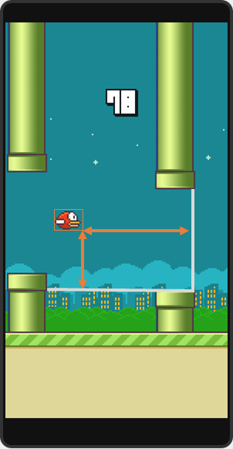

Slide 7
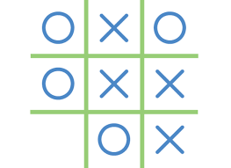
Sequential tasks
How could we learn to play tic-tac-toe?
  What do we want to optimize (i.e., what’s the reward)?
  What are the actions?
  How would we represent state?
  How would we figure out how to act (to maximize the reward)?

Slide 8
Reinforcement Learning (RL)
RL algorithms attempt to find a policy
  maximizing cumulative reward for the agent
  over the course of the problem
Typically represented by a Markov Decision Process
RL differs from supervised learning:
  correct input/output pairs are never presented
  sub-optimal actions never explicitly corrected

Slide 9
Grid World
The agent lives in a grid
Walls block the agent’s path
The agent’s actions do not always go as planned:
  80% of the time, the action North takes the agent North
  (if there is no wall there)
  10% of the time, North takes the agent West; 10% East
  If there is a wall in the direction the agent would have been taken, the agent stays put
Small “living” reward each step
Big rewards come at the end
Goal: maximize sum of rewards*

Slide 10
Grid Futures
Deterministic Grid World
Stochastic Grid World
 | X
 | X
E N S W
E N S W
?
 | X
X
 | X
 |  | X

Slide 11
Markov Decision Processes
An MDP is defined by:
  A set of states s ∈ S
  A set of actions a ∈ A
  A transition function T(s,a,s’)
    Prob that a from s leads to s’
    i.e., P(s’ | s,a)
    Also called the model
  A reward function R(s, a, s’)
    Sometimes just R(s) or R(s’)
  A start state (or distribution)
  Maybe a terminal state
  A discount factor: γ
MDPs are a family of non-deterministic search problems
  Reinforcement learning: MDPs where we don’t know the transition or reward functions

Slide 12


What is Markov about MDPs?
Andrey Markov (1856-1922)
“Markov” generally means that given the present state, the future and the past are independent
For Markov decision processes, “Markov” means:

Slide 13
Solving MDPs
In deterministic single-agent search problems, want an optimal plan, or sequence of actions, from start to a goal
In an MDP, we want an optimal policy π*: S → A
  A policy π gives an action for each state
  An optimal policy maximizes expected utility if followed
  Defines a reflex agent
Optimal policy
when R(s, a, s’) = -0.03
for all non-terminal s

Slide 14
Example Optimal Policies
R(s) = -0.01
R(s) = -0.03
R(s) = -0.4
R(s) = -2.0

Slide 15
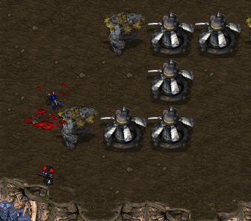

Slide 16
Recap: Defining MDPs
Markov decision processes:
  States S
  Start state s₀
  Actions A
  Transitions P(s’|s,a) (or T(s,a,s’))
  Rewards R(s,a,s’) (and discount γ)
MDP quantities so far:
  Policy = Choice of action for each state
  Utility (or return) = sum of discounted rewards
s
a
s, a
s,a,s’
s’

Slide 17
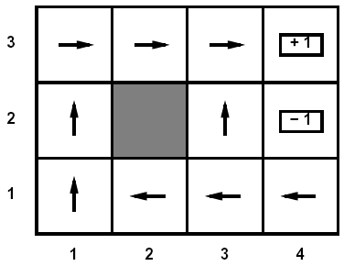
Optimal Utilities
Fundamental operation: compute the values (optimal expectimax utilities) of states s
Why? Optimal values define optimal policies!
Define the value of a state s:
  V*(s) = expected utility starting in s and acting optimally
Define the value of a q-state (s,a):
  Q*(s,a) = expected utility starting in s, taking action a and thereafter acting optimally
Define the optimal policy:
  π*(s) = optimal action from state s
s
a
s, a
s,a,s’
s’

Slide 18
Value Iteration
Idea:
  Start with V₀*(s) = 0, which we know is right (why?)
  Given V_{i}*, calculate the values for all states for depth i+1:
  This is called a value update or Bellman update
  Repeat until convergence
Theorem: will converge to unique optimal values
  Basic idea: approximations get refined towards optimal values
  Policy may converge long before values do

Slide 19


Example: Value Iteration
V₁
V₂
Information propagates outward from terminal states and eventually all states have correct value estimates

Slide 20



Example: Value Iteration
V₂
V₃
Information propagates outward from terminal states and eventually all states have correct value estimates

Slide 21
Discounted Rewards
Rewards in the future are worth less than an immediate reward
  Because of uncertainty: who knows if/when you’re going to get to that reward state
Notes:
Sum to inf

Slide 22
Discounted Rewards
Discount factor ϒ (often .9-1.0)
Assume a reward years in the future is only worth of the value of immediate reward
For each state, calculate a utility value equal to the Sum of Future Discounted Rewards

Slide 23
Reinforcement Learning
Reinforcement learning:
  Still assume an MDP:
    A set of states s ∈ S
    A set of actions (per state) A
    A model T(s,a,s’)
    A reward function R(s,a,s’)
    A discount factor γ (could be 1)
  Still looking for a policy π(s)
  New twist: don’t know T or R
    i.e. don’t know which states are good or what the actions do
    Must actually try actions and states out to learn

Slide 24
Passive Learning
Simplified task
  You don’t know the transitions T(s,a,s’)
  You don’t know the rewards R(s,a,s’)
  You are given a policy π(s)
  Goal: learn the state values
  … what policy evaluation did
In this case:
  Learner “along for the ride”
  No choice about what actions to take
  Just execute the policy and learn from experience
  We’ll get to the active case soon
  This is NOT offline planning! You actually take actions in the world and see what happens…

Slide 25
Model-Based Learning
Idea:
  Learn the model empirically through experience
  Solve for values as if the learned model were correct
Simple empirical model learning
  Count outcomes for each s,a
  Normalize to give estimate of T(s,a,s’)
  Discover R(s,a,s’) when we experience (s,a,s’)
Solving the MDP with the learned model
  Iterative policy evaluation, for example
s
π(s)
s, π(s)
s, π(s),s’
s’

Slide 26
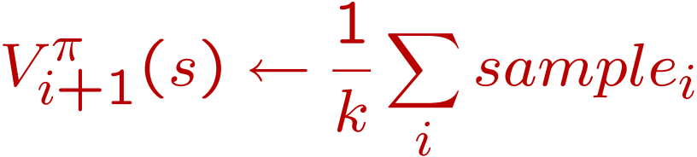
Sample-Based Policy Evaluation?
s
Who needs T and R? Approximate the expectation with samples (drawn from T!)
π(s)
s, π(s)
s, π(s),s’
s₂’
s₁’
s₃’
s’
Almost! But we only actually make progress when we move to i+1.

Slide 27
Temporal-Difference Learning
Big idea: learn from every experience!
  Update V(s) each time we experience (s,a,s’,r)
  Likely s’ will contribute updates more often
Temporal difference learning
  Policy still fixed!
  Move values toward value of whatever successor occurs: running average!
s
π(s)
s, π(s)
s’
Sample of V(s):
Update to V(s):
Same update:

Slide 28

Exponential Moving Average
Exponential moving average
  Makes recent samples more important
  Forgets about the past (distant past values were wrong anyway)
  Easy to compute from the running average
Decreasing learning rate can give converging averages

Slide 29
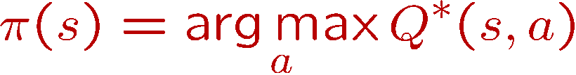
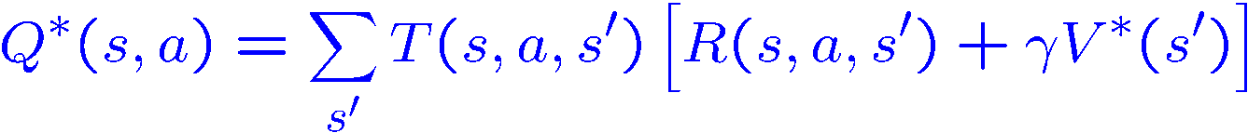
Problems with TD Value Learning
TD value leaning is a way to do policy evaluation
However, if we want to turn values into a (new) policy, we’re sunk:
Idea: learn Q-values directly
s
a
s, a
s,a,s’
s’

Slide 30
Active Learning
Full reinforcement learning
  You don’t know the transitions T(s,a,s’)
  You don’t know the rewards R(s,a,s’)
  You can choose any actions you like
  Goal: learn the optimal policy
  … what value iteration did!
In this case:
  Learner makes choices!
  Fundamental tradeoff: exploration vs. exploitation
  This is NOT offline planning! You actually take actions in the world and find out what happens…

Slide 31

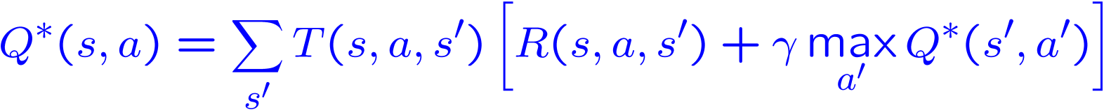
Q-Learning
Q-Learning: sample-based Q-value iteration
Learn Q*(s,a) values
  Receive a sample (s,a,s’,r)
  Consider your old estimate:
  Consider your new sample estimate:
  Incorporate the new estimate into a running average:

Slide 32
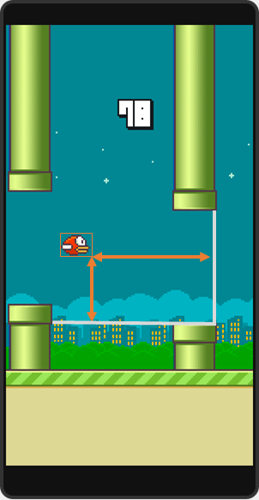
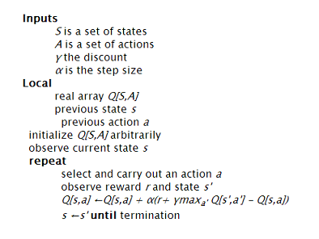

Slide 33
Q-Learning Properties
Amazing result: Q-learning converges to optimal policy
  If you explore enough
  If you make the learning rate small enough
  … but not decrease it too quickly!
  Basically doesn’t matter how you select actions (!)
Neat property: off-policy learning
  learn optimal policy without following it (some caveats)
S |  |  |  |  |  | E
S |  |  |  |  |  | E

Slide 34
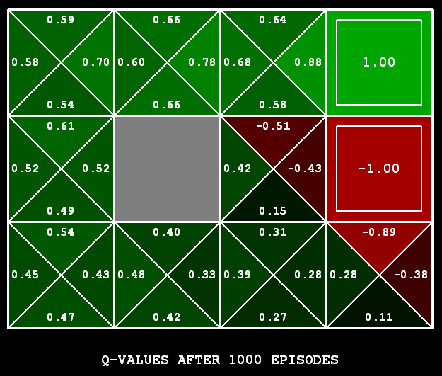
Q-Learning
Q-learning produces tables of q-values:

Slide 35
Exploration / Exploitation
Several schemes for forcing exploration
  Simplest: random actions (ε greedy)
    Every time step, flip a coin
    With probability ε, act randomly
    With probability 1-ε, act according to current policy
  Problems with random actions?
    You do explore the space, but keep thrashing around once learning is done
    One solution: lower ε over time
    Another solution: exploration functions

Slide 36
The Story So Far: MDPs and RL
Things we know how to do:
Techniques:
If we know the MDP
  Compute V*, Q*, π* exactly
  Evaluate a fixed policy π
If we don’t know the MDP
  We can estimate the MDP then solve
  We can estimate V for a fixed policy π
  We can estimate Q*(s,a) for the optimal policy while executing an exploration policy
Model-based DPs
  Value and policy Iteration
  Policy evaluation
Model-based RL
Model-free RL:
  Value learning
  Q-learning

Slide 37
Q-Learning
In realistic situations, we cannot possibly learn about every single state!
  Too many states to visit them all in training
  Too many states to hold the q-tables in memory
Instead, we want to generalize:
  Learn about some small number of training states from experience
  Generalize that experience to new, similar states
  This is a fundamental idea in machine learning, and we’ll see it over and over again

Slide 38




Example: Pacman
Let’s say we discover through experience that this state is bad:
In naïve q learning, we know nothing about this state or its q states:
Or even this one!

Slide 39
Feature-Based Representations
Solution: describe a state using a vector of features
  Features are functions from states to real numbers (often 0/1) that capture important properties of the state
  Example features:
    Distance to closest ghost
    Distance to closest dot
    Number of ghosts
    1 / (dist to dot)²
    Is Pacman in a tunnel? (0/1)
    …… etc.
  Can also describe a q-state (s, a) with features (e.g. action moves closer to food)

Slide 40
Linear Feature Functions
Using a feature representation, we can write a q function (or value function) for any state using a few weights:
Advantage: our experience is summed up in a few powerful numbers
Disadvantage: states may share features but be very different in value!

Slide 41
Function Approximation
Q-learning with linear q-functions:
Intuitive interpretation:
  Adjust weights of active features
  E.g. if something unexpectedly bad happens, disprefer all states with that state’s features
Formal justification: online least squares

Slide 42



Example: Q-Pacman

Slide 43
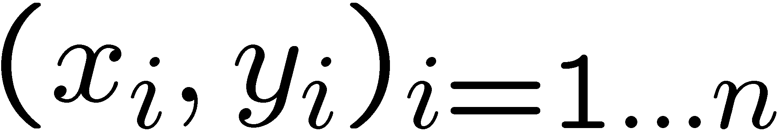
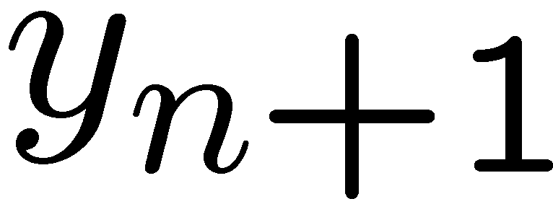
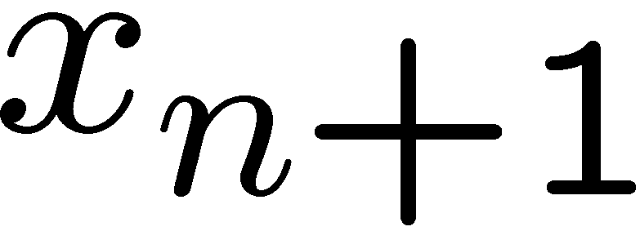
Linear regression
40
26
24
20
22
20
30
20
40
30
0
10
20
0
10
20
0
10
0
Given examples
Predict
given a new point
Notes:
Figure 1: scatter(1:20,10+(1:20)+2*randn(1,20),'k','filled'); a=axis; a(3)=0; axis(a);

Slide 44
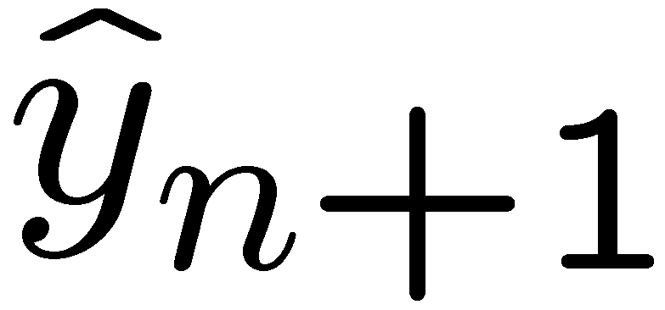
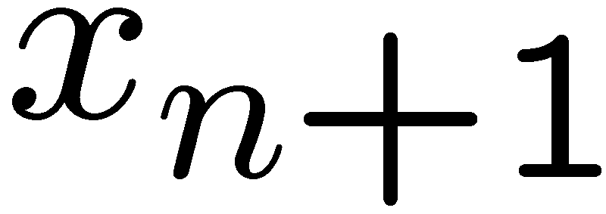
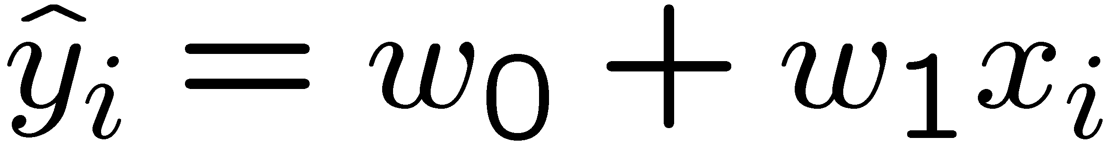
Linear regression
40
26
24
20
22
20
30
20
40
30
0
10
20
0
20
0
10
0
Prediction
Prediction
Notes:
Figure 1: scatter(1:20,10+(1:20)+2*randn(1,20),'k','filled'); a=axis; a(3)=0; axis(a);

