Slide 1
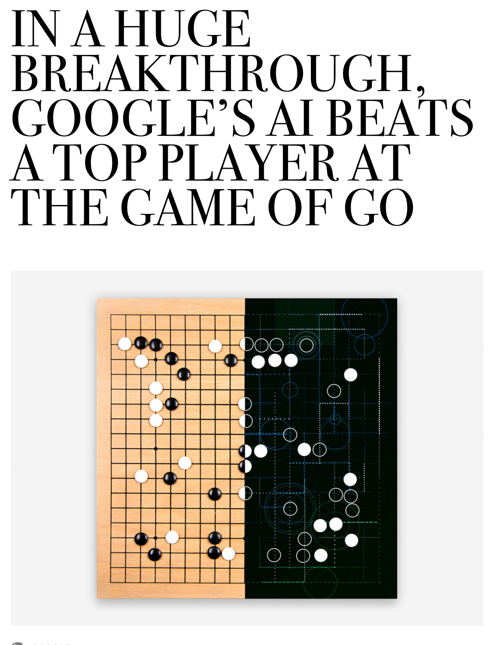

Slide 2
Gaits

Slide 3
Cost of Transportation

Slide 4
Wheeled Mobile Robots
Most popular locomotion mechanism
Highly efficient
Simple mechanical implementation
Balancing is not usually a problem
Suspension system needed to allow all wheels to maintain ground contact on uneven terrain

Slide 5
Wheeled Mobile Robots
Focus is on
Traction
Stability
Maneuverability
Control

Slide 6
Wheel Designs
a) Standard wheels
2 DOF
b) Castor wheels
2 DOF

Slide 7
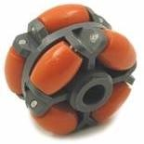
Wheel Designs
c) Swedish (Omni) wheels
3 DOF
d) Ball or spherical wheel
3 DOF
Think mouse ball
Suspension issue

Slide 8
Wheeled Mobile Robots
Stability of a vehicle is guaranteed with 3 wheel
center of gravity is within the triangle formed by ground contact points of wheels
Stability is improved by 4 and more wheels
Bigger wheels allow to overcome higher obstacles
But require higher torque or reductions in the gear box
Most arrangements are non-holonomic
require high control effort
Combining actuation and steering on one wheel makes design complex and adds additional errors for odometry
Notes:
however, this arrangements are hyperstatic and require a flexible suspension system.

Slide 9
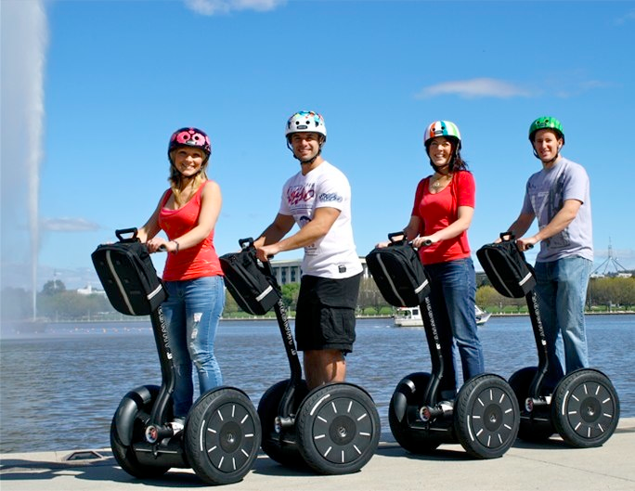
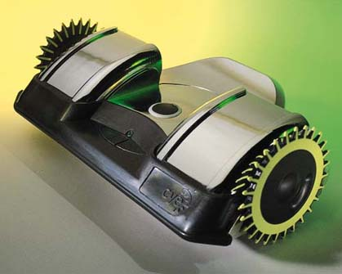
Static Stability with Two Wheels
Achieved by ensuring center of mass is below wheel axis
Or using fancy balancing

Slide 10
Motion Control
Kinematic/dynamic model of the robot
Model the interaction between wheel and ground
Definition of required motion
Speed control
Position control
Control law that satisfies the requirements

Slide 11
Mobile Robot Kinematics
Description of mechanical behavior of the robot for design and control
Similar to robot manipulator kinematics
However, mobile robots can move unbound with respect to their environment:
No direct way to measure robot’s position
Position must be integrated over time
Leads to inaccuracies of the position (motion) estimate
Understanding mobile robot motion starts with understanding wheel constraints placed on robot’s mobility

Slide 12
Configuration: complete specification of the position of every point of the system. Position and orientation. Also, called a pose
Configuration space: space of all possible configurations
Workspace: the 2D or 3D ambient space the robot is in.

Slide 13
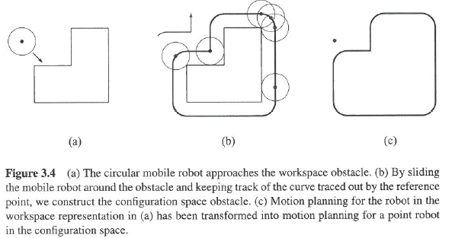

Slide 14
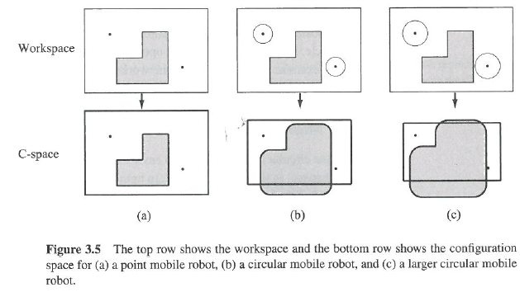

Slide 15
Beyond trial and error….
Establish mathematically how robot should move
Kinematics: how robot will move given motor inputs
Inverse-kinematics: how to move motors to get robot to do what we want
https://www.youtube.com/watch?v=FzCORl5BU0Q

Slide 16
Robot is at (initial frame)
x_{I},y_{I},θ_{I}
Wants to get to some
location but can’t control
x_{I},y_{I},θ_{I} directly
Notes:
V(t)

Slide 17
Robot can know
Speeds of wheels: φ₁…φ_{n}
Steering angle of steerable wheels: β₁…β_{m}
Speed with which steering angles are changing:
β₁…β_{m}

Slide 18
Robot can know
Speeds of wheels: φ₁…φ_{n}
Steering angle of steerable wheels: β₁…β_{m}
Speed with which steering angles are changing:
β₁…β_{m}
These define the forward motion of the robot, the forward kinematics:
f(φ₁…φ_{n,} β₁…β_{m,} β₁…β_{m})=[x_{I},y_{I},θ_{I}]^{T}
Notes:
!Put bottom eq on board!

Slide 19
Want we want
Inverse Kinematics
[φ₁…φ_{n,} β₁…β_{m,} β₁…β_{m}] ^{T}=f(x_{I},y_{I},θ_{I})

Slide 20
Robot
Robot knows how movement relative to center of rotation (P)
Not same as knowing how moves in world
Initial Frame
Robot Frame
Notes:
P
Y_I
X_I
Y_R
X_R
Theta_I = Theta_R

Slide 21
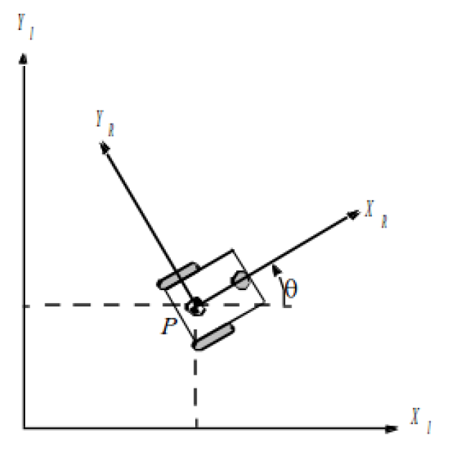
Robot Position: ξ_{I}=[x_{I},y_{I},θ_{I}]^{T}
Mapping motion between frames
ξ_{R}= ?? ξ_{I}
Notes:
Put E_i on board

Slide 22
[x_{R},y_{R},θ_{R}]^{T} = ? [x_{I},y_{I},θ_{I}]^{T}
Notes:
3x3 matrix
R11 R12 R13
R21 R22 R23
R31 R32 R33
Theta dot?
Theta dot _R = xdot_I * R31 + ydot_x * R32 + Theta dot_I * R33
0 + 0 + 1
Theta doesn’t directly get added into sum -> R13 R23 = 0

Slide 23
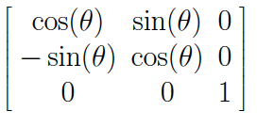
Robot Position: ξ_{I}=[x_{I},y_{I},θ_{I}]^{T}
Mapping between frames
ξ_{R}=R(θ)ξ_{I}
=R(θ)[x_{I},y_{I},θ_{I}]^{T}
where
R(θ)=
Notes:
Write out E^dot_R = Rmatix E^dot_I

Slide 24
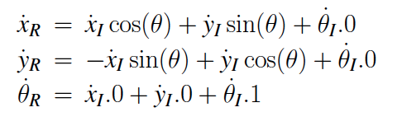
R(θ)

Slide 25
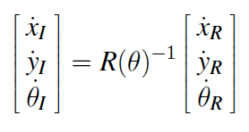
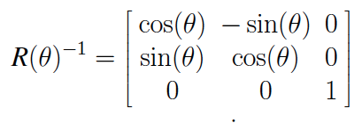
ξ_{R}=R(θ)ξ_{I}
Still isn’t what we want… we want the reverse of this
ξ_{I}=R(θ)⁻¹ξ_{R}

Slide 26
R(θ)⁻¹

Slide 27
If we know the relative changes in x, y, and θ, we can find the global position. How do we know what these values are?

Slide 28
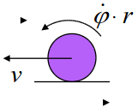
Speed of the wheels
Constraints
Movement on a horizontal plane
Point contact of wheels
Wheels are not deformable
Pure rolling: velocity is 0 at contact point
No friction for rotation
Steering axes orthogonal to surface
Wheels connected by rigid frame

Slide 29
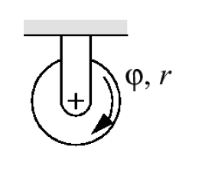
Differential Drive
Wheels rotate at φ
Each wheel contributes
rφ/2
to motion of center of rotation
Speed = sum of two wheels
Rotation due to right wheel is
ω_{r}=rφ/2l
Counterclockwise about left wheel
l is distance between wheel and center of rotation

Slide 30
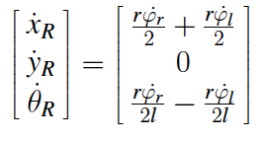
Differential Drive
Rotation due to left wheel:
ω_{l}=-rφ/2l
Counterclockwise about right wheel
Combining components:

Slide 31
Example 1/3
θ=π/2=90 degrees
r=1
l=1
φ_{l}=4, φ_{r}=2
What is the change in the initial frame of reference?
sin(π/2)=1, cos(π/2)=0

Slide 32
Example 2/3
θ=π/4=45 degrees
r_{l}=2, r_{r}=3
l=5
φ_{l}= φ_{r} =6
sin(π/4)=1/√2, cos(π/4)=1/√2

