Slide 1
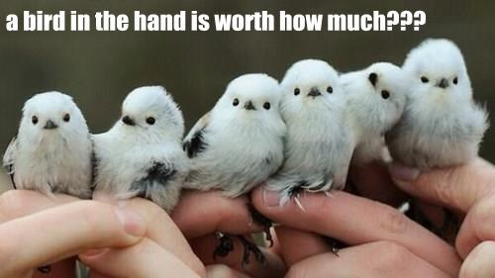
Final Project Rubric
20: Fully explained idea or question addressed (Why is it interesting? What’s the payoff if it works?)
20: Experiments and/or theoretical work adequately addresses idea/question
20: Background & Related Work (Is it clear how this work is related to other things in the field? Is it clear what is/isn’t novel?)
15: Conclusion and discussion of future work (What are the next steps for you, or others, who are interested in this?)
10: Writing quality (scaled)
10: Presentation quality (Does this look like something you’d submit to a conference?)

