Slide 1
Class material vs. Lab material
Lab 2, 3 vs. 4 ,5, 6
BeagleBoard / TI / Digilent
GoPro

Slide 2
Class material vs. Lab material
Lab 2, 3 vs. 4 ,5, 6
BeagleBoard / TI / Digilent
GoPro

Slide 3
There is no ideal drive configuration that simultaneously maximizes stability, maneuverability, and controllability.
For example, typically inverse correlation between controllability and maneuverability.

Slide 4
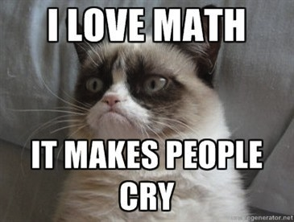

Slide 5
Holonomicity
If the controllable degrees of freedom is equal to the total degrees of freedom then the robot is said to be holonomic.
Holonomic constraints reduce the number of degrees of freedom of the system
If the controllable degrees of freedom are less than the total degrees of freedom it is non-holonomic.
A robot is considered to be redundant if it has more controllable degrees of freedom than degrees of freedom in its task space.

Slide 6
Why study holonomic constraints?
How many independent motions can our turtlebot robot produce?
2 at the most
How many DOF in the task space does the robot need to control?
3 DOF
The difference implies that our system has holonomic constraints

Slide 7
Open loop control vs. Closed loop control

Slide 8
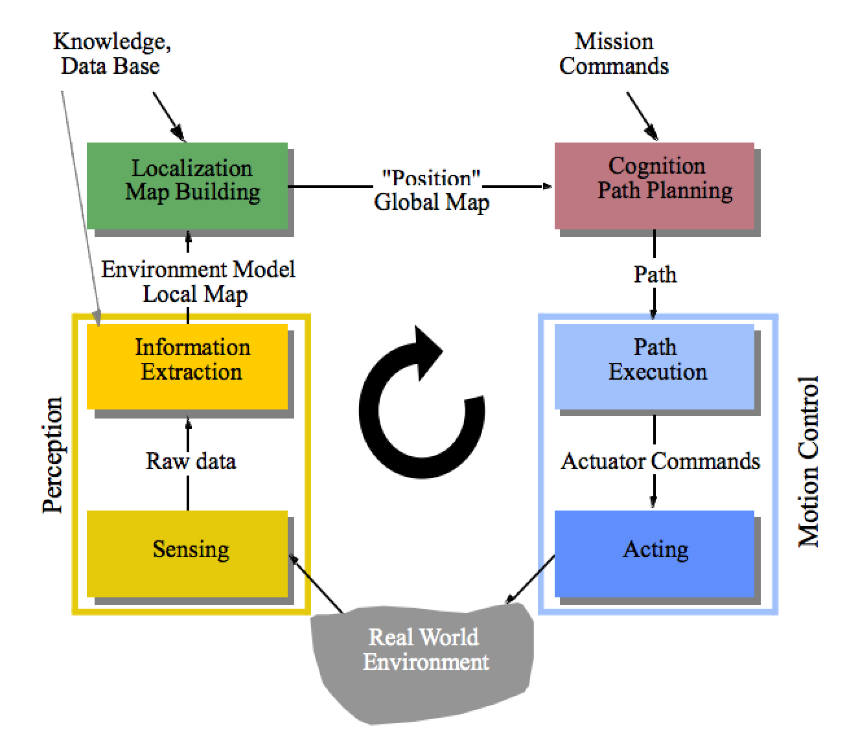
Open loop control vs. Closed loop control
Recap
Control Architectures
Sensors & Vision
Control & Kinematics

Slide 10
Core AI Problem
Mobile robot path planning: identifying a trajectory that, when executed, will enable the robot to reach the goal location
Representation
State (state space)
Actions (operators)
Initial and goal states
Plan:
Sequence of actions/states that achieve desired goal state.

Slide 11
Compute Path
Smooth it and satisfy differential constraints
Design a feedback control law that tracks the trajectory
Design a trajectory (velocity function) along the path
Model of the world
Execute

Slide 12
Fundamental Questions
How is a plan represented?
How is a plan computed?
What does the plan achieve?
How do we evaluate a plan’s quality?

Slide 13
1) World is known, goal is not

Slide 14
2) Goal is known, world is not

Slide 15
3) World is known, goal is known

Slide 16
4) Finding shortest path?

Slide 17
5) Finding shortest path with costs

Slide 18
The World consists of...
Obstacles
Places where the robot can’t (shouldn’t) go
Free Space
Unoccupied space within the world
Robots “might” be able to go here
There may be unknown obstacles
The state may be unreachable

Slide 19
Configuration Space (C-Space)
Configuration Space: the space of all possible robot configurations.
Data structure that allows us to represent occupied and free space in the environment

Slide 20
Configuration Space
Point robot (no constraints)
C
C_{free}
q_{goal}
C_{obs}
q_{init}
For a point robot moving in 2-D plane, C-space is

Slide 21
What if the robot is not a point?

Slide 22
What if the robot is not a point?
Expand obstacle(s)
Reduce robot

Slide 23
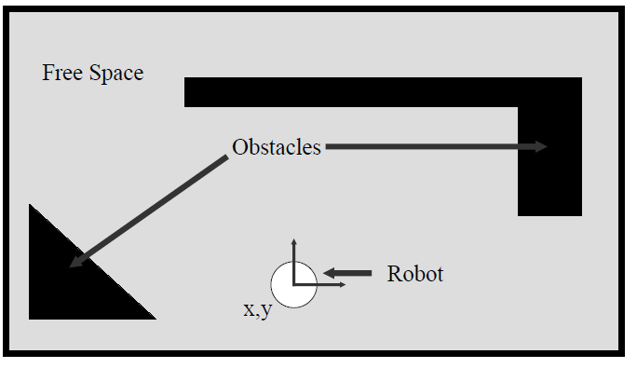
Example Workspace

Slide 24
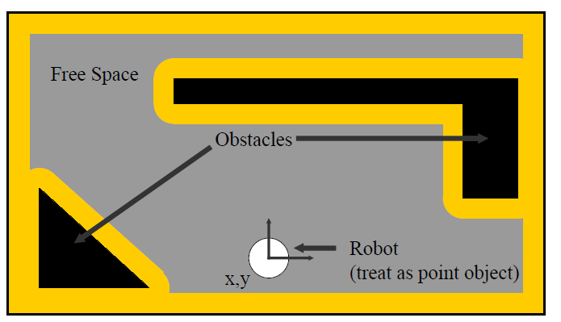
Example Workspace

Slide 25
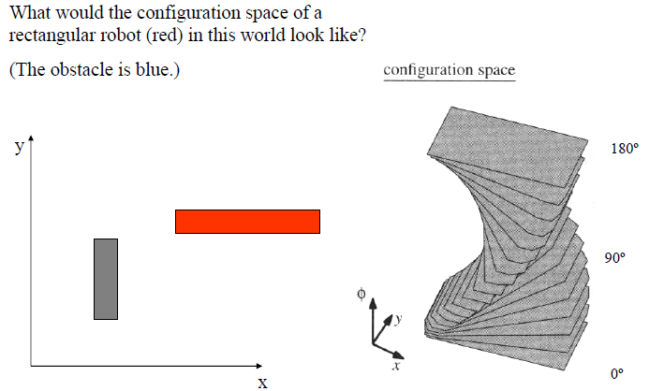
If we want to preserve the angular component…

Slide 26
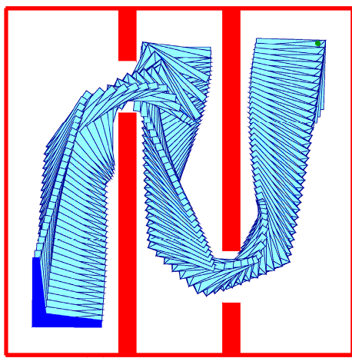
Rigid Body Planning

Slide 27
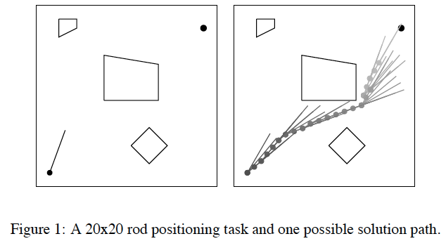
Transfer in Reinforcement Learning via Shared Features: Konidaris, Scheidwasser, and Barto, 2002

Slide 28
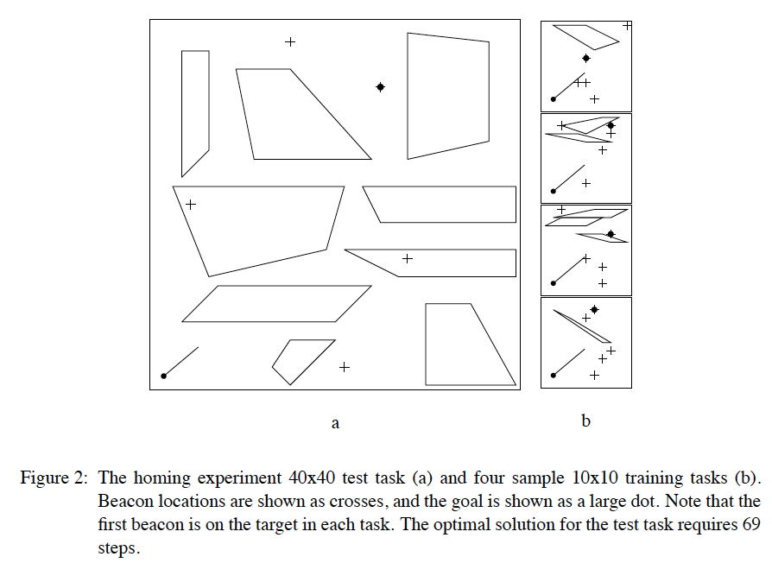

Slide 29
Back to Path Planning…
Typical simplifying assumptions for indoor mobile robots:
2 DOF for representation
robot is round, so that orientation doesn’t matter
robot is holonomic, can move in any direction

Slide 30
Back to Path Planning…
Now lets assume that someone gave us a map. How do we plan a path from $q_{init}$ to $q_{goal}?$
start
Fundamental Questions
goal
How is a plan represented?
How is a plan computed?
What does the plan achieve?
How do we evaluate a plan’s quality?

Slide 31
start
goal

Slide 32
Occupancy Grid
start
goal

Slide 33
Occupancy Grid, accounting for C-Space
start
goal

Slide 34
Occupancy Grid, accounting for C-Space
start
goal
Slightly larger grid size can make the goal unreachable.
Problem if grid is “too small”?

