Slide 1
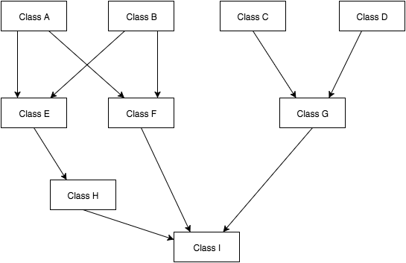
Parallel Build System
Manjot Brar, School of EECS, Washington State University, Pullman WA (manjot.brar@wsu.edu)
IMD
Proposed Approach
-Topological Sorting of graph to produce build schedule
-Running tests such as unit tests while processes are waiting
-Dynamically distribute processors when resources are needed
Problem and challenges
Main Outcomes
PROBLEM STATEMENT:
Input: Directed Acyclic Graph
Output: Parallel Build Schedule
SIGNIFICANCE:
-Decrease build times when compared to a serial build
CHALLENGES:
-Distributing work among processors efficiently
-Bottlenecks (nodes with large indegree)
-Keeping processors busy if they finish early
-Improve speed of large builds by implementing parallel approach
-Provide scheduling for a parallel build
-Encourage well designed “#include” hierarchy which will help speedup builds by reducing bottlenecks in the system
REFERENCES:
http://google-engtools.blogspot.com/2011/09/build-in-cloud-distributing-build-steps.html
https://randomascii.wordpress.com/2014/03/22/make-vc-compiles-fast-through-parallel-compilation/
12/6/15

