Slide 1
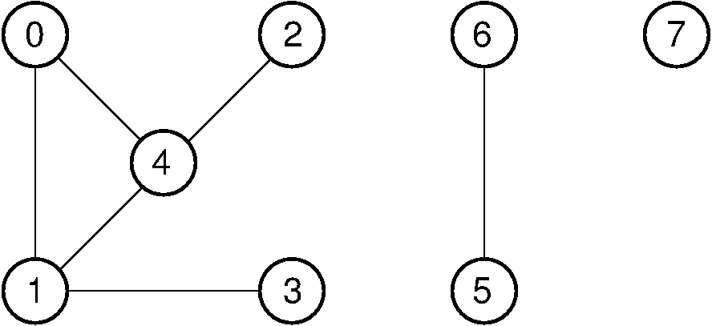
Parallel Connected Component Detection Sam Fields, School of EECS, Washington State University, Pullman WA, sam.fields@wsu.edu
IMD
Proposed Approach
Assign a section of the edge list to each process. Edges form parent/child relationships. The child’s parent is set to the highest parent it can find by traversing upwards. This forms the initial connected components.
After the connected components have been created, each process will iterate over their section, and based on the highest parent will sort them into groups for output.
Problem and challenges
Main Outcomes
PROBLEM STATEMENT: Given a list of edges from a graph G(V, E), determine how many distinct connected components are in the graph using a parallel algorithm. Output the vertices that belong to each connected component.
SIGNIFICANCE: The algorithm should result in a faster run time vs serial run time.
CHALLENGES:
Determining the most efficient way to distribute work
Merging the individual connected components in an efficient way
Parallel algorithm design for detecting connected components in parallel
Time and space complexity analysis
12/7/2015

