Slide 1
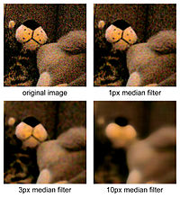
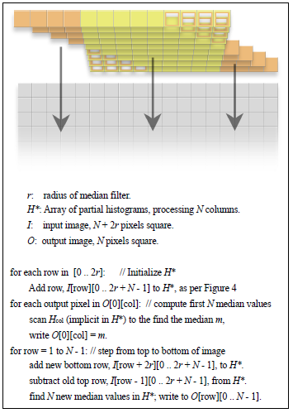
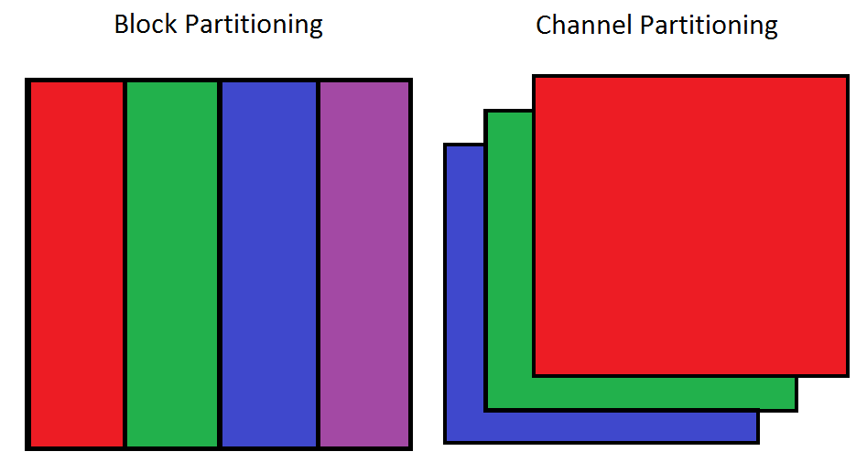
Parallel Median Filter using OpenMP Matthew Godmere, School of EECS, Washington State University, Pullman WA
IMD
Proposed Approach
Goal is to develop an efficient parallel median filter with OpenMP using two methods
Block partitioning is scalable but suffers from inefficient kernel initializations and array caching
Channel partitioning has
optimal kernel initializations
and caching but is limited to
the number of channels in
the image
Problem and Challenges
Main Outcomes
Block partitioning performed well when tested up to four threads, showing diminishing returns due to inefficient histogram overlap and caching
Channel partitioning performed the best due to efficient and isolated array caching and histogram binning
A hybrid block-channel partitioning could be developed and tested for a scalable tradeoff between both methods
REFERENCES:
T. Huang, G. Yang, and G. Tang, "A fast two-dimensional median filtering algorithm", IEEE Trans. Acoust., Speech, Signal Processing, vol. 27, no. 1, pp. 13–18, 1979
Weiss, Ben. "Fast Median and Bilateral Filtering." (2006): 1-8. Web. 7 Dec. 2015. <http://www.shellandslate.com/fastmedian.html>.
PROBLEM STATEMENT:
Accept an n-channel input image and perform parallel median filtering using kernel size r
SIGNIFICANCE:
Channel partitioning should be most efficient but a block-channel partition could be scalable tradeoff
An efficient parallel median filter can benefit real-time vision applications that need exact solutions
CHALLENGES:
Median filter algorithms are not separable or linear which makes naïve parallelization infeasible
Serial filtering algorithms often present complex optimizations that make it difficult parallelize
7 December 2015

