Slide 1
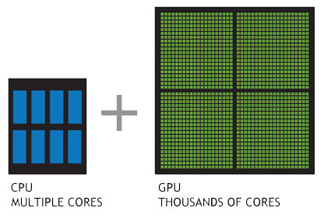
GPUs for plant biology Md. Kamruzzaman, School of EECS, Washington State University, Pullman WA (methun@eecs.esu.edu)
IMD
Picture/Diagram
Related to Project
Proposed Approach
Main idea is to improve computational performance using GPU beside CPU. CPU has multicore but GPU has many-cores. Each core is responsible for single thread (processing unit) that is also known as work item. Many work items groups together to form work group. This is a SIMD model in a shared memory system. Each work item is responsible to compute dot product of a pair of vectors. We pick as more work items as possible to complete all dot products simultaneously.
Problem and challenges
Main Outcomes
PROBLEM STATEMENT: Performing vector dot(scalar) product between two high dimensional vectors is time consuming in serial code. The time complexity is O(n) for serial code where n is the dimension of the vector.
SIGNIFICANCE: I used two vectors of float type where size of each of them is (1024*64*8). I got almost 150 times better performance in GPU then CPU.
CHALLENGES: Population vs SNPs data is 2D but each time we pick two single rows or columns and perform dot product. If we pick each two columns and send these to each work item to compute dot products then we can introduce more parallelism.
After using GPU to perform dot product we observed 5 times better performance compared to serial code with CPU only. The reason behind this low improvement is we are not only doing dot product in a single work item but also doing other staffs like uncompressing, calculating p-value, etc.
Framework: OpenCL
Editor: Xcode 7.1.1
GPU: AMD Radeon R9 M370X/Intel Iris Pro
12/07/2015

