Slide 1
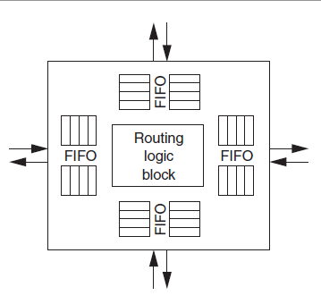
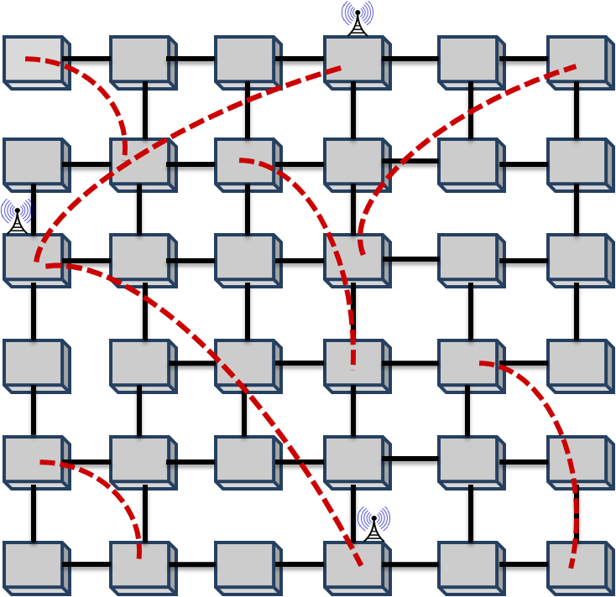
NoC simulator parallelization Xian Li, School of EECS, Washington State University, Pullman WA (xli1@eecs.wsu.edu)
IMD
Proposed Approach
Try to transfer global variable into private variables. The critical function should be a independent module.
Insert reduction clause if there is no dependency. Insert critical/atomic in necessary positions.
Using static/dynamic scheduling based on the execution process.
Using parallel algorithm instead of serial algorithms.
Targeting shared memory system(OpenMP).
Problem and challenges
Main Outcomes
PROBLEM STATEMENT: Implementation of a parallel network on chip(NoC) simulator based on serial version. With higher execution speed and the same routing algorithm.
SIGNIFICANCE: Speed up, robust and easy to use.
CHALLENGES: Serial algorithm with implicit dependency, large amount of global variables.
Speed up of network on chip simulation
REFERENCES:
Partha Pratim Pande, Cristian Grecu, Michael Jones, André Ivanov, Res Saleh, "Performance Evaluation and Design Trade-offs for Network on Chip Interconnect Architectures”, IEEE Transactions on Computers, vol. 54, no. 8, pp. 1025-1040, August 2005.
Date Prepared

