Slide 1
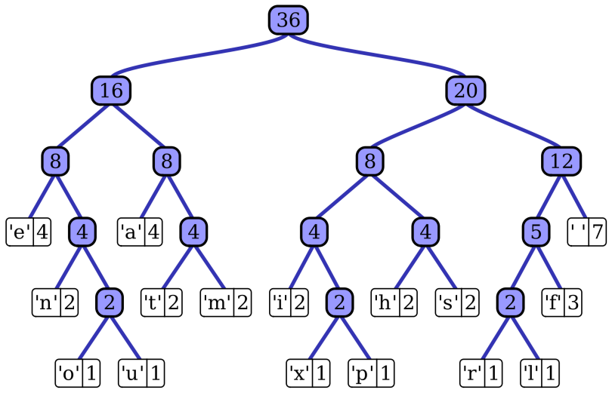
Parallel Huffman Encoding Student name, School of EECS, Washington State University, Pullman WA (email)
IMD
Proposed Approach
Using OpenMPI, have each proc compress an equal amount of data. Experiment with different methods of storing offsets of data compressed by each proc. Experiment with methods of distributing compressed data among procs to maintain parallel efficiency – try distributing so each proc decompresses what it originally compressed, or distribute by compressed size so each proc decompresses a similar amount of compressed data. Experiment with different character frequency distributions and see how it affects efficiency for both methods.
Problem and challenges
Main Outcomes
PROBLEM STATEMENT: Huffman Encoding is a compression/decompression algorithm which maps characters to bit sequences based on frequency. The input is a file, and the output is a compressed file.
SIGNIFICANCE: Hopefully great speedup for very large files. Varying character frequency will compress to smaller sizes, but will probably pose more issues for maintaining parallel efficiency.
CHALLENGES: - -Impossible to know where to split the compressed data without splitting a character.
--Offsets must be stored, which takes disk space.
--Different chunks could compress/decompress to very different sizes, affecting efficiency.
1. Greatly increase the speed of compressing and decompressing large files using Huffman Encoding.
2. Determine the most effective method of work distribution to maintain efficiency.
3. Experiment with storage schemes which enable efficient decompression without compromising disk space and discover which method strikes the best balance between speed and disk space efficiency.
REFERENCES: md5sum tool for file compression and decompression accuracy verification. Shell of Adam Carter's Huffman 223 Assignment (infrastructure, algorithm and parallelization is mine)
Date Prepared

