Slide 1
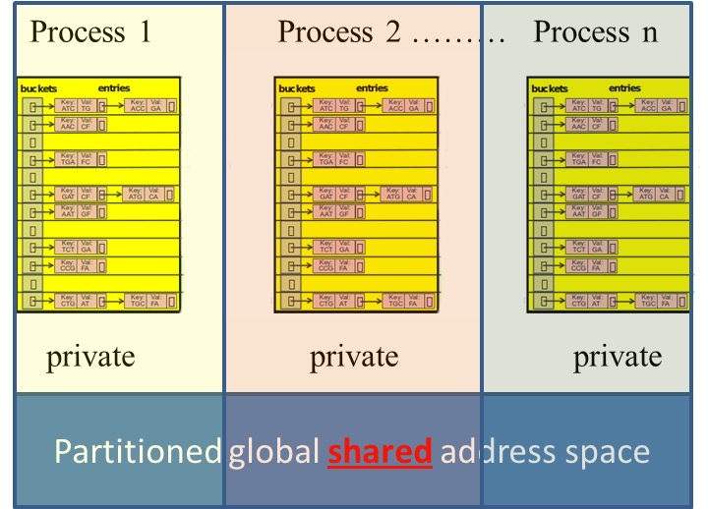
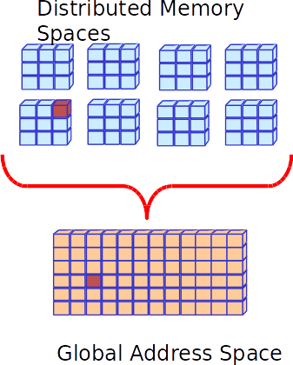
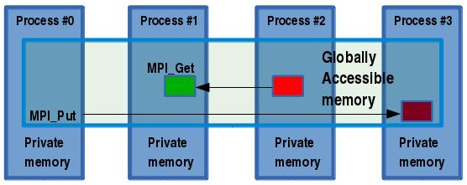
Implementing a Distributed Hash Table Priyanka Ghosh, School of EECS, Washington State University, Pullman WA (pghosh@eecs.wsu.esu)
IMD
Proposed Approach
Proposed implementation techniques that utilize atomic ‘Get’ & ‘Put’ operations in order to perform ‘Insert’ and ‘Lookup’ queries:
version 1: PGAS approach : using the Global Arrays library (or Chapel)
version 2: MPI-3 RMA interface
Problem and challenges
PROBLEM STATEMENT:
In certain applications, (e.g. genome assembly), the input data can easily span to a few hundred GB’s to up to a TB of data, making it impossible to store within the memory of a single node, thereby distributing data among several nodes is crucial in terms of obtaining scalability.
Input: A set of ’p’ local hash tables, storing ’N/p’ entries in the memory of ’p’ different processes.
Output: A distributed Hash table ’D’, accessible by all ’p’ processes, storing at most ’N’ entries.
A DHT is a data-structure that provides the utilities of a regular hash table, in local memory, storing data in the form (key, value) pairs, performing insert and lookup functionalities, only in a distributed fashion, i.e the key-values pairs are distributed across multiple nodes, with each process managing(owning) a part of the table.
Main Outcomes & Challenges
Target locality so that the data being accessed is preferably stored within the local memory of the process
Minimize communication by performing batch processing (using collective operations)
perform insert operations in batches, instead of element-wise insert
Handle skewed data:
Over-populating a single bucket
Over-populating multiple buckets of a single node
REFERENCES:
Nieplocha, Jarek, Bruce Palmer, Vinod Tipparaju, Manojkumar Krishnan, Harold Trease, and Edoardo Aprà. "Advances, applications and performance of the global arrays shared memory programming toolkit." International Journal of High Performance Computing Applications 20, no. 2 (2006): 203-231.
12/08/2015

