Slide 1
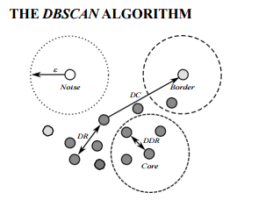
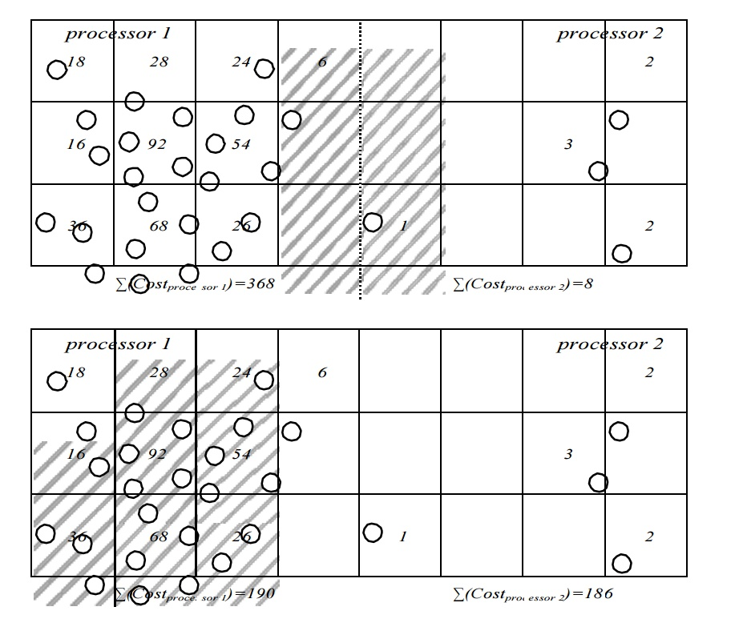
Multithreaded DBScan Ritche Long, School of EECS, Washington State University, Pullman WA (rlong0702@gmail.com)
IMD
Proposed Approach
Transitioning away from an R* or k-d Tree approach to parallelizing.
Heuristic Load Balancing (using a GRID based approach such as STING)
Dynamic scheduling to avoid poor allocations of work (work stealing)
Localized DBSCAN
Merge
Problem and challenges
Main Outcomes
PROBLEM STATEMENT: INPUT: Synthetically generated data into DBScan()
OUTPUT: Density-Based Clusters
SIGNIFICANCE: -Speedup using heuristic load balancing
- Speed up neighborhood searches using hyper grid decompositions. (STING)
- CHALLENGES:
- High Communication Overhead
Load Balancing
Synthetic Generation of Data
Comparisons with serial and distributed variants should remain the same in terms of outputting clusters.
Šidlauskas, Darius, et al. "Trees or grids?: indexing moving objects in main memory." Proceedings of the 17th ACM SIGSPATIAL International Conference on Advances in Geographic Information Systems. ACM, 2009.
Ester, Martin, et al. "A density-based algorithm for discovering clusters in large spatial databases with noise." Kdd. Vol. 96. No. 34. 1996.
Wang, Wei, Jiong Yang, and Richard Muntz. "STING: A statistical information grid approach to spatial data mining." VLDB. Vol. 97. 1997.
Date Prepared

