Slide 1
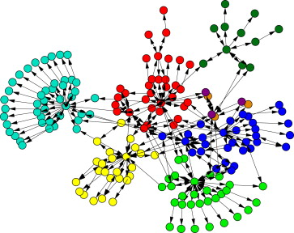
Community Detection On Spark Sumit Purohit, School of EECS, Washington State University, Pullman WA (spurohit@wdu.edu)
IMD
Proposed Approach
Literature Survey of Irregular Applications
Parallel heuristics based Algorithm for CD
Experimentation with different graph representations on data partitioning, and load balancing
Implementation on a distributed spark cluster
Run Same Dataset on MPI and Spark system to investigate:
Run time
Data Partitioning
Task Communication
Santo Fortunato
http://dx.doi.org/10.1016/j.physrep.2009.11.002
Problem and challenges
Main Outcomes
PROBLEM STATEMENT: Given a weighted undirected graph G(V, E, w) Identify “Communities” in the graph which are subset of V
SIGNIFICANCE:
Community Detection algorithm in Big Scale In-Memory Data Processing Engine Apache Spark
Comparative Study of MPI and Apache Spark
Acquire Deep Understanding of different Parallel Systems
CHALLENGES:
Scalability
Instrumentation Challenges to compare different Programming Models for an Irregular Applications.
List the Project’s main outcomes
Apache Spark Based Implementation of existing algorithm
Generation of Metrics to compare MPI vs Spark
New Algorithm to take advantage of Distributed architecture of Apache Spark
Publication
REFERENCES:
H Lu, M Halappanavar, and A Kalyanaraman. "Parallel Heuristics for Community Detection.”
S. Fortunato, Community detection in graphs
Louvain, findcommunities. <https://sites.google.com/site/findcommunities/>
12/07/2015

