Slide 1
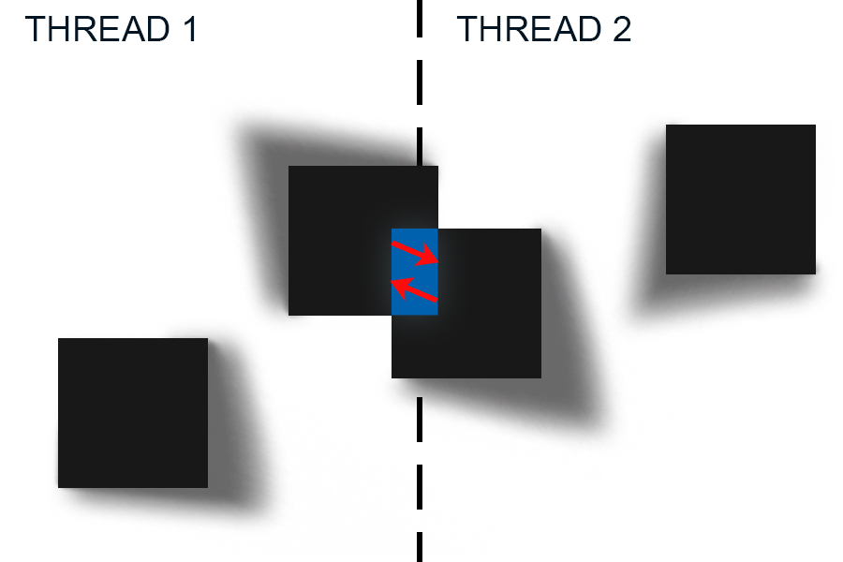
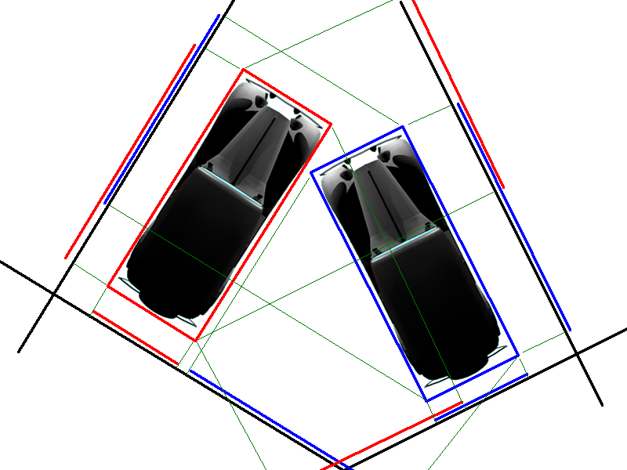
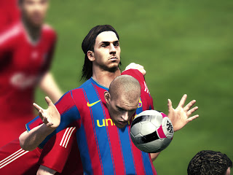
2D Collision Detection in Parallel Carson Tolleshaug, School of EECS, Washington State University, Pullman WA (carson.tolleshaug@gmail.com)
IMD
Proposed Approach
Object-oriented design (object to object comparisons)
This means using a shared memory system
Map area divided into “neighborhoods” with each thread accounting for one neighborhood
When an object crosses the bounds of the neighborhood it will be shared with the adjacent neighborhood thread.
Problem and challenges
Main Outcomes
PROBLEM STATEMENT:
Goal: Determine parameters for maximum speedup.
Input: # of objects, # of frames, # of threads
Output: Average time per frame
SIGNIFICANCE:
This is a common problem in physics simulations and frequently used in games. This calculation needs to happen many times a second.
CHALLENGES:
Object sharing (between threads) without responding to the same collision twice
Object transferring
Determine the number of threads which can calculate collision detection and response the fastest for a given input size
Determine the parameters that allow the maximum number of objects that can be used and maintain a consistent minimum of 30 and 60 calculations per second.
Ultimately, have a good idea of the most (time) efficient approach to resolving collisions.
REFERENCES:
Cars image: www.euclideanspace.com
FIFA image: igetmykicksonunit66.blogspot.com
12/07/15

