Slide 1
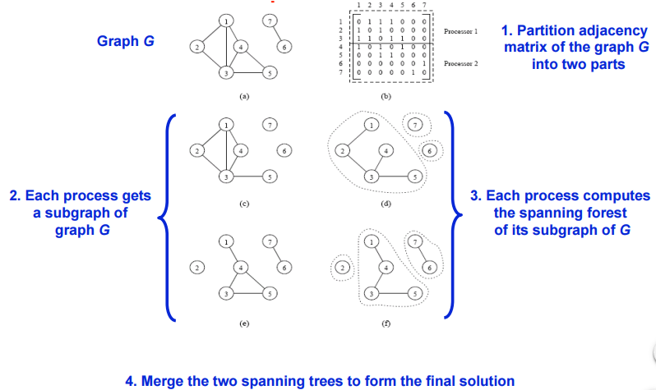
Parallel Object Detection in Images Forrest Weston, School of EECS, Washington State University, Pullman WA (Forrest.Weston@gmail.com)
 | Proposed Approach Divide image into P pieces transform each to matrix representation Run independent connected component algorithm on each proc result: P spanning forests Merge spanning forests until only one remains.
Problems and Challenges Problem Statement: Accepts image file, outputs file containing number of objects and their respective bounds. Significance: Can be used to speedup other applications involving image processing, such as object recognition. Challenges: Determining if spanning forests need to be merged | Main Outcomes Determine the number of objects that exist in an image. Provide bounds for objects in an image. References: http://www.cs.rice.edu/~vs3/comp422/lecture-notes/comp422-lec24-s08-v2.pdf

