Slide 1

(1 - 1) Computer Software & Software Development
H&K Chapter 1
Instructor - Andrew S. O’Fallon
CptS 121 (August 26, 2026)
Washington State University

Slide 2
Course Collaborators
A lot of material for this course was adapted from Chris Hundhausen’s course or developed concurrently with him

Slide 3
What is Expected in this Course?
To learn how to approach and solve problems differently, including some interview like questions
To build enough programming skills to be one step closer to landing an internship
Dedication
And of course, hard work
You up for the challenge?

Slide 4
What is Computer Science? (1)
Computer science is the study of computers and computational systems, with a particular focus on algorithms
  Intersects theory with practice
  Requires thinking in abstract and concrete terms
  Not just about building computers and developing programs
  Involves planning, designing, developing and applying systems
  Applies analysis to algorithm efficiency, and software performance
What are areas of study in Computer Science?
  Artificial intelligence - Big data / data analytics
  - Machine Learning - Bioinformatics
  Networks - Software engineering
  Graphics - Computer systems
  Security - Database systems - Many others

Slide 5
What is Computer Science? (2)
What is an algorithm?
  A sequence of instructions that solve a problem
Why are algorithms so important to computer science?
  If we can specify an algorithm…
    We can automate the solution
    We can also repeat a solution to a problem

Slide 6
Activities: Discuss, Write, and Execute an Algorithm
Activities (in pairs):
  (1) Verbally discuss (only) an algorithm using for drawing a triangle on the whiteboard with a dry erase marker – wait until the instructor indicates to move forward
  (2) Write an algorithm using basic English words and phrases (not programming language statements) for drawing a triangle on the whiteboard with a dry erase marker – wait until the instructor indicates to move forward
  (3) Execute the algorithm and draw the triangle described by the algorithm on a tablet, piece of paper, or the whiteboard

Slide 7
Class Analysis of Triangle Drawing Activity? (1)
Was the triangle drawn as expected?
  If no:
    Was there any miscommunication between you and your partner about how to write the algorithm?
    Was it because the algorithm was incomplete and/or ambiguous?
    Was it because the activity statements were incomplete and/or ambiguous?
      What kinds of clarifying questions could you ask to better understand the activity statements?

Slide 8
Class Analysis of Triangle Drawing Activity? (2)
Does your triangle look the same as others in the class?
  If no, why?
    Could the activity statements have provided more information?
    Could you have asked clarifying questions?

Slide 9
Formal Definition of Algorithm
A well-ordered collection. . .
Of unambiguous and effectively computable operations. . .
That produces a result. . .
And halts in a finite amount of time.

Slide 10
Is this an Algorithm? (4)
Apply small amount of shampoo to hair
Work into scalp for about 1 minute
Rinse thoroughly
Repeat
No! Why not?
Hint: Is it well ordered? Does it halt?

Slide 11
How are Algorithms Put Together?
Sequenced instructions
  do them in the order given
Conditional instructions
  do them if a condition is true
Iterative instructions
  do them while a condition is true

Slide 12
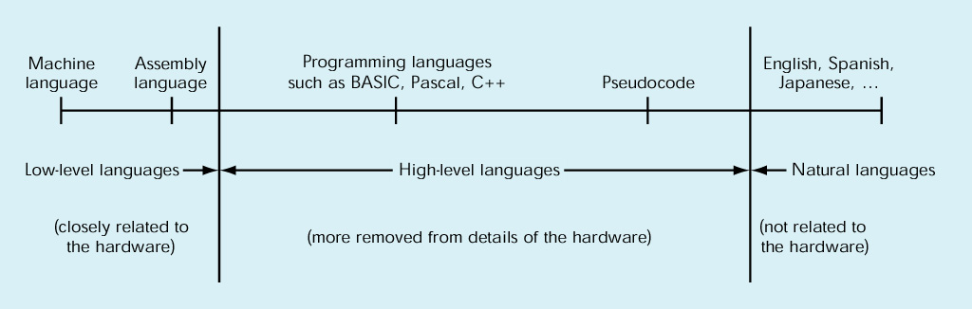
High-Level Programming Languages (1)
High-level programming languages
  The continuum of languages:
  Low-level languages were created from the perspective of the machine; working with 1’s and 0’s, also known as logic levels
  High-level languages, have natural language like elements

Slide 13
High-Level Programming Languages (2)
Problem: Computers can’t understand high-level programming languages
Solution: They must be translated
  Programmer uses a text editor to write a text-based source file in a programming language
  Compiler translates source file
    Checks to make sure that program is syntactically correct
    If so, the compiler translates the program into an object file with machine language instructions

Slide 14
High-Level Programming Languages (3)
Object file translated by compiler will not execute!
  High-level programs often make use of software libraries containing predefined pieces of code, including
    Math functions
    Input/output functions
  In order to execute, object file must be linked to object files containing these predefined pieces of code
  A Linker program performs this operation
  A Loader program loads the linked program into memory so that it can be executed

Slide 15
High-Level Programming Languages (4)
Executing Programs
  In this class, programs will execute in a text-based window called a console
  Input data can be entered at command-line prompts
  Output results will be displayed in the console window
  In the real world, many programs have a graphical user interface (GUI)
  GUI programming is, however, beyond the scope of this course

Slide 16
High-Level Programming Languages (5)
Integrated Development Environments (IDE)
  Combine compiler, linker, and loader with a source code editor – we use Microsoft Visual Studio Community 2026 in this course
    Generally, a single button will start the translation process
  Provide a variety of tools to assist programmers, for example:
    Source code syntax highlighting
    Autocompletion lists ("Intellisense")
    A debugger, which allows a programmer to step through programs, one instruction at a time
    A testing framework for developing unit tests

Slide 17
Software Development Method
Equivalent to the “Scientific Method” in the sciences, and the “Systems Approach” in business
Six basic steps:
  Specify problem requirements
  Analyze the problem
  Design an algorithm to solve the problem
  Implement the algorithm
  Test and verify the completed program
  Maintain and update the program

Slide 18
Applying the Software Development Method (1)
Developing software is an iterative process, your first solution is generally not your best!
Your understanding of software your required to build evolves as you understand the problem more!
At this point don’t be afraid to make mistakes!
Example problem: Compute the volume of a cone

Slide 19
Applying the Software Development Method (2)
Data Requirements
  Problem input:
  radius (of the base), height (of the cone)
  Problem output:
  volume (of the cone)
  Relevant formula:
  volume = 1 / 3 * pi * radius² * height

Slide 20
Applying the Software Development Method (3)
Design
  Algorithm
    Get the radius and height for the cone
    Compute the volume of the cone
    Display the resultant volume of the cone
  Refined algorithm
    Get the radius and height for the cone
    Compute the volume of the cone
      volume = 1 / 3 * pi * radius² * height
    Display the resultant volume of the cone

Slide 21
Applying the Software Development Method (4)
Implementation (in C)
#include <stdio.h> /* Needed for printf (), scanf () */
#define PI 3.14159 /* Constant macro */
int main (void)
{
int height = 0, radius = 0;
double volume = 0.0;
printf ("Enter height of cone as integer: "); /* Displays prompt message */
scanf ("%d", &height); /* Gets the value from the user/keyboard */
printf ("Enter radius of base of cone as integer: ");
scanf ("%d", &radius);
/* Compute the volume of the given cone */
volume = ((double) 1 / 3) * PI * radius * radius * height;
/* Display the resultant volume of the given cone */
printf ("Volume of cone with radius %d and height %d is %lf.\n", radius, height, volume);
return 0;
}

Slide 22
Applying the Software Development Method (5)
Note: At this point, don't worry about understanding the details of C syntax! We'll get to that later
Testing
  We would execute the program, trying several different input data values and observing the results
    Debugging is NOT testing! It’s a result of testing!
  Each test is defined by a test case
    A test case provides actual inputs, system state or configuration information, and expected results
  Should always test “boundaries” of inputs and conditions

Slide 23
Applying the Software Development Method (6)
Maintenance
  Most software requires continual improvements, adaptations, and corrections; software patches are a result of maintenance

Slide 24
Next Lecture…
We've covered the general software development method
It's time to start learning the C language!

Slide 25
References
J.R. Hanly & E.B. Koffman, Problem Solving and Program Design in C (8th Ed.), Pearson Education, Inc., 2016

