Slide 1

(6-1) Iteration in C
H&K Chapter 5
Instructor - Andrew S. O’Fallon
CptS 121 (September 23, 2024)
Washington State University

Slide 2
Iterative Constructs (1)
Recall that algorithms are composed of three different kinds of statements:
  Sequence: the ability to execute a series of instructions, one after the other.
  Conditional: the ability to execute an instruction contingent upon some condition.
  Iteration: the ability to execute one or more instructions repeatedly.
This week, we'll learn about loops: the ability to repeatedly execute a sequence of statements.

Slide 3
Iterative Constructs (2)
You have already seen many examples of iteration
Consider, for example, the following segment of the tollbooth application presented in lecture:
axles1 = read_num_axles(infile);
weight1 = read_weight(infile);
axles2 = read_num_axles(infile);
weight2 = read_weight(infile);
axles3 = read_num_axles(infile);
weight3 = read_weight(infile);
toll1 = compute_toll(axles1,weight1);
toll2 = compute_toll(axles2, weight2);
toll3 = compute_toll(axles3, weight3);
display_toll(axles1, weight1, toll1);
display_toll(axles2, weight2, toll2);
display_toll(axles3, weight3, toll3);
Notice that this segment repeats four statements:
axles = read_num_axles(infile);
weight = read_weight(infile);
toll = compute_toll(axles,weight);
display_toll(axles, weight, toll);

Slide 4
Iterative Constructs (3)
How to decide when a loop is needed
  Are any steps repeated?
    No → No loop required
    Yes → Do you know in advance how many steps are repeated?
      No → Use a conditional loop
      Yes → Use a counting loop
Kinds of loops
  Counting loop (for or while): executes a fixed number of times)
  Sentinel-controlled or Endfile-Controlled loop (for or while): (process data until a special value is encountered, e.g., end-of-file)

Slide 5
Iterative Constructs (4)
Kinds of loops (cont.)
  Input validation loop (do-while): Repeatedly accept interactive input until a value within a specified range is entered
  General conditional loop (while, for): Repeatedly process data until a desired condition is met
Let’s look at examples of each of these loop patterns, and how they are implemented in C

Slide 6
Counter Loops (1)
Pseudocode for a counter loop:
Set loop counter to 0
while (loop counter < final count)
… (Do data processing)
add 1 to loop counter
endwhile

Slide 7
Counter Loops (2)
Implementing Counter Loops: the while loop
while (<repetition-condition>)
{
<body>
}

Slide 8
Counter Loops (3)
Notes on while loops:
  <repetition-condition> is evaluated at beginning of loop. If it evaluates to true, the loop body is executed. If it evaluates to false, control shifts to first statement after loop body
  <body> contains one or more C statements
  After last statement in <body> is executed, control is shifted back to beginning of loop, and <repetition-condition> is re-evaluated.
  “Progress” must be made within the loop. That is, something must be done so that <repetition-condition> eventually evaluates to false. Otherwise we have an “infinite loop”

Slide 9
Counter Loops (4)
Example: Notice that the Tollbooth code segment we looked at earlier can be rewritten as a counter while loop in C:
int count;
count = 0; /* Initialize counter */
while (count < 3)
{
axles = read_num_axles(infile);
weight = read_weight(infile);
toll = compute_toll(axles,weight);
display_toll(axles, weight, toll);
count = count + 1; /* increment counter */
}

Slide 10
Counter Loops (5)
Another alternative for implementing Counter Loops: the for loop
for (<initialization>;
<repetition-condition>;
<update-expression>)
{
<body>
}

Slide 11
Counter Loops (6)
Notes on for loops:
  <initialization> statement initializes the loop control variables before loop is executed the first time
  <repetition-condition> is tested at beginning of loop. If it is true, loop <body> is executed.
  <body> contains one or more C statements
  After last statement in <body> is executed, control is shifted back to beginning of loop. Then, <update-expression> is executed. Finally, <repetition-condition> is re-evaluated.
  As with while loops, the <update-expression> must define “progress.” That is, something must be done so that <repetition-condition> eventually evaluates to false. Otherwise we have an “infinite loop”

Slide 12
Counter Loops (7)
Example: Notice that the Tollbooth segment we just looked at can also be rewritten as a counter for loop in C:
int count;
for (count = 0; count < 3; count = count + 1)
{
axles = read_num_axles(infile);
weight = read_weight(infile);
toll = compute_toll(axles,weight);
display_toll(axles, weight, toll);
}
<repetition-condition>
<initialization>
<update-expression>

Slide 13
Aside: Compound Assignment Operators
Notice that the <update-expression>s in loops are often of the form:
count = count + 1
C defines special assignment operators to define statements of this form more compactly:
  count += 1 is equivalent to count = count + 1
  count -= increment is equivalent to count = count – increment
  product *= product is equivalent to product = product * product
  sum /= divisor is equivalent to sum = sum/divisor
  remainder %= 2 is equivalent to remainder = remainder % 2

Slide 14
Aside: Increment and Decrement Operators (1)
The ++ and -- operators take a single variable as their operands. The side effect of the operator is to increment or decrement its operand by one:
  count++ has the effect of count = count + 1
  count-- has the effect of count = count – 1
Note: ++ and -- can be placed either before or after their variable operator:
  Pre-increment or pre-decrement (e.g., ++count,
  --count ): value of expression is value of variable after the increment or decrement is applied
  Post-increment of post-decrement (e.g., count++, count--): value of expression is value of variable before the increment or decrement is applied

Slide 15
Aside: Increment and Decrement Operators (2)
You try it: What are the values of i, j, and k after each of the following statements is executed?
int i, j, k;
i = 2;
j = 3 + i++;
k = 3 + ++i;
i *= ++k + j--;
i /= k-- + ++j;

Slide 16
Counter Loops (8)
Notice that we can rewrite our previous while loop with these new operators:
int count;
count = 0; /* Initialize counter */
while (count < 3) {
axles = read_num_axles(infile);
weight = read_weight(infile);
toll = compute_toll(axles,weight);
display_toll(axles, weight, toll);
count++; /* increment counter */
}

Slide 17
Counter Loops (9)
Notice that we can also rewrite our previous for loop with these new operators:
int count;
for (count = 0; count < 3; count++)
{
axles = read_num_axles(infile);
weight = read_weight(infile);
toll = compute_toll(axles,weight);
display_toll(axles, weight, toll);
}

Slide 18
Counter Loops (10)
Accumulating a value
  Suppose that we want to keep track of the total number of tolls collected by the tollbooth. We could accumulate this value from within the loop body:
  int count, toll_total;
  for (count = 0, toll_total = 0; count < 3; count++)
{
axles = read_num_axles(infile);
weight = read_weight(infile);
toll = compute_toll(axles,weight);
display_toll(axles, weight, toll);
toll_total += toll; /* add toll to toll_total */
}

Slide 19
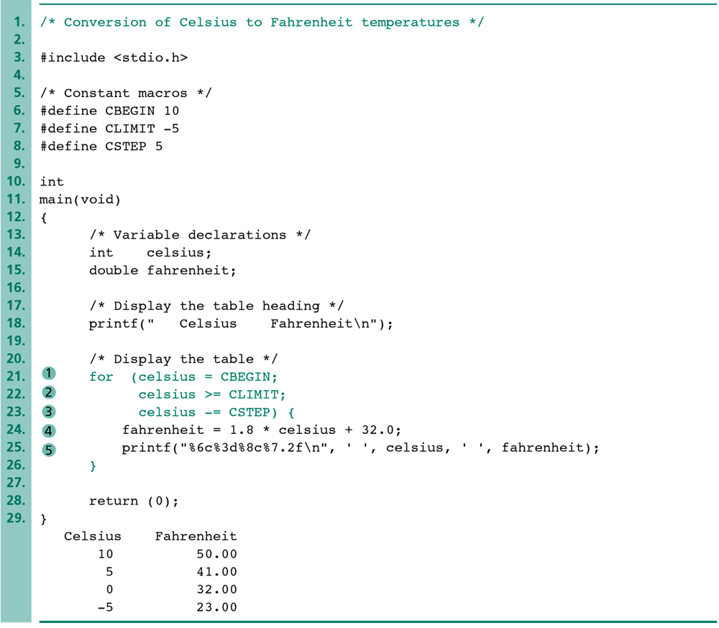
Counter Loops (11)
Loop increments other than 1

Slide 20
Next Lecture…
We'll discuss several additional loop patterns:
  Conditional loops
  Sentinel-controlled loops
  Endfile-controlled loops
  Flag-controlled loops

Slide 21
References
J.R. Hanly & E.B. Koffman, Problem Solving and Program Design in C (8th Ed.), Addison-Wesley, 2016
P.J. Deitel & H.M. Deitel, C How to Program (7th Ed.), Pearson Education, Inc., 2013.

Slide 22
Collaborators
Chris Hundhausen

