Slide 1

(7-1) Modular Programming
H&K Chapter 6
Instructor - Andrew S. O’Fallon
CptS 121 (September 30, 2024)
Washington State University

Slide 2
Functions with Output Parameters (1)
In many situations, we would like to define functions that compute more than one value
  A function that computes the min and max of numbers
  A function that computes the variance and deviation
  Many others…
Is that possible?

Slide 3
Functions with Output Params (2)
Yes, it is! Function parameters would appear a promising place to start. But we first need to understand precisely what happens when we call a function with parameters, e.g.,
  void foo (int a, char b, double c);
  int main (void)
  {
  int myint;
  char mychar;
  double mydouble;
  myint = 12;
  mychar = 'a';
  mydouble = 23.45;
  foo (myint, mychar, mydouble);
  …
  }
  void foo (int a, char b, double c)
  {
  /* This does random, meaningless stuff */
  ++a;
  b = 'd';
  c *= 2;
  }

Slide 4
Functions with Output Params (3)
Remember that each function has a separate area of memory for storing its local variables and parameters. Each data area exists only when the function is active. Before the call to foo, memory might look something like this:
Function main
data area
myint
12
mychar
'a'
mydouble
23.45

Slide 5
Functions with Output Params (4)
Then, when function foo is called from main, the foo function's data area becomes active, and the actual parameter values passed to foo are copied to spaces in its memory area:
Function main
data area
Function foo
data area
myint
a
12
copied
12
mychar
b
copied
'a'
'a'
mydouble
c
copied
23.45
23.45

Slide 6
Functions with Output Params (5)
Finally, when function foo finishes executing, its memory area disappears, and control returns to the main function. The state of memory is thus as it was prior to the call to foo:
Function main
data area
myint
12
mychar
'a'
mydouble
23.45

Slide 7
Functions with Output Params (6)
Since foo's data area goes away after execution, there's no way for foo to communicate with main through its parameter list. What we'd like is a two-way flow, something like this:
Function main
data area
Function foo
data area
copied
myint
a
12
copied
12
copied
mychar
b
'a'
'a'
copied
mydouble
copied
c
23.45
23.45
copied

Slide 8
Functions with Output Params (7)
Let’s look at the definition of a pointer
  A variable that stores as its contents the address of another variable
We should be able to use these address values to access a variable indirectly
Indirect access to these memory locations also will allow for modification to the contents

Slide 9
Functions with Output Params (8)
We like to visualize pointers with the following:
pointer
integer
1000
42
2000
1000

Slide 10
Functions with Output Params (9)
In C, we can achieve the effect of output parameters by passing memory addresses (pointers) instead of values. Here's how we could modify the previous code to accomplish this:
  void foo(int* a, char* b, double* c);
  int main(void)
  {
  int myint;
  char mychar;
  double mydoubl;
  myint = 12;
  mychar = 'a';
  mydouble = 23.45;
  /* pass memory locations of variables, not vars themselves */
  foo(&myint, &mychar, &mydouble);
  …
  }
  void foo(int *a, char *b, double *c) {
  ++(*a); /* autoincrement the value at memory pointed to by a */
  *b = 'd'; /* assign to memory pointed to by b */
  *c *= 2; /* assign to memory pointed to by b */
  }

Slide 11
Functions with Output Params (10)
In order to visualize what the previous code is doing, we'll need to number (arbitrarily) the memory locations at which the variable values are stored:
Since foo's parameters contain memory locations and not values, foo can use those memory locations to access, and ultimately to change, the original values in the main function. Such changes are called "side effects".
Function main data area
Function foo data area
&myint
myint
a
100
12
100
&mychar
mychar
b
200
'a'
200
&mydouble
mydouble
c
300
23.45
300

Slide 12
Aside: The Many Faces of *
By now, you might find the multiple meanings of the '*' operator confusing. Let's review them.
  Meaning one: "multiplication"
    e.g., 5 * 3
  Meaning two: "pointer to"
    e.g., char *c;
  Meaning three: "follow the pointer" (unary indirection)
    e.g., *i = 4;
  Each of these meanings is markedly different!

Slide 13
More About Pointers (1)
We can apply arithmetic operations to pointers
  We can increment pointers: ptr++, ++ptr, ptr = ptr + 1, ptr = ptr + n, where n is an integer
  We can decrement pointers: ptr--, --ptr, ptr = ptr – 1, ptr = ptr - n

Slide 14
More About Pointers (2)
Let’s declare two pointers as follows:
  char *char_ptr = NULL;
  int *int_ptr = NULL;
Let’s now declare two “regular” variables
  char character = ‘A’;
  int number = 42;
We can now assign the addresses of the “regular” variables to the pointers as follows:
  char_ptr = &character;
  int_ptr = &number;

Slide 15
More About Pointers (3)
We can indirectly modify the value to which each pointers “points” by dereferencing it:
  *char_ptr = ‘B’; // Overwrites the ‘A’ in character
  *int_ptr = 25; // Overwrites the 42 in number
In the future, we’ll be able to access contigous blocks of memory by using pointer arithmetic!!!

Slide 16
You Try It
With a partner, design a function divide that accepts four arguments:
  number: an integer input parameter
  divisor: an integer input parameter
  result: an integer output parameter
  remainder: an integer output parameter
The function divides number by divisor. The result is placed into the output parameter result, and the remainder is placed into the output parameter remainder. Also show how a main function would call divide.

Slide 17
Scope (1)
As has been discussed in previous lectures, the scope of an identifier is the region of a program within which the identifier is defined. In general:
  #define macro definitions have global scope, meaning that they are defined within the entire source file
  A function is visible to all functions defined below it. However, its local variables are visible only to itself.

Slide 18
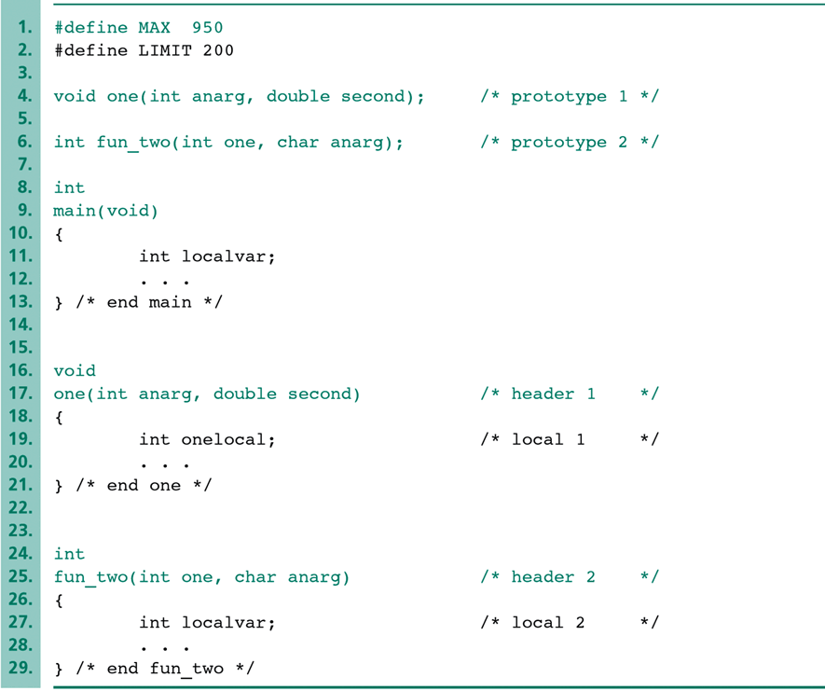
Scope (2)
Identify the scope of the identifiers in the following example:

Slide 19
Next Lecture…
An extended example that includes several functions with input and output parameters
  Prepare yourself by studying the extended example in Section 6.6
Debugging techniques
Common programming errors

Slide 20
References
J.R. Hanly & E.B. Koffman, Problem Solving and Program Design in C (8th Ed.), Addison-Wesley, 2016
P.J. Deitel & H.M. Deitel, C How to Program (7th Ed.), Pearson Education , Inc., 2013.

Slide 21
Collaborators
Chris Hundhausen

