Slide 1

(9-2) Strings I
H&K Chapter 8
Instructor - Andrew S. O’Fallon
CptS 121 (October 16, 2024)
Washington State University

Slide 2
String Fundamentals
A string is a sequence of characters terminated by the null character (‘\0’)
  “This is a string” is considered a string literal
  A string may include letters, digits, and special characters
A string may always be represented by a character array, but a character array is not always a string
A string is accessed via a pointer to the first character in it
This week, we'll learn more about how to work with strings in the C Language

Slide 3
String Basics (1)
Whether you realize it or not, you've been working with C strings all semester:
printf("CptS %d is fun!\n",121);
It's just that we haven't ever declared a string variable. In C, a string is represented as an array of characters:
char name [20]; /* declares a variable name that can hold a
string of length 20 */
Be sure to always account for the ‘\0’ in your array declarations
  name[ ] may have up to 19 characters + 1 for the null character
string

Slide 4
String Basics (2)
As with other data types, we can even initialize a string when we declare it:
char name[20] = “Bill Gates";
char *name = “Bill Gates";
char name[] = {‘B’, ‘i’, ‘l’, ‘l’, ‘ ‘, ‘G’, ‘a’, ‘t’, ‘e’,
‘s’, ‘\0’;}
// These are equivalent string declarations!
Here's what the memory allocated to name looks like after either of the above is executed:
null character (terminates all strings)
name
B
i
l
l
G
a
t
e
s
\0
?
?
?
?
?
?
?
?
?
0
1
2
3
4
5
6
7
8
9
10
11
12
13
14
15
16
17
18
19

Slide 5
String Basics (3)
Notes on the null character
  When a string is initialized on the line it is declared, the compiler automatically "null terminates" the string
  All of C's string handling functions work only with null-terminated strings; any characters to the right of the null character are ignored
  The ASCII value of the null character is 0

Slide 6
String Basics (4)
When a variable of type char* is initialized with a string literal, it may be placed in memory where the string can’t be modified
If you want to ensure modifiability of a string store it into a character array when initializing it

Slide 7
String Basics (5)
Populating a string using scanf ( )
char my_string [50];
// The address of operator (&) is not required because the name of the
// array is an address
scanf (“%s”, my_string);
  Notes on scanf ( ):
    Using %s will automatically append a null character to the end of the string
    Reads character-by-character until whitespace is encountered, i.e. if the user enters:
    Bill Gates, only “Bill” is read; however, “Gates” is still in the input stream
Displaying a string using printf ( )
  printf (“%s\n”, my_string);
  Notes on printf ( ):
    Using %s will display character-by-character until a null character is encountered; white space and printable special characters will be displayed
    If a null character is missing from the end of the string, all contiguous memory will be printed until a null character happens to be found in memory

Slide 8
String Basics (6)
Arrays of Strings
  Suppose we want to store a list of students in a class
  We can do this by declaring an array of strings, one row for each student name:
  #define NUM_STUDENTS 5
  #define MAX_NAME_LENGTH 31
  char student_names[NUM_STUDENTS][MAX_NAME_LENGTH];
  We can initialize an array of strings "in line":
  char student_names[NUM_STUDENTS][MAX_NAME_LENGTH] =
  {"John Doe", "Jane Smith", "Sandra Connor", "Damien White",
  "Metilda Cougar"};
  In most cases, however, we're probably going to want to read the names in from the keyboard or a file…

Slide 9
String Basics (7)
Printing Out and Reading In Strings
#include <stdio.h>
#define [NUM_STUDENTS] 5
#define [MAX_NAME_LENGTH] 31
char student_names[NUM_STUDENTS][MAX_NAME_LENGTH];
int i;
for (i = 0; i < NUM_STUDENTS; ++i)
{
printf("Please enter student name: ");
scanf("%s",student_names[i]);
printf("The name '%s' was just read in.\n", student_names[i]);
}
Is the above code robust? Could it lead to a run-time crash?

Slide 10
String Basics (8)
  Just as is the case for doubles and ints, we can specify a field width in a printf statement involving a string (%s). By default, the string is right justified within that field, e.g.,
  printf("string value: %5s\n",my_string);
  /* string is right justified within field of 5 */
  If we want to left-justify the string, we specify a negative field width, e.g.,
  printf("string value: %-5s\n",my_string);
  /* string is left justified within field of 5 */

Slide 11
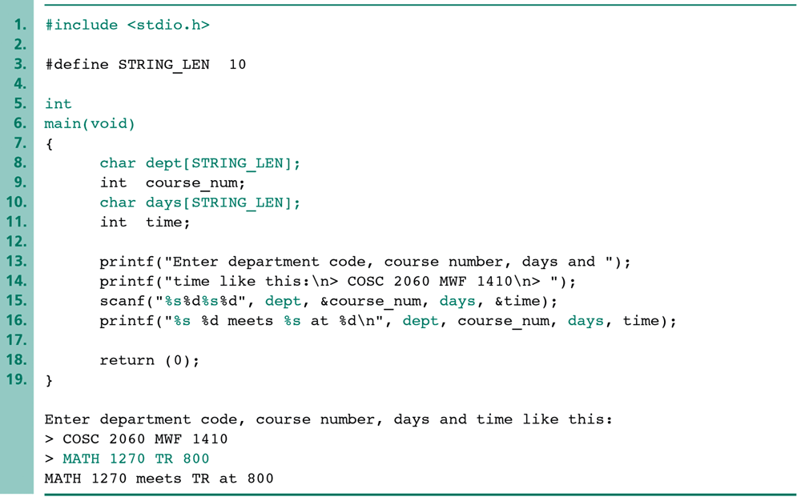
String Basics (9)
Reading in multiple data types alongside the string data type:

Slide 12
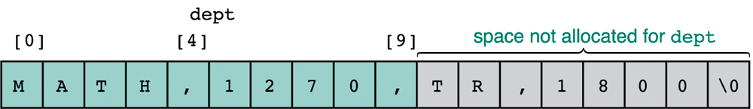
String Basics (10)
When the previous program is run and the user enters the following (which is not in the correct format):
MATH,1270,TR,1800
The scanf call
scanf("%s%d%s%d",dept,&course_num,days,&time);
interprets this all as one string, storing it to dept (bad news!):
Moral: We need a more robust way to read in multiple data types (Stay tuned!)

Slide 13
String Basics (11)
Example problem:
  Write a segment of code that prompts the user for a word of length 24 characters or less, and prints a statement like this:
  fractal starts with the letter f
  Have the program process words until it encounters a "word" beginning with the character '9'.

Slide 14
String Basics (12)
Solution:
  #include <stdio.h>
  #define STRING_LENGTH 25
  int main()
  {
  char name[STRING_LENGTH];
  int done;
  do
  {
  done = 0;
  printf("Enter a name ('9') to quit: ");
  scanf("%s",name);
  if (name[0] == '9')
  done = 1;
  else
  printf("%s starts with the letter %c.\n",
  name,name[0]);
  } while (!done);
  return (0);
  }

Slide 15
String Basics (13)
Use gets() to read a complete line, including whitespace, from the keyboard until the <enter> key is pressed; the <enter> is not included as part of the string
  Usage: gets(my_array)
  If the user enters “Bill Gates” and presses <enter>, the entire string will be read into my_array excluding the <enter> or newline
Use puts() to display a string followed by a newline
  Usage: puts(my_array)

Slide 16
What To Look Forward To…
More on Strings:
  String handling library functions
  Arrays of Pointers
  Character input/output and robust string input
  Character conversion
  String processing example

Slide 17
References
J.R. Hanly & E.B. Koffman, Problem Solving and Program Design in C (8th Ed.), Addison-Wesley, 2016.
P.J. Deitel & H.M. Deitel, C How to Program (7th Ed.), Pearson Education , Inc., 2013.

Slide 18
Collaborators
Chris Hundhausen

