Slide 1
(4-4) Streams and File Processing in C++
Instructor - Andrew S. O’Fallon
CptS 122 (June 27, 2024)
Washington State University

Slide 2
What is a Stream? A Refined Definition
A sequence of objects (generally just considered bytes) that flow from a device to memory or from memory to a device
For input operations, the bytes flow from the device (i.e. keyboard, network connection, disk, etc.) to main memory
For output operations, the bytes flow from main menu to the device (screen, printer, etc.)

Slide 3
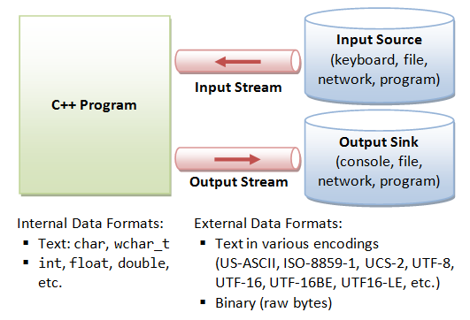
Abstraction of a Stream
Image courtesy of: http://www.ntu.edu.sg/home/ehchua/programming/cpp/images/IOstreams.png

Slide 4
Analogy for a Stream
A conveyer belt
You can place an item in sequence on the belt, i.e. into the stream (insertion or output operation)
You can remove an item in sequence from the belt, i.e. take from the stream (extraction or input operation)

Slide 5
Classic Streams vs. Standard Streams
The classic input/output streams for C++ supported byte-sized chars, which represented the ASCII characters
Many alphabets require more characters than can be represented by a byte and the ASCII character set does not provide the characters
The Unicode character set provides these ones
C++ provides standard stream libraries to process Unicode characters (wchar_t)

Slide 6
Standard Streams in C++ (1)
For standard input/output streams, include <iostream>
cin is a predefined object of class istream and is connected to the standard input device (i.e. keyboard)
cin >> var // cin applying stream extraction operator – stops at whitespace for strings
cout is a predefined object of class ostream and is connected to the standard output device (i.e. screen)
cout << var // cout applying stream insertion operator

Slide 7
Standard Streams in C++ (2)
Member function getline()will read a line from the stream
Inserts a null character at the end of the array of characters, removes and discards the ‘\n’ from the stream (i.e. stored as a C string)

Slide 8
Recall the File Processing Algorithm!
Step 1: open the desired file
Opening is based on filename and permissions (read, write, or append)
Associates a file with a stream
Step 2: process the file
Read data from the file
Does not affect file
Write data to the file
Completely overwrites existing file
Add data to the end of the file
Retains previous information in file
Step 3: close the file
Disassociates a file from a stream

Slide 9
Files Streams in C++ (1)
For input/output streams to work with files, include <fstream>
ifstream objects enable input from a file
ofstream objects enable output to a file
fstream objects for input from and output to a file
Associate file with a file stream either during construction (applying the constructor or by calling open())
fstream fstr(“filename.txt”) // an instantiation of fstream object or fstr.open(“filename.txt”) // after instantiation

Slide 10
Files Streams in C++ (2)
Read from files using:
fstr >> var; // applying the stream extraction operator – stops at whitespace for strings
fstr.getline () // to read entire line into a character array
Stored as a C string
Write to files using:
fstr << var; // applying the stream insertion operator

Slide 11
Files Streams in C++ (3)
Each file ends with an end-of-file marker (EOF)
check if at end of file using fstr.eof()
Close a file using:
fstr.close();

Slide 12
Closing Thoughts on Files
Files are required for many applications
Files may be created and manipulated in any manner appropriate for an application

Slide 13
References
P.J. Deitel & H.M. Deitel, C++: How to Program (9th ed.), Prentice Hall, 2014
J.R. Hanly & E.B. Koffman, Problem Solving and Program Design in C (8th Ed.), Addison-Wesley, 2016

Slide 14
Collaborators
Jack Hagemeister

