Slide 1
Deep Learning – An Introduction
Aaron Crandall, 2015

Slide 2
What is Deep Learning?
Architectures with more mathematical transformations from source to target
Sparse representations
Stacking based learning approaches
More focus on handling unlabeled data
More complex nodes in the network
  I'm not sure this is needed

Slide 3
Motivations for Deep Learning
Automatic feature extraction
  Less human effort
Unsupervised learning
  Modern data sets are enormous
Concept learning
  We want stable concept learners
Learning from unlabeled data
  Not only unsup, but unlabeled

Slide 4
Why Deep Learning?
Shallow models are not for learning high-level abstractions
  Ensembles do not learn features first
  Graphical models could be deep nets, but mostly not
Unsupervised learning could be “local-learning”
  Resemble boosting with each layer being like a weak learner

Slide 5
More of Why
Learning is weak in directed graphical models with many hidden variables
  Sparsity and regularization
Existing unsupervised learning often do not learn multiple levels of representation
  Layer-wised unsupervised learning
Multi-task learning
  transfer learning and self-taught learning
Other issues:
  scalability & parallelism
  big data

Slide 6
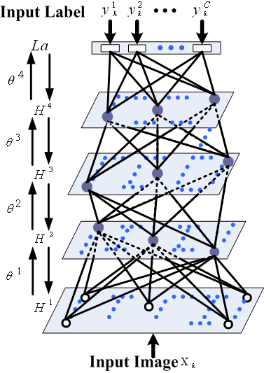
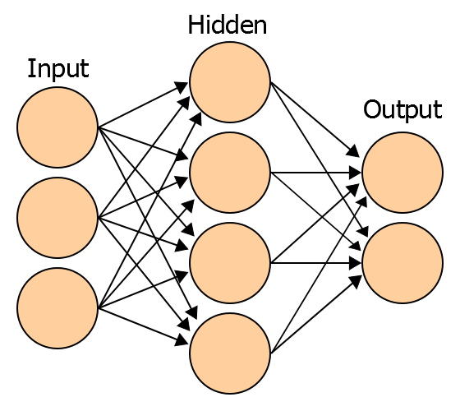
Shallow vs. Deep Learning
Most AI has been shallow architectures:
  1-3 layers of transformation
Deep architectures just do more:
  4-7 layers (or more) of transformation
Deep is also a comparative term

Slide 7
Depth Comparisons
Different algorithms have depths in transformations
  HMM: 2-3
  Neural Nets: 2-3
  Naive Bayes: 2
  SVM: 3
  Ensembles: <past level>++
Bengio's work shows more depth is beneficial
  (If you can train it properly)

Slide 8
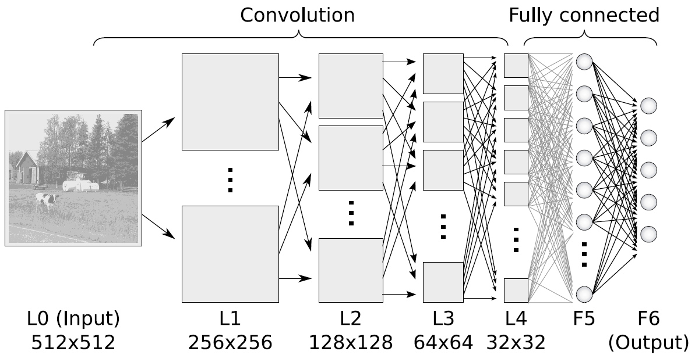
Depths of Deep Learning
Convolutional Neural Networks

Slide 9
Feature Extraction
Hinton's work centers around not needing to find good features
  He argues that once you have the right features from the data, the algorithm you pick is relatively unimportant
  The normal process is very intuitive and requires significant hands on work by AI developers
  Other approaches try to automatically determine the “best” features before passing them to the classifier, but often at a significant computational cost
  The goal is then to find algorithms (both training and architecturally) to not explicitly do that feature discovery work, but to build a system directly from the data itself

Slide 10
The Vanishing Gradient Problem
Gradient is progressively getting more dilute
  Below top few layers, correction signal is minimal
Gets stuck in local minima
  Especially since they start out far from ‘good’ regions (i.e., random initialization)
In usual settings, we can use only labeled data
  Almost all data is unlabeled!
  The brain can learn from unlabeled data
This has plagued Backpropogation (for 20+ years)

Slide 11
Deep Network Training
Use unsupervised learning (greedy layer-wise training)
  Allows abstraction to develop naturally from one layer to another
  Help the network initialize with good parameters
Perform supervised top-down training as final step
  Refine the features (intermediate layers) so that they become more relevant for the task
  Many papers call this “smoothing” or a “finishing” pass

Slide 12
Deep Belief Networks (DBNs)
Probabilistic generative model
Deep architecture – multiple layers
Bidirectional layer interconnections
Unsupervised pre-learning provides a good initialization of the network
  Maximizing the lower-bound of the log-likelihood of the data
Supervised fine-tuning
  Generative: Up-down algorithm
  Discriminative: backpropagation
Hinton et. al 2006

Slide 13
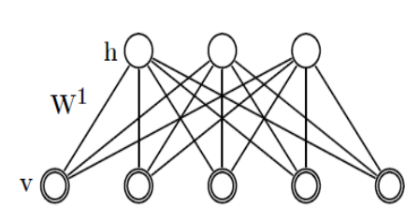
DBN Greedy training
First step:
  Construct an RBM with an input layer v and a hidden layer h
Train the RBM
  One (or more) passes for each sample in the training set

Slide 14
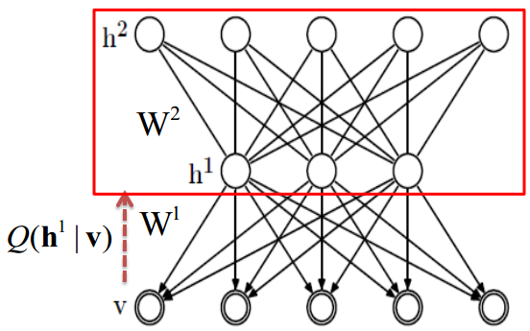
DBN Greedy training
Second step:
  Stack another hidden layer on top of the RBM to form a new RBM
  Fix W1, sample h1 from Q(h1 | v) as input. Train W2 as RBM.

Slide 15
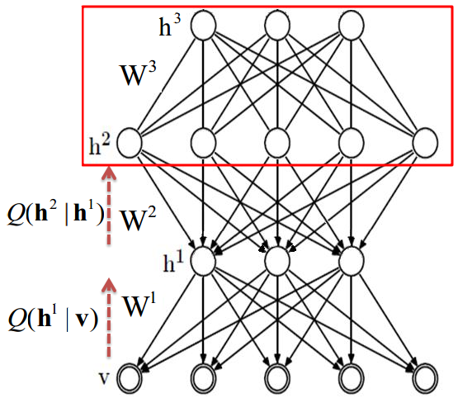
DBN Greedy training
Third step:
  Continue to stack layers on top of the network, train it as previous step, with sample sampled from Q(h2 | h1)
And so on...

Slide 16
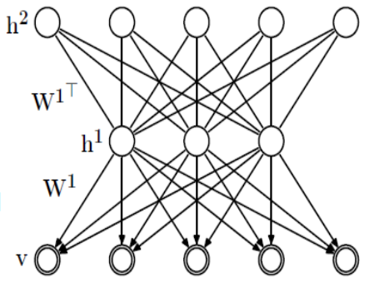
Why greedy training works?
RBM specifies P(v,h) from P(v|h) and P(h|v)
  Implicitly defines P(v) and P(h)
Key idea of stacking
  Keep P(v|h) from 1st RBM
  Replace P(h) by the distribution generated by 2nd level RBM

Slide 17
Summary of Predictive Sparse Coding (Supervised Deep Nets)
Phase 1: train first layer using PSD
Phase 2: use encoder+absolute value as feature extractor
Phase 3: train the second layer using PSD
Phase 4: use encoder + absolute value as 2nd feature extractor
Phase 5: train a supervised classifier on top
Phase 6: (optional): train the entire system with supervised back-propagation

Slide 18
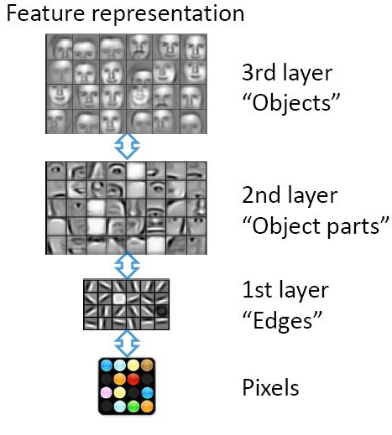
Hierarchical Learning
Mimics mammalian vision
Natural progression from low to high level structure
Easier to monitor what is being learned
Lower level representations may be used for various tasks

Slide 19
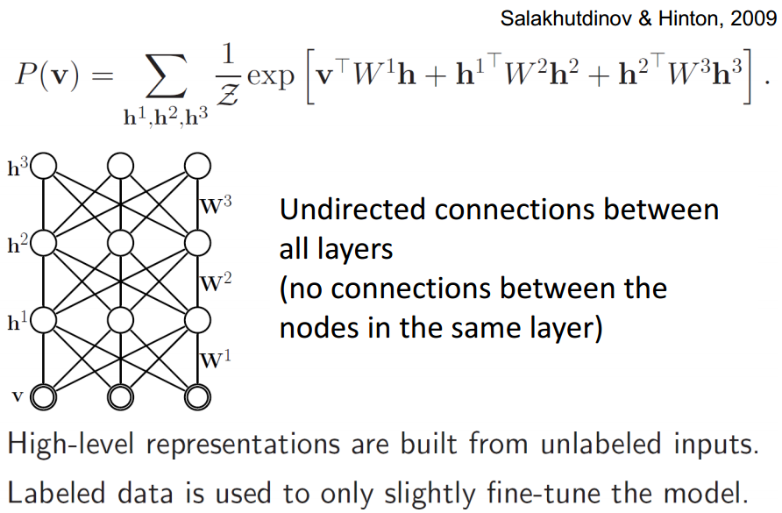
Deep Boltzmann Machines
Slide Credit: R. Salskhutdinov

Slide 20
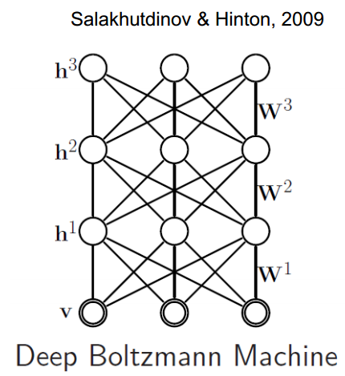
Deep Boltzmann Machines
Pre-training:
  Can (must) initialize from stacked RBMs
Generative fine-tuning:
  Positive phase: variational approximation (mean-field)
    This does resemble backprop in many ways.
  Negative phase: persistent chain (stochastic approxiamtion)
    Estimates the function currently being integrated by the Boltzmann machine
  Discriminative fine-tuning:
    backpropagation

Slide 21
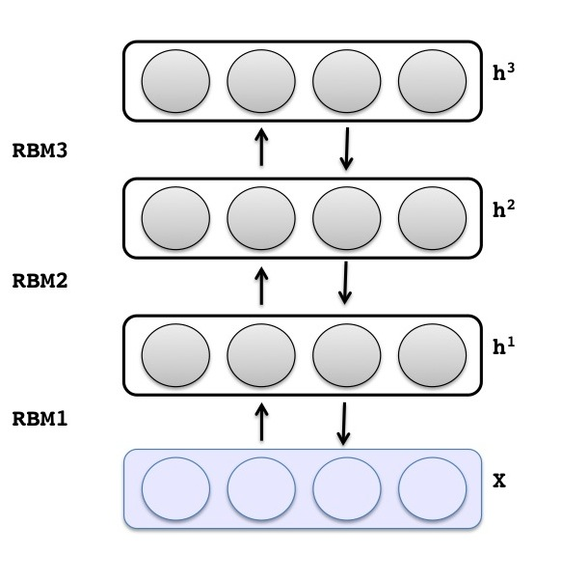
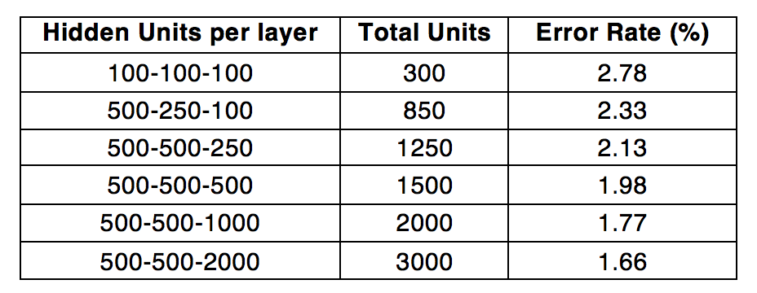
Examples of Success: Handwriting Classifier
Learning on predicting MNIST handwriting
Stacked learning
Core DBN implementation
Hadoop execution
https://www.paypal-engineering.com/2015/01/12/deep-learning-on-hadoop-2-0-2/

Slide 22
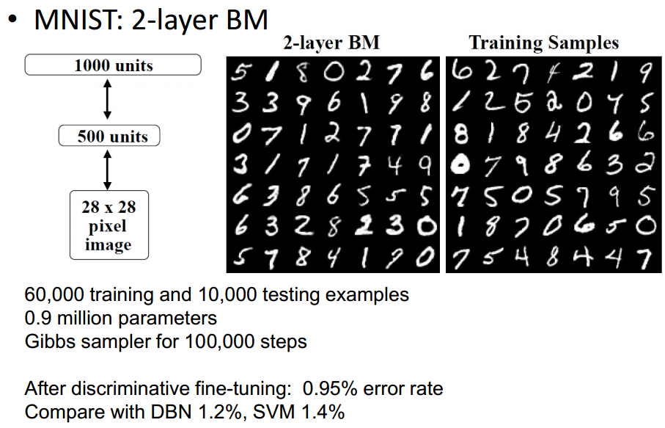
Experiments
The problem is BM vs DBN training time: 1000:1 iterations per sample
Video of Hinton Here!
https://www.youtube.com/watch?feature=player_detailpage&v=AyzOUbkUf3M#t=1290

Slide 23
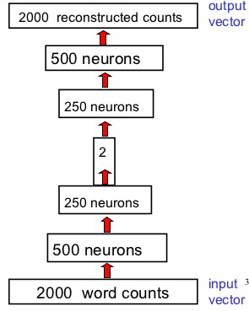
Deep Autoencoder Architecture
Trained in layers
Fixed input width
Only input is word frequency of 2000 most common words for each document
400k documents
Input == Output target
  With all data forced through 2 nodes

Slide 24
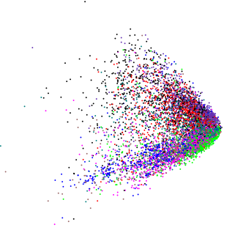
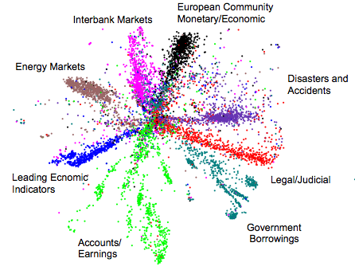
PCA vs. DBN Autoencoder on Texts
Hinton video #2
https://www.youtube.com/watch?feature=player_detailpage&v=AyzOUbkUf3M#t=1898

Slide 25
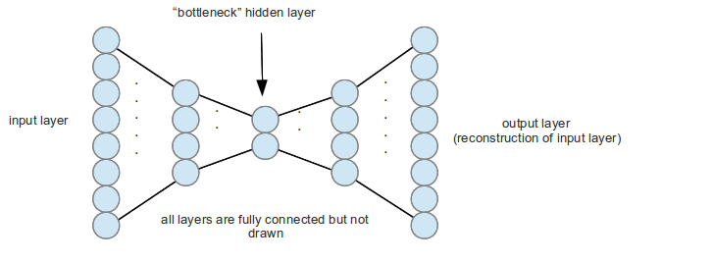
Denoising Autoencoder
Input == Output training
Data passes through reduced feature space, forcing compression through feature extraction

Slide 26
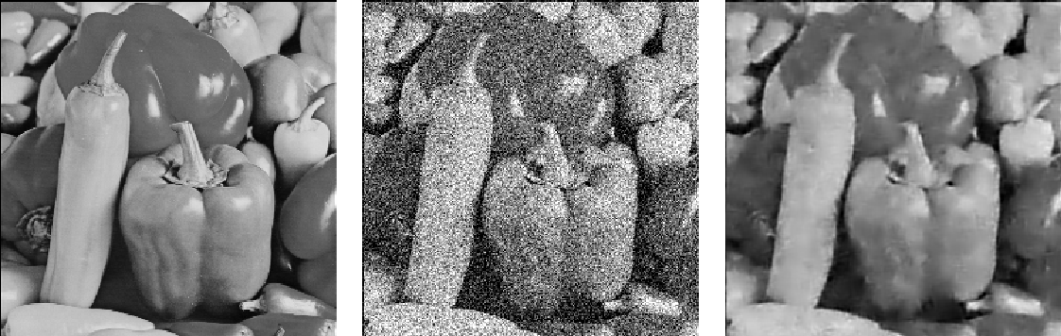
Denoising An Image
It is never perfect, but…
http://www.cs.nyu.edu/~ranzato/research/projects.html

Slide 27
Why Google Wanted This
Google stole Hinton from Univ of Toronto
The primary need was for similarity analysis of documents
Hinton's Autoencoders were shown to compress documents into a binary representation where each bit would find the neighboring documents in n dimensional space
https://www.youtube.com/watch?feature=player_detailpage&v=AyzOUbkUf3M#t=2034

Slide 28
Convolutional Neural Networks
More complex initial layers
Feed forward only
Stacked backpropogation training
Focused on vision processing
Overlapping neurons within the visual field
Reduced interconnectivity, exploiting physically related sub-fields within the data
Explicit pooling stages to bring prior layer’s independent processing units into the next stage
Low pre-processing target
http://deeplearning.net/tutorial/lenet.html

Slide 29
An Alternative Architecture: NuPIC
From a startup called Numenta:
  http://numenta.org/
  http://numenta.org/htm-white-paper.html
Very biologically inspired
Hierarchal Temporal Memory (HTM)
  Designed to do real time streaming of temporal data with sparse learning and multi-target functions in unsupervised situations
Each level of the structure has multiple layers, where the training is randomly targeted
Jeff Hawkins talk
https://www.youtube.com/watch?v=1_eT5bsS4bQ#t=242

Slide 30
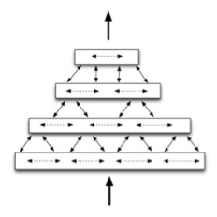
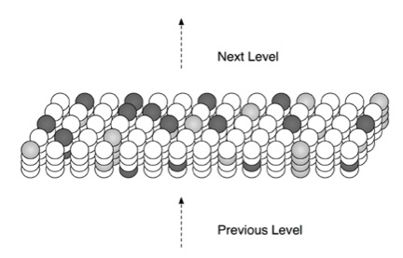
NuPic Internals: HTM
Hierarchical
  Levels of stacked cells
Temporal
  Operates over time series data in an unsup manner
Memory
  Columns of cells decide to activate based on input, previous status of connected neighbors

Slide 31
NuPIC Advantages
Open Source community active
Designed for temporal data
Designed for feedback loop control systems
Strong prediction capabilities
  (Grok is used on power market data)
Unsupervised
Parallelizable for large data sets

Slide 32
An Overlooked Approach: NEAT
NeuroEvolutionary Augmentation Topologies
Ken Stanley, UT Austin 2002
Proposed alternative to backpropogation
Genetic algorithms to evolve both the structure and optimize the weights of ANN’s
Often increased the depth of the network many fold

Slide 33
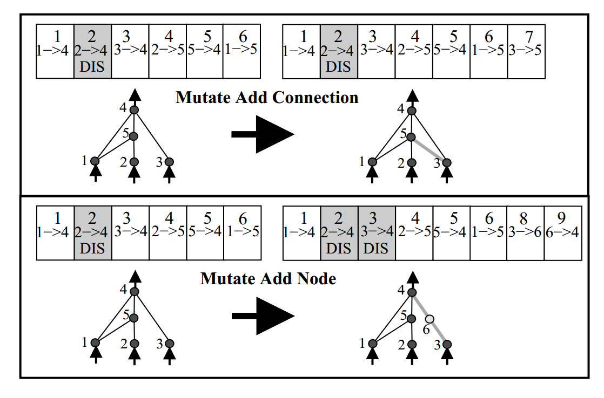
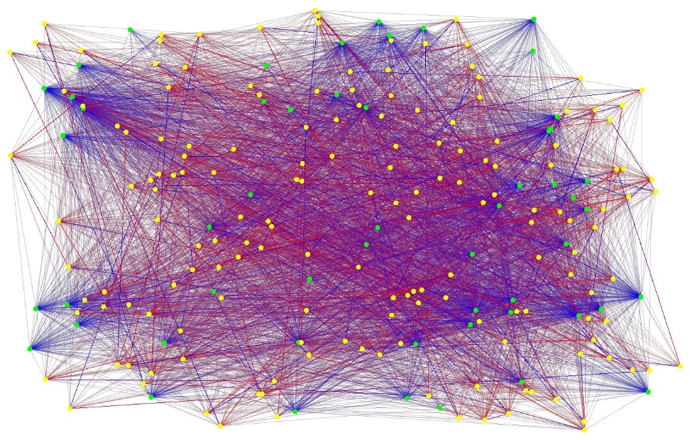
NEAT In Operation
NEAT still under development:
http://www.cs.ucf.edu/~kstanley/neat.html
NEAT based space fighting game: Galactic Arm’s Race
-- Weapons available are evolved by players

Slide 34
Dropout Training
“Hiding” parts of the network during trainingAllows for greater multi-function learning
Proof against overfitting
All percentage dropouts work, even 50+%
Applied to DBN and Convolutional ANN
Hinton, Geoffrey E., et al. "Improving neural networks by preventing co-adaptation of feature detectors." arXiv preprint arXiv:1207.0580 (2012).
Ba, Jimmy, and Brendan Frey. "Adaptive dropout for training deep neural networks." Advances in Neural Information Processing Systems. 2013.
Srivastava, Nitish. Improving neural networks with dropout. Diss. University of Toronto, 2013.

Slide 35
What is the Major Contribution of Deep Learning so far (IMO)?
Boltzmann Machines/Restricted Boltzmann Machines
More layers == Good
Training algorithms
  (stacking approaches)
Unsupervised learning algorithms
Distributed representation
Sparse learning (multi-target learning)
Improved vision and NLP processing
So… which one?

Slide 36
What is the Major Contribution of Deep Learning so far (IMO)?
Boltzmann Machines/Restricted Boltzmann Machines
More layers == Good
Training algorithms
  (stacking approaches)
Unsupervised learning algorithms
Distributed representation
Sparse learning (multi-target learning)
Improved vision and NLP processing

Slide 37
DeepMind Startup News
Acquired by Google last year ($650m)
Building general learners
Primarily focused on game playing to evaluate AI approaches
  Plays Atari and some other early 1980’s games
Trying to add memory architectures to DBNs
Seeks to handle streaming data through persistence across temporal events
Very secretive, but hiring
http://deepmind.com/

Slide 38
Other Deep Learning Startups
Enlitic – Healthcare oriented
Ersatz Labs – Data to prediction services
MetaMind - NLP with recursive nets
Nervana Systems – Deep nets on cloud 2 proc
Skymind – Hadoop algorithms

Slide 39
Summary
Deep Learning is the field of leveraging deeper models in AI
Deep Belief Networks
  Unsupervised & Supervised abilities
NuPIC
  Handles unlabeled streaming temporal data
Convolutional nets
  Primarily vision, but lots of others
Deep systems are the current leaders in vision, NLP, audio, documents and semantics
If you want a job at Google (Bing, FB, etc) either know deep learning (or beat it)

Slide 40
*THE* Resource
http://deeplearning.net

Slide 41
<This space intentionally left blank>

Slide 42
