Slide 1
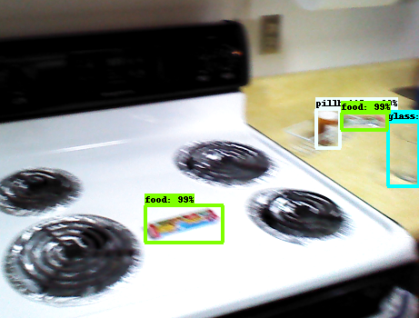
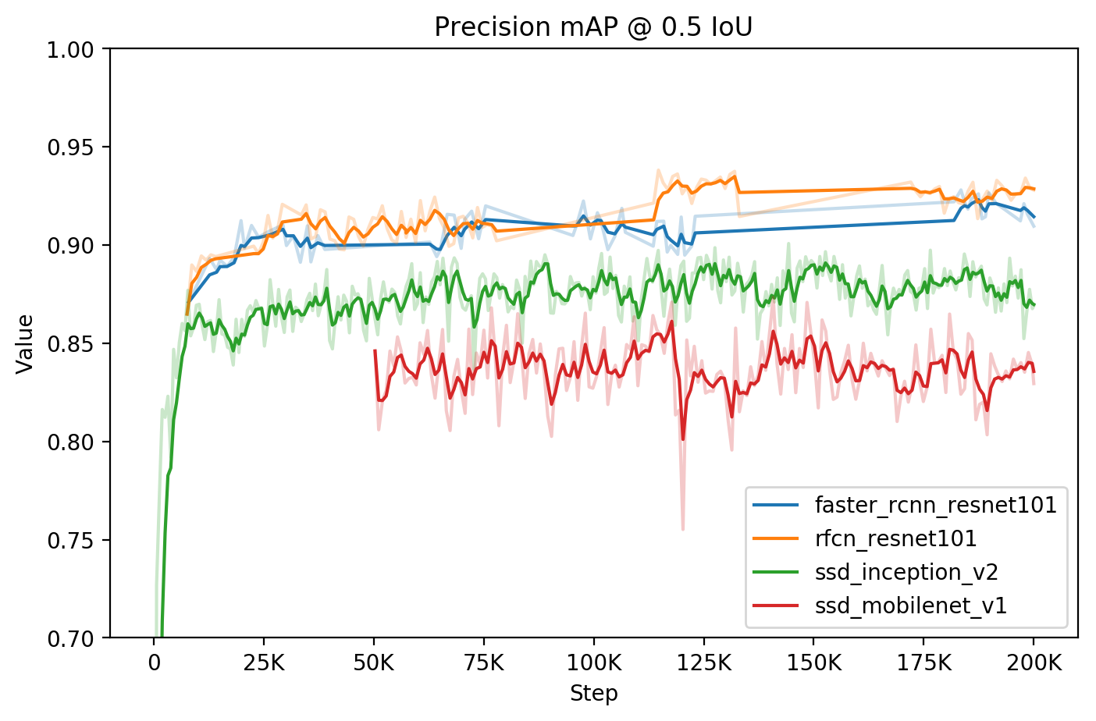
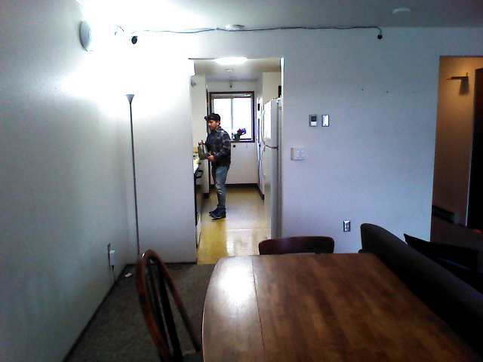
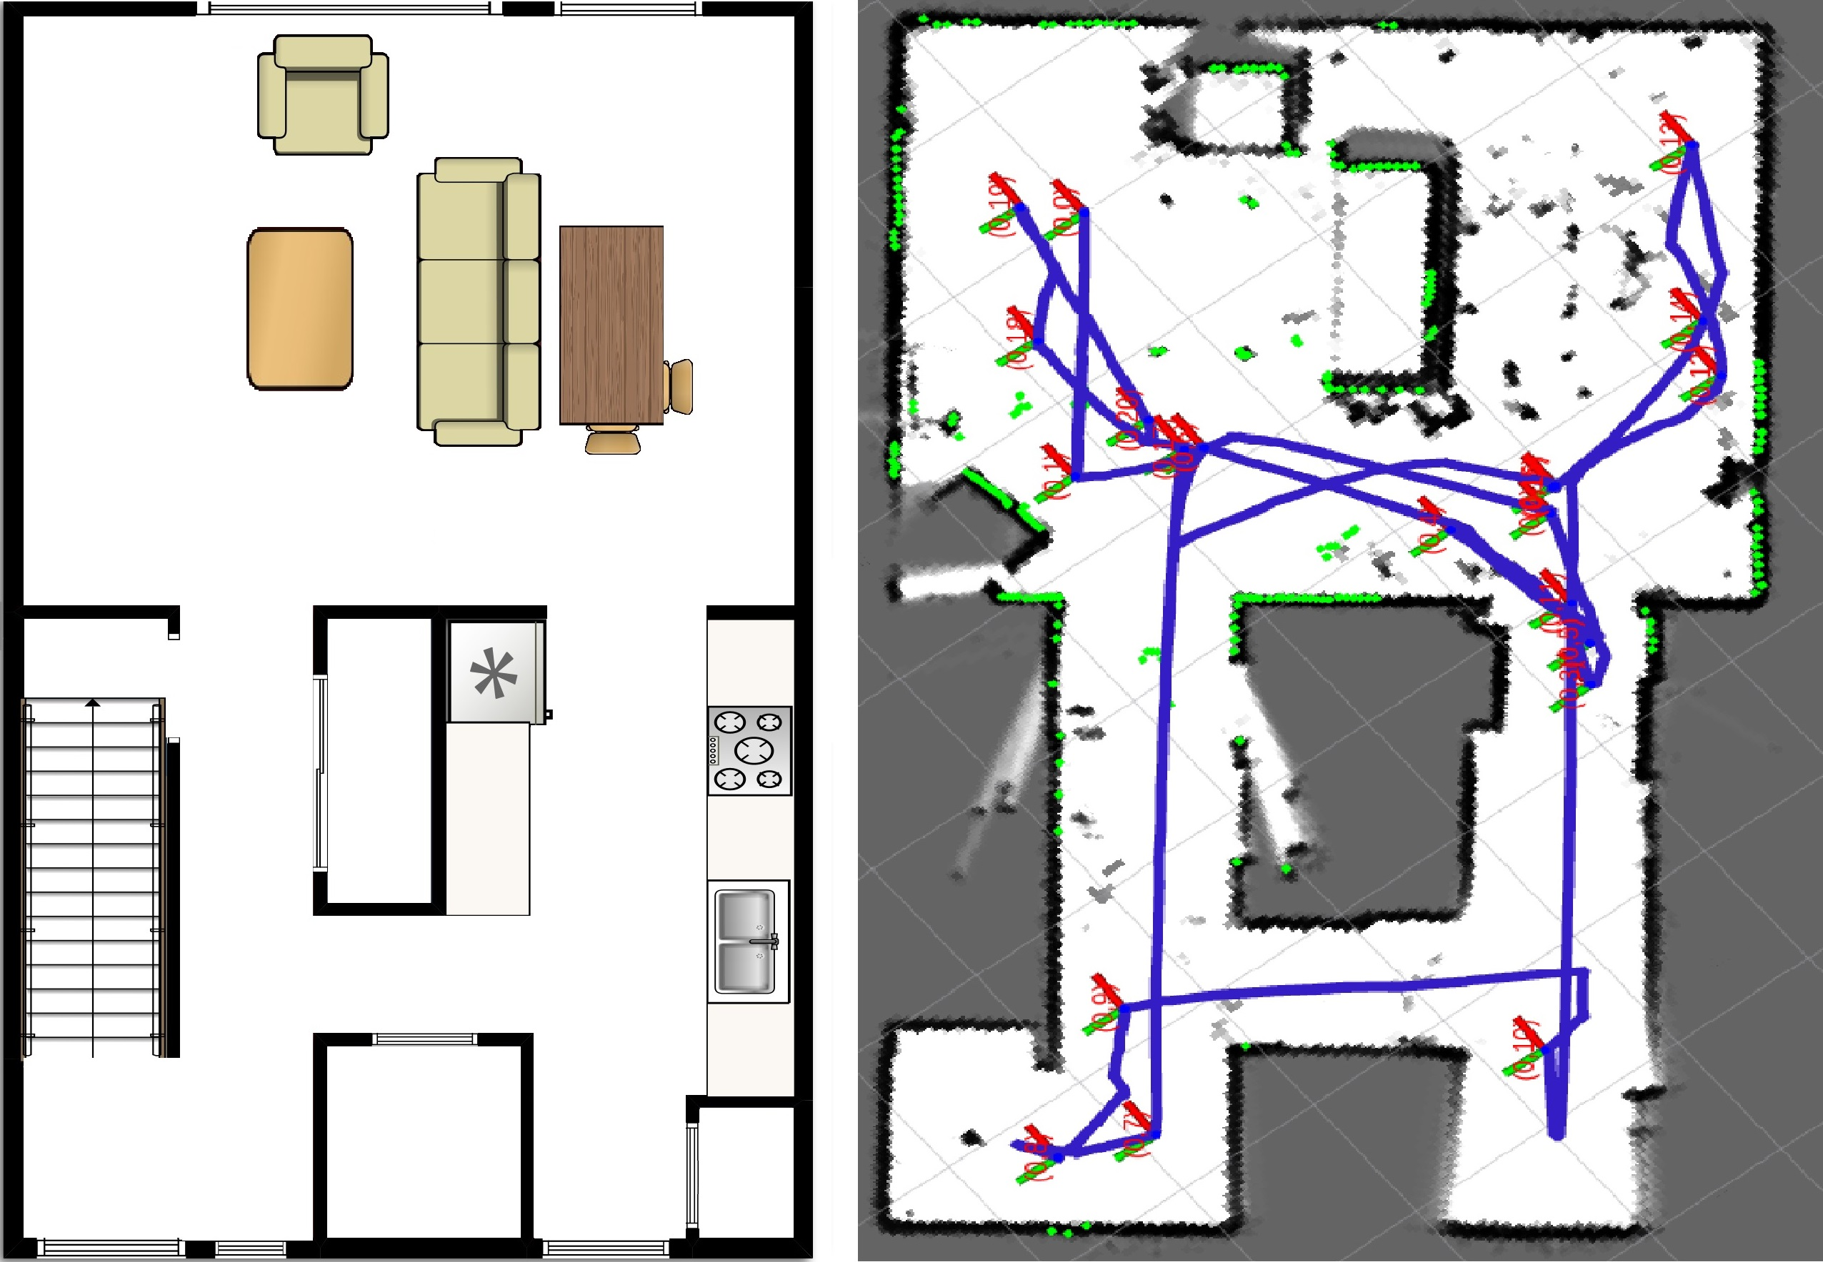
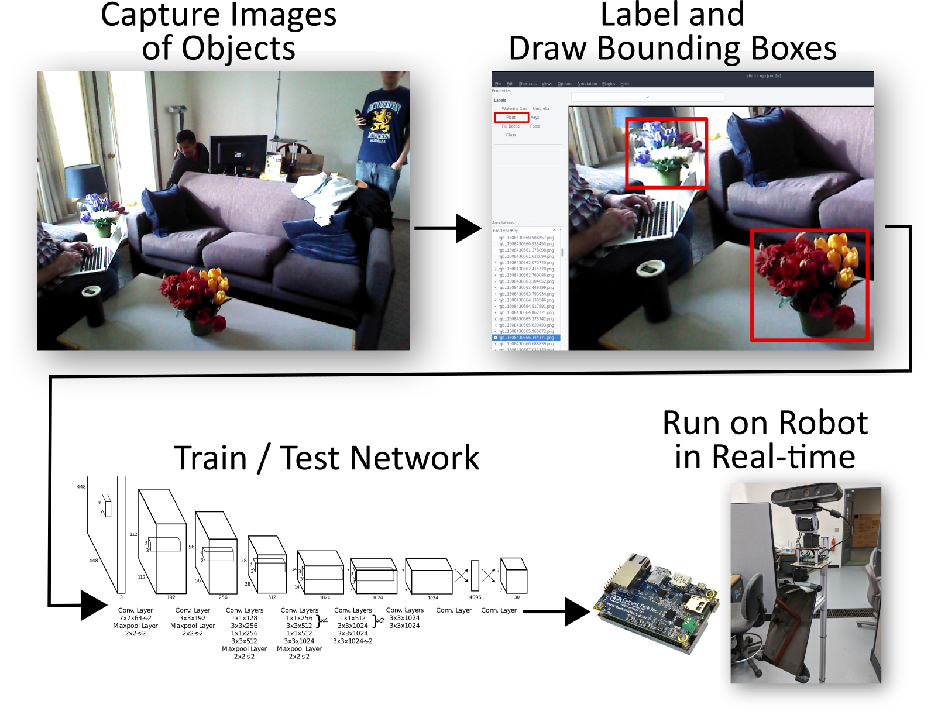
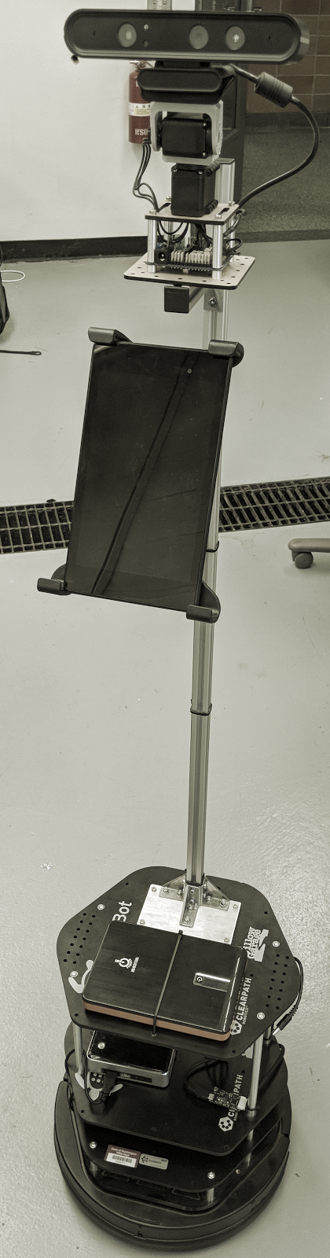
Robotic Activity Support (RAS)
Luke Etherton, Christopher Pereyda, and Garrett Wilson
School of EECS and Department of Psychology
Washington State University
Background
Methods & Procedure
Object Detection
With an aging population (Marson 158), in a number of years the health care system will need to help a large increase in people (Desai 857). To reduce this strain on the health care system, we can help older adults remain functionally independent as they age so they can remain in their own homes longer. To aid with this goal, CASAS has developed smart homes that can provide activity recognition, e.g. recognize when a person is sleeping, cooking, or eating, from motion sensors, door open/closed sensors, relays, and temperature sensors (Cook).
Interface
Below is a sample of predictions made by the CNN (the bounding boxes around each recognized object) and a plot of precision versus how long it has been trained for different network architectures. The best precision is about 0.93 with the R-FCN network. This precision is calculated based on a classification being "correct" if the intersection divided by the union of the predicted and ground truth boundary boxes is at least 0.5.
For the interface that we are looking to obtain, we are looking for the best voices that are pleasant and can be heard/understood by older adults, the avatar that will be liked and not seen as frightening, and the video perspective that best suites older adults when viewing the instructional videos on the tablet attached to the robot. We will determine this by surveying participants that are students at Washington State University in the hopes that it will be generalizable for older adults. Later, we will conduct another questionnaire with older adults to determine the best interface.
To further extend this work, we are introducing a robot into the smart home to provide robotic activity support (RAS). This robot will help older adults that have cognitive impairment complete daily tasks, e.g. taking medication, watering plants, and walking the dog.
Navigation
Our navigational system is a combination of ROS Gmapping and Google Cartographer. Cartographer is an opensource Simultaneous Localization and Mapping (SLAM) utility that creates highly accurate maps. At right an example floorplan for the CASAS smart home is compared to the Cartographer map created by our robot. Gmapping is a simple method to integrate the robot hardware and the SLAM system to create a movement plan for the robot to follow and move towards a set goal.
Figure 5: Detected Objects
Figure 6: Precision of Different Networks
The plot shows that R-CNN and R-FCN are the most precise, but when run these will likely be slow. On the other hand, the two SSD networks have lower precision but will likely be faster to make predictions. Now we will need to test framerates to balance speed and precision.
Figure 1: Watering plants in a smart home
Navigation
Figure 3: CASAS Smart home floorplan and created map
The ultimate goal of the navigational system is to allow the robot to fetch items located using the object detection system in a seamless fashion. This is done by marking the location of the found objects in the map and then allowing the operator or smart system to get the item without need for using any map information.
It can be seen from our example map in Figure 4 that it does not detect objects outside of the Lidar's vertical range, namely the tables. We will need to integrate additional distance detection devices to avoid all potential collisions. We can easily do this with the onboard camera because it has a depth sensor built-in.
The current movement plan is not optimized for our system's specific needs, high stability and low deviation. To remedy this we will tune the various parameters of Gmapping to allow for a smoother and more precise set of movements. This will reduce the chance of the robot falling and increase the likelihood of correctly finding objects in the world.
Object Detection
Components
Object detection is preformed using a convolutional neural network (CNN). Before training the network, first we obtained training data by taking many pictures in the smart apartment of the objects to recognize. Then we labeled where the objects were in each of the pictures. Next, we trained the CNN using both YOLO and several networks on TensorFlow. Finally, we can then save the network and put it on the robot to test with real-time video.
The robot design is based on Eaton, et. al. (Eaton). Three components of this robot are: the interface, navigation, and object detection.
The interface provides a way for the human to interact with the robot. If help is needed, the robot will approach the resident, and via the speakers ask "How can I help?" while displaying options on the tablet's screen.
To approach the resident, the navigation system uses Lidar to create a map of the house and locate itself in the map. When told to go to a particular location, it finds a path using the map and drives the robot to the desired location.
Using the camera, object detection determines the 3D position of a set of known objects and saves the locations in the map. Then, when requested, the robot can navigate to the object if the person forgot where they left it.
Object
Detection
Figure 4: method for object detection, YOLO v1 network shown
Conclusions / Future Work
Interface
For the interface, there will be more questionnaires taken to figure out which interface appeals most to people. Next time we will use a less robotic looking interface as well as the voice. Navigation is currently only usable through a GUI. We plan to implement a purely code-based method for accessing navigation to allow for fully autonomous operation. We will also need to consider collisions with objects that are out of sight from our Lidar. A future solution will integrate the camera to find objects that will cause collisions. For object detection, the current results show the precision of the different networks. Next, the networks will have to be saved and tested on the NVidia Jetson to see if any of these networks are fast enough to run in real-time. After that, we will have to evaluate if it performs well when following a person around who may occlude the objects to recognize. Overall, we have made progress developing the foundation for the robot activity support.
Results & Discussion
Interface
Twenty-seven participants completed a questionnaire with a rating scale from 1 to 5: 1 being did not like it at all and 5 being really like it. They were asked about their preferences for six different voices (items 1-6), six different faces (items 7-12), and 3 different video perspectives (items 13-15). The results show that there was not any generalizability through this data. However, we did find out some important information in that the interface needs to be less robotic and more humanistic sounding.
Navigation
 | Item 1 | Item 2 | Item 3 | Item 4 | Item 5 | Item 6
Mean | 3.63 | 3.59 | 2.63 | 2.01 | 2.96 | 2.56
SD | 0.884 | 0.971 | 0.839 | 1.02 | 1.255 | 1.188
References
Figure 2: The Robot
 | Item 7 | Item 8 | Item 9 | Item 10 | Item 11 | Item 12 | Item 13 | Item 14 | Item 15
Mean | 3.89 | 2.22 | 3.07 | 3.015 | 2.31 | 2.56 | 3.41 | 2.74 | 3.56
SD | 0.934 | 1.121 | 1.492 | 0.907 | 1.011 | 1.219 | 1.279 | 1.13 | 1.013
Cook, Diane J., et al. "CASAS: A smart home in a box." Computer 46.7 (2013): 62-69.
Desai, Abhilash K., George T. Grossberg, and Dharmesh N. Sheth. "Activities of Daily Living in patients
with Dementia." CNS drugs 18.13 (2004): 853-875.
Eaton, Eric, et al. "Design of a Low-Cost Platform for Autonomous Mobile Service Robots."
Marson, Daniel, and Katina R. Hebert. "Functional assessment." Geriatric neuropsychology: Assessment and
intervention (2006): 158-197.
Table 1: Initial interface questionnaire results

