Slide 1


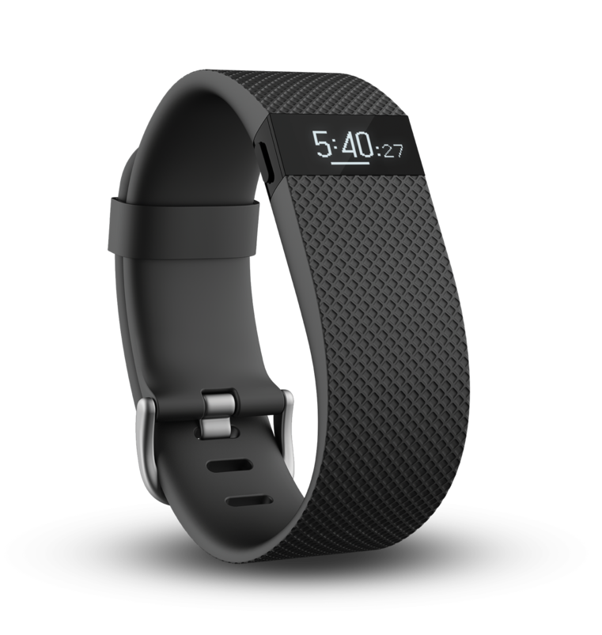
Using Wearable Sensors to Detect Changes in Physical Activity
Alyssa La Fleur¹, Jordana Dahmen², Dr. Gina Sprint³, Dr. Diane Cook³, and Dr. Douglas Weeks⁴
¹Chemistry Department, Mathematics &
Computer Science Department, Whitworth University
²School of Biological Sciences, Washington State University
³School of Electrical Engineering and Computer Science, Washington State University
⁴St. Luke’s Rehabilitation Institute, Spokane WA
Introduction:
Wearable sensor technology has become increasingly popular and had begun to be utilized in various healthcare disciplines.
There are enormous applications for wearable technology in rehabilitation and physical intervention settings because of the difficulties inherent in assessing unsupervised physical activity through self-reporting
Two different population groups
are being tested in this study to
asses if the Charge HR Fitbit
(See Figure 1) is able to detect
changes over time in both an
inpatient and a free-living setting.
Results:
Artificial Data:
Participant (Group) | Sliding Pairwise P-Value | Baseline Pairwise P-Value
A (A) | 0.367074061 | 0.042360491
B (A) | 0.226255536 | 0.001204391*
C (A) | 0.208204856 | 2.91723E-05*
1 (B) | 0.429489038 | 0.002313116*
2 (B) | 0.473261316 | 0.004955814*
3 (B) | 0.332504467 | 0.006931577*
4 (B) | 0.36734231 | 0.001547665*
5 (B) | 0.414015744 | 0.172833841
6 (B) | 0.392285976 | 1.13493E-05*
7 (B) | 0.495701926 | 0.127623405
8 (B) | 0.471464286 | 0.207930333
Figure 4: Total Steps Graph for Artificial Data. Four weeks of artificial normally distributed step data was generated using different means for steps taken in an hour. Means used to generate data were 150 (A), 151 (B), 151.1 (C), and 200 (D).
Figure 1: The Charge HR Fitbit
Methods:
Procedure
Group A: Saint Luke’s Rehabilitation Institute (n=3, mean age=59.5 yrs)
Participants were selected based on the following criteria: mobile-capable, aged 18+, English speaking, recently admitted, and appearing cognitively capable for the study.
Two Charge HR Fitbits were set up for each patient, with one being attached and the other acting as a fully-charged alternate. Fitbits were worn at all times during inpatient treatment, unless pool therapy was employed.
Daily check-ins were given. Skin integrity and Fitbit status were checked. Every four days, Fitbits were swapped.
Group B: Pullman, WA residents (n=8, mean age=25.5 yrs)
Participants were selected based on the following criteria: ability to receive text messages, aged 18+, and willingness to wear Fitbits.
One Charge HR Fitbit was set up for each participant. They were instructed to wear the Fitbit at all times for two weeks and to charge during sleep every fourth night.
Daily text message reminders were sent to wear the Fitbit.
Data Analysis
Collected minute by minute data for complete days of sensor was downloaded from fitbit.com wearing using a custom program.
Steps walked per day were then calculated, and a pairwise student t-test with a Bonferroni p-value correction (See Table 1) was employed on both sliding data (where each full day was paired with the following day) and baseline data (where all days were paired with the step values of the first day).
The critical p-value for significance after the Bonferroni correction was 0.025.
Weeks Compared | F-Test | T-test
Week A vs Week B | 0.756258354 | 0.025975666*
Week A vs Week C | 0.249306227 | 0.11674847
Table 2: A F-Test was performed, and it was found that the variances did not differ significantly (critical value for both degrees of freedom being 6 is 8.47). A two-sample equal variance t-test was used to prove that the means were different for generated weeks.
Table 1: P-values obtained for all sliding window based pairwise student t-tests significant values are bolded and have an asterisk.
Weeks Compared | Sliding T-Test | Baseline T-Test
Week A vs Week C | 0.37226229 | 0.298049788
Week A vs Week D | 0.165439096 | 0.008552631*
Table 3: The artificial data was used to demonstrate that the sliding scale t-tests can effectively detect changes in steps taken, with a larger p-value corresponding with a smaller difference in mean steps taken, and a smaller p-value with a larger difference in steps.
Conclusions:
There is a significant difference between the size of the difference between the first and second half of the therapy treatment for Group A when compared to the first and second week of Group B (p=2.43628E-07). Based on this, the participants in Group A are improving their amount of physical activity and not just experiencing normal differences in walking present in group B. This experiment validates that our method can effectively capture significant changes in physical activity when they occur in the data.
Figure 2: Average Steps Graph for Group A. The average steps during the participants 1st half of therapy compared to their 2nd half of therapy with error bars. A student t-test found the differences between participants insignificant with a p value of 0.2376.
Future Work:
Since we had such a small sample size we are going to continue this study and recruit more participants to hopefully improve our statistical significance.
Also, since there was such a large gap in age between Group A and Group B, it would be better to have our two groups be more similar in age to eliminate other variables that could affect the outcome.
Results:
Average Weeks | Sliding T-Test | Baseline T-Test
Group A vs Group B | 0.09147544 | 0.000285483*
Group B vs Group A | 0.346868227 | 0.051594546
Group A with Self | 0.212382017 | 0.001766552*
Group B with Self | 0.272622783 | 0.010142826*
Acknowledgments:
This work was funded by the National Institute of Aging (NIA) grant R25AG046114 and the National Science Foundation Research Experiences for Undergraduates Program under Grant No. 1460917. We would also like to thank the physical therapy staff at Saint Luke’s Rehabilitation Institute.
Table 1: The averages of the first week of Group A and Group B compared using a sliding window approach with paired t-tests. Significant values are bolded and have an asterisk.
Figure 3: Average Steps Graph for Group B. The average steps during the participants 1st week compared to their 2nd week with error bars. A student t-test found the differences between participants insignificant with a p value of 0.2768.

