Slide 1
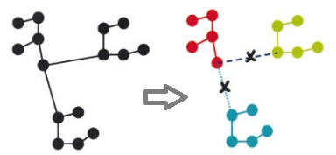

Minimum Spanning Tree Partitioning Algorithm for Microaggregation
Gokcen Cilingir
10/11/2011

Slide 2
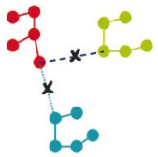
Challenge
How do you publicly release a medical record database without compromising individual privacy? (or any database that contains record-specific private information)
The Wrong Approach:
Just leave out any unique identifiers like name and SSN and hope to preserve privacy.
Why?
The triple (DOB, gender, zip code) suffices to uniquely identify at least 87% of US citizens in publicly available databases.*
Quasi-identifiers
*Latanya Sweeney. k-anonymity: a model for protecting privacy. International Journal on Uncertainty, Fuzziness and Knowledge-based Systems,
10 (5), 2002; 557-570.

Slide 3
A model for protecting privacy: k-anonymity
Definition:
A dataset is said to satisfy k-anonymity for k > 1 if, for each
combination of quasi-identiﬁer values, at least k records exist
in the dataset sharing that combination.
If each row in the table cannot be distinguished from at least other k-1 rows by only looking a set of attributes, then this table is said to be k-anonymized on these attributes.
Example:
If you try to identify a person from a k-anonymized table by the triple (DOB, gender, zip code), you’ll find at least k entries that meet with this triple.

Slide 4
Statistical Disclosure Control (SDC) Methods
Statistical Disclosure Control (SDC) methods have two conflicting goals:
Minimize Disclosure Risk (DR)
Minimize Information Loss (IL)
Objective: Maximize data utility while limiting disclosure risk to an acceptable level
Notes:
Many measures of IL is out there: Mean variation of data,
Mean variation of data means, Mean variation of data variances,
Mean variation of data covariates

Slide 5
One approach for k-anonymity: Microaggregation
Microaggregation can be operationally defined in terms of two steps:
Partition: original records are partitioned into groups of similar records containing at least k elements (result is a k-partition of the set)
Aggregation: each record is replaced by the group centroid.
Microaggregation was originally designed for continuous numerical data and recently extended for categorical data by basically defining distance and aggregation operators suitable for categorical data types.
Notes:
aggregation operator: for example, the mean for numerical data or the median for categorical data

Slide 6
Optimal microaggregation
Optimal microaggregation: find a k-partition of a set that maximizes the total within-group homogeneity
More homogenous groups mean lower information loss
How to measure within-group homogeneity?
within-groups sums of squares(SSE)
For univariate data, polynomial time optimal microaggregation
is possible.
Optimal microaggregation is NP-hard for multivariate data!
Notes:
Are there any other measures for information loss?
a large number of measures which quantify the ‘group homogeneity’ have been reported in the literature. These
are usually based on several distance deﬁnitions, such as the Euclidean distance, the Minkowski
distance and the Chebyshev distance. The most common homogeneity measure for clustering is the
within-group sum of squares, the SSE
analysis of variance methods can be used as alternative
methods to investigate the degree of information that is retained

Slide 7
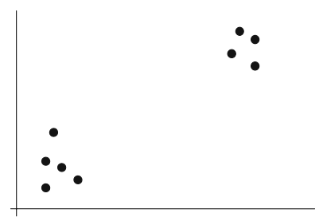
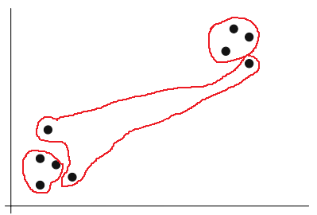
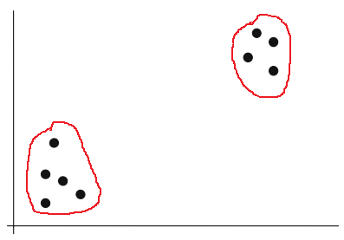
Heuristic methods for microaggregation on multivariate data
Approach 1: Use univariate projections of multivariate data
Approach 2: Adopt clustering algorithms to enforce group size constraint: each cluster size should be at least k and at most 2k-1
Fixed-size microaggregation: all groups have size k, except perhaps one group which has size between k and 2k−1.
Data-oriented microaggregation: all groups have sizes varying between k and 2k−1.
Notes:
Since the problem of k-anonymization is essentially a search over a space of possible multi-dimensional solutions,
standard heuristic search techniques such as genetic algorithms or simulated annealing can be effectively used.

Slide 8
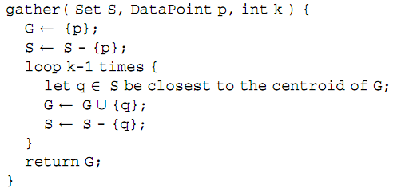
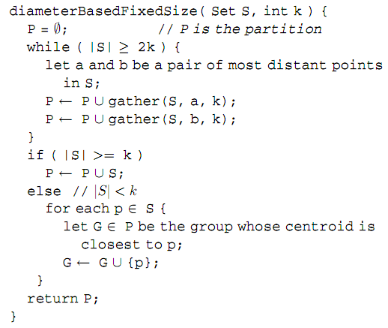
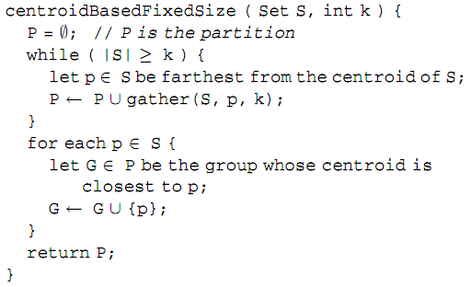
Fixed-size microaggregation
Notes:
Pick a point p and gather its nearest k-1 neighbors to form a cluster.
Recursively apply the idea to the rest of the data
How do we pick p at each step of cluster formation.

Slide 9
A data-oriented approach: k-Ward
Ward’s algorithm (Hierarchical - agglomerative)
Start with considering every element as a single group
Find nearest two groups and merge them
Stop recursive merging according to a criteria (like distance threshold or cluster size threshold)
k-Ward Algorithm
Use Ward’s method until all elements in the dataset belong to a
group containing k or more data elements (additional rule of
merging: never merge 2 groups with k or more elements)

Slide 10
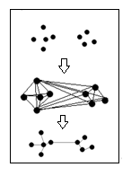
Minimum spanning tree (MST)
A minimum spanning tree (MST) for a weighted undirected graph G is a spanning tree (a tree containing all the vertices of G) with minimum total weight.
Prim's algorithm for finding an MST is a greedy algorithm.
Starts by selecting an arbitrary vertex and assigning it
to be the current MST.
Grows the current MST by inserting the vertex closest to
one of the vertices that are already in the current MST.
Exact algorithm; finds MST independent of the starting vertex
Assuming a complete graph of n vertices, Prim’s MST construction algorithm runs in O(n²) time and space

Slide 11
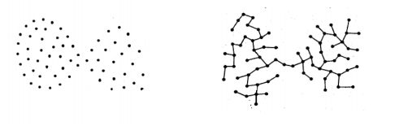
MST-based clustering
Which edges we should remove?
→ need an objective to decide
Most simple objective: minimize the total edge distance of all the resultant N sub-trees (each corresponding to a cluster) Polynomial-time optimal solution: Cut N-1 longest edges.
More sophisticated objectives can be defined, but global optimization of those objectives will likely to be costly.
Notes:
When using MST-representation of a dataset, one needs an objective to decide which edge to remove next (inconsistent edges). Each edge removal results in one more cluster)

Slide 12
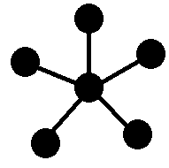
MST partitioning algorithm for microaggregation
MST construction: Construct the minimum spanning tree over the data
points using Prim’s algorithm.
Edge cutting: Iteratively visit every MST edge in length order, from
longest to shortest, and delete the removable edges*
while retaining the remaining edges. This phase produces a
forest of irreducible trees⁺ each of which corresponds to a
cluster.
Cluster formation: Traverse the resulting forest to assign each data point
to a cluster.
Further dividing oversized clusters: Either by the diameter-based or by
the centroid-based fixed size method
* Removable edge: when cut, resulting clusters do not violate the minimum size constraint
+ Irreducible tree: tree with all non-removable edges. Ex:
Notes:
MST partitioning algorithm has 3 phases
An additional phase is needed to further divide the oversized clusters

Slide 13
MST partitioning algorithm for microaggregation – Experiment results
Methods compared:
Diameter-based fixed size method: D
Centroid-based fixed size method : C
MST partitioning alone: M
MST partitioning followed by the D: M-d
MST partitioning followed by the C: M-c
Experiments on real data sets Terragona, Census and Creta:
C or D beats the other methods on all of these datasets
D beats C on Terragona, C beats D on Census and D beats C marginally on Creta
M-d and M-c got comparable information loss
Notes:
In such cases, the fixed-size methods are forced to group points belonging to distinct clusters, hence, points that are well separated in space.

Slide 14
MST partitioning algorithm for microaggregation – Experiment results(2)
Findings of the experiments on 29 simulated datasets:
M-d and M-c works better on well-separated datasets
Whenever well separated clusters contained fixed number y of data points, M-d and M-c beats fixed-size methods when y is not a multiple of k
MST- construction phase is the bottleneck of the algorithm (quadratic time complexity)
Dimensionality of the data has little impact on the total running time
Notes:
In such cases, the fixed-size methods are forced to group points belonging to distinct clusters, hence, points that are well separated in space.
Constant factors are very different

Slide 15
MST partitioning algorithm for microaggregation – Strengths
Simple approach, well-documented, easy to implement
Not many clustering approaches existed in the domain at the time, proposed alternatives → centroid idea inspired improvements on the
diameter-based fixed method
Effect of data set properties on the performance is addressed systematically.
Comparable information loss values with the existing methods, better in the case of well separated clusters
Holds time-efficiency advantage over the existing fixed-size method
When multiple parsing of the data set is needed (perhaps for trying different k values), algorithm is efficiently useful (since single MST construction will be needed)
Notes:
Like Natural clustering in the data, size of the data set, data dimensionality and the number of points in natural clusters is observed on simulated data sets.

Slide 16
MST partitioning algorithm for microaggregation – Weaknesses
Higher information loss than the fixed-size methods on real datasets that are less naturally clustered.
Still not efficient enough for massive data sets due to requiring MST construction.
Upper bound on the group size cannot be controlled with the given MST partitioning algorithm.
Real datasets used for testing were rather small in terms of cardinality and dimensionality (!)
Other clustering approaches that may apply to the problem are not discussed to establish the merits of their choice.
Notes:
forced to resort to combination of fixed sized methods with MST partitioning to control the upper bound.

Slide 17
Discussion on microaggregation
At what value of k is microaggregated data safe?
Is one measure of information loss sufficient for the comparison of algorithms?
How can we modify an efficient data clustering algorithm to solve the microaggregation problem? What approaches one can take?
What are the similar problems in other domains (clustering with lower and upper size constraints on the cluster size)?

Slide 18
Discussion on microaggregation(2)
Finding benchmarks may be difficult due to the confidentiality of the datasets as they are protected
How reversible are different SDC methods? If a hacker knows about what SDC algorithm was used to create a protected dataset, can he launch an algorithm specific re-identification attack? Should this be considered in DR measurements?
How much information loss is “worth it” to use a single algorithm (e.g. MST) for a wider variety of applications?

Slide 19
Discussion on the paper
How can we make this algorithm more scalable?
How could we modify this algorithm to put an upper bound on the size of a cluster?
Was there a necessity to consider centroid-based fixed size microaggregation over diameter-based?

Slide 20
References
Microaggregation
Michael Laszlo and Sumitra Mukherjee. Minimum Spanning Tree Partitioning Algorithm for Microaggregation. IEEE Trans. on Knowl. and Data Eng. 17(7): 902-911 (2005)
J. Domingo-Ferrer and J.M. Mateo-Sanz. Practical Data-Oriented Microaggregation for Statistical Disclosure Control. IEEE Trans. Knowledge and Data Eng. 14(1):189-201 (2002)
Ebaa Fayyoumi and B. John Oommen. A survey on statistical disclosure control and micro-aggregation techniques for secure statistical databases. Softw. Pract. Exper. 40(12):1161-1188 (2010)
Josep Domingo-Ferrer, Francesc Sebe, and Agusti Solanas. A polynomial-time approximation to optimal multivariate microaggregation. Comput. Math. Appl. 55(4): 714-732 (2008)
MST-based clustering
C.T. Zahn. Graph-Theoretical Methods for Detecting and Describing Gestalt Clusters. IEEE Trans. Computers. 20(4):68-86 (1971)
Y. Xu, V. Olman, and D. Xu, Clustering Gene Expression Data Using a Graph-Theoretic Approach: An Application of Minimum Spanning Tree, Bioinformatics, 18(4): 526-535 (2001)

Slide 21
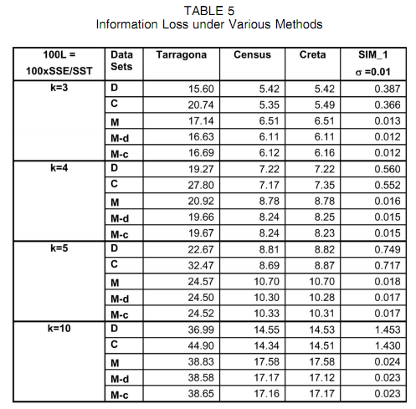
Additional slides
Notes:
In such cases, the fixed-size methods are forced to group points belonging to distinct clusters, hence, points that are well separated in space.

Slide 22
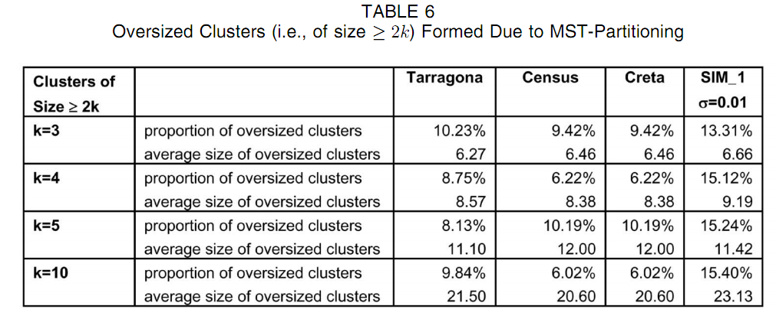
Additional slides

Slide 23
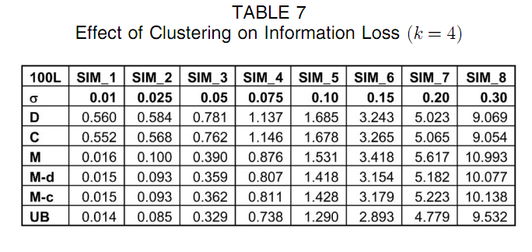
Additional slides

Slide 24
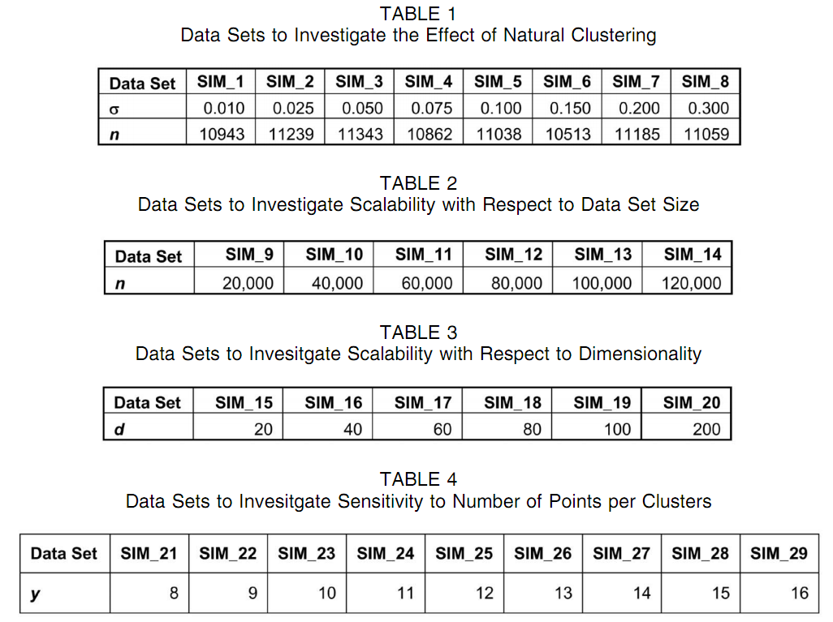
Additional slides

