Slide 1

“Identifying Suspicious URLs: An Application of Large-Scale Online Learning” Paper by Justin Ma, Lawrence K. Saul, Stefan Savage, and Geoffrey M. Voelker. In Proceedings International Conference on Machine Learning (ICML '09).
Ngizambote Mavana
Joel Helkey

Slide 2
Outline
Goal
Casus Belli
Protective Mechanisms
Modus Operandi
Features
Online Algorithms
Evaluation
Conclusion

Slide 3
Goal
Detection of malicious web sites from the lexical, and host-based features of their URLs.
This is achieved by successfully implementing applications of online learning algorithms for the purpose of predicting malicious URLs.

Slide 4
Casus Belli
The 2005 FBI Computer Crime Survey addresses one of the highest priorities in the Federal Bureau of Investigation(FBI);
The survey results are based on the responses of
2066 organizations;
The purpose of this survey was to gain an accurate understanding of what computer security incidents are being experienced by the full spectrum of sizes and types of organizations within the United States.

Slide 5
Casus Belli (cont.)
“The 2005 FBI Computer Crime Survey should serve as a wake up call to every company in America.”
Frank Abagnale , Author and subject of ‘Catch Me if You Can’ , Abagnale and Associates
“This computer security survey eclipses any other that I have ever seen. After reading it, everyone
should realize the importance of establishing a proactive information security program.”
Kevin Mitnick, Author, Public Speaker, Consultant, and Former Computer Hacker • Mitnick Security Consulting

Slide 6
Casus Belli (cont.)
The Key Findings of the survey are inter alia:
In many of the responding organizations, a common theme of frustration existed with the nonstop barrage of viruses, Trojans, worms, and spyware.
Although the usage of antivirus, antispyware, firewalls, and antispam software is almost universal among the survey respondents, many computer security threats came from within the organizations.

Slide 7
Casus Belli(cont.)
Of the intrusion attempts that appeared to have come from outside the organizations, the most common countries of origin appeared to be United States, China, Nigeria, Korea, Germany, Russia, and Romania.
“The exponentially increasing volume of complaints received monthly at the IC3 have shown that cyber criminals have grown increasingly more sophisticated in their many methods of deception. This survey reflects the urgent need for expanded partnerships between the public and private sector entities to better identify and more effectively respond to incidents
of cyber crime.”
Daniel Larkin, FBI Unit Chief Internet Crime Complaint Center (www.ic3.gov)

Slide 8
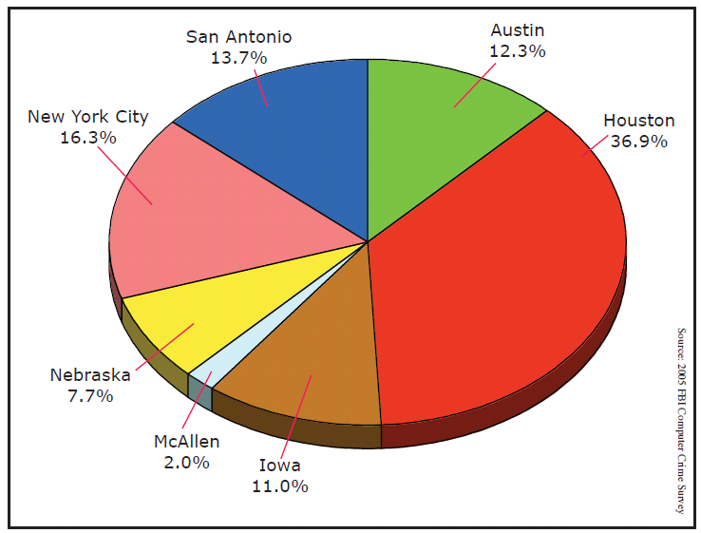
Casus Belli(cont.)

Slide 9
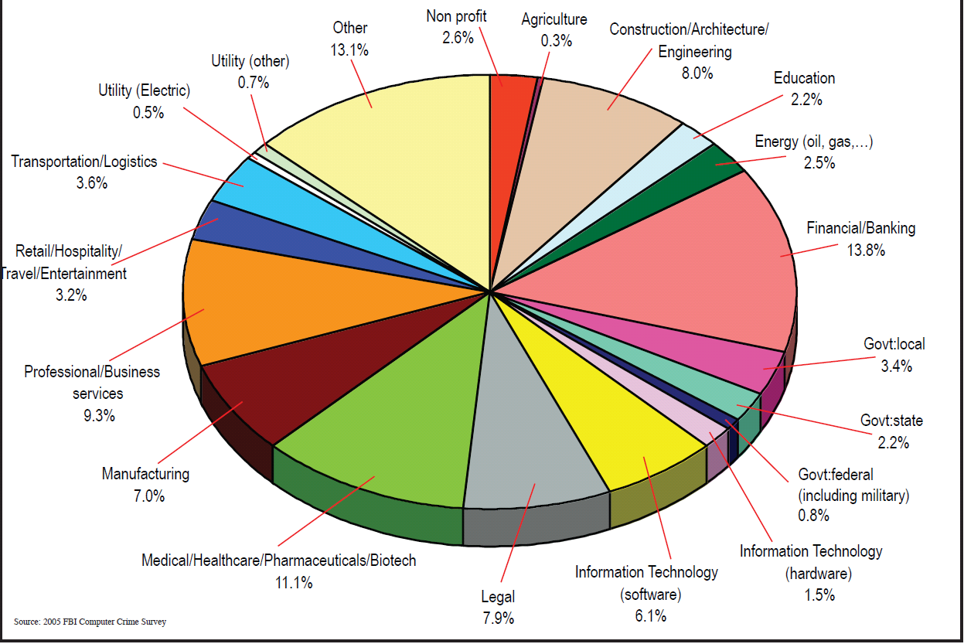
Casus Belli(cont.)

Slide 10
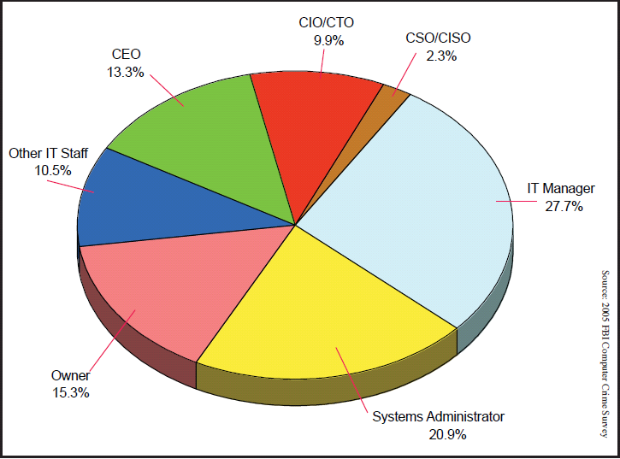
Casus Belli(cont.)

Slide 11
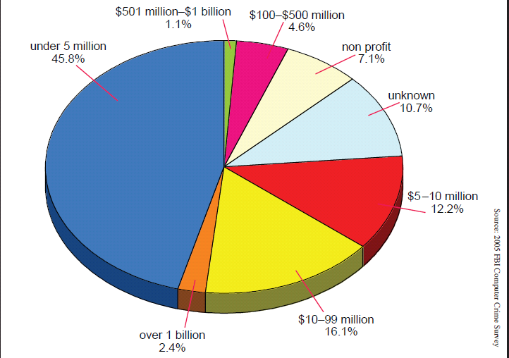
Casus Belli(cont.)

Slide 12
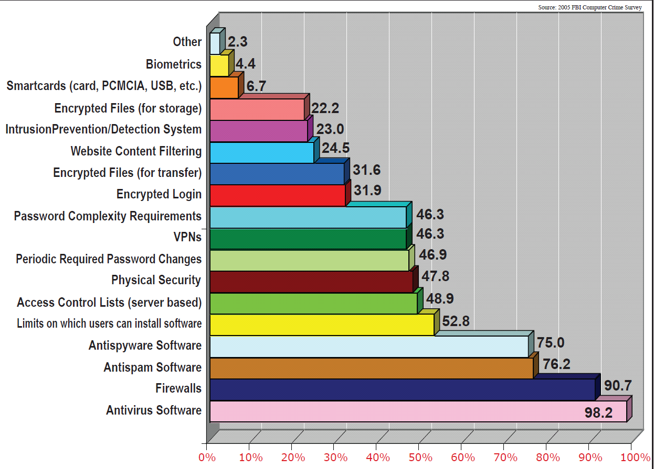
Casus Belli(cont.)

Slide 13
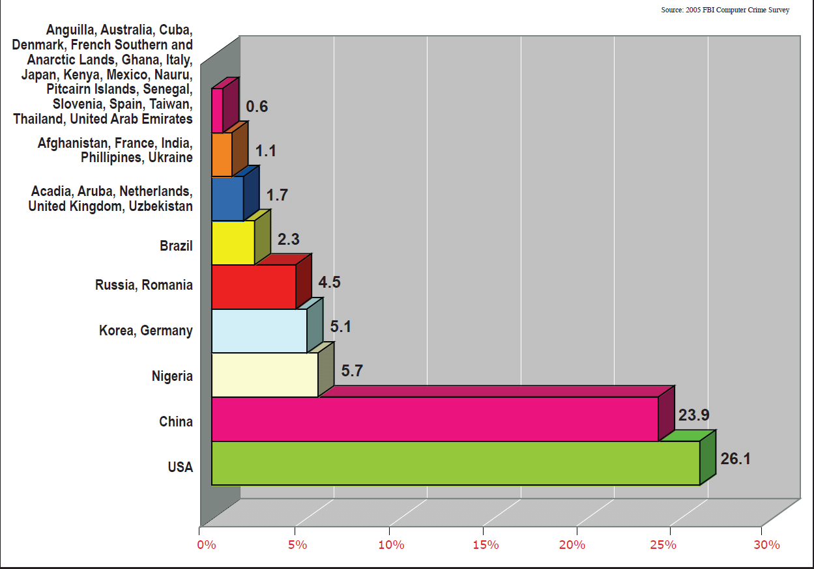
Casus Belli(cont.)

Slide 14
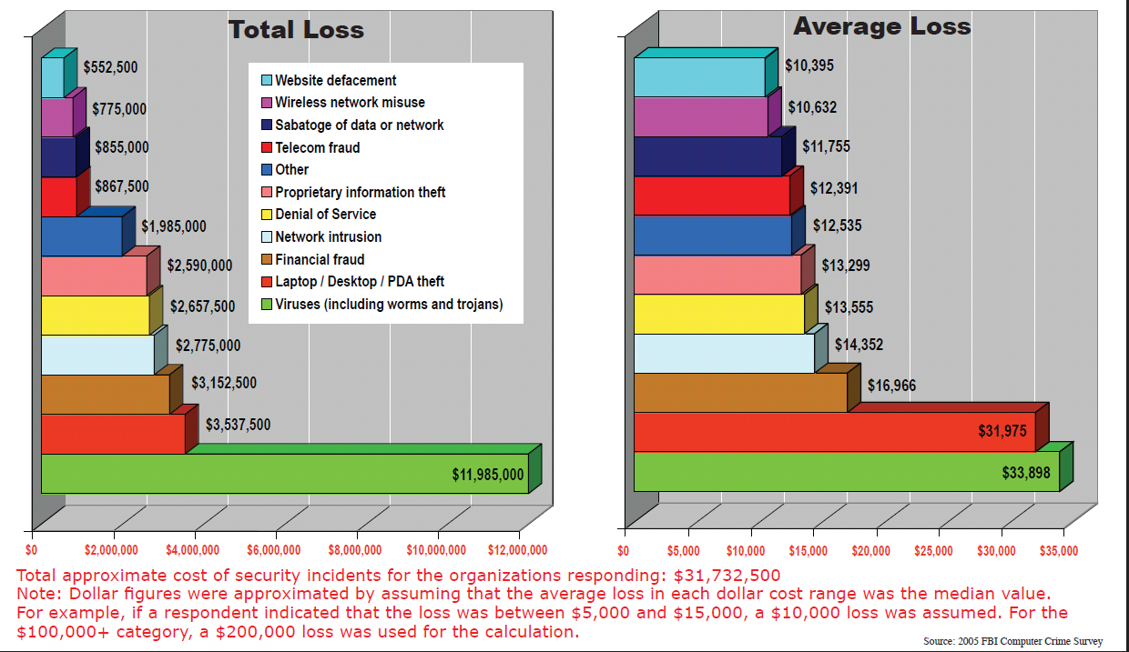
Casus Belli(cont.)

Slide 15
Protective Mechanisms
Various security systems have been deployed to protect users;
Most common technique used rely on “blacklisting” approach;
The approach has its limitations; e.g. “blacklisting” is never comprehensive nor up-to-date;
Other systems intercept, and analyze full website content as it downloaded.

Slide 16
Protective Mechanisms(cont.)
This paper proposes a complementary technique, lightweight real-time classification of URL, in order to predict whether or not the associated site is malicious;
Uses various lexical, and host based features of the URL for classification with the exclusion of web page content;
Researchers motivated by studies done by (chou et al., 2004; McGrath & Gupta, 2008).

Slide 17
Modus Operandi
Built a URL classification system that uses a live feed of labeled URLs from a large web mail provider, and that collects features for the URLs in real time;
Show that online algorithms can be more accurate than batch algorithms in practice;
Compare classical, and modern online learning algorithms;
Relevance of continuous retraining over newly-encountered features for adapting the classifier to detect malicious URLs.

Slide 18
Features
Lexical features used to capture the property that malicious tend to look different than benign ones;
Host-based features used to describe properties of the web site host as identify by the host name portion of the URL.

Slide 19
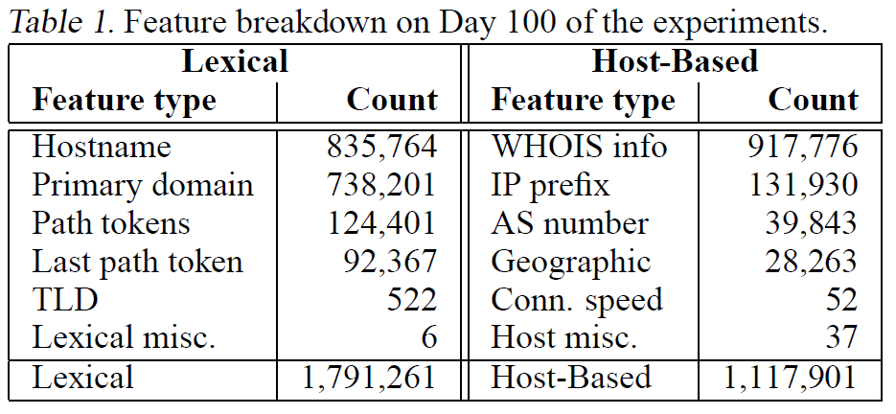
Features(cont.)

Slide 20
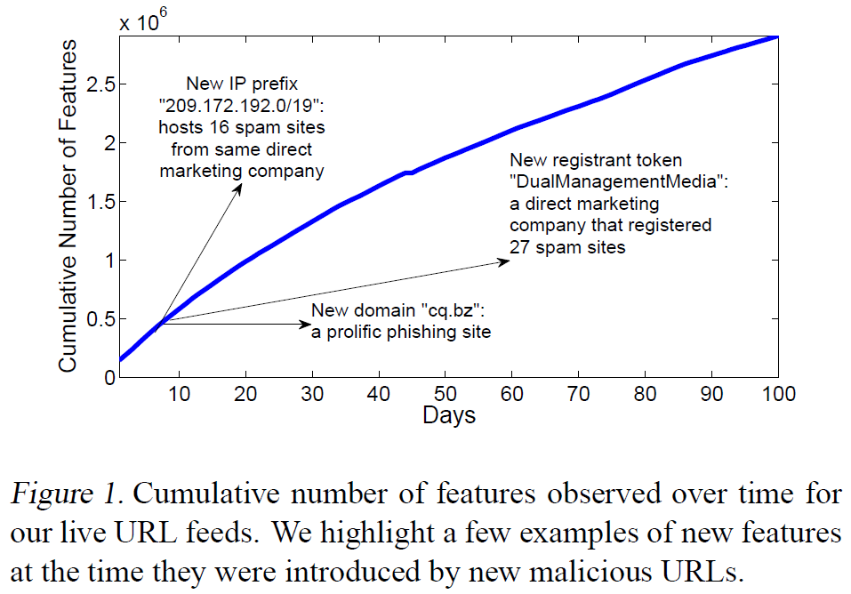
Features(cont.)

Slide 21
Related Work
This paper is similar to the work done by Garera et al. (2007), who classify phishing URLs using logistic regression over 18 hand-selected features;
Provos et al.(2008) , who study drive-by exploit URLs, and use patented ML algorithm along with features from web content;
Fette et al., (2007) & Bergholz et al. (2008) who examined selected properties of URLs contained within an e-mail to aid the ML classification of phishing e-mails.

Slide 22
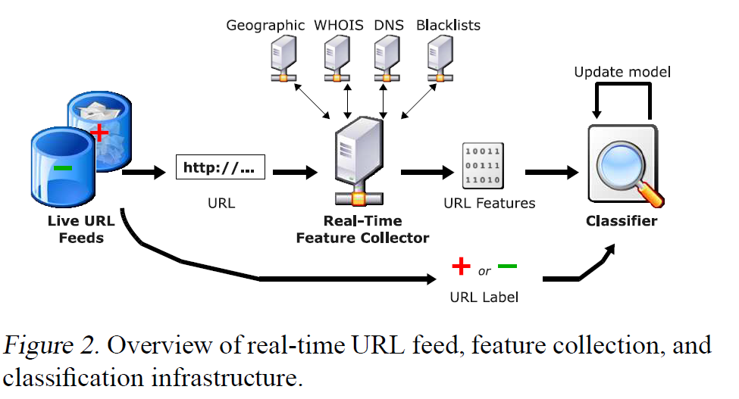
Data Collection

Slide 23
Identifying Suspicious URLs: An Application of Large-Scale Online Learning
This paper explores online learning approaches for predicting malicious URLs.
The application is appropriate for online algorithms:
as the size of the training data is larger than can be efficiently processed in batch
and because the distribution of features that typify malicious URLs can be continuously changing.
They demonstrate that recently-developed online algorithms such as CW can be highly accurate classifiers, capable of achieving classification accuracies up to 99%.

Slide 24
Identifying Suspicious URLs: An Application of Large-Scale Online Learning
Introduction
Security issues, etc.
Description of application, feature breakdown, etc.

Slide 25
Online learning
An online learning (or prediction) algorithm observes instances in a sequence of trials.
In each trial the algorithm
receives an instance,
produces a prediction.
Then it receives a label, which is the correct prediction for the instance.
Goal - to minimize the total number of prediction mistakes it makes.
To achieve this goal, the algorithm may update its prediction mechanism after each trial to be more accurate in later trials.

Slide 26
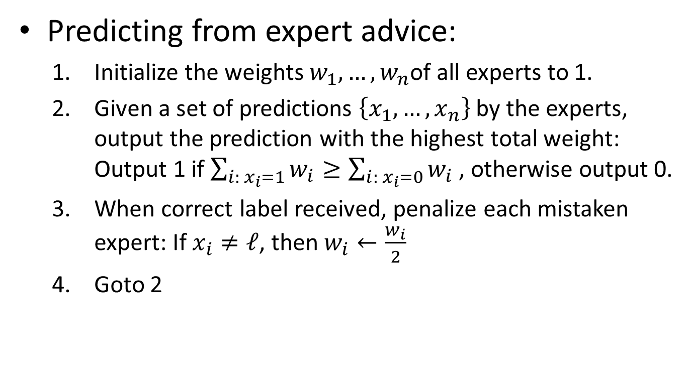
Online learning Weighted Majority (simple)
Predicting from expert advice:
Initialize the weights $w_{1}, …, w_{n}$of all experts to 1.
Given a set of predictions $\left\{x_{1}, …, x_{n}\right\}$ by the experts, output the prediction with the highest total weight: Output 1 if $\sum_{i: x_{i}=1}{w_{i}≥\sum_{i: x_{i}=0}{w_{i} }}$, otherwise output 0.
When correct label received, penalize each mistaken expert: If $x_{i}≠ℓ$, then $w_{i}←\frac{w_{i}}{2}$
Goto 2

Slide 27
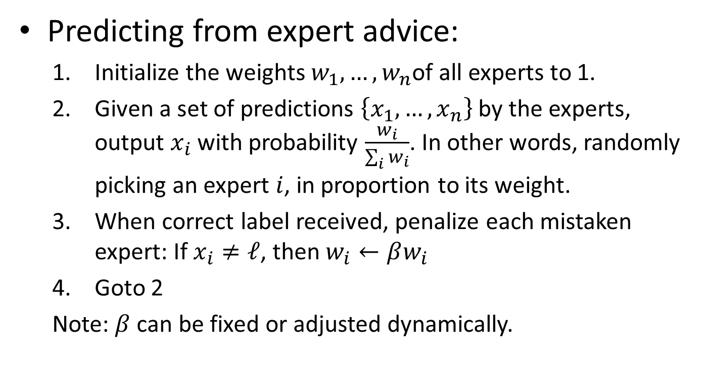
Online learning Weighted Majority (randomized)
Predicting from expert advice:
Initialize the weights $w_{1}, …, w_{n}$of all experts to 1.
Given a set of predictions $\left\{x_{1}, …, x_{n}\right\}$ by the experts, output $x_{i}$ with probability $\frac{w_{i}}{\sum_{i}{w_{i}}}$. In other words, randomly picking an expert $i$, in proportion to its weight.
When correct label received, penalize each mistaken expert: If $x_{i}≠ℓ$, then $w_{i}←βw_{i}$
Goto 2
Note: $β$ can be fixed or adjusted dynamically.

Slide 28
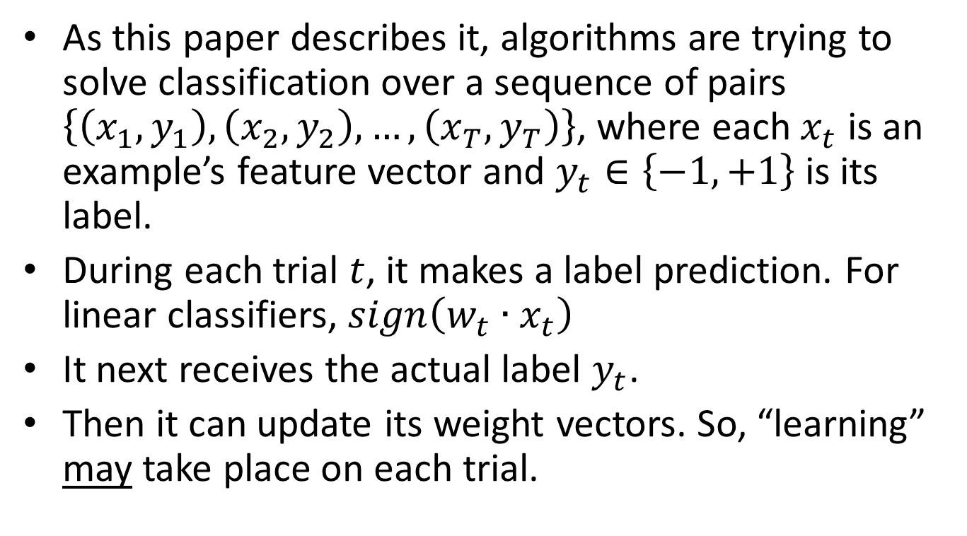
Online learning
As this paper describes it, algorithms are trying to solve classification over a sequence of pairs $\left\{\left(x_{1},y_{1}\right),\left(x_{2},y_{2}\right), …,\left(x_{T},y_{T}\right)\right\}$, where each $x_{t}$ is an example’s feature vector and $y_{t}∈\left\{−1,+1\right\}$ is its label.
During each trial $t$, it makes a label prediction. For linear classifiers, $sign\left(w_{t}∙x_{t}\right)$
It next receives the actual label $y_{t}$.
Then it can update its weight vectors. So, “learning” may take place on each trial.

Slide 29
Online learning Perceptron
The paper starts with the “classical” Perceptron algorithm. It is designed for answering yes/no questions.
The class of hypotheses used for predicting answers is the class of linear separators in the vector space. Therefore, each hypothesis can be described using a weight vector.

Slide 30
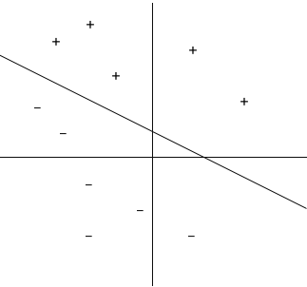


Online learning Perceptron
Consider a two dimensional plane with a linear separator through the plane separating the positive and negative regions.
The linear separator is represented by the following:
where w is weight vector, x is feature vector, and w₀ is a scalar quantity added to the function when the linear separator does not pass through the origin.
$\vec{w}∙\vec{x}+w_{0}≥0$, predict 1
$\vec{w}∙\vec{x}+w_{0}<0$, predict -1

Slide 31
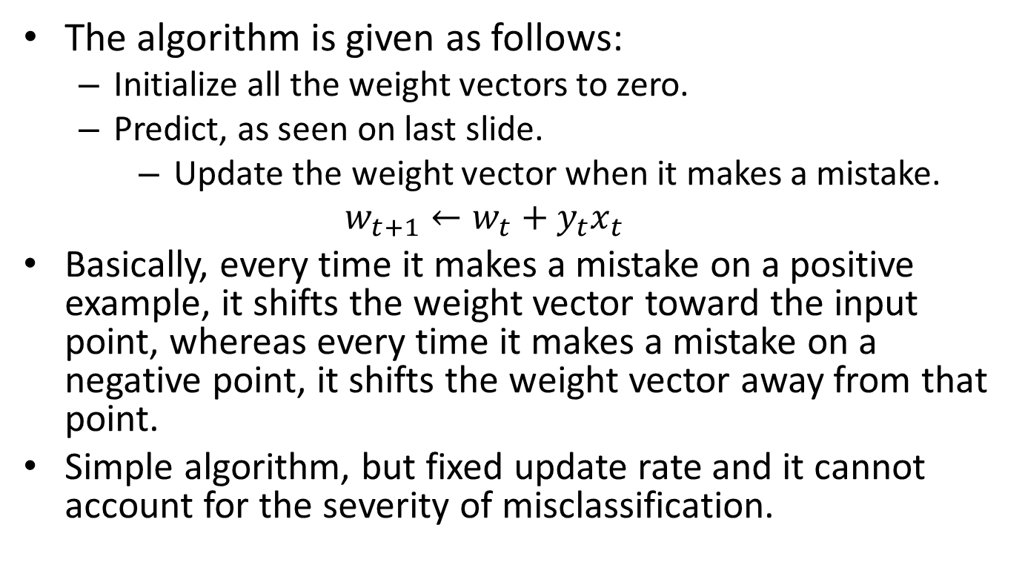
Online learning Perceptron
The algorithm is given as follows:
Initialize all the weight vectors to zero.
Predict, as seen on last slide.
Update the weight vector when it makes a mistake.
$$w_{t+1}←w_{t}+y_{t}x_{t}$$
Basically, every time it makes a mistake on a positive example, it shifts the weight vector toward the input point, whereas every time it makes a mistake on a negative point, it shifts the weight vector away from that point.
Simple algorithm, but fixed update rate and it cannot account for the severity of misclassification.

Slide 32
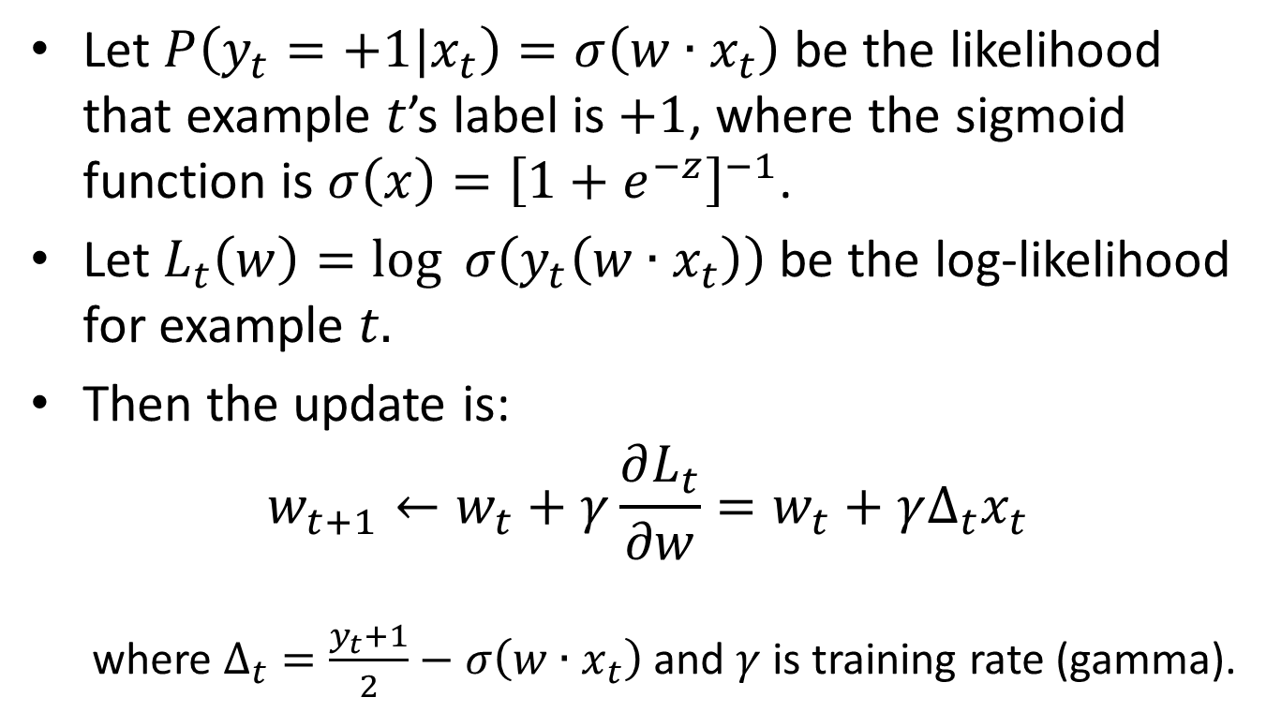
Online learning Logistic Regression with Stochastic Gradient Descent
Let $P\left(y_{t}=+1|x_{t}\right)=σ\left(w∙x_{t}\right)$ be the likelihood that example $t$’s label is $+1$, where the sigmoid function is $σ\left(x\right)={\left[1+e^{−z}\right]}^{−1}$.
Let $L_{t}\left(w\right)=\log{ σ\left(y_{t}\left(w∙x_{t}\right)\right)}$ be the log-likelihood for example $t.$
Then the update is:
$$w_{t+1}←w_{t}+γ\frac{∂L_{t}}{∂w}=w_{t}+γΔ_{t}x_{t}$$
where $Δ_{t}=\frac{y_{t}+1}{2}−σ\left(w∙x_{t}\right)$ and $γ$ is training rate (gamma).

Slide 33
Online learning Logistic Regression with Stochastic Gradient Descent
Authors say they do not decrease 𝛾 over time, so parameters can continually adapt to new URLs.
Note that the update allows for the weights to be updated even when there is no prediction mistake.

Slide 34
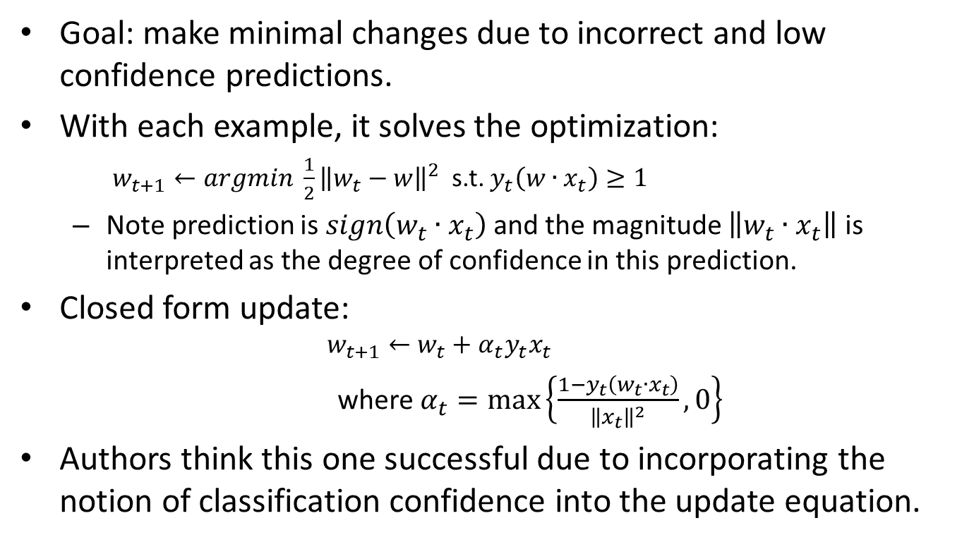
Online learning Passive-Aggressive (PA) Algorithm
Goal: make minimal changes due to incorrect and low confidence predictions.
With each example, it solves the optimization:
$w_{t+1}←argmin \frac{1}{2}{\left\|w_{t}−w\right\|}^{2}$ s.t. $y_{t}\left(w∙x_{t}\right)≥1$
Note prediction is $sign\left(w_{t}∙x_{t}\right)$ and the magnitude $\left\|w_{t}∙x_{t}\right\|$ is interpreted as the degree of confidence in this prediction.
Closed form update:
$$w_{t+1}←w_{t}+α_{t}y_{t}x_{t}$$
where $α_{t}=\max\left\{\frac{1−y_{t}\left(w_{t}∙x_{t}\right)}{{\left\|x_{t}\right\|}^{2}},0\right\}$
Authors think this one successful due to incorporating the notion of classification confidence into the update equation.

Slide 35
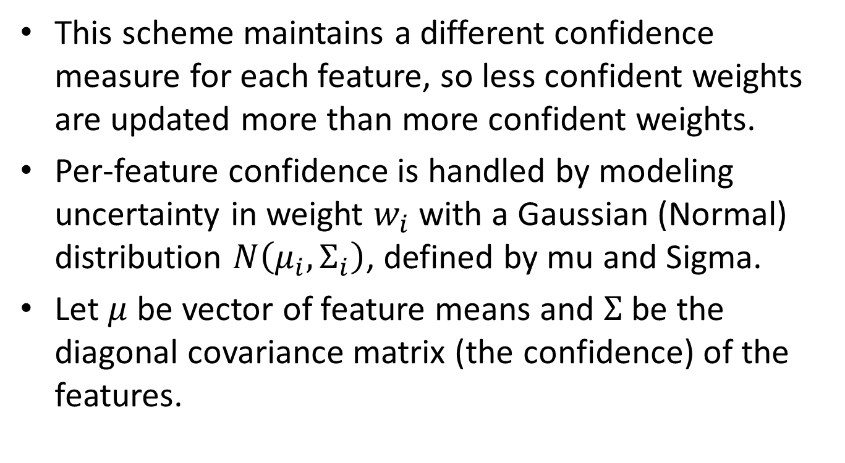
Online learning Confidence-Weighted (CW) Algorithm
This scheme maintains a different confidence measure for each feature, so less confident weights are updated more than more confident weights.
Per-feature confidence is handled by modeling uncertainty in weight $w_{i}$ with a Gaussian (Normal) distribution $N\left(μ_{i}, Σ_{i}\right)$, defined by mu and Sigma.
Let $μ$ be vector of feature means and $Σ$ be the diagonal covariance matrix (the confidence) of the features.

Slide 36

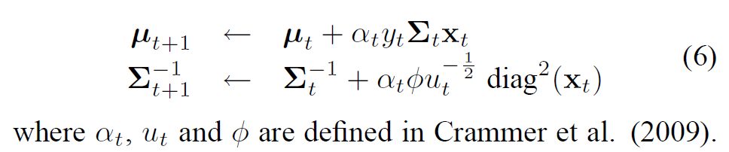
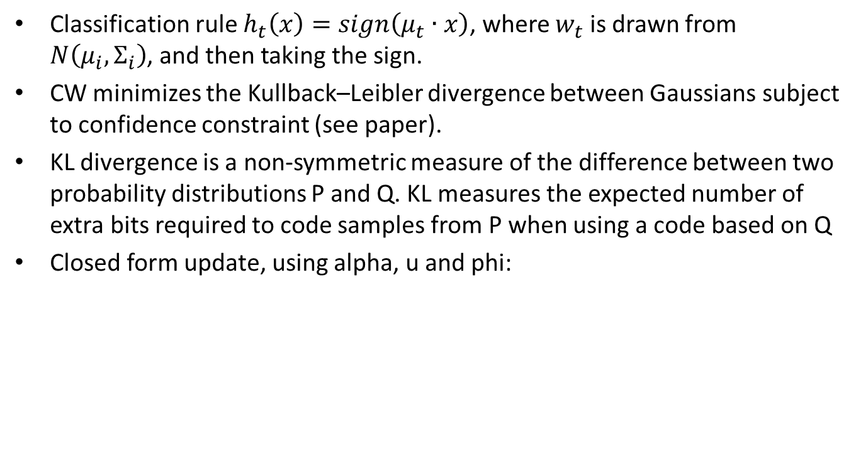
Online learning Confidence-Weighted (CW) Algorithm
Classification rule $h_{t}\left(x\right)=sign\left(μ_{t}∙x\right)$, where $w_{t}$ is drawn from $N\left(μ_{i}, Σ_{i}\right)$, and then taking the sign.
CW minimizes the Kullback–Leibler divergence between Gaussians subject to confidence constraint (see paper).
KL divergence is a non-symmetric measure of the difference between two probability distributions P and Q. KL measures the expected number of extra bits required to code samples from P when using a code based on Q
Closed form update, using alpha, u and phi:

Slide 37
Online learning Confidence-Weighted (CW) Algorithm
Idea with CW is: If variance of a feature large, then more ‘aggressive’ update to the feature mean.
And since CW takes into account each feature’s weight confidence, it is applicable to this application since the data feed continually has incoming mix of recurring and new features.

Slide 38
Online learning Related Algorithms
They also experimented with nonlinear classification using online kernel-based algorithms
Forgetron (Dekel et al., 2008)
Projectron (Orabona et al., 2008).
Preliminary evaluations revealed no improvement over linear classifiers.

Slide 39
Online learning Evaluation
Paper evaluation section addresses the following questions:
Do online algorithms provide any benefit over batch algorithms?
Which online algorithms are most appropriate for our application?
And is there a particular training regimen that fully realizes the potential of these online classifiers?

Slide 40
Online learning training regimen
By “training regimen”, it refers to:
When the classifier is allowed to retrain itself after attempting to predict the label of an incoming URL.
Continuous - the classifier may retrain its model after each incoming example.
Interval-based - the classifier may only retrain after a specified time interval has passed (for example, one day).
How many features the classifier uses during training.
Fixed - train using a pre-determined set of features for all evaluation days.
Variable - allow the dimensionality of our models to grow with the number of new features encountered.

Slide 41
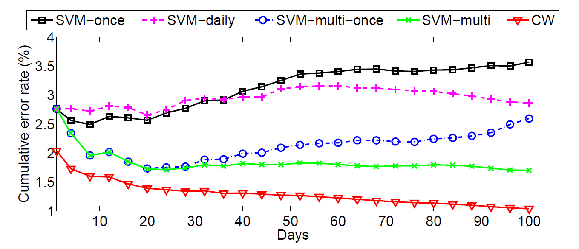
Online learning Do online algorithms provide any benefit over batch algorithms?
Cumulative error rates for CW and for batch algorithms under different training sets.

Slide 42
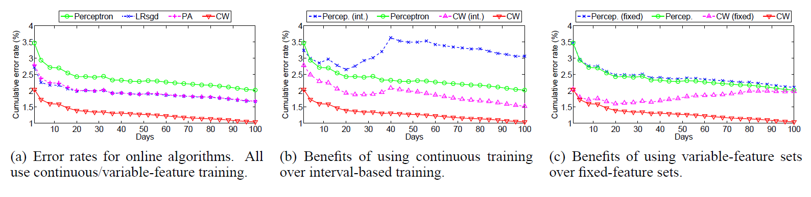
Online learning Which online algorithms are most appropriate for our application? Is there a training regimen that fully realizes the potential of these online classifiers?
Comparison of Online Algorithms

Slide 43
Conclusion
Despite the achieved accuracies of up to 99% by using the online algorithm CW, URLs classification is a challenging task.
Features collection & classification infrastructure design raises security concerns;
Security is a process, and not a product;
Testing for all possible weakness, in a system, is impossible;
Detection, and response is one of the best way to improve security.

Slide 44
Discussion on the topic
Should the blacklist feature be included?
Seems as if they should have said how accurate that feature was and what impact its inclusion had on the final outcome.

Slide 45
Discussion on the topic
Most common question was related to the number of features. How to handle high dimensionality of this approach? Feature space quickly becomes large (and sparse), which has space and time issues due to needing more memory to store weights and time to calculate prediction. Over time just increases without bound…
The bag-of-words approach contributes to this issue, is there a better way (or any other way) than the bag-of-words concept?

Slide 46
Discussion on the topic
Abstract question – why hook up features directly? Why not have learning algorithms associated with each weight?
Paper approach is experimental, but focused on one application in one domain. Question is - are you convinced by this approach? Would you need experiments from more applications across multiple domains? Would a theoretical comparison of the algorithms be more convincing?

Slide 47
Discussion on the topic
Several questioned ratio of benign to malicious URLs- what would be a reasonable number?
What other domains or applications can be used with online learning? (Besides this one or spam filtering, that is)

Slide 48
Discussion on the topic
If a person knew this approach was being used, could they trick the system into classifying a good URL as malicious (say for a competitor’s site)? Or the flip side, how could they trick the system to label a malicious site as NOT malicious (benign)?
What are the problems associated with predictions that turn out to be wrong?
Was comparison to SVM necessary?

