Slide 1
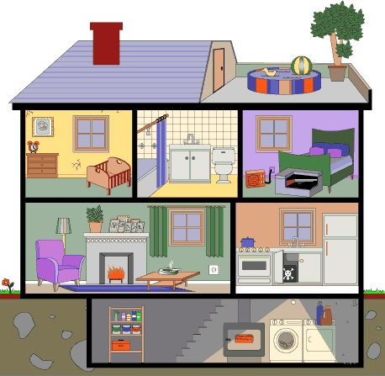
Orange
School of Electrical Engineering
and Computer Science
Topics in Machine Learning
Fall 2011
Notes:
This is a type of supervised learning
Find correlations between within-set items

Slide 2
What is Orange?
Open source data mining toolkit
Designed to add extensions for new techniques
Python scripts
Runs on Linux, Windows (used here), Mac OS
http://orange.biolab.si/

Slide 3
Widget catalog
http://orange.biolab.si/doc/catalog/

Slide 4
Data Representation
Supports multiple formats (C4.5, Weka, others)
We will use tab separated data entries
First line lists attributes
Second line gives type of attribute
Nominal (“discrete”, “d”)
Continuous (“continuous”, “c”)
Ignored field (“ignore”, “i”)
Third line lists target class (“class” in appropriate column)
Default is tab format, use “tab” file extension

Slide 5
Voting
Names, data
Tab file
Party | HaInf | WatPr | Budgt | DrFee | ElSal | ReSch | TestB | Nicar | Missl
d | d | d | d | d | d | d | d | d | d
class
Rep | n | y | n | y | y | y | n | n | n
Rep | n | y | n | y | y | y | n | n | n
Dem |  | y | y |  | y | y | n | n | n
Dem | n | y | y | n |  | y | n | n | n
Dem | y | y | y | n | y | y | n | n | n

Slide 6
Start Orange in Python
Start up Python
In Windows, start up PythonWin, move to directory with data file
Import orange

Slide 7
Python Example
import orange
data = orange.ExampleTable(“voting")
print "Attributes:",
for i in data.domain.attributes:
print i.name,
print
print "Class:", data.domain.classVar.name
print "First 5 data items:“
for i in range(5):
print data[i]
Notes:
Put data in Python25 folder
Type this program in
Open this program file
Click on Run

Slide 8
Supervised Learning in Orange
import orange, orngTest, orngStat
# set up the learners
majority = orange.MajorityLearner()
majority.name = "majority“
learners = [majority]
# compute accuracies on data
data = orange.ExampleTable("voting")
results = orngTest.crossValidation(learners, data, folds=10)
cm = orngStat.computeConfusionMatrices(results, classIndex=data.domain.classVar.values.index('democrat'))
print "Majority", orngStat.CA(results)[0]

Slide 9
Result
>>> Majority 0.613794926004

Slide 10
Homework #1
http://eecs.wsu.edu/~cook/ml/hw/hw1.pdf

