Slide 1
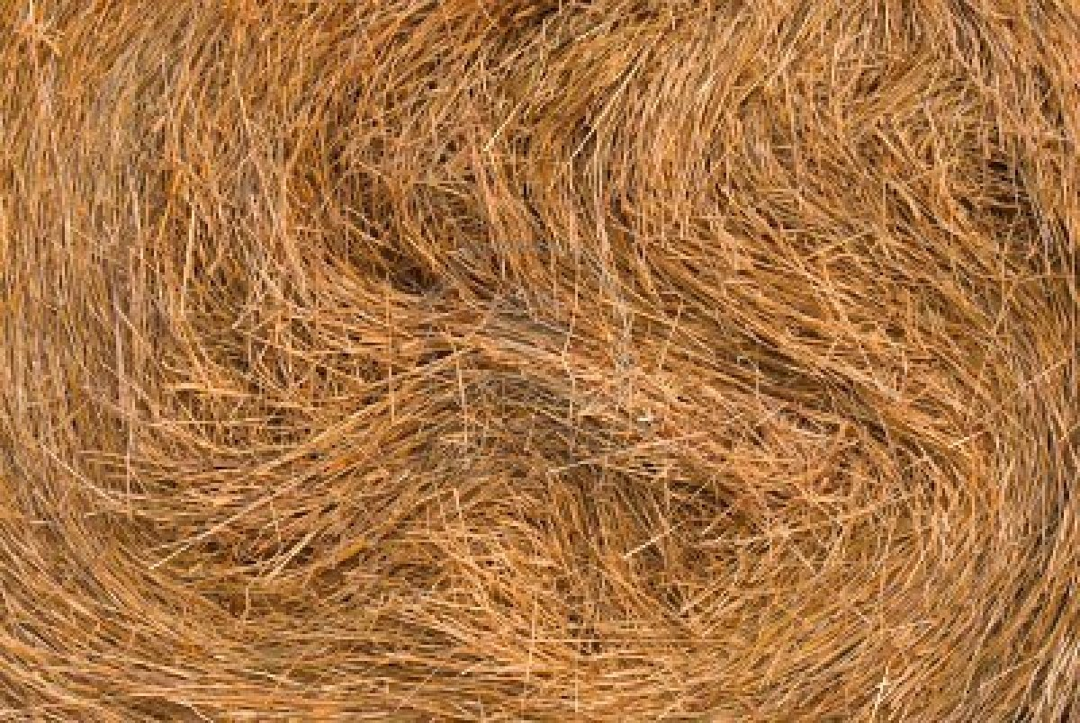
Rare Category Detection in Machine Learning
Prafulla Dawadi
Topics in Machine Learning

Slide 2
Outline
Part I
  Examples
  Rare Class, Imbalanced Class, Outliers
Part II
  (Rare)Category Detection
Part III
  Kernel Density Estimation
  Mean Shift and Hierarchal Mean Shift
  Hierarchical Mean Shift for Category Detection
  Experimental Results
  Discussions

Slide 3
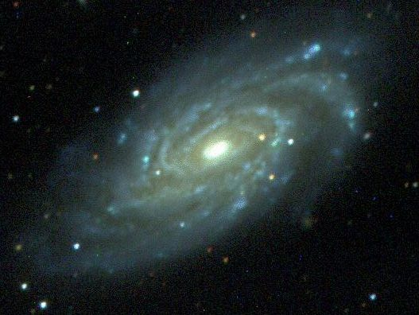

Examples
In, astronomical dataset , percentage of unusual galaxies are 0.001% of dataset
Fraudulent credit card transactions are very few
Network Intrusions, spam images , diagnosis of rare medical condition, oil spill in satellite images, etc contains rare classes.

Slide 4
Rare Class
Number of Instance of one classes are abundantly large than other.
Minority classes are INTERSTING
[Vatturi & Wong, 2009] , [Pelleg & Moore 2005]
Challenges
Noisy classes looks similar to rare class
Classifier is overwhelmed with the majority class
  Number of instances of Fraudulent Transactions vs Normal Transactions

Slide 5
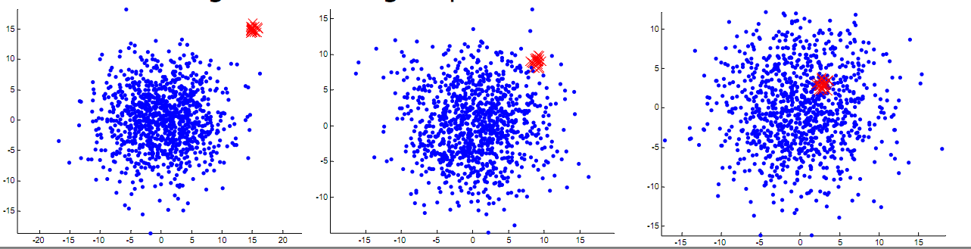
Rare Class and Separability
Rare Class and Separability
http://videolectures.net/cmulls08_he_rcd/

Slide 6
Rare Class vs. Imbalanced Class Classifier
Rare class is extreme case of imbalanced classification problem [Han et al. 2009]
Classifier for Imbalanced Class dataset focuses on overall accuracy of each class
  Metric : G-Mean, ROC curve
Classifier for Rare Class dataset puts heavy emphasis on learning minority class.
  Metric : Precision, Recall, F-measure, for rare class learning [Han et al. 2009]

Slide 7
Rare Class vs. Outliers
“ Most of the objects (99.9%) are well explained by current theories and …. remainder are anomalies, but 99% of these anomalies are uninteresting, and only 1% of them (0.001% of the full dataset) are useful … rest type of anomalies, called boring anomalies, are records which are strange for uninteresting reasons……The useful anomalies are extraordinary objects which are worthy of further research” [Pelleg & Moore 2005]
Outliers are typically single point, separable from normal examples and are scattered over the space. [He & Carbonell 2008]
Rare class assumes minority classes are compact in the feature space and may overlap with the majority class.
  Which one is a tougher problem : Imbalanced Class, Rare class, and Outliers.

Slide 8
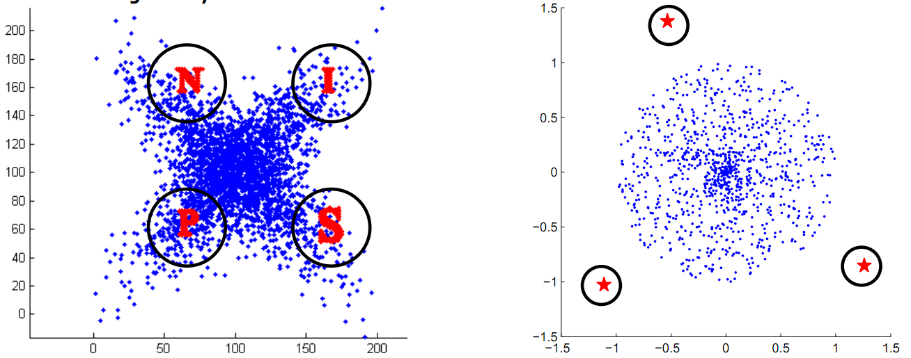
Rare Class vs. Outliers
Rare Class
Outliers
[He & Carbonell 2008]
http://videolectures.net/cmulls08_he_rcd/

Slide 9
Rare Class Learning
Common Techniques :
Sampling Techniques
  Oversample, Under sample, SMOTE etc
Cost Sensitive Learning
Cost Sensitive Boosting
  Adacost, Cost sensitive Boosting, Smote Boost etc
  [Han et al] for good introduction of these techniques

Slide 10
Part II
Category Detection

Slide 11
Category Detection
Problem :Given a set of unlabelled examples,
Where X_{i} belongs to R and are from m distinct categories labeled y_{i} = {1,2,..,m}
Objective : Bring to the users attention at least a single instance from each category in few queries. [Vatturi & Wong, 2009]
Challenge : Discover rare categories/class
Stopping Criteria : Labeling cost or prior information

Slide 12
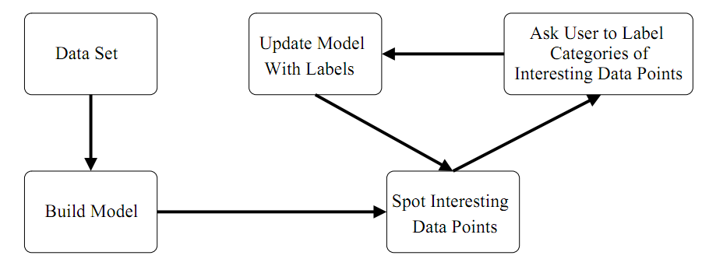
Category Detection
Category Detection Loop [Vatturi & Wong, 2009]

Slide 13
Category Detection and Active Learning
Active Learning
Aims in improving classifier performance with prior information of class and least label requests
Category Detection
Starting with no labeled examples, discover minority classes with least label requests
[He & Carbonell 2008]

Slide 14
Why Category Detection
Theoretical Importance
“Furthermore, rare category detection is a bottleneck in reducing the overall sampling complexity of active learning … Learning can not improve the label complexity of passive learning if different classes are not balanced in the data set…” [Dasgupta 2005 ] [He 2010]
Practical Importance
Category detection can be used in many real applications.
Domain expert can analyze trends of Fraudulent transactions

Slide 15
Assumptions
Smoothness : underlying distribution of each majority classes are sufficiently smooth.
Compactness : examples from the same minority class form a compact representation
[He 2010]

Slide 16
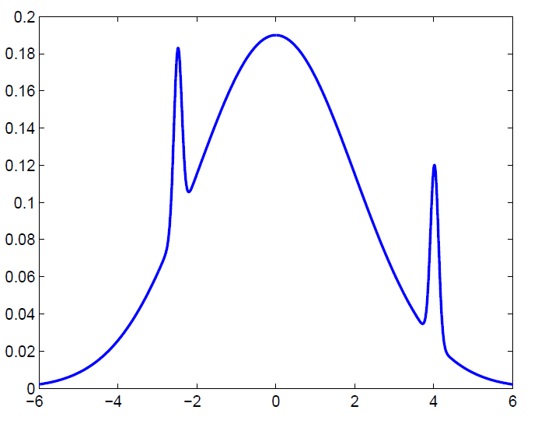
Assumptions
Synthetic Rare class has lower variance than the majority class [He 2010]

Slide 17
Issues
How to detect rare categories in an unbalanced, unlabeled data set with the help of an oracle?
How to detect rare categories with different data types, such as graph data, stream data, etc?
How to do rare category detection with the least information about the data set?
How to select relevant features for the rare categories?
How to design effective classification algorithms which fully exploit the property of the minority classes (rare category classification)?
[He 2010] [Vatturi & Wong, 2009]
http://videolectures.net/cmulls08_he_rcd/

Slide 18
Part III
Category Detection Using Hierarchical Mean Shift
  Pavan Vatturi
  Weng-Keen Wong
  Oregon State University

Slide 19
Question
Given arbitrary distribution of data, how would you determine which density it belongs to ?

Slide 20
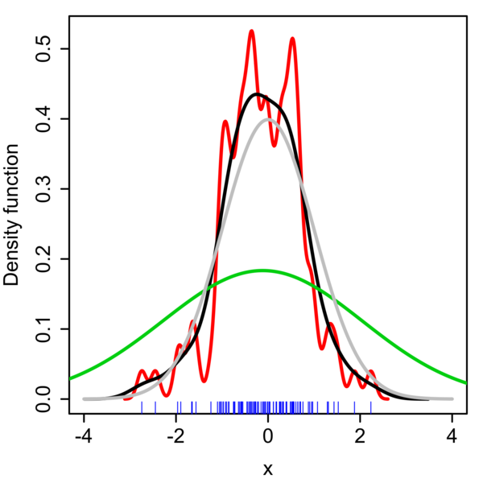
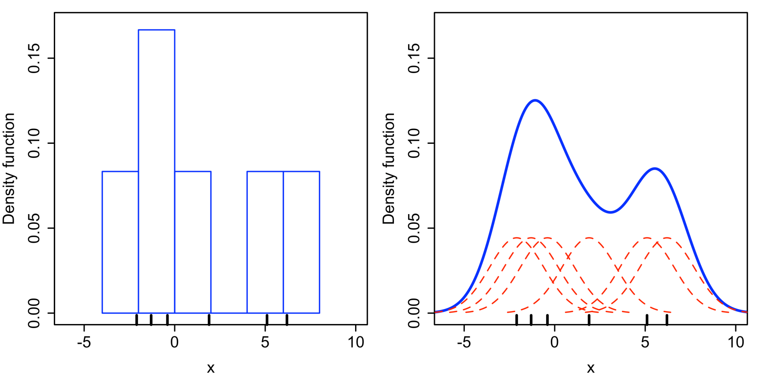

Kernel Density Estimation
Histogram
Kernel Density Estimation
http://en.wikipedia.org/wiki/Kernel_density_estimation

Slide 21
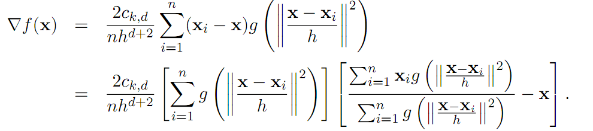
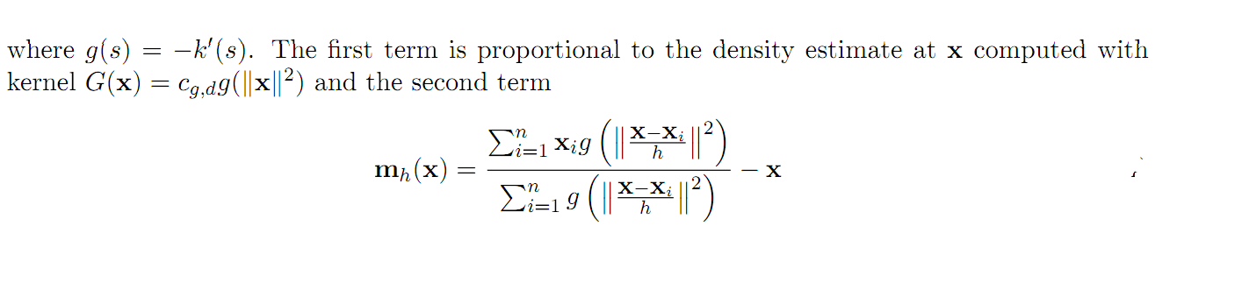
Density Gradient Estimation
The gradient density estimation is :
is the mean shift. The mean shift vector always points toward the direction of the maximum increase in the density.
http://homepages.inf.ed.ac.uk/rbf/CVonline/LOCAL_COPIES/TUZEL1/MeanShift.pdf

Slide 22
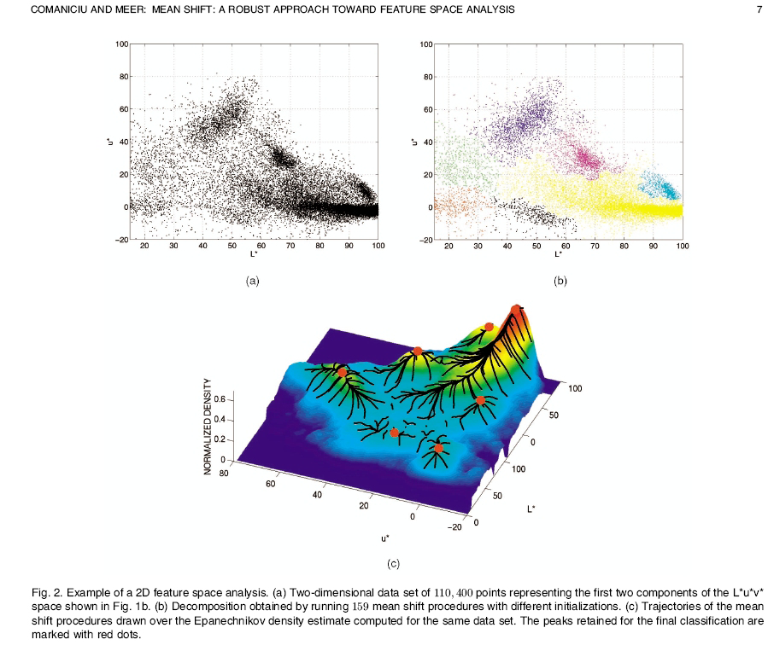
Mean Shift Algorithm

Slide 23
Mean Shift Algorithm
Mean Shift
Compute the mean shift vector, m_{h}(x^{t})
Translate the window by x^{t+1}= x^{t} + m_{h}(x^{t})
Mean Shift Clustering
Run the mean shift procedure to find the stationary points of the density function
Prune these points by retaining only local maxima
The set of all locations that converge to the same mode defines the basin of attraction of that mode. The points which are in the same basin of attraction is associated with the same cluster. [ Cheng 1995]

Slide 24
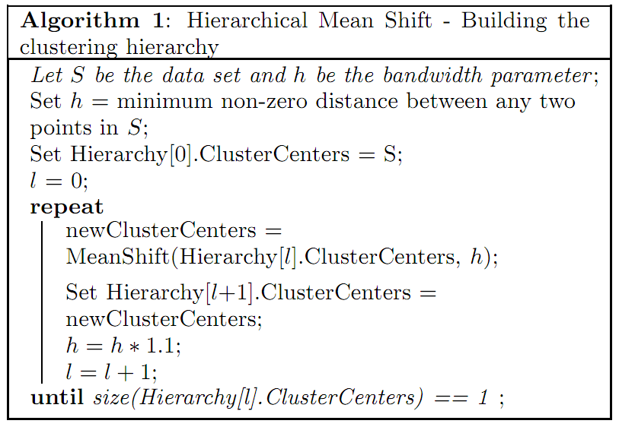
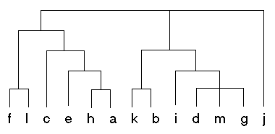
Hierarchical Mean Shift
Bandwidth
Maintain :
Total distance moved by mean shift
Previous cluster centers and original query data points

Slide 25
Methodology
Data Standardization
Building Cluster Hierarchy
Query The user
Tiebreaker
Computational Consideration

Slide 26
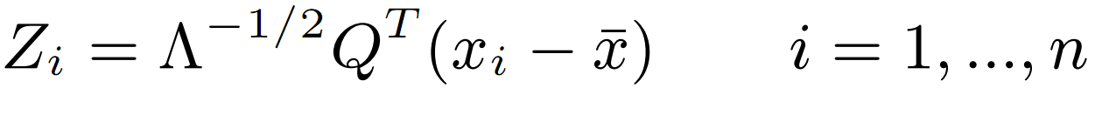
Data Standardization
Sphere the data

Slide 27
Cluster Hierarchy and Labeling
Step 1
Step 2
Step 3
Cluster the data set with Hierarchical Mean shift with increasing Bandwidth
Bandwidth
At each height for each cluster Ci Maintain the Cluster Validity List
Present the clustering with high validity criteria for labeling

Slide 28
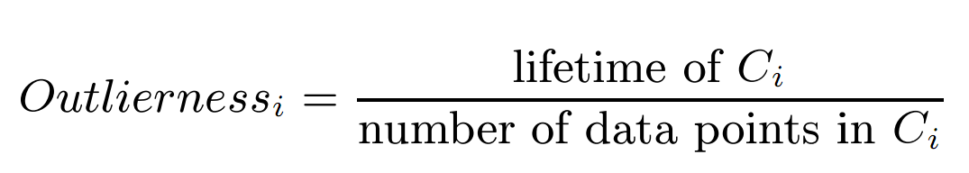
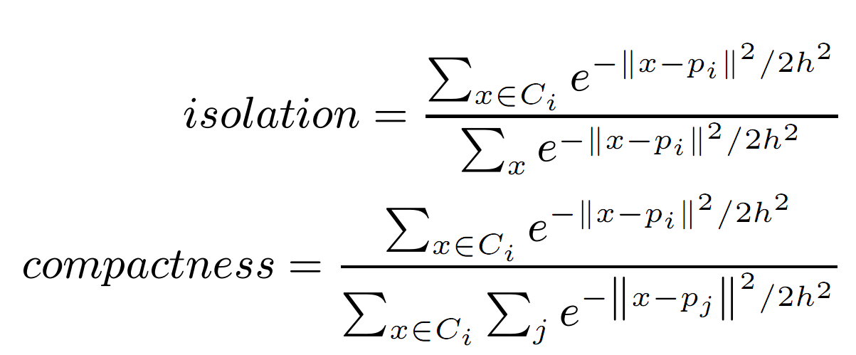
Query the User : Active Learning
Evaluate cluster using cluster goodness criteria
Outlierness : How long can cluster survive?
Compact-Isolation
P_{i} = cluster centers

Slide 29
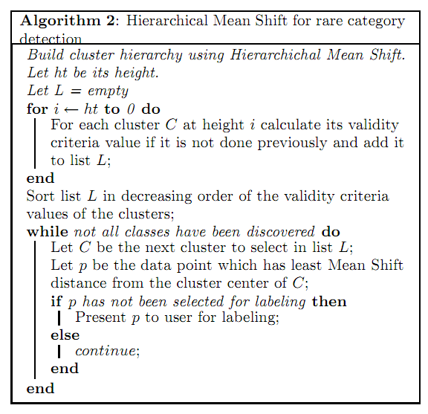
Algorithm

Slide 30
Methodology
Tiebreaker
Can happen for low bandwidth value when it is scanning for high compact reason
HAD : Highest Average Distance
Computational Consideration
Is expensive as distance with all other points needs to be calculated
  Use KD -tree

Slide 31
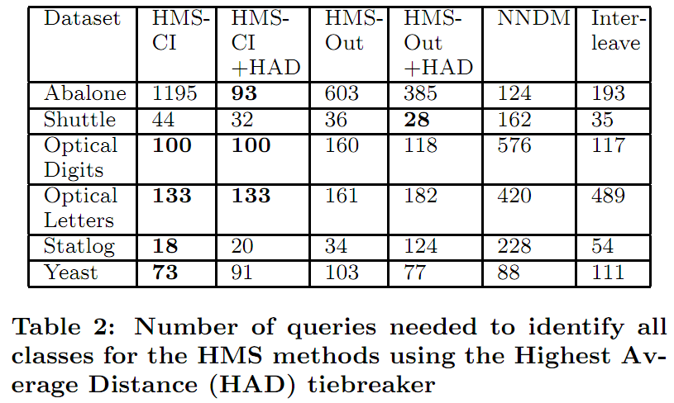
Experimental Results
Dataset : Abalone, Shuttle, Optical Digits, Optical Letters, Statlog and Yeast

Slide 32
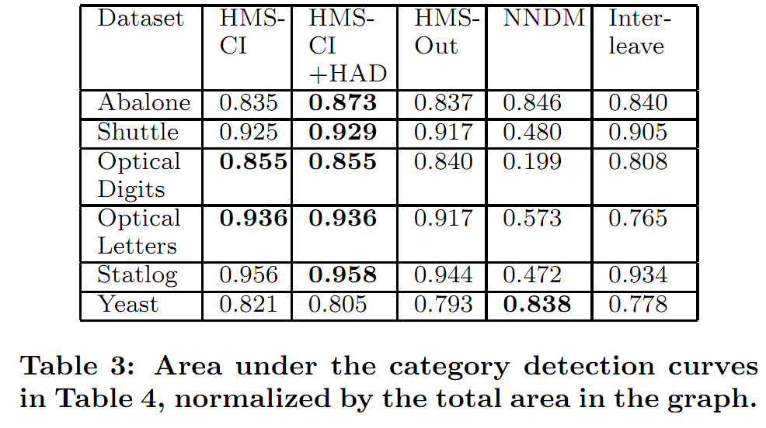
Experimental Results
Dataset : Abalone, Shuttle, Optical Digits, Optical Letters, Statlog and Yeast

Slide 33
Strength
Uses non-parametric mean shift clustering technique hence does not require prior knowledge regarding the properties of the data set.
Reduces the number of queries to the user needed to discover all the categories in data

Slide 34
Weakness
Reference vs Query dataset
Stopping criteria
Subsampled dataset
Determining increasing bandwidth size
Scalability
High dimension and Kernel Density Estimation
Supervised Approach

Slide 35
Discussion
Comparison with Conventional Clustering Algorithm
  Kmeans etc.
Application and Use of Category Detection

Slide 36
References
[Han et al. 2009 ] Rare Class Mining: Progress and Prospect
[Pelleg & Moore 2004] Dan Pelleg and Andrew Moore. Active learning for anomaly and rare-category detection. In Advances in Neural Information Processing Systems 18, December
2004
[He & Carbonell 2008] Jingrui He and Jaime Carbonell. Nearest-neighbor-based active learning for rare category detection. In J.C. Platt, D. Koller, Y. Singer, and S. Roweis, editors, Advances in Neural Information Processing Systems 20, pages 633–640. MIT Press, Cambridge, MA, 2008
[Vatturi & Wong, 2009] Vatturi, P. & Wong, W.-K. (2009). Category detection using hierarchical meanshift. in KDD
[Cheng 1995] Yizong Cheng. Mean shift, mode seeking, and clustering. IEEE Trans. Pattern Anal. Mach. Intelligence 17(8):790–799, 1995
[Comaniciu & Meer 2002] D. Comaniciu and P. Meer. Mean shift: A robust approach toward feature space analysis. IEEE Trans. Pattern Anal. Machine Intell., 24:603–619, 2002
[He 2010 ] J. He, Rare Category Analysis, Phd Thesis, CMU

Slide 37
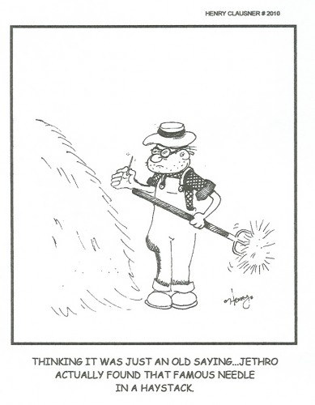
http://henryclausner.com/2011/the-needle-in-the-haystack/

