Slide 1
Human Performed Semi-Supervised Classification Too
Zhu, Rogers, Qian, Kalish
Presented by Syeda Selina Akter

Slide 2
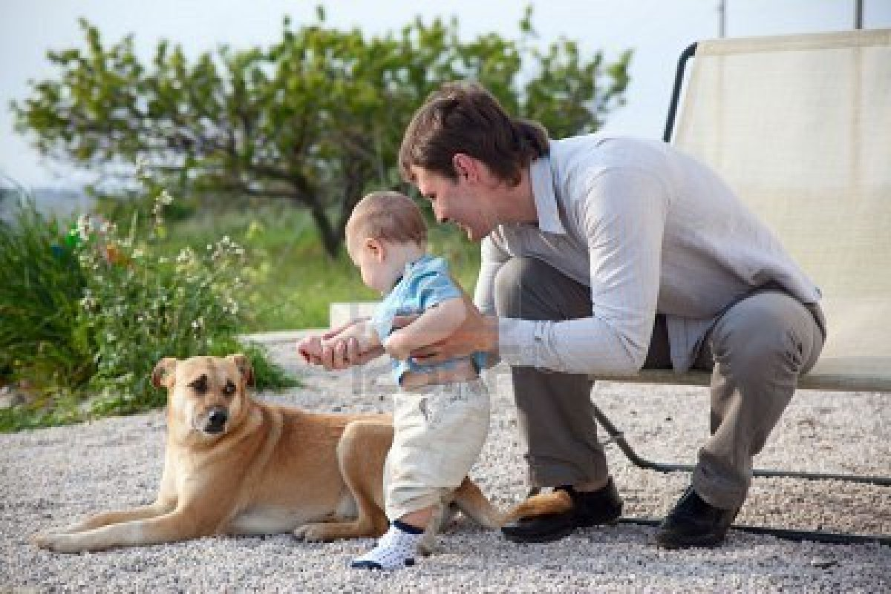

Real World Situations

Slide 3
Objective
Do humans use unlabeled data in addition to labeled data?
Can this behavior be explained by mathematical models for Semi-supervised Machine Learning?

Slide 4
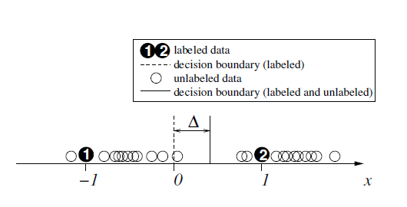
Semi-Supervised Learning Method
Based on the assumption that each class form a coherent group

Slide 5
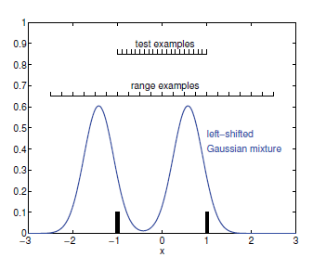
Experiment
Participant receives
2 labeled examples at x=-1
and at x=1
Participant receives unlabeled
examples sampled from true
class feature distributions

Slide 6
Examples
Artificial Fish
Might reflect prior knowledge about the category
Circles of different size
Prior knowledge about size
Limited for displaying on Computer Screen

Slide 7









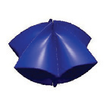

Examples
−2.5
−2.0
−1.5
−1.0
−0.5
0.5
1.0
1.5
2.0
2.5
0
Artificial 3D stimuli: shapes change with x

Slide 8
Examples
Block 1 (labeled)
2 labeled examples at x=1 and x=-1
Each example 10 times
Block 2 (test)
X=-1,-0.9,…-0.1,0,0.1…,0.9,1
21 evenly spaced unlabeled examples

Slide 9
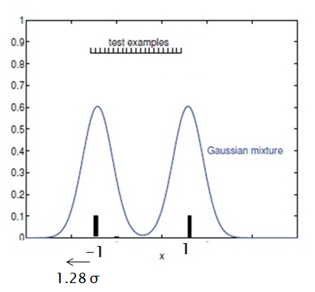
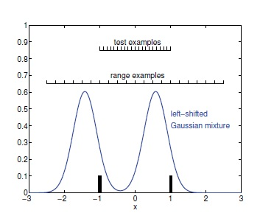

Examples
Block 3 (unlabeled-1)
1.28 σ
1.28 σ

Slide 10
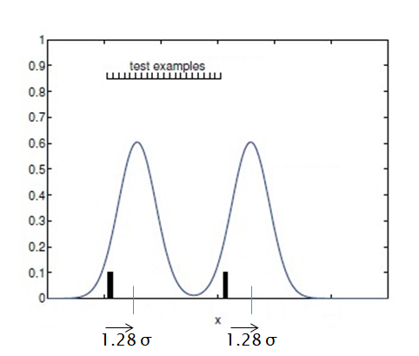
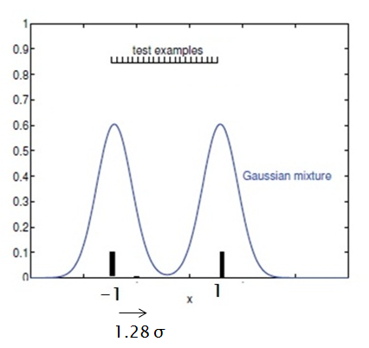

Examples
Block 3 (unlabeled-1)
Right shifted
Gaussian Mixture
-1
1

Slide 11
Examples: Unlabeled
Right shifted
Gaussian Mixture
-1
1
1.28 σ
1.28 σ
Labeled data
off center and not prototypical
not outlier too

Slide 12
Examples: Unlabeled
Ranged examples
Right shifted
Gaussian Mixture
-1
1
1.28 σ
1.28 σ
x ε [-2.5, 2.5]
ensure both groups span the same range
decision is not biased by range of examples

Slide 13
Examples
Block 4 and 5
Same 21 range examples
Different 230 random examples from Gaussian Mixtures
Block 6
Same as block 2
21 evenly distributed test examples from range [-1,1]
Test whether decision boundary changed after seeing unlabeled examples

Slide 14
Procedure
Told stimuli are microscopic pollens
Press B or N to classify
Label: audio Feedback
No audio feedback for unlabeled data
12 L-subjects, 10 R-subjects
Each Subjects see 6 blocks of data, i.e, same 815 stimuli
Random order

Slide 15
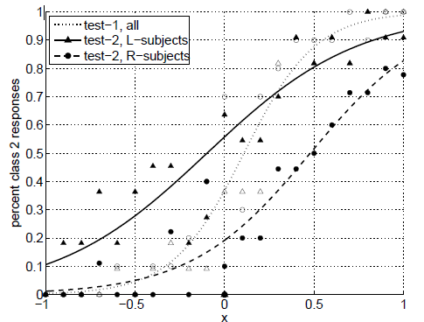

Observations
Fit logistic regression function
To the data
Decision boundary after test-1
at x=0.11
Steep Curve indicated decision
consistency
Decision boundary for
R-Subjects after test-2
at x= 0.48
Decision boundary for
L-subjects after test-2
at x=-0.10
Unlabeled data affects decision boundary

Slide 16
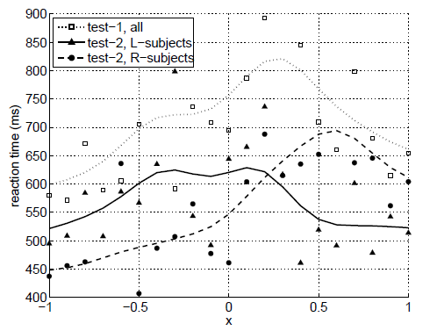
Observations
Closer to decision boundary
indicates longer reaction time
Test 2 overall faster than
test-1
Familiarity with experiments
L-Subject and R-subject reaction
Time supports decision boundary
shift

Slide 17
Semi-Supervised Model
Explain human experiment by following two-component Gaussian Mixture Model
Parameter, θ
Priors for parameter θ

Slide 18

Semi-Supervised Model
Expectation Maximization (EM) algorithm
Maximize following objective

Slide 19
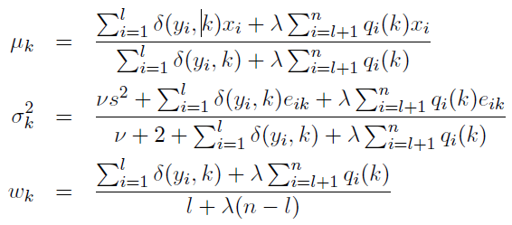
Semi-Supervised Model
E-step:
M-step:

Slide 20

Semi-Supervised Model
EM finds θ
Predictions through Bayes Rule

Slide 21
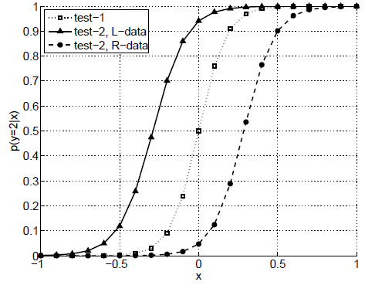
Results
GMM fit with EM on block 1, 2 data
GMM fit with EM on block 1-6
data for L-Subjects
GMM fit with EM on block 1- 2
data for R-Subjects
The model predicts decision boundary shift

Slide 22
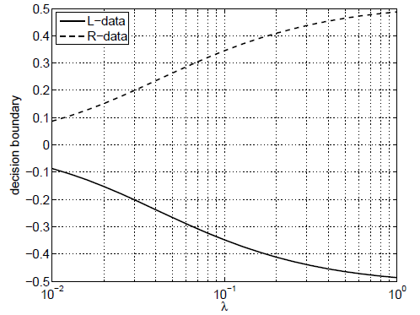
Results
λ controls decision boundary shift
λ→ 0
effect of unlabeled block diminishes
Observed distance of 0.58 in
Human supervised learning
at λ = 0.06
People treat unlabeled examples
less importantly than labeled examples

Slide 23

Results
Reaction time = RT1 + RT2
RT1 = base reaction time
Decreases with experience
For test 1 , RT1 = b1
For test 2, RT1 = b2
b2 < b1
RT2: based on difficulty
of example
P(y|x) ∼ 0 or 1, X easy
P(y|x) ∼ 0.5, x difficult
RT2= Entropy of the prediction, h(x)

Slide 24
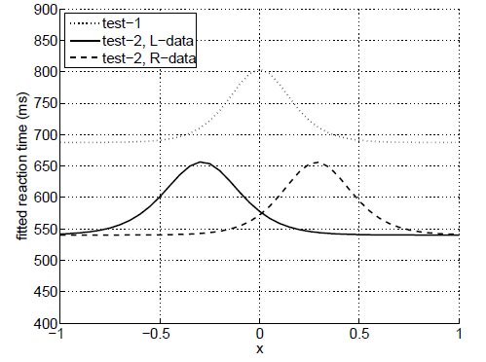
Results
Reaction time model:
Where,
Value of a and b found
with least squares from
human experiment
data

Slide 25
Discussions
Decision curve noticeably flatter than prediction curve
Not due to averaging the decision across the subjects
Decision curve flatter for each subject too
Differences in memory of human and machine
Machine uses all past examples
while Human memory might degrade

Slide 26
Discussions
Co-training, S3VM and other techniques in humans should be explored
Small number of Participants
Needs to explore when the assumption of coherent group is wrong
Does order of unlabeled stimuli affect?
Exploring using multiple dimensions of features
Conflicting Results (VDR Study)
Complex settings
Too many labeled data

Slide 27
Discussions
What is the optimal number of unlabeled data needed to reflect human learning
Control Group
Null Hypothesis
How study of human learning improves Machine Learning Research?

