Slide 1
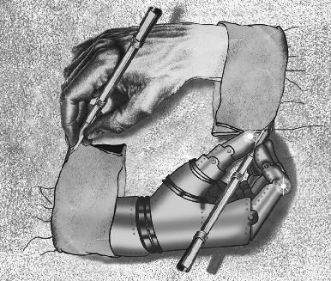
Time Series Analysis
School of Electrical Engineering
and Computer Science
Topics in Machine Learning
Fall 2011

Slide 2
Time Series Discussions
Overview
Basic definitions
Time domain
Forecasting
Frequency domain
State space
Notes:
There are three main perspectives here: time domain, frequency domain, state space
Time series data is processed to represent it, to model it, to understand it, and to use it to replace missing values or forecast future values.
Here we will focus on the modeling and interpretation, Yujue will take over with forecasting next Thursday

Slide 3
Why Time Series Analysis?
Sometimes the concept we want to learn is the relationship between points in time
Notes:
Time series does not fit as much under ML as is does under general AI, pattern recognition, and signal processing.
Then why include it here? Because time is a huge component in many real-world problems and data sets.
Be aware of the issues and known techniques, then you can use them in your ML techniques and design new ML strategies for processing this data.

Slide 4
What is a time series?
Time series: a sequence of measurements over time
A sequence of random variables
x₁, x₂, x₃, …
Notes:
Subscript t is time period
For our discussions t is discrete time period, Assume time periods are of equal length
There are techniques to handle continuous time intervals, but we will restrict our discussions to discrete
When you consider data collections, the collection method usually results in discrete sampled data timesteps
We will also focus on univariate distributions for the most part (only one variable), can be extended to the multivariate case

Slide 5

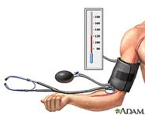
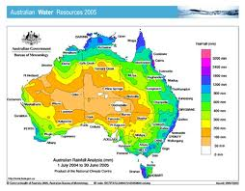
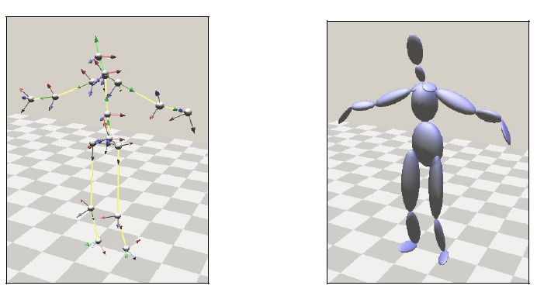
Time Series Examples
Definition: A sequence of measurements over time
Finance
Social science
Epidemiology
Medicine
Meterology
Speech
Geophysics
Seismology
Robotics
Notes:
Finance: stock market data such as the NYSE (New York Stock Exchange) market closing values, business data such as sales figures in successive weeks or months
Social science: follow birth rates, school enrollments in particular regions
Epidemiologist: #flu cases for time period (combine with text mining – in fact, text mining used for stock market analysis and forecasting as well, good way to combine ML methods)
Medicine: blood pressure measurements over time to evaluate drugs for hypertension
Meterology: global warming indicated by global temperature measurements?
Speech modeling: Transmission of voice recordings; time series characteristics used to recognize and translate speech
Geophysics: deposits over time provide long-range approximations of temperature and rainfall
Seismology: Recordings aid in mapping fault lines, distinguishing between earthquakes and nuclear explosions
Robotics: Motion capture and analysis, gesture recognition

Slide 6
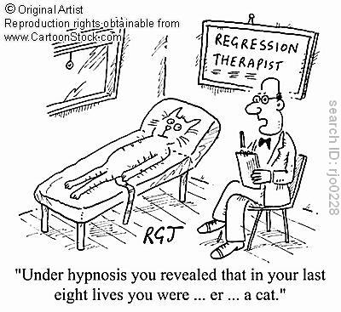
Three Approaches
Time domain approach
  Analyze dependence of current value on past values
Frequency domain approach
  Analyze periodic sinusoidal variation
State space models
  Represent state as collection of variable values
  Model transition between states
Notes:
Regress means to go backward, in time series we regress a data point to another data point that occurred earlier in time
Sinusoidal means follows a sine wave

Slide 7
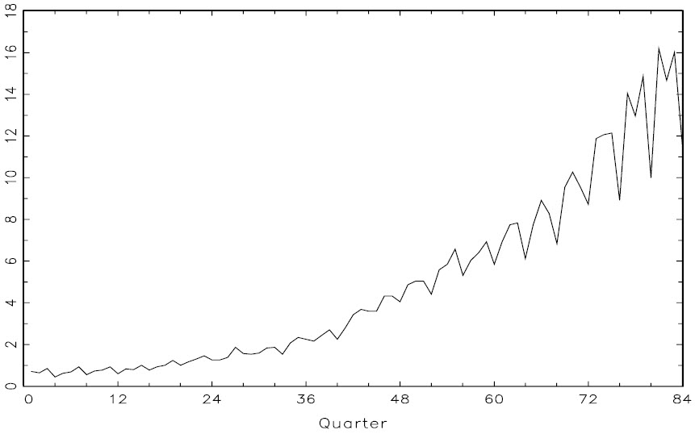
Sample Time Series Data
Johnson & Johnson quarterly earnings/share, 1960-1980
Notes:
What do you notice? No wrong answers.
Primary patterns: gradually increasing underlying trend
Regular variation superimposed on trend that repeats over quarters
Later
J&J picture, frequency of oscillation is one cycle per year (4 quarters), or .25 cycles per observation

Slide 8
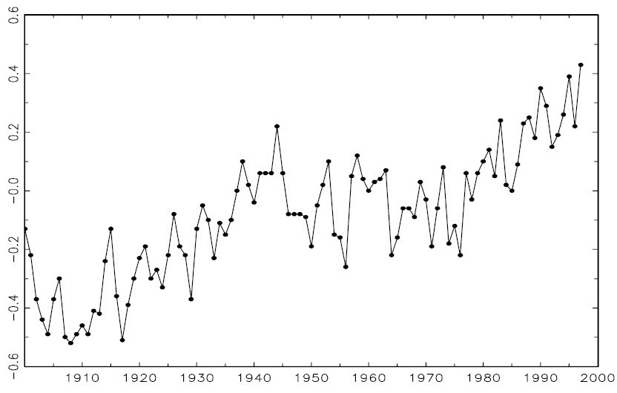
Sample Time Series Data
Yearly average global temperature deviations
Notes:
Deviations in degrees centigrade, 1900-1997
These values could be used to look at the question of global warming
The question is, is the trend natural or caused by human-induced changes
Examine 638 years of glacial sediment data for long-term temperature proxy, these % changes in temperature are not unusual over period of 100 years
More interested in trend than particular periodicities
***Need long enough time span***

Slide 9
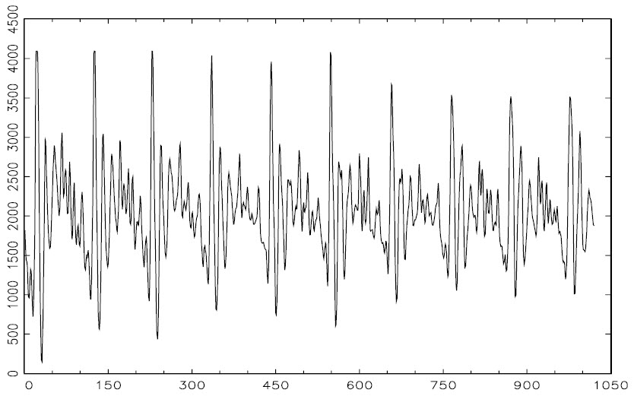
Sample Time Series Data
Speech recording of “aaa…hhh”, 10k pps
Notes:
10,000 points per second, 1 second total time
What do you note?
Signal is repetitive, regular periodicities
Spectral analysis can produce a signature of signal, compare with library entries to find match and recognize sound
Separation between wavelets is pitch period, here pulses caused by opening and closing of glottis
Glottis is combination of vocal cords and space between the cords

Slide 10
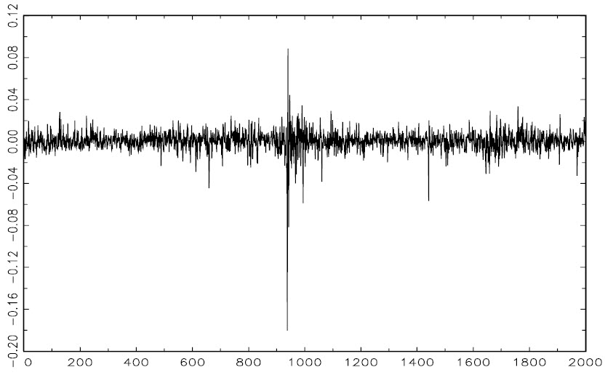
Sample Time Series Data
NYSE daily weighted market returns
Notes:
2/2/84 – 12/31/91
What do you notice?
Mean is stable, Areas of volatility
Crash of October 19, 1987
Data shows volatility cluster, highly volatile times cluster together in time
Goal could be to forecast volatility of future returns
Stochastic volatility models, ARCH, GARCH

Slide 11
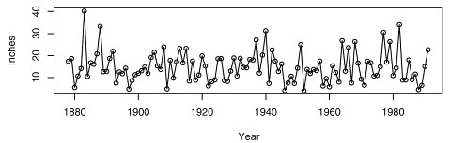
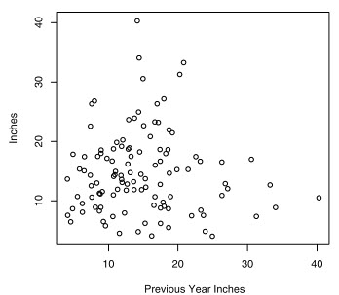
Not all time data will exhibit strong patterns…
LA annual rainfall
Notes:
Much variation, some extremes (1883 very wet, 1983 very dry)
Are consecutive years related? If so, can forecast next year’s rain from this year’s rain
Scatterplot shows neighboring years
Little or no relation, no trends, no general tendencies

Slide 12
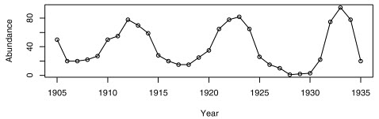
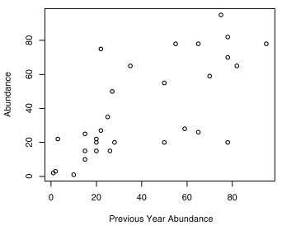
…and others will be apparent
Canadian Hare counts
Notes:
Neighboring values are very related
Upward trend in plot
Quantify relationship with correlation value

Slide 13
Time Series Discussions
Overview
Basic definitions
Time domain
Forecasting
Frequency domain
State space

Slide 14
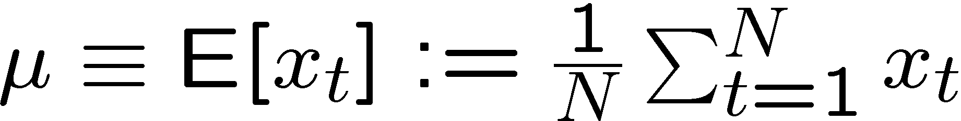
Definitions
Mean
Variance
variance σ
mean μ
Notes:
Miu
Mean also indicates expected value of a variable
What we usually think of as average
Average in general means the middle, usual, common value
Mean is green line in middle
sigma
Variance is span indicated by red lines

Slide 15
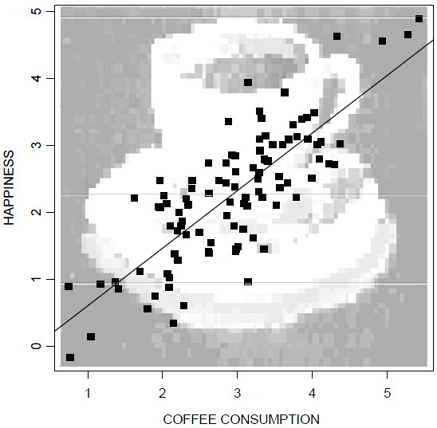
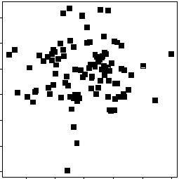
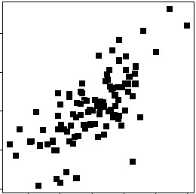
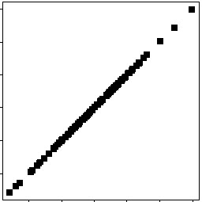
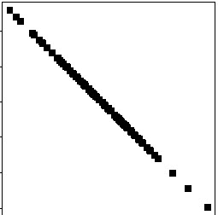
Definitions
Covariance
Correlation
r=0.7
r=1.0
r=-1.0
r=0.0
Notes:
We indicated that time series is relevant for ML because we want to learn the relationship between time-varying data points
These values allow us to quantify the relationship between variables
Covariance is an indication that two variables are associated with each other
Measure of how much they change together
Question: Which variable will any x covary most strongly with?
A variable will covary with itself most strongly
In fact, covariance of a variable with itself is an alternative definition of variance
NOTE: Size of covariance depends on variability of variables (large variability, maximize covariance is large; small variability, maximum covariance is small)
We can divide covariance by product of the standard deviation of the valuables to evaluate the magnitude of the covariance
This results in the definition of correlation
Note that r is a common notation for correlation, this is a quantitative index of association between two variables
Ignore: It is the average of the products of the z scores (z scores are the cumulated differences between points and the mean)
The denominator is the product of the standard deviations
This is also called the Pearson product-moment correlation coefficient
If r positive there is a positive correlation; if negative, negative correlation or anticorrelation; if 0, no correlation
Indicates degree of linear dependence between the variables

Slide 16
Definitions
Covariance
Correlation
Notes:
Covariance is an indication that two variables are associated with each other
Measure of how much they change together
NOTE: Size of covariance depends on variability of variables (large variability, maximize covariance is large; small variability, maximum covariance is small)
Question: Which variable will any x covary most strongly with?
A variable will covary with itself most strongly
In fact, covariance of a variable with itself is an alternative definition of variance
We can divide covariance by product of the standard deviation of the valuables to evaluate the magnitude of the covariance
This results in the definition of correlation

Slide 17
Correlation
Y
Y
Y
X
X
X
r = +1
r = +.3
r = 0
Y
Y
Y
X
X
X
r = -1
r = -.6
r = 0
Notes:
Note that r is a common notation for correlation, this is a quantitative index of association between two variables, it is average of products of the z scores (z scores are the cumulated differences between points and the mean)
The denominator is the product of the standard deviations
This is also called the Pearson product-moment correlation coefficient
If r positive positive correlation; if negative, negative correlation or anticorrelation; if 0, no correlation
In third example, Y stays constant regardless of the value of X
In sixth example, Y’s value varies but seems independent of the value of X
Indicates degree of linear dependence between the variables

Slide 18
Redefined for Time
Mean function
Ergodic?
Autocovariance
lag
Autocorrelation
Notes:
When “mean function” is used in time series analysis it refers to the mean value for a particular time value
If the mean computed over time t is the same as the ensemble mean (all points in distribution) then ergodic
Ergodic means every sequence or sample is equally representative of the whole
This means system has same behavior averaged over time as averaged over space (universe)
So covariance and correlation expressed relationship between variables, but we are interested in the relationship between a single variable’s values at different points in time
Gamma
Lag is time offset being examined for covariance or correlation
Might find a relationship between time the Holders eat supper on Tuesdays (basketball days for Ryan), h = 7 days
Relationship between 1st quarter earners each year, h = 4 quarters
Rho (row)
Autocorrelation can be higher order, expressed as a function of the previous 1, 2, 3, .. time points
Tests such as Durbin-Watson provided measures of significance of autocorrelation

Slide 19
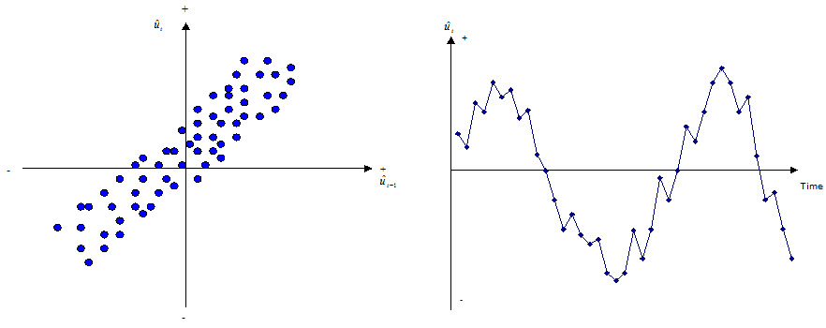
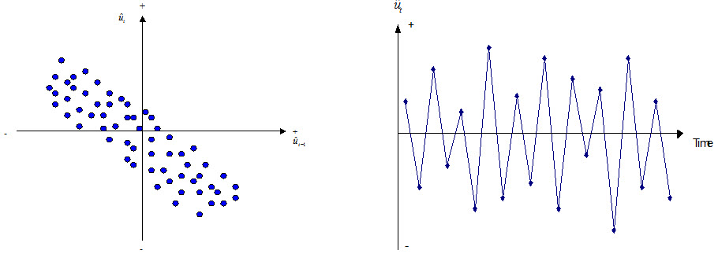
Autocorrelation Examples
lag
Positive
lag
Negative

Slide 20
Stationarity – When there is no relationship
{X_{t}} is stationary if
  μ_{X}(t) is independent of t
  γ_{X}(t+h,t) is independent of t for each h
In other words, properties of each section are the same
Special case: white noise
Notes:
Stationary if no systematic change in mean, in variance, and if there are no periodic variations
Does not change statistical properties with time
Properties of one section of the data are much like those of any other section
gamma is covariance
Ergodic process, can sample process at one instant and it will be the same at every other time
White noise: {X_t} sequence of uncorrelated random variables, each with zero mean and variance
X_t is stationary and also known as white noise

Slide 21
Time Series Discussions
Overview
Basic definitions
Time domain
Forecasting
Frequency domain
State space

Slide 22
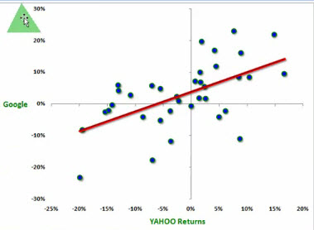
Linear Regression
Fit a line to the data
Ordinary least squares
  Minimize sum of squared
  distances between points
  and line
Try this out at http://hspm.sph.sc.edu/courses/J716/demos/LeastSquares/LeastSquaresDemo.html
y = βx + ε
Notes:
Which type of learning algorithm computes this function for us? Neural network. In particular, a perceptron.
Remember, it learns function w1x1+w2x2+…+wnxn + wt > 0. Different method, uses gradiant descent, has some immunity to noise
Often see this as y = ax + b, a is slope, b is y intercept
Residual for its point is vertical distance between data point and line (hyperplane)
OLS
Compute sum of square residuals
To get parameters that minimize RSS (residual sum of squares), compute partial derivative for each parameter and equate it with 0
Our parameters are a and b, compute ∂(RSS)/∂ (a) = 0

Slide 23
R²: Evaluating Goodness of Fit
Least squares minimizes
the combined residual
Explained sum of squares
is difference between line
and mean
Total sum of squares is the total of these two
y = βx + ε
Notes:
Y^hat = point on regression line, Y_i is individual data point
RSS is residual sum of squares
ESS is difference between line and mean (difference explained by time-varying function which is modeled by line)
TSS also called decomposition of variance
TSS is also measured as squared difference between points and mean
Visualization of TSS on next slide

Slide 24
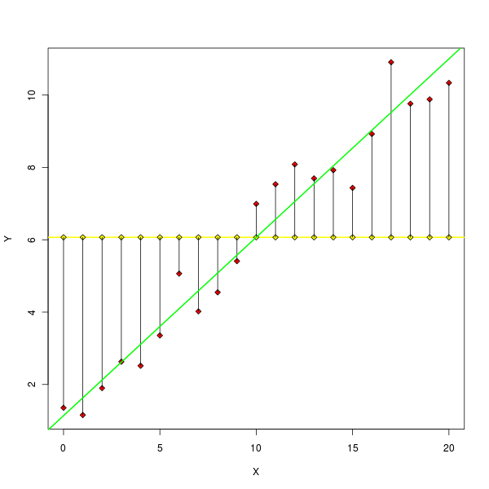
R²: Evaluating Goodness of Fit
R², the coefficient
of determination
0 ≤ R² ≤ 1
Regression minimizes RSS and so
maximizes R²
y = βx + ε
Notes:
R2 describes what percentage of total variability is described by the model in question
Since OLS minimizes RSS, OLS provides the largest possible R2 (among linear models), maximizing at 1

Slide 25
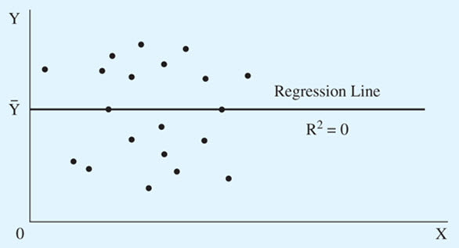
R²: Evaluating Goodness of Fit
Notes:
X and Y not related
Since TSS = RSS + ESS, when all of the error is due to difference between line and points, not between points and mean, R2 will be 0

Slide 26
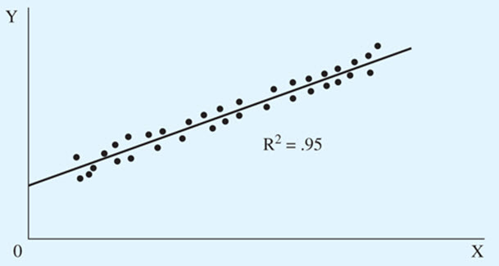
R²: Evaluating Goodness of Fit
Notes:
In this picture all of the variability is due to difference between points between line and mean (the fact that points vary with time and do not stay at mean)
Very little difference between points and line

Slide 27
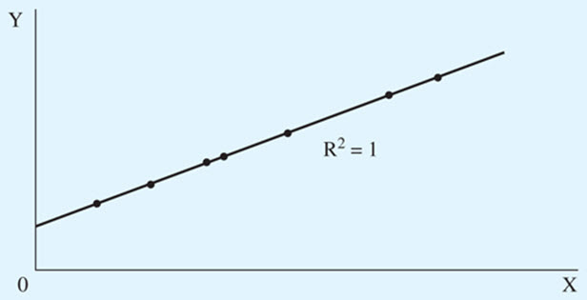
R²: Evaluating Goodness of Fit
Notes:
In this picture all variance due to difference between points and mean
No difference between points and line

Slide 28
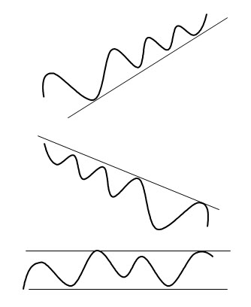
Linear Regression
Can report:
  Direction of trend (>0, <0, 0)
  Steepness of trend (slope)
  Goodness of fit to trend (R²)
Notes:
Trend analysis can help to identify improving or deteriorating conditions.
r2 Traditionally used for linear relationships but can be applied to nonlinear fit as well (then referred to as R2)

Slide 29
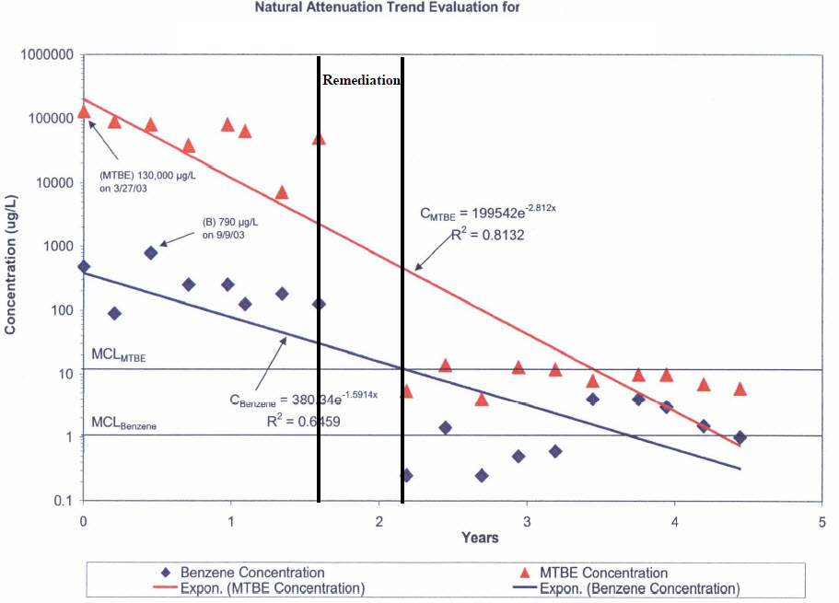
Examples
Notes:
R2 does not tell significance, can use t statistic for this
Here are sample points and linear regressed line with R2 value
Benzene concentrations

Slide 30
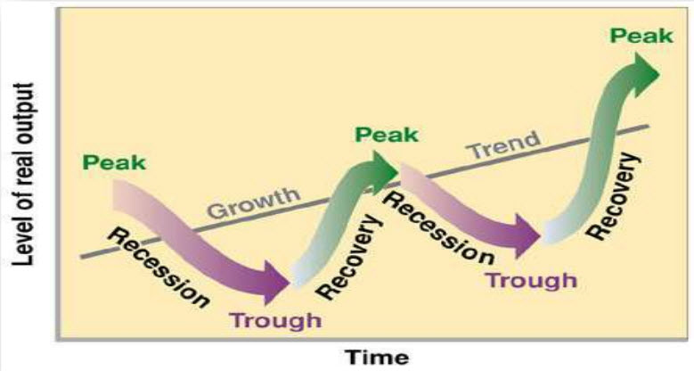
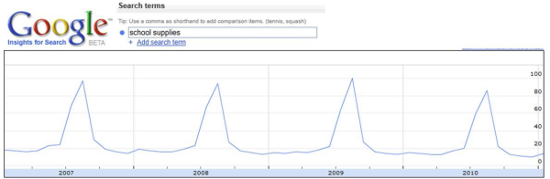
What if a linear trend does not fit my data well?
Could be no relationship
Could be too much local variation
  Want to look at longer-term trend
  Smooth the data
Could have periodic or seasonality effects
  Add seasonal components
Could be a nonlinear relationship
Notes:
Question: Give examples of likely seasonal effects
Sales by quarter, temperature by season, I see electricity by month in Avista data
What is this?
Google query for “school supplies”
For seasonal effects, relies on expert knowledge to segment the data into time frames where data is fairly constant in that time frame
If do not know height in that time frame (amplitude) or width of time frame (frequency), use Fourier series described later

Slide 31
Moving Average
Compute an average of the last m consecutive data points
4-point moving average is
Smooths white noise
Can apply higher-order MA
Exponential smoothing
Kernel smoothing
Notes:
Exponential smoothing like exponential decay
Kernel smoothing uses weight function, or kernel, to average observations
Weights can be learned

Slide 32
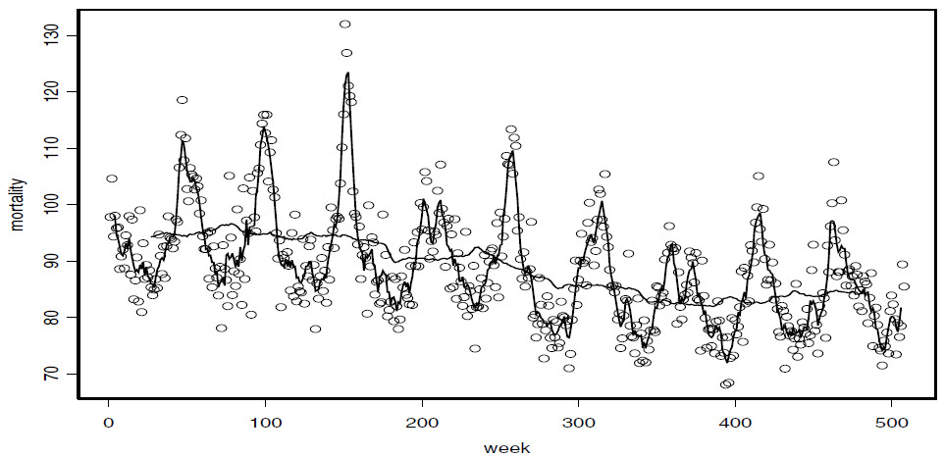
Power Load Data
53 week
5 week
Notes:
Five-week moving average and 53-week moving average

Slide 33
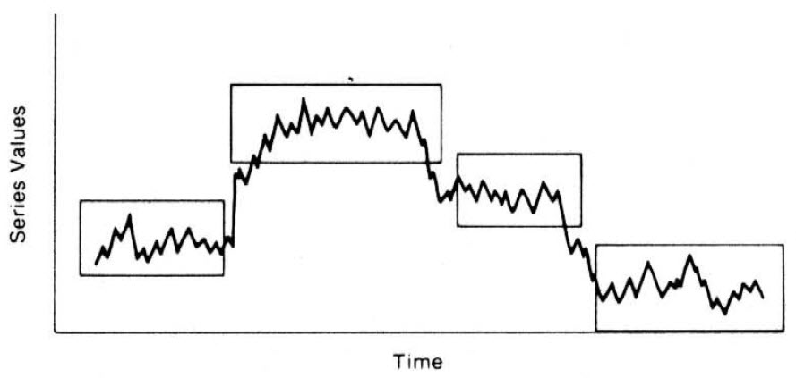
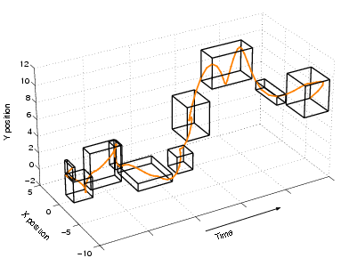
Piecewise Aggregate Approximation
Segment the data into linear pieces
Interesting paper
Notes:
Each segment can be analyzed as a linear function
Use symbolic approximation
Hot Sax: Efficiently finding the most unusual time series subsequence
Good pictures in the paper

Slide 34
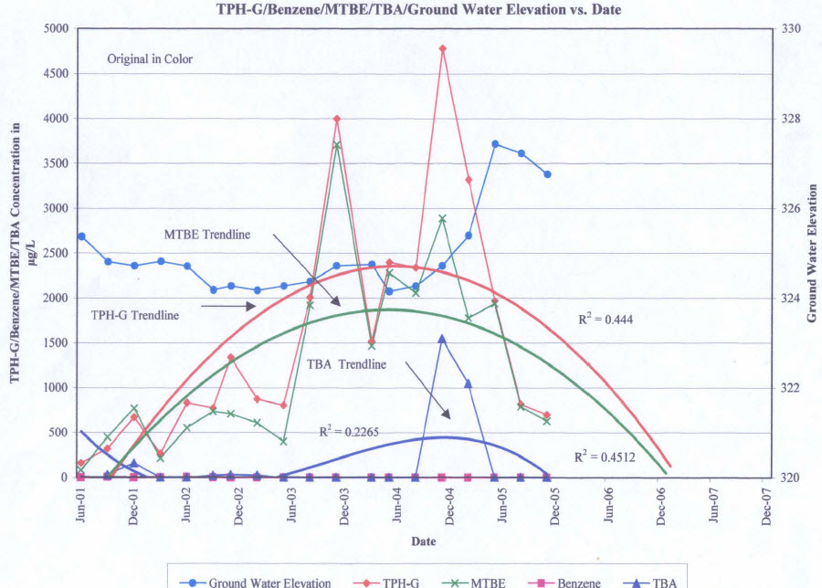
Nonlinear Trend Examples

Slide 35
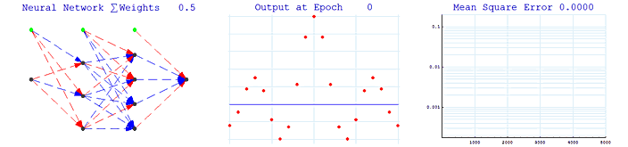
Nonlinear Regression
Notes:
Middle picture shows how model starts out as line and gradually morphs to nonlinear trend and fits points

Slide 36
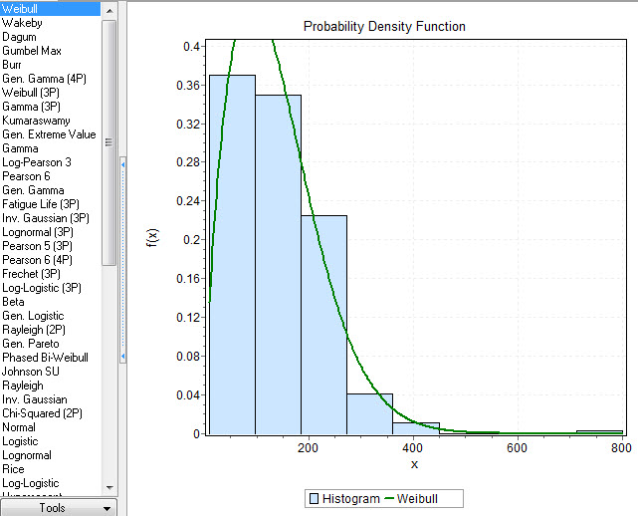
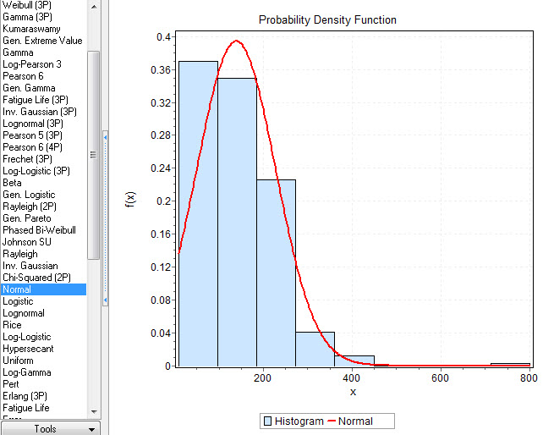
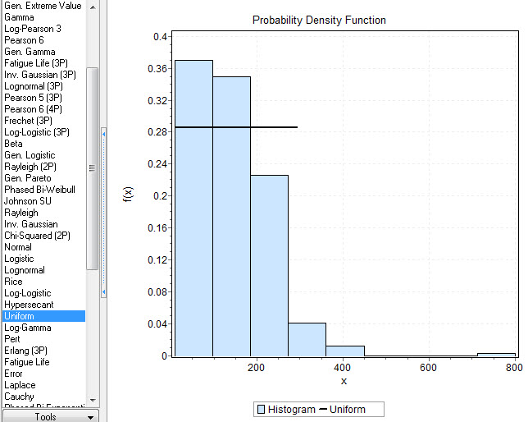
Fit Known Distributions
Notes:
Power data, 346 homes
KS value

Slide 37

ARIMA: Putting the pieces together
Autoregressive model of order p: AR(p)
Moving average model of order q: MA(q)
ARMA(p,q)

Slide 38
ARIMA: Putting the pieces together
Autoregressive model of order p: AR(p)
Moving average model of order q: MA(q)
ARMA(p,q)
Notes:
AR only on this slide
AR based on idea that the current value xt in the series is a function of p past values, x_t-1, x_t-2, .., x_t-p
P determines the number of steps into the past needed to forecast the current value
Phi (fee)
X_t is stationary, phis are non-zero constants, w_t is white noise (assume Gaussian white noise, mean zero)
Formula simple if assume mean of x_t is zero, can add terms if not zero
The formula is similar to the linear regression model, so regression with this formula is called auto regression (or self regression)

Slide 39
AR(1),
Notes:
Departures from the mean can be quite prolonged; strong shocks take considerable time to die out
Phi is 0.9 so each point is heavily dependent upon the previous point (and add Gaussian white noise)
Phi is positive valued so positive changes tend to be followed by another positive change and vice versa

Slide 40
AR(1),

Slide 41
ARIMA: Putting the pieces together
Autoregressive model of order p: AR(p)
Moving average model of order q: MA(q)
ARMA(p,q)
Notes:
There are q lags in the MA and the thetas are parameters
W_t is Gaussian white noise
Theta

Slide 42
ARIMA: Putting the pieces together
Autoregressive model of order p: AR(p)
Moving average model of order q: MA(q)
ARMA(p,q)
  A time series is ARMA(p,q) if it is stationary and
Notes:
There are q lags in the MA and the thetas are parameters
W_t is Gaussian white noise
Theta

Slide 43
ARMA
Start with AR(1) sequence
This means
Which we can solve given roots z_{i}
Notes:
Roots of the equation and initial condition rho(0) are all we need

Slide 44
ARIMA (AutoRegressive Integrated Moving Average)
ARMA only applies to stationary process
Apply differencing to obtain stationarity
  Replace its value by incremental change from last value
A process x_{t} is ARIMA(p,d,q) if
  AR(p)
  MA(q)
  Differenced d times
Also known as Box Jenkins
Differenced | x1 | x2 | x3 | x4
1 time |  | x2-x1’ | x3’-x2’ | x4’-x3’
2 times |  |  | x3’-2x2’+x1’ | x4’-2x3’+x2’
Notes:
If nonstationary then distance past has a much (or more) weight than recent past
Stationary means statistical parameters do not change with time
We can manipulate data to make it stationary
Replace values with differences
Note that x1’ is no longer available for analysis (can keep to integrate back to original data)
2 times, x4 = (x4’-x3’) – (x3’-x2’) = x4’-2x3’+x2’
If the original series has a linear trend, the first difference of the series has a constant mean

Slide 45
Time Series Discussions
Overview
Basic definitions
Time domain
Forecasting
Frequency domain
State space
Notes:
Yujue will talk about forecasting
Predict future values

Slide 46
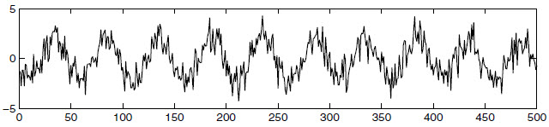
Express Data as Fourier Frequencies
Time domain
  Express present as function of the past
Frequency domain
  Express present as function of oscillations, or sinusoids
Notes:
Express regularity of series in terms of periodic variations of underlying phenomenon that produce the series
Would be very difficult to express with autocorrelation, many parameters
Express as Fourier frequencies driven by sine waves, need fewer parameters

Slide 47
Time Series Definitions
Frequency, ω, measured at cycles per time point
J&J data
  1 cycle each year
  4 data points (time points) each cycle
  0.25 cycles per data point
Period of a time series, T = 1/ω
  J&J, T = 1/.25 = 4
  4 data points per cycle
  Note: Need at least 2
Notes:
Omega
J&J picture, frequency of oscillation is one cycle per year (4 quarters), or .25 cycles per observation
Period is number of time points per cycle
Data that occurs at discrete time points will need at least two points to determine a cycle
Therefore highest frequency of interest is .5 cycles per point
This is the folding frequency, defines highest frequency that can be seen in discrete sampling

Slide 48
Fourier Series
Time series is a mixture of oscillations
  Can describe each by amplitude, frequency and phase
  Can also describe as a sum of amplitudes at all time points
  (or magnitudes at all frequencies)
  If we allow for mixtures of periodic series then
Take a look
Notes:
Want to represent time series by its sinusoids, or oscillations
We can represent each point in polar coordinates as magnitude (distance from origin) and angle (to real positive axis)
Using Euler’s formula we can represent each point in the sinusoid by its Real part (here alpha_i) and imaginary part (here beta_i)
A is amplitude
Phi is phase (shift in sine or cosine wave)
Omega is frequency (number of cycles per point)
The web page allows you to play with A, phi, and omega
Note that sin x gives first x value where the y exists (in this case, x is w_i * t)
Add 2*pi to get second value, 4*pi to get the third value, and so forth
This is the Fourier series representation for a particular time series

Slide 49
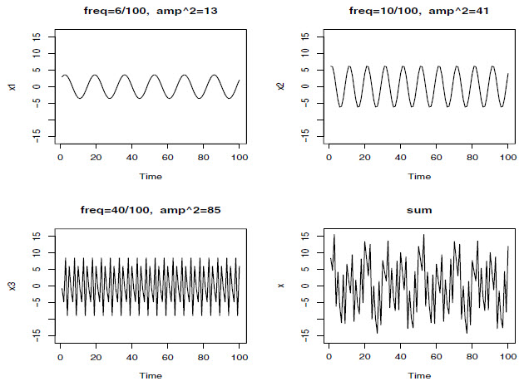
Example
Notes:
If argument to cos and sin is larger, cycle will be faster
Remember frequency is number of cycles per point
If coefficient is larger, then amplitude is greater

Slide 50
How Compute Parameters?
Regression
Discrete Fourier Transform
DFTs represent amplitude and phase of series components
Can use redundancies to speed it up (FFT)
Notes:
If use regression we have n data points and n parameters so the regression fit will be perfect
DFT transforms discrete something (wave, financial data, process) in time domain to a discrete frequency domain representation
Therefore it is possible to form any function f(x) as a sum of sine wave magnitudes with increasing frequency (more detail), follow blue arrow
d(j/n) is the Fourier transform of N discrete samples of the function f(x), which in this case is the time function x_t
In the continuous Fourier transform the summation would be replaced by an integral
The “e” part is cos(p) – i sin(p) with p=2*pi*t*j/n, this is the conversion
DFT is O(n^2), FFT is O(nlogn)
FFT uses the fact that the complex roots of the function form a group so there are redundancies
Intuitively, complex DFT numbers represent the amplitude and phase of the sinusoidal components of the series
We are basically computing the regression of the data on the sinusoids at the fundamental frequencies j/n
Extra
A complex number is a rectangular coordinate but we can write it as polar coordinate in terms of distance from the origin and angle that it makes with positive real exist
r(cos(theta) + i sin(theta)), where r = sqrt(R^2+I^2) and theta=tan^-1(I/R)
Euler’s formula is e^i*theta = cos(theta) + i sin(theta)
To find the period, we compared the time series with sinusoids of many different periods
Therefore, a good “description” (or basis) would consist of all these sinusoids
This is precisely the idea behind the discrete Fourier transform
The coefficients capture the similarity (in terms of amplitude and phase) of the series with sinusoids of different periods

Slide 51
Breaking down a DFT
Amplitude
Phase
Notes:
R is real, I is imaginary

Slide 52
Example
2
GBP
1
1 frequency
0
-1
2
2 frequencies
GBP
1
0
-1
2
3 frequencies
GBP
1
0
-1
2
5 frequencies
GBP
1
0
-1
2
10 frequencies
GBP
1
0
-1
2
20 frequencies
GBP
1
0
-1

Slide 53
Periodogram
Measure of squared correlation between
  Data and
  Sinusoids oscillating at frequency of j/n
  Compute quickly using FFT
Notes:
Sinusoids oscillating at frequency of j/n
This is j cycles in n time points

Slide 54
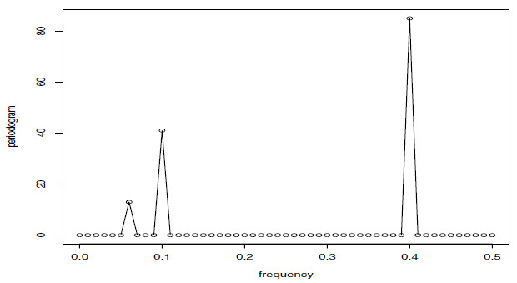
Example
P(6/100) = 13, P(10/100) = 41, P(40/100) = 85
Notes:
Shows various components that make up time series
This suggests that a periodogram can provide insight into the components that make up the time series
If we consider the data xt in the example as a color (waveform) made up
of primary colors xt1, xt2, xt3 at various strengths (amplitudes), then we might
consider the periodogram as a prism that decomposes the color xt into its
primary colors (spectrum). Hence the term spectral analysis.
Another fact that may be of use in understanding the periodogram
Any stationary time series may be thought of, approximately, as the sperposition of sines and cosines oscillating at various frequencies

Slide 55
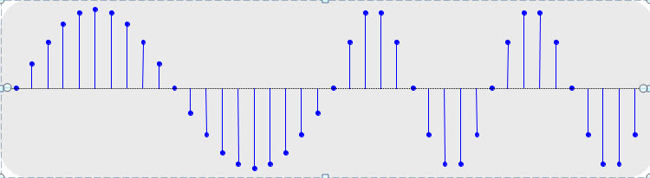
Wavelets
Can break series up into segments
  Called wavelets
  Analyze a window of time separately
  Variable-sized windows
Notes:
We did this earlier with linear series

Slide 56
Time Series Discussions
Overview
Basic definitions
Time domain
Forecasting
Frequency domain
State space

Slide 57
State Space Models
Current situation represented as a state
  Estimate state variables from noisy observations over time
  Estimate transitions between states
Kalman Filters
  Similar to HMMs
    HMM models discrete variables
    Kalman filters models continuous variables
Notes:
Kalman filters estimate state variables from noisy observations at different points in time

Slide 58

Conceptual Overview
x
Lost on a 1-dimensional line
Receive occasional sextant position readings
  Possibly incorrect
Position x(t), Velocity x’(t)

Slide 59
Conceptual Overview
Current location distribution is Gaussian
Transition model is linear Gaussian
The sensor model is linear Gaussian
Sextant Measurement at t_{i}: Mean = μ_{i} and Variance = σ²_{i}
Measured Velocity at t_{i}: Mean = μ’_{i} and Variance = σ’²_{i}
Noisy information
Notes:
Position at time i+delta given previous position and velocity is gaussian distributed
If constant velocity, would be previous position + velocity(delta)
Linear gaussian means linear function of current state plus Gaussian noise

Slide 60
Kalman Filter Algorithm
Start with current location (Gaussian)
Predict next location
  Use current location
  Use transition function (linear Gaussian)
  Result is Gaussian
Get next sensor measurement (Gaussian)
Correct prediction
  Weighted mean of previous prediction and measurement

Slide 61
Conceptual Overview
prediction
Measurement at i
We generate the prediction for time i+Δ, prediction is Gaussian
GPS Measurement: Mean = μ_{i+Δ} and Variance = σ²_{i +Δ}
They do not match
Notes:
Current distribution is Gaussian, transition model is linear Gaussian
Linear Gaussian means linear function of current state plus Gaussian noise

Slide 62
Conceptual Overview
prediction
corrected estimate
measurement at i+Δ
Corrected mean is the new optimal estimate of position
New variance is smaller than either of the previous two variances
Notes:
The new state estimate lies in between the predicted state and the measured state and has a better estimated uncertainty than either alone

Slide 63
Updating Gaussian Distributions
One-step predicted distribution is Gaussian
After new (linear Gaussian) evidence, updated distribution is Gaussian
Transition
Prior
New measurement
Previous step
Notes:
Integral is there because need to sum over all values in the previous Gaussian distribution
If prediction is Gaussian and sensor model P(e_t+1|X_t+1) is linear Gaussian, then after conditioning on the new evidence, the updated distribution is also a Gaussian distribution

Slide 64
Why Is Kalman Great?
The method, that is…
Representation of state-based series with general continuous variables grows without bound
Notes:
Compare with particle filters (as known as sequential Montre Carlo methods)
Particle filters are also like HMMs, also handle continuous variables instead of discrete
Particle filters are not restricted to Gaussian distributions
Gaussians are restricted enough to allow efficient exact inference
Because not restricted, can grow arbitrarily complex
Bound by just working with sample, or population (like a GA)
Given sufficient sample they approach the Bayesian optimal estimate
Not exact

Slide 65
Why Is Time Series Important?
Time is an important component of many processes
Do not ignore time in learning problems
ML can benefit from, and in turn benefit, these techniques
  Dimensionality reduction of series
  Rule discovery
  Cluster series
  Classify series
  Forecast data points
  Anomaly detection

