Slide 1

Slides for Chapter 6:
Indirect Communication
From Coulouris, Dollimore, Kindberg and Blair
Distributed Systems:
Concepts and Design
Edition 5, © Addison-Wesley 2012
Text extensions to slides © David E. Bakken, 2012-2020

Slide 2
Introduction [6.1]
Cambridge researchers:
  “All problems in computer science can be solved by another level of indirection.”
Jim Gray (RIP)
  “There is no performance problem that cannot be solved by eliminating a level of indirection.”
Indirect communication: communication between entities in a DS through an intermediary with no direct coupling between sender and receiver(s).
Lots of variations in
  Intermediary
  Coupling
  Implementation details and tradeoffs therein

Slide 3
Indirect communication (cont.)
Why have decoupled comms? Client-server interaction
  Hard to change server to one with same functionality
  Harder to deal with failure
  …. Other change is expected (what kinds?)
Note: continuum between server “group” and intermediary..
  We look at group communication in Sec 6.2

Slide 4
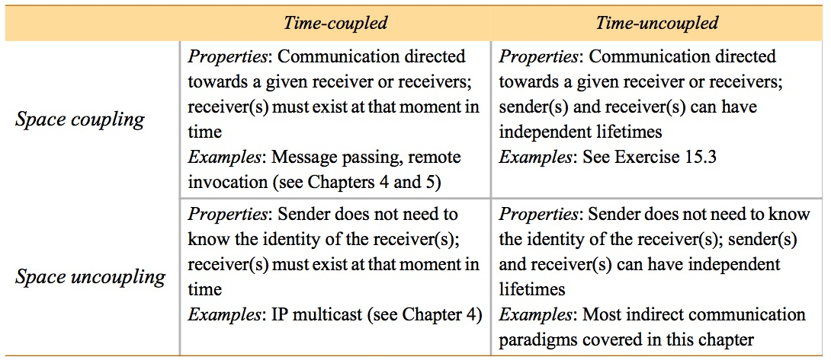
Figure 6.1
Space and time coupling in distributed systems
Q: is time/space uncoupling same as asynchronous invocation?
Instructor’s Guide for Coulouris, Dollimore, Kindberg and Blair, Distributed Systems: Concepts and Design Edn. 5
© Pearson Education 2012

Slide 5
Group communication [6.2]
Group communication: Send messages to a group endpoint
  Delivered to all members (modulo reliability guarantees)
  Sender not aware of identity of receivers
  Ergo, (thin) abstraction layer above IP multicast or an overlay net
Adds a lot of value
  Detecting failures
  Managing group membership (processes in the group)
  Reliability guarantees
  Ordering guarantees

Slide 6
Group communication (cont.)
Very useful building block for DSs, esp. reliable ones
  Reliable dissemination of info to large # “clients” (esp. finance)
  Collaborative applications: multiple users with common view
  Wide range of fault-tolerance building blocks
    Consistent update of replicated data
    Highly available (replicated) servers
More on group communications next:
  Programming models
  Implementation issues
  Case study: JGroups toolkit [NOT TESTABLE]

Slide 7
Programming model [6.3.1]
Central abstraction: group & associated membership
  Processes join (explicitly) or leave (explicitly or by failure)
  Send single message to the group of N, not N unicast messages
Compare and contrast with IP multicast?
Early work started in the late 1980s, still going strong

Slide 8
Process groups and object groups
Most research on process groups
  Abstraction: resilient process
  Messages delivered to a process endpoint, no higher
  Messages typically unstructured byte arrays, no marshalling etc
  Level of service ≈ socket
Object group: higher level approach
  Collection of objects (same class!) process same invocations
  Replication can be transparent to clients
    Invoke on single object (proxy)
    Requests sent by group communication
    Voting in proxy usually
  Research started in mid 1990s (Electra, Eternal, AQuA)
Process groups still more widely researched & deployed

Slide 9
Other key distinctions in group comm. services
Closed group: only members may multicast to it
  Useful: coordinating among cooperating servers (usually replicas)
Open group: a process outside group may send to it
  Useful: delivering events to interested parties, client request to server replica group
Overlapping groups: entities may belong to >1 group
Non-overlapping groups: 0 or 1 groups for an entity
Synchronous and asynchronous systems
Note: above has HUGE impact on multicast algorithms
  Big reason why lots of research on this!
  …. And that is even without Byzantine failure

Slide 10
Figure 6.2
Open and closed groups
Instructor’s Guide for Coulouris, Dollimore and Kindberg Distributed Systems: Concepts and Design Edn. 4
© Pearson Education 2005

Slide 11
Implementation issues [6.2.2]
Reliable delivery
  Unicast delivery reliability properties (note: not my favorite terms!)
    Delivery integrity: message received same as sent, never delivered twice
    Delivery validity: outgoing message eventually delivered
  Group communication reliability properties build on this
    Delivery integrity: deliver message correctly at most once to group members
              Note: stronger than RPC delivery guarantees!
    Delivery validity: message sent will be eventually delivered (if not all group members fail)
    Agreement/consensus: Delivered to all or none of the group members
              Note: also called atomic delivery

Slide 12
Ordered delivery
Possible strengths of ordering
  FIFO ordering: first-in-first-out from a single sender to the group
  Causal ordering: preserves potential causality, happens before (Chap 14)
  Total ordering: messages delivered in same order to all processes
Perspective (not testable unless later covered…)
  Strong reliability and ordering is expensive: scale limited
  More probabilistic approaches & weaker delivery guarantees researched a lot last decade

Slide 13
Group membership management
Key elements
  Provide interface for group membership changes
  Failure detection
  Notifying members of group membership changes
    Sometimes with strong properties: virtual synchrony
  Performing group address expansion
  Q: what of these does IP multicast perform?

Slide 14
Figure 6.3
The role of group membership management
Group
address
expansion
Group
Leave
send
Multicast
Group membership
communication
Fail
management
Join
Process group
Instructor’s Guide for Coulouris, Dollimore, Kindberg and Blair, Distributed Systems: Concepts and Design Edn. 5
© Pearson Education 2012

Slide 15
Case study: JGroups toolkit [NOT TESTABLE]
Java toolkit, based on Cornell/Birman’s research
Architecture
  Channel: most primitive API
  Building blocks: higher-level APIs built on top of channels
  Protocol stack: different underlying comms. protocols

Slide 16
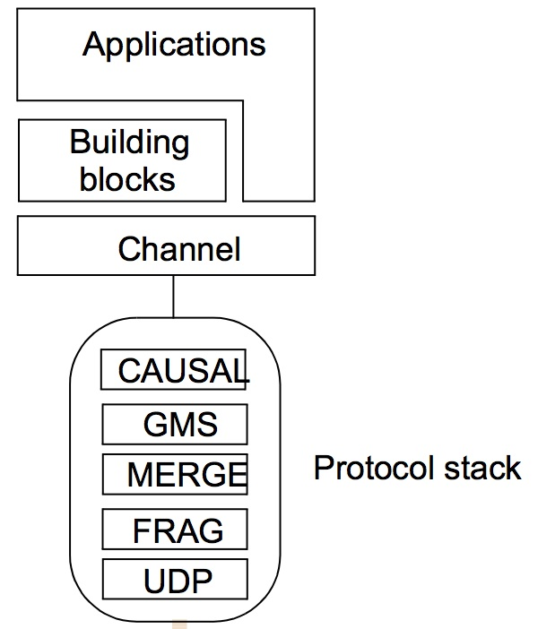
Figure 6.4
The architecture of JGroups
Instructor’s Guide for Coulouris, Dollimore, Kindberg and Blair, Distributed Systems: Concepts and Design Edn. 5
© Pearson Education 2012

Slide 17
JGroups channels
Channel object: handle/reference for a group
  Note: different from channel-based publish-subscribe (6.3.1)
Sends messages with some form of reliable multicast
Basic operations
  connect to a named group
  Leave a group: disconnect operation
  close: shut down channel object
Other operations (admin stuff)
  getView returns current member list
  getState returns app state history

Slide 18
JGroups example
Simple example: intelligent fire alarm sends “Fire!” message to group
To raise the alarm:
  FireAlarmJG alarm = new FireAlarmJG();
  Alarm.raise();
To receive the alarm:
  FireAlarmConsumerJG alarmCall = new FireAlarmConsumerJG();
  String msg = alarmCall.await();
  System.out.println(“Alarm received: “ + msg);

Slide 19
Figure 6.5
Java class FireAlarmJG
=====================================
import org.jgroups.JChannel;
public class FireAlarmJG {
public void raise() { // raise alarm, i.e. send “Fire!” message
  try {
    JChannel channel = new JChannel();
    channel.connect("AlarmChannel"); // can create group
    Message msg = new Message(null, null, "Fire!"); channel.send(msg);
  }
  catch(Exception e) {
}
}
Instructor’s Guide for Coulouris, Dollimore, Kindberg and Blair, Distributed Systems: Concepts and Design Edn. 5
© Pearson Education 2012

Slide 20
Figure 6.6
Java class FireAlarmConsumerJG
import org.jgroups.JChannel;
      public class FireAlarmConsumerJG {
        public String await() {
try {
JChannel channel = new JChannel();
channel.connect("AlarmChannel");
Message msg = (Message) channel.receive(0);
return (String) msg.GetObject();
} catch(Exception e) {
return null;
}
}
}
Instructor’s Guide for Coulouris, Dollimore, Kindberg and Blair, Distributed Systems: Concepts and Design Edn. 5
© Pearson Education 2012

Slide 21
JGroups building blocks & protocol stack
Building blocks examples
  MessageDispatcher: sends msg, waits for (some) replies
  RpcDispatcher: invokes a method on all objects, wait for replies
  NotificationBus: distribited event bus, with any serializable Java object
Protocol stack (some, from Fig 6.4):
  UDP: obvious, but uses IP multicast with UDP
  FRAG: message fragmentation and reassembly
  MERGE: deals with network partitioning (multiple versions)
  GMS: group membership
  CAUSAL: causal ordering
  (lots of other protocols available: FIFO, total, discover, failure detection, encryption, flow-control, … & layers stack in any order)

Slide 22
Public-subscribe systems [6.3]
Pub-sub AKA distributed event systems
  Most widely used from this chapter
  Publishers publish structured events to event service (ES)
  Subscribers express interest in particular events
  ES matches published events to subscriptions
Applications (lots…)
  Financial info systems
  Other live feeds of real-time data (including RSS)
  Cooperative working (events of shared interest)
  Ubiquitous computing (location events, .... from infrastructure)
  Lots of monitoring applications, including internet net. mon.
  Key part of Google infrastructure (chap 21)

Slide 23
Example: dealing room system
Example: dealing room for stock trading
  Let users see latest market prices of stock they care about
  Info for a given stock arrives from multiple sources
  Dealers only care about stocks they own (or might)
  May only care to know above some threshold, in addition
Possible structure: two (kinds of) tasks
  Info provider process receives updates (events) from a single external source
  Dealer process creates subscription for each stock its user(s) express interest in

Slide 24
Figure 6.7
Dealing room system
Dealer’s computer
External
Dealer’s computer
source
Dealer
Notification
Notification
Dealer
Notification
Information
provider
Notification
Notification
Notification
Notification
Dealer’s computer
Dealer’s computer
Notification
Information
provider
Notification
Dealer
Notification
Dealer
External
source
Instructor’s Guide for Coulouris, Dollimore and Kindberg Distributed Systems: Concepts and Design Edn. 4
© Pearson Education 2005

Slide 25
Characteristics of pub-sub systems
Heterogeneity
  Able to glue together systems not designed to work together, with pub-sub technology
  Have to come up with an external description of what can be subscribed to: simple flat, rich taxonomy, etc
Asynchrony
  Decoupling means you never have to block!
Possible delivery guarantees
  All subscribers receive all events (atomicity)
  Real-time
  …

Slide 26
Pub-sub programming model
Publishers
  Disseminate event e through publish(e)
  (Sometimes, fancier) register/advertise via a filter (pattern over all events) f : advertise (f)
  Expressiveness of pattern is the subscription model (later slide)
  Can also remove the offer to publish: unadvertise (f)
Subscribers
  Subscribe via a filter (pattern) f: subscribe(f)
  Receive event e matching f: notify(f)
  Cancel their subscription: unsubscribe(f)

Slide 27
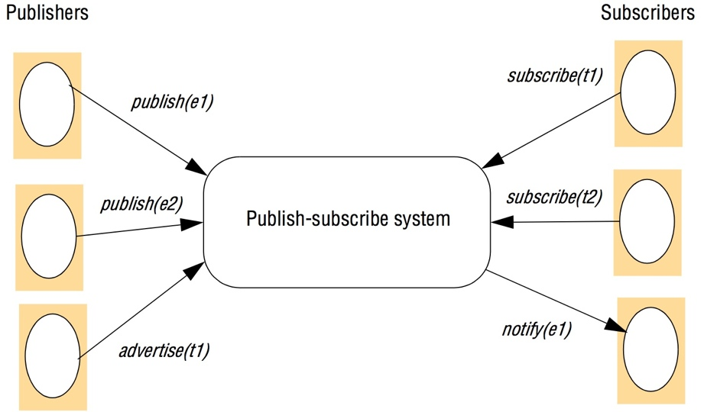
Figure 6.8
The publish-subscribe paradigm
Instructor’s Guide for Coulouris, Dollimore and Kindberg Distributed Systems: Concepts and Design Edn. 4
© Pearson Education 2005

Slide 28
Subscription models of pub-sub systems
Channel-based
  Publishers publish to named channels
  Subscribers get ALL events from channel
  Very simplistic, no filtering (all other models below do)
  CORBA Event Services uses this (DDS precursor)
Topic-based (AKA subject-based)
  Each notification expressed in multiple fields, one being topic
  Subscriptions choose topics
  Hierarchical topics can help (e.g., old USENET rec.sports.cricket)

Slide 29
Subscription models of pub-sub systems (cont.)
Content-based
  Generalization of topic based
  Subscription is expression over range of fields (constraints on values)
  Far more expressive than channel-based or topic-based
Type-based
  Use object-based approaches with object types
  Subscriptions defined in terms of types of events
  Matching in terms of types or subtypes of filter
  Ranges from coarse grained (type names) to fine grained (attributes and methods of object)
  Advantage: clean integration with object-based programming languages

Slide 30
Subscription models of pub-sub systems (cont.)
Other kinds
Objects of interest: like type-based, but on change in state of object
For mobile: also match based on context
Concept-based subscriptions: not just syntax, but semantics of events.
Fancier (e.g., financial trading): complex event processing (CEP)
  Patterns between different events, locations, time, ..
  I.e. patterns can be logical, temporal, or spatial
  For more, see ACM’s Distributed Event-Based Systems (DEBS) conference

Slide 31
Implementation issues [6.2.3]
Many ways to delivery events efficiently to subscribers
Also can be requirements for security, scalability, failure handling, concurrency, QoS
A number of key implementation choices follow..

Slide 32
Centralized vs. distributed implementations
Simple way: single centralized broker node
Q: Limitations?
Most implementations are network of brokers (Fig 6.9)
  E.g., GridStat
Some implementations are peer-to-peer (P2P)
  All publisher and subscriber nodes act as the pub-sub broker
  E.g., RTI DDS
Q: Plusses and minuses of network of brokers vs. P2P?

Slide 33
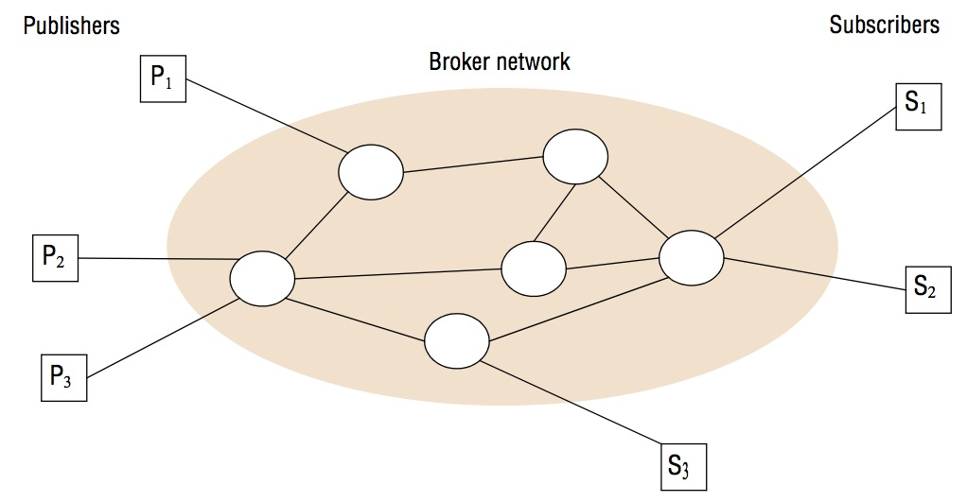
Figure 6.9
A network of brokers
Instructor’s Guide for Coulouris, Dollimore and Kindberg Distributed Systems: Concepts and Design Edn. 4
© Pearson Education 2005

Slide 34
Overall systems architecture
Centralized schemes simple…
Implementing channel-based or topic-based simple
  Map channels/topics onto groups
  Use the group’s multicast (possibly reliable, ordered, ..)
Implementation of content/type/ more complicated
  Ranges of choices follow in fig 6.10

Slide 35
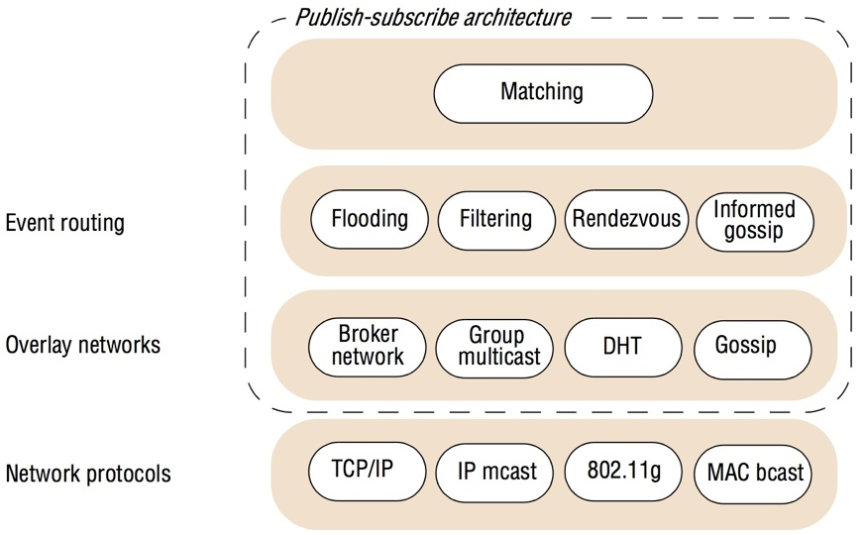
Figure 6.10
The architecture of publish-subscribe systems
Instructor’s Guide for Coulouris, Dollimore and Kindberg Distributed Systems: Concepts and Design Edn. 4
© Pearson Education 2005

Slide 36
Implementation choices in content-based routing (CBR)
Flooding (with duplicate suppression)
  Simplest version
    Send event to all nodes on a network
    Can use underlying multicast/broadcast
  More complicated
    Brokers arranged in acyclic forwarding graph
    Each node forwards to all its neighbors (except one that sent it to node)
Filtering (filter-based routing)
  Only forward where path to valid subscriber
  I.e., subscription info propagated through network towards publ’s
  Detail:
    Each node maintain neighbors list
    For each neighbor, maintain subscription list/criteria
    Routing table with list of neighbors and subscribers downstream

Slide 37
Figure 6.11
Filtering-based routing
upon receive publish(event e) from node x 1
matchlist := match(e, subscriptions) 2
  send notify(e) to matchlist; 3
    fwdlist := match(e, routing); 4
      send publish(e) to fwdlist - x; 5
upon receive subscribe(subscription s) from node x 6
if x is client then 7
  add x to subscriptions; 8
    else add(x, s) to routing; 9
      send subscribe(s) to neighbours - x; 10
Instructor’s Guide for Coulouris, Dollimore and Kindberg Distributed Systems: Concepts and Design Edn. 4
© Pearson Education 2005

Slide 38
Implementation choices in CBR (cont.)
Advertisements
  propagate advertisements towards subs’ (symmetrical to filtering)
Rendezvous (Fig 6.12)
  Consider set of possible events as an event space
  Partition event space among brokers in net. (rendezvous nodes)
  SN(s): for given subscrip. s, returns set of nodes responsible for it
  EN(e): for event e, rtn list of nodes that match e against subscriptions
  Mapping intersection rule: SN(s)∩ EN(e) must be nonempty if e matches s
  Distributed hash table (DHT) variant: map events and subscriptions onto a rendezvous nodes via DHT (Sec 4.5.1)
Routing can be done via gossiping (epidemic multicast)

Slide 39
Figure 6.12
Rendezvous-based routing
upon receive publish(event e) from node x at node i
rvlist := EN(e);
if i in rvlist then begin
  matchlist :=match(e, subscriptions);
  send notify(e) to matchlist;
end
send publish(e) to rvlist - i;
upon receive subscribe(subscription s) from node x at node i
rvlist := SN(s);
if i in rvlist then
  add s to subscriptions;
else
  send subscribe(s) to rvlist - i;
Instructor’s Guide for Coulouris, Dollimore and Kindberg Distributed Systems: Concepts and Design Edn. 4
© Pearson Education 2005

Slide 40
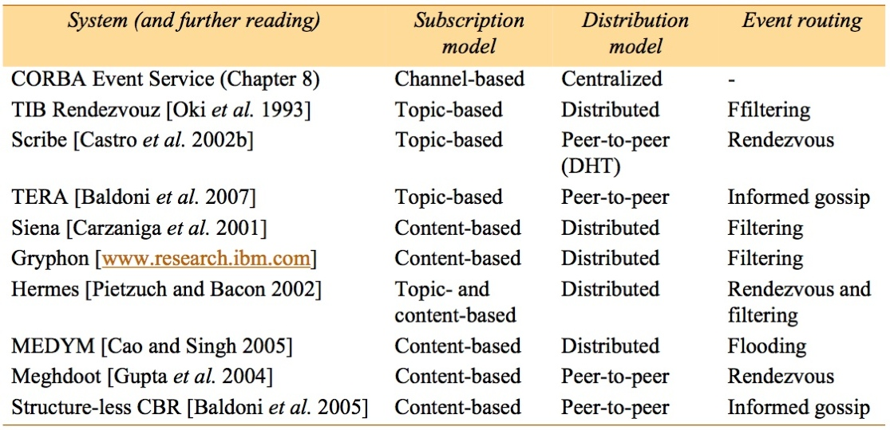
Figure 6.13
Example publish-subscribe system
Instructor’s Guide for Coulouris, Dollimore and Kindberg Distributed Systems: Concepts and Design Edn. 4
© Pearson Education 2005

Slide 41
Message queues [6.4]
(Distributed) message queues: intermediary between producers and consumers of data
  Point-to-Point, not one-to-many
  Supports time and space uncoupling
  AKA Message-Oriented Middleware (MOM)
  LOTS of commercial products
  Main use: Enterprise Application Integration (EAI)
  Also a lot for transactions (6.4.1)
Programming model: producer sends msg; consumers can
  Blocking receive
  Non-blocking receive (polling)
  Notify

Slide 42
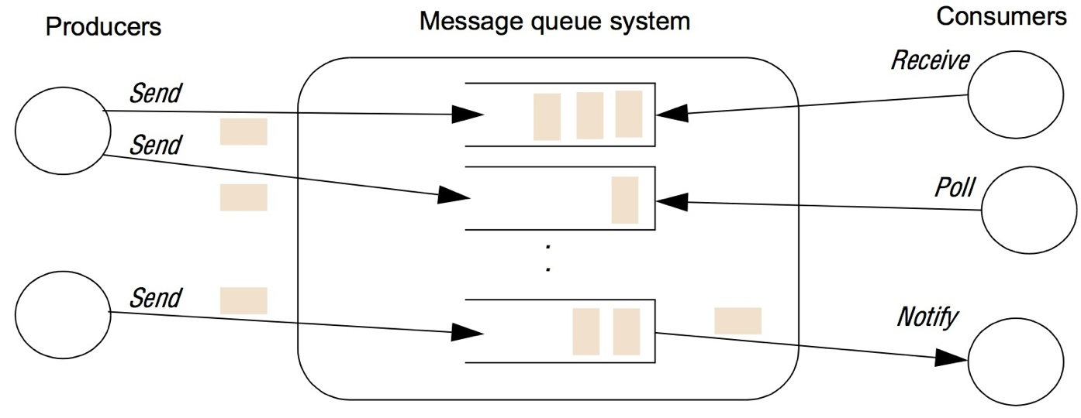
Figure 6.14
The message queue paradigm
Instructor’s Guide for Coulouris, Dollimore and Kindberg Distributed Systems: Concepts and Design Edn. 4
© Pearson Education 2005

Slide 43
Programming model [6.4.1] (cont.)
Many processes can send to a queue, many can remove from it
Queuing policy: usually FIFO, but also priority-based
Consumers can select based on metadata
Database integration common use; e.g. Oracle AQ
  Messages are a row in a (relational) database
  Queues are database tables that can be SQL-queried against

Slide 44
Programming model (cont)
Messages are persistent
  Store until removed
  Store on a disk
Other common functionality
  Transaction support: all-or-none operations
  Automatic message transformation: on arrival, message transforms data from one format to another (data heterogeneity)
  Security (at least confidentiality)
Q: How different from message passing from Chap 4?

Slide 45
Implementation issues [6.3.2]
Key choice: centralized vs. distributed implementation
  Tradeoffs?
Case study: IBM Websphere MQ
  Queue managers host and manage queues, enable apps to access via Message Queue Interface (MQI)
    Connect or disconnect to/from a queue
    Send/receive messages to/from a queue (via a RPC call)
    Clients not on same host (usual case) vi a client channel (w/proxy+stub)

Slide 46
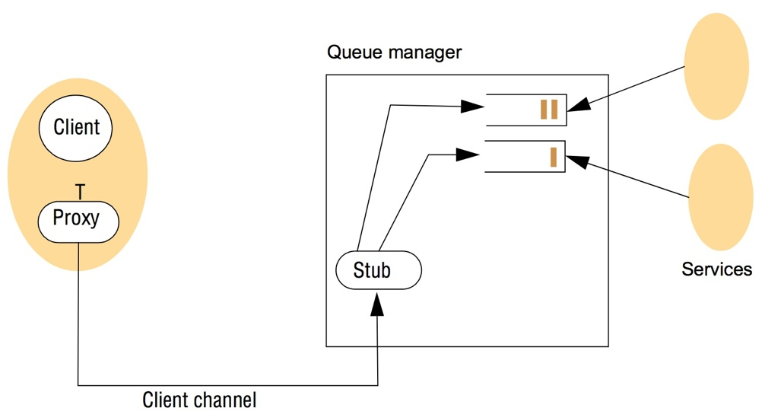
Figure 6.15
A simple networked topology in WebSphere MQ
Instructor’s Guide for Coulouris, Dollimore and Kindberg Distributed Systems: Concepts and Design Edn. 4
© Pearson Education 2005

Slide 47
IBM WebSphere (cont.)
Queues usually linked into a federated structure
  Resembles pub-sub, but choose right topology for app
  Queues linked with message channel(MC)
  Message channel agent (MCA) manages each end of MC
  Queue managers have routing tables
  Lots of tools to create different topologies, manage components, etc
Hub-and-spoke topology (common)
  Hub has lots of services (and resources to support)
  Spoke queues are distant, place close(r) to clients
  Clients interface with spoke queues

Slide 48
Case study: Java Messaging Service (JMS) [6.4.3] [NOT TESTABLE]
JMS supports both pub-sub and MQs
  Many vendors; others provide interface (e.g., WebSphere)
Key roles in JMS
  JMS client: Java app that produces or consumes messages
    JMS producer: creates a message and places in a queue
    JMS consumer: removes a message from a queue and uses it
  JMS provider: any system that implements the JMS spec
  JMS message: object used to communicate between JMS clients
  JMS destination: object supporting indirect communication in JMS
    JMS topic: supports pub-sub
    JMS queue: (um, obvious)

Slide 49
Programming with JMS
First create a connection from client to providor with connection factory
  TopicConnection or QueueConnection
Use connection to create ≥1 session
  Series of ops for creating, producing, consuming msgs for a given logical task
  Also supports transactions
  One session can handle topics OR queues, not both

Slide 50
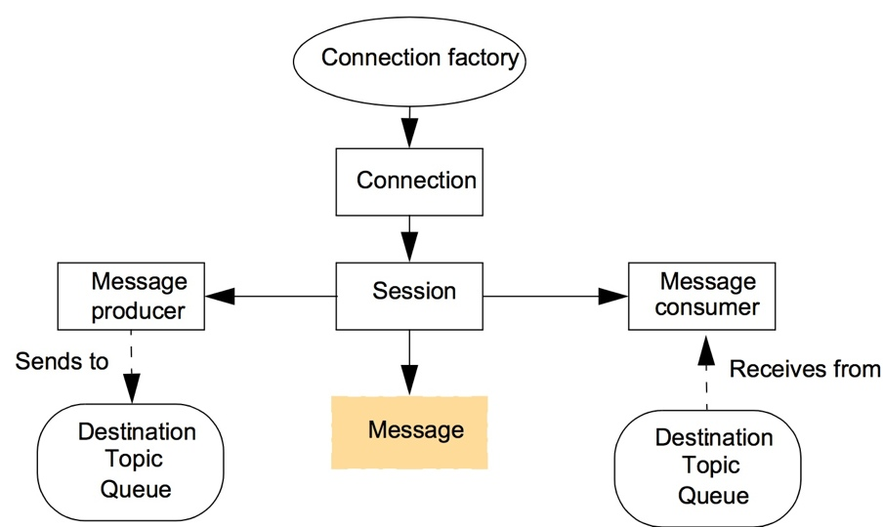
Figure 6.16
The programming model offered by JMS
Instructor’s Guide for Coulouris, Dollimore and Kindberg Distributed Systems: Concepts and Design Edn. 4
© Pearson Education 2005

Slide 51
JMS session objects
Message has 3 parts
  Header: everything needed to identify & route msg
    Destination, priroity, expiration date, message ID, timestamp
  Properties: user-defined meta-data
  Body: opaque data
Message producer: object that publishes messages to a topic or sends to a queue
Message consumer: subscribe to topics or receive from Q
  Can associate filters w/consumer: specify a message selector
    subset of SQL
  Two modes for receiving messages
    Block with receive operation
    Create message listener object with a callback object onMessage

Slide 52
Figure 6.17
Java class FireAlarmJMS
// Usage: alarm.raise()
import javax.jms.*;
import javax.naming.*;
public class FireAlarmJMS { // more complex than Jgroups: create connection, session, publisher, message
// Lines 2-5 find the right connection factory and topic with JNDI (Lines 2-5)
public void raise() {
  try { 1
    Context ctx = new InitialContext(); 2
    TopicConnectionFactory topicFactory = 3
      (TopicConnectionFactory)ctx.lookup ("TopicConnectionFactory"); 4
      Topic topic = (Topic)ctx.lookup("Alarms"); 5
      TopicConnection topicConn = 6
        topicConnectionFactory.createTopicConnection(); 7
      TopicSession topicSess = topicConn.createTopicSession(false, // false means not transactional 8
        Session.AUTO_ACKNOWLEDGE); // session ACKS msg receipt 9
        TopicPublisher topicPub = topicSess.createPublisher(topic); 10;
    TextMessage msg = topicSess.createTextMessage(); 11
    msg.setText("Fire!"); 12
    topicPub.publish(message); 13
} catch (Exception e) { 14
} 15
}
Instructor’s Guide for Coulouris, Dollimore and Kindberg Distributed Systems: Concepts and Design Edn. 4
© Pearson Education 2005

Slide 53
Figure 6.18
Java class FireAlarmConsumerJMS
import javax.jms.*; import javax.naming.*;
public class FireAlarmConsumerJMS // similar to producer!
public String await() {
try { 1
  Context ctx = new InitialContext(); 2
  TopicConnectionFactory topicFactory = 3
    (TopicConnectionFactory)ctx.lookup("TopicConnectionFactory"); 4
        Topic topic = (Topic)ctx.lookup("Alarms"); 5
  TopicConnection topicConn = 6
topicConnectionFactory.createTopicConnection(); 7
TopicSession topicSess = topicConn.createTopicSession(false, 8
Session.AUTO_ACKNOWLEDGE); 9
TopicSubscriber topicSub = topicSess.createSubscriber(topic); 10
topicSub.start(); 11
TextMessage msg = (TextMessage) topicSub.receive(); 12
return msg.getText(); 13
} catch (Exception e) { 14
return null; 15
}16
} // await()
} // FireAlarmConsumerJMS – this missing in book!
Instructor’s Guide for Coulouris, Dollimore and Kindberg Distributed Systems: Concepts and Design Edn. 4
© Pearson Education 2005

Slide 54
Shared memory approaches [6.5]
Abstraction: memory locations then tuple space
Distributed shared memory (DSM) [6.5.1]
  Read and write with API “like” ordinary memory
  Updates propagated by the runtime system of the DSM
  Mostly for parallel apps or if data items can be directly accessed
  Not as appropriate for client-server
  Replicas of data kept & managed (problems: replication, caching)
  Can be very useful in non-uniform access (NUMA) parallel comp’s
  Memory space can be persistent

Slide 55
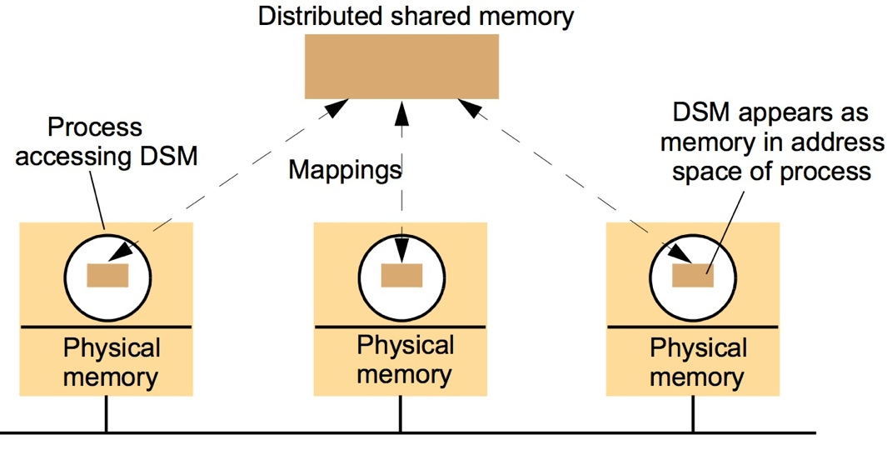
Figure 6.19
The distributed shared memory abstraction
Instructor’s Guide for Coulouris, Dollimore and Kindberg Distributed Systems: Concepts and Design Edn. 3
© Addison-Wesley Publishers 2000

Slide 56
Message passing (MP) compared to DSM
Both are lower-level than client-server or pub-sub
Service offered
  MP:
    variables have to be marshalled by apps
    Producers and consumers protected from each other (no shared memory)
  DSM:
    No marshalling (implications?)
    Supports pointers
    No app-level synchronization: DSM runtime takes care of
    Persistent DSM supports temporal decoupling
Efficiency
  DSM peformance varies widely, including access patterns
  DSM can hide the fact that something is remote (good or bad?)

Slide 57
Tuple space communication [6.5.2]
A tuple is an ordered list of type values
Tuple space is an (unordered) bag of tuple
Can withdraw based on a specified value (or any value)
Primitives added
  out(“Subtask”, velocity, i, j, k)
  in(“subtask”, ?myVelocity, ?row, 3, ?factor)
  rd(“subtask”, ?myVelocity, ?row, 3, ?factor)
Journal paper from Bakken’s dissertation cited on Page 268 of CDKB5 (“Bakken and Schlichting [1995]”).

Slide 58
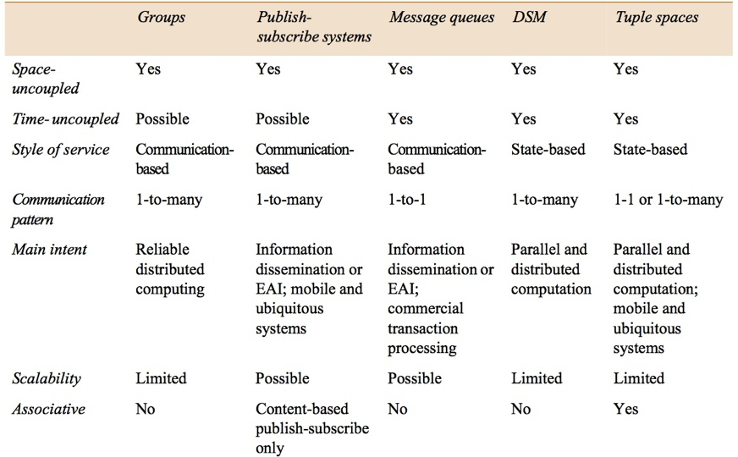
Figure 6.27
Summary of indirect communication styles
Instructor’s Guide for Coulouris, Dollimore and Kindberg Distributed Systems: Concepts and Design Edn. 4
© Pearson Education 2005

