Slide 1
EE434: ASIC and Digital Systems
Final Review 1
Jacob Murray
School of EECS, WSU
jmurray@eecs.wsu.edu

Slide 2
Structure of the Exam
Seven to eight problems with multiple parts
All topics will be almost equally represented
Will look similar to layout of sample exam

Slide 3
Overview
Circuit Design Methodologies
Implementation Techniques
RTL Design and Synthesis

Slide 4
Circuit Design Methodology
Static CMOS
Pseudo NMOS
Pass-transistor
Transmission Gate
Domino Logic

Slide 5
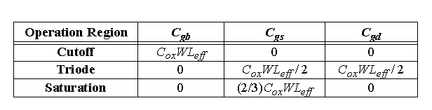
Gate Capacitance
Cut-off
Resistive
Saturation

Slide 6
Threshold Drops
V_{DD}
V_{DD}
PUN
S
D
V_{DD}
D
0 → V_{DD}
S
0 → V_{DD} - V_{Tn}
V_{GS}
C_{L}
C_{L}
PDN
V_{DD} → 0
V_{DD} → |V_{Tp}|
V_{GS}
D
C_{L}
S
C_{L}
V_{DD}
S
D
Notes:
Why PMOS in PUN and NMOS in PDN … threshold drop
NMOS transistors produce strong zeros; PMOS transistors generate strong ones

Slide 7
Complex CMOS Gate
B
A
C
D
OUT = D + A • (B + C)
A
D
B
C
Notes:
Shown synthesis of pull up from pull down structure

Slide 8
Constructing a Complex Gate

Slide 9
Basic CMOS Gate Sizing
NAND and NOR gate sizing

Slide 10
Issues with Pass Transistor Logic
Threshold drop
Capacitive feed through
Charge sharing

Slide 11
NMOS Only Logic: Level Restoring Transistor
V
DD
Level Restorer
V
DD
M
r
B
M
2
X
A
M
Out
n
M
1
• Advantage: Full Swing
• Restorer adds capacitance, takes away pull down current at X
• Ratio problem

Slide 12
Complementary Pass Transistor Logic

Slide 13
Transmission Gate
C
C
A
B
A
B
C
C
C =
2.5 V
A =
2.5 V
B
C
L
C
= 0 V

Slide 14
Pass-Transistor Based Multiplexer
The control signal S turns the transfer gates on and off depending on its value.
When S=1, the upper transfer gate is on and output follows
When S=0, the lower transfer gate is on and output follows
Exercise: Implement the Multiplexer with static CMOS and compare with this

Slide 15
Dynamic Gate
on
Clk
M_{p}
Clk
M_{p}
off
1
Out
Out
In₁
C_{L}
((AB)+C)
A
In₂
PDN
C
In₃
B
Clk
M_{e}
off
Clk
M_{e}
on
Two phase operation
Precharge (Clk = 0)
Evaluate (Clk = 1)
Notes:
For lecture
Evaluate transistor, Me, eliminates static power consumption

Slide 16
Conditions on Output
Once the output of a dynamic gate is discharged, it cannot be charged again until the next precharge operation.
Inputs to the gate can make at most one transition during evaluation.
Output can be in the high impedance state during and after evaluation (PDN off), state is stored on C_{L}
This behavior is fundamentally different than the static counterpart that always has a low resistance path between the output and one of the power rails.
Notes:
This behavior is fundamentally different than the static counterpart that always has a low resistance path between the output and one of the power rails.

Slide 17
Properties of Dynamic Gates
Logic function is implemented by the PDN only
  number of transistors is N + 2 (versus 2N for static complementary CMOS)
Full swing outputs
Non-ratioed - sizing of the devices does not affect the logic levels
Faster switching speeds
  reduced load capacitance due to lower input capacitance (C_{in})
  reduced load capacitance due to smaller output loading (C_{out})
Notes:
CL being lower also contributes to power savings

Slide 18
Properties of Dynamic Gates
Overall power dissipation usually higher than static CMOS
  no static current path ever exists between V_{DD} and GND
  no glitching
  higher transition probabilities
  extra load on Clk
Needs a precharge/evaluate clock

Slide 19
Issues in Dynamic Design 1: Charge Leakage
CLK
Clk
M_{p}
Out
A
C_{L}
V_{Out}
Evaluate
Clk
M_{e}
Precharge
Leakage sources
Leakage sources are reverse-biased diode and the sub-threshold leakage of the NMOS pull down device.
Notes:
leakage sources are reverse-biased diode and the sub-threshold leakage of the NMOS pull-down device.
Charge stored on CL will leak away with time (input in low state during evaluation)
Requires a minimum clock rate - so not good for low performance products such as watches (or when have conditional clocks)
PMOS precharge device also contributes some leakage due to reverse bias diode and subthreshold conduction that, to some extent, offsets the leakage due to the pull down paths.

Slide 20
Solution to Charge Leakage
Keeper
Clk
M_{p}
M_{kp}
A
Out
C_{L}
B
Clk
M_{e}
Same approach as level restorer for pass-transistor logic
During precharge, Out is VDD and inverter out is GND, so keeper is on
Notes:
During precharge, Out is VDD and inverter out is GND, so keeper is on
During evaluation if PDN is off, the keeper compensates for drained charge due to leakage.
If PDN is on, there is a fight between the PDN and the PUN - circuit is ratioed so PDN wins, eventually
Note Psc during switching period when PDN and keeper are both on simultaneously

Slide 21
Issues in Dynamic Design 2: Charge Sharing
Initially, C_{A} discharged and C_{L} fully charged
Charge stored originally on C_{L} is redistributed (shared) over C_{L} and C_{A} leading to reduced robustness
Clk
M_{p}
Out
A
C_{L}
B=0
C_{A}
Clk
M_{e}
C_{B}
Notes:
CA initially discharged and CL fully charged.

Slide 22
Solution to Charge Redistribution
Clk
M_{p}
M_{kp}
Clk
Out
A
B
Clk
M_{e}
Precharge internal nodes using a clock-driven transistor (at the cost of increased area and power)

Slide 23
Issues in Dynamic Design 3: Clock Feedthrough (Charge Injection)
Coupling between Out and Clk input of the precharge device due to the gate to drain capacitance. So voltage of Out can rise above V_{DD}. The fast rising (and falling edges) of the clock couple to Out.
Clk
M_{p}
Out
A
C_{L}
B
Clk
M_{e}
Notes:
Danger is that signal levels can rise enough above VDD that the normally reverse-biased junction diodes become forward-biased causing electrons to be injected into the substrate.

Slide 24
Clock Feedthrough
Clock feedthrough
Clk
Out
In₁
In₂
In₃
Voltage
In &
Clk
In₄
Out
Clk
Time, ns
Clock feedthrough

Slide 25
Cascading Dynamic Gates
V
Clk
Clk
Clk
M_{p}
M_{p}
Out2
Out1
In
In
Clk
Clk
V_{Tn}
M_{e}
M_{e}
Out1
ΔV
Out2
t
Only 0 → 1 transitions allowed at inputs!
Notes:
Out2 should remain at VDD since Out1 transitions to 0 during evaluation. However, since there is a finite propagation delay for the input to discharge Out1 to GND, the second output also starts to discharge.
The second dynamic inverter turns off (PDN) when Out1 reaches VTn.
Setting all inputs of the second gate to 0 during precharge will fix it.
Correct operation is guaranteed (ignoring charge redistribution and leakage) as long as the inputs can only make a single 0 -> 1 transition during the evaluation period

Slide 26
Cascading Dynamic Gates
Out2 should remain at V_{DD} since Out1 transitions to 0 during evaluation. However, since there is a finite propagation delay for the input to discharge Out1 to GND, the second output also starts to discharge.
The second dynamic inverter turns off (PDN) when Out1 reaches V_{Tn}.
Setting all inputs of the second gate to 0 during precharge will fix it.
Correct operation is guaranteed (ignoring charge redistribution and leakage) as long as the inputs can only make a single 0 → 1 transition during the evaluation period

Slide 27
Domino Logic
Clk
M_{p}
Clk
M_{p}
M_{kp}
Out1
Out2
1 → 1
1 → 0
0 → 0
0 → 1
In₁
In₂
PDN
In₄
PDN
In₃
In₅
Clk
M_{e}
Clk
M_{e}
Ensures all inputs to the Domino gate are set to 0 at the end of the precharge period. Hence, the only possible transition during evaluation is 0 → 1
Notes:
Ensures all inputs to the Domino gate are set to 0 at the end of the precharge period. Hence, the only possible transition during evaluation is 0 -> 1

Slide 28
Why Domino?
Clk
In_{i}
PDN
In_{i}
PDN
In_{i}
PDN
In_{i}
PDN
In_{j}
In_{j}
In_{j}
In_{j}
Clk
Like falling dominos!

Slide 29
Properties of Domino Logic
Only non-inverting logic can be implemented
Very high speed
  static inverter can be skewed, only 0 → 1 transition
  Input capacitance reduced
Notes:
First 32 bit micro (BellMAC 32) was designed in Domino logic
Now a rather rare design style due to non-inverting logic only

Slide 30
Differential (Dual Rail) Domino
off
on
Clk
M_{p}
M_{kp}
M_{kp}
M_{p}
Clk
Out = AB
Out = AB
1 0
1 0
A
!A
!B
B
Clk
M_{e}
Solves the problem of non-inverting logic
Notes:
AND/NAND differential logic gate. The inputs and their complements come from other differential DR gates and thus all inputs are low during precharge and make a conditional transition from 0 to 1.
Annotations show state during evaluate cycle (CLK = 1)
Expensive - but can implement any arbitrary function.
Use significant power since they have a guaranteed transition every single clock cycle (regardless of signal statistics, since either Out or !Out will transition from 0 to 1).
Not ratioed (even though have a cross-coupled PMOS pair)

Slide 31
Sequential Circuits
Difference between latch and flip-flops
Design of latches and flip-flops using transmission gates
Different Design trade-offs
Role of non-overlapping clocks

Slide 32
Timing Definitions
CLK
t
Register
t
su
t
hold
D
Q
D
DATA
CLK
STABLE
t
t
c
2
q
Q
DATA
STABLE
t

Slide 33
Storage Mechanisms
Static
Dynamic
CLK
D
Q
CLK
Needs a positive feedback loop to hold the data
Holds data by storing charge on capacitance

Slide 34
Implementation Methodology
Different digital circuit design methodologies
  Custom, semi-custom, array-based
Characteristics of CPLDs and FPGAs
Implementation of logic functions using MUX and LUTs
Hard and Soft Macro

Slide 35
Array-Based Programmable Logic
I
5
I
4
I
3
I
2
I
1
I
0
Programmable
I
I
I
I
Programmable
OR array
3
2
1
0
OR array
I
5
I
4
I
3
I
2
I
1
I
0
Fixed OR array
Programmable AND array
Fixed AND array
Programmable AND array
O
3
O
2
O
1
O
0
O
3
O
2
O
1
O
0
O
3
O
2
O
1
O
0
PLA
PROM
PAL
Indicates programmable connection
Indicates fixed connection

Slide 36
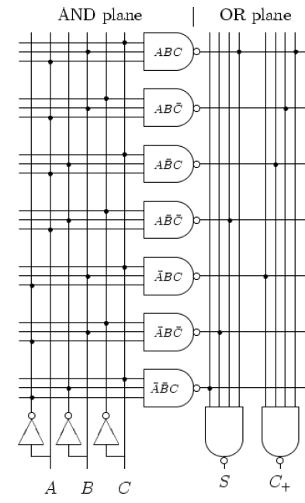
Implementing functions with PLA

Slide 37
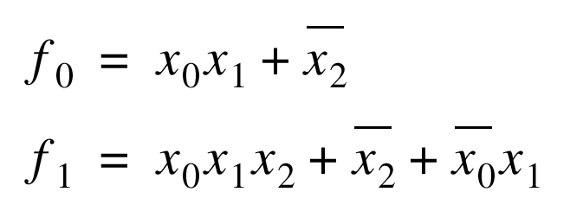
Programming a PROM
1
X
2
X
1
X
0
: programmed node
NA
NA
f
1
f
0

Slide 38
2-input MUX as programmable logic block
Configuration
A
B
S
F=
0
0
0
0
0
X
1
X
A
0
0
Y
1
Y
F
0
Y
X
XY
B
1
X
0
Y
XY
Y
0
X
XY
Y
1
X
X
+
Y
S
1
0
X
X
1
0
Y
Y
1
1
1
1

Slide 39
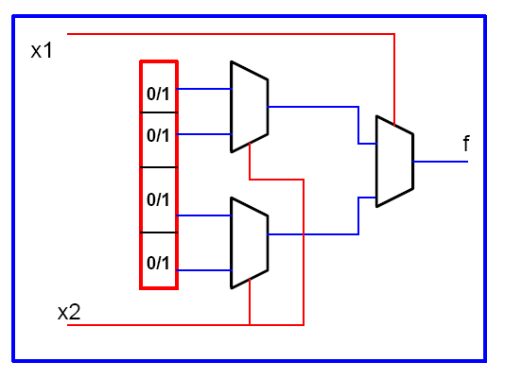
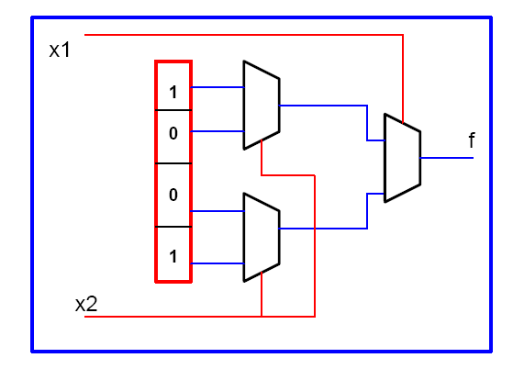
Two-input LUT

Slide 40
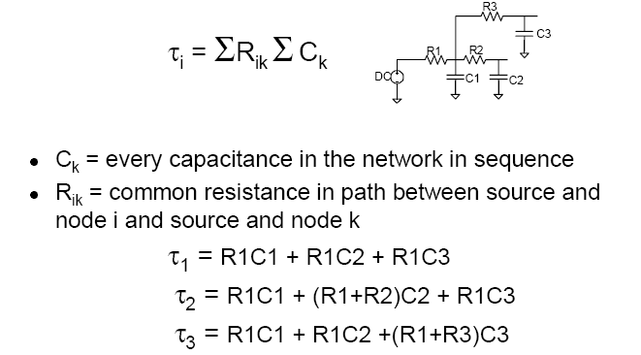
Elmore Delay

Slide 41
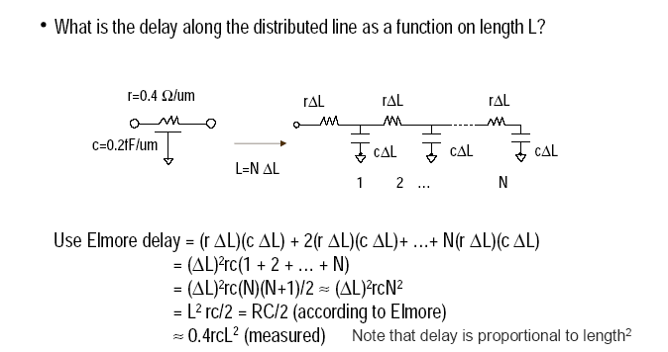
Delay of a wire

Slide 42
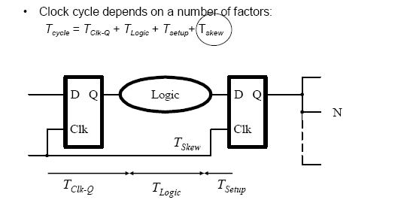
Clock Design Issues

Slide 43
Reducing Power in Clocking
Gated Clocks:
  can gate clock signals through AND gate before applying to flip-flop; this is more of a total chip power savings
  all clock trees should have the same type of gating whether they are used or not, and at the same level - total balance
Reduce overall capacitance (again, shielding vs. spacing)
(a) higher total cap./less area (b) lower cap./ more area
  Tradeoff between the two approaches due to coupling noise
  approach (a) is better for inductive noise; (b) is better for capacitive noise
shield
clock
shield
Signal 1
clock
Signal 2

Slide 44
VHDL
You will NOT need to write any long complicated code
You should be able to write small pieces of VHDL
Understand common coding mistakes
Understand process and sensitivity list
Be able to detect limitations in a block of code

Slide 45
Verilog
You will NOT need to write any long complicated code
You should be able to write small pieces of Verilog
Understand common coding mistakes
Be able to detect limitations in a block of code

Slide 46
Verilog
Do you see any problem with the following Verilog code? Please explain.
always @ (posedge clk, posedge reset)
if (reset) q <= 0;
else q <= d;
always @ (set)
if (set) q <= 1;
endmodule

Slide 47
Verilog
When we tried to simulate the following code, sometimes we observed ‘x’ at the output. What is the reason behind such an observation? Explain.
module mux_2 (input [3:0] d0, d1,
input s,
output [3:0] y);
tristate t0 (d0, s, y);
tristate t1 (d1, s, y);
endmodule

Slide 48
Verilog
Following is the module declaration of a D flip-flop with an asynchronous active-low reset. Complete the description of the flip-flop using Verilog.
module flipflop (D, Clock, Resetn, Q);
input D, Clock, Resetn;
output Q;
reg Q;
always @ (…)
…
endmodule

Slide 49
Verilog
The following piece of Verilog code is to be used to model a Mux. When synthesized would it behave like a Mux? If not, what would it be? Explain.
module mux (input [3: 0] d_0, d_1,
input s, output reg [3: 0] y);
always @ (posedge s)
if (s) y <= d_1;
else y <= d_0;
endmodule

