Slide 1
EE434: ASIC and Digital Systems
Final Review 2
Jacob Murray
School of EECS, WSU
jmurray@eecs.wsu.edu

Slide 2
Structure of the Exam
Seven to eight problems with multiple parts
All topics will be almost equally represented
Will look similar to layout of sample exam

Slide 3
Overview
Finite State Machines
Test Methodologies
Fault Modeling
Design for Test (DFT)
JTAG
BIST
SoC Test

Slide 4
Finite State Machines
State transition graph
Reachability of states
Homing sequence
Equivalent states
State encoding

Slide 5
Recognizer state transition graph
1/0
0/0
Bit 1
0/0
Bit 2
1/1

Slide 6
Reachability
State is reachable if there is a path from given state.
May be created by state encoding:
s0
s1
s2
s3

Slide 7
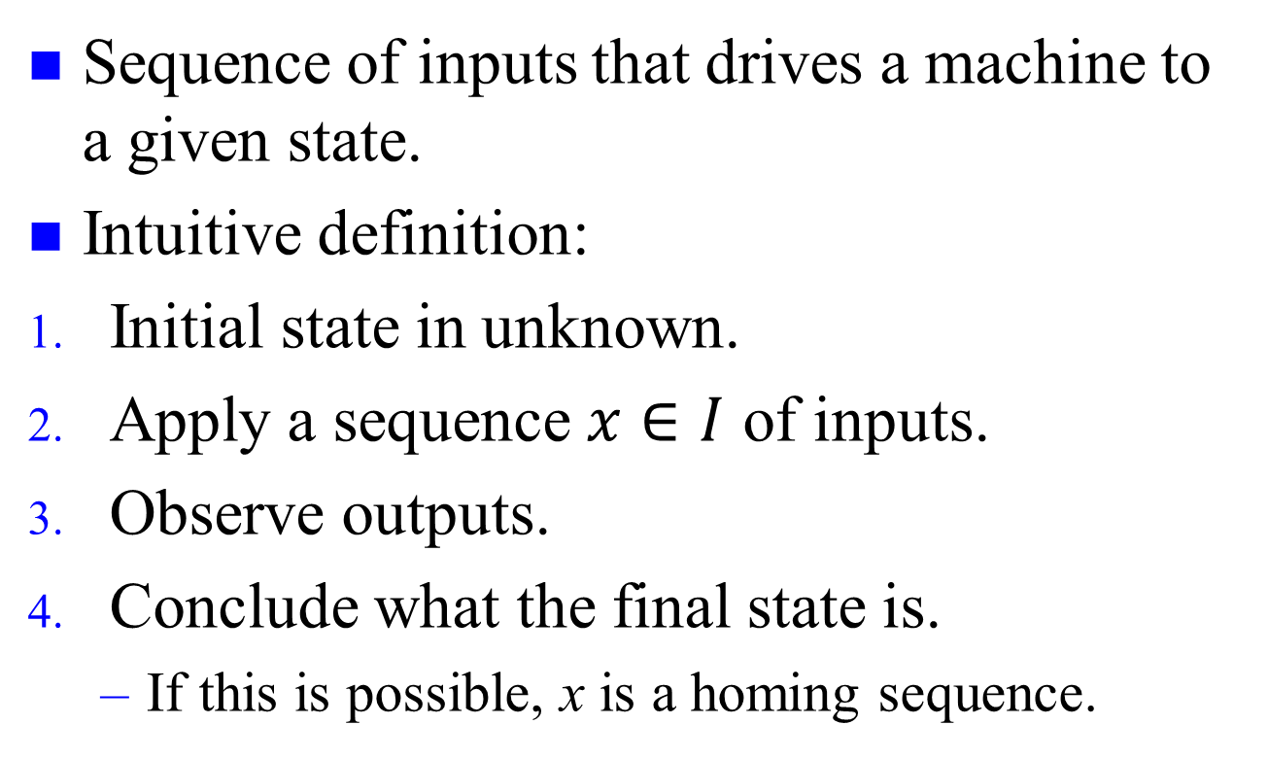
Homing sequence
Sequence of inputs that drives a machine to a given state.
Intuitive definition:
Initial state in unknown.
Apply a sequence $x∈I$ of inputs.
Observe outputs.
Conclude what the final state is.
  If this is possible, x is a homing sequence.
s0
s1
s2

Slide 8
Equivalent states
States are equivalent if they cannot be distinguished by any input sequence:
0/0
s1
s2
-/1
1/0
-/0
-/0
s3
s4
States s2 and s3 are equivalent

Slide 9
Test Methodologies
Defects and faults
Real tests
Testing types

Slide 10
Defect vs. Fault
To become a fault, the defect needs to connect two disjoint conductors or disconnect a continuous pattern

Slide 11
Real Tests
Based on analyzable fault models, which may not map on real defects.
Incomplete coverage of modeled faults due to high complexity.
Some good chips are rejected. The fraction (or percentage) of such chips is called the yield loss.
Some bad chips pass tests. The fraction (or percentage) of bad chips among all passing chips is called the defect level.

Slide 12
Testing as Filter Process
Good chips
Prob(pass test) = high
Mostly
good
chips
Prob (good) = y
Fabricated
chips
Prob(pass test) = low
Prob(fail test) = low
Defective chips
Mostly
bad
chips
Prob(bad) = 1- y
Prob(fail test) = high

Slide 13
Roles of Testing
Detection: Determination whether or not the device under test (DUT) has some fault.
Diagnosis: Identification of a specific fault that is present on DUT.
Device characterization: Determination and correction of errors in design and/or test procedure.
Failure mode analysis (FMA): Determination of manufacturing process errors that may have caused defects on the DUT.

Slide 14
Types of Testing
Verification testing, characterization testing, or design debug
  Verifies correctness of design and of test procedure – usually requires correction to design
Manufacturing testing
  Factory testing of all manufactured chips for parametric faults and for random defects
Acceptance testing (incoming inspection)
  User (customer) tests purchased parts to ensure quality

Slide 15
Fault Modeling
Definitions related to testing
Stuck-at fault model
  Single
  Multiple
Fault equivalence
Fault dominance
Test vectors needed to detect faults
Transistor Faults

Slide 16
Stuck-at Fault
The circuit is modeled as an interconnection of Boolean gates
Each connecting line can have two types of faults
  Stuck-at-1 (s-a-1) & Stuck-at-0 (s-a-0)
A circuit with n lines can have 3^{n}-1 possible stuck line combinations
  Each line can be in one of the three states:(s-a-1),(s-a-0), or fault free
An n-line circuit can have at most 2n single stuck-at faults

Slide 17
Single Stuck-at Fault
Three properties define a single stuck-at fault
    Only one line is faulty
    The faulty line is permanently set to 0 or 1
    The fault can be at an input or output of a gate
Example: XOR circuit has 12 fault sites ( ) and 24 single stuck-at faults
Faulty circuit value
Good circuit value
c
j
s-a-0
0(1)
a
d
g
1(0)
1
h
z
0
1
i
b
e
1
f
k
Test vector for h s-a-0 fault

Slide 18
Fault Equivalence
Number of fault sites in a Boolean gate circuit = #PI + #gates + #(fanout branches)
Fault equivalence: Two faults f1 and f2 are equivalent if all tests that detect f1 also detect f2.
If faults f1 and f2 are equivalent then the corresponding faulty functions are identical.
Fault collapsing: All single faults of a logic circuit can be divided into disjoint equivalence subsets, where all faults in a subset are mutually equivalent. A collapsed fault set contains one fault from each equivalence subset.

Slide 19
Equivalence Rules
sa0
sa0
sa1
sa1
sa0 sa1
sa0 sa1
WIRE
sa0 sa1
sa0 sa1
AND
OR
sa0 sa1
sa0 sa1
sa0
sa1
NOT
sa0
sa1
sa0 sa1
sa0 sa1
sa0 sa1
sa0 sa1
sa0
NAND
NOR
sa1
sa0 sa1
sa0
sa0 sa1
sa1
sa0
FANOUT
sa1

Slide 20
Equivalence Example
sa0 sa1
Faults removed by equivalence
collapsing
sa0 sa1
sa0 sa1
sa0 sa1
sa0 sa1
sa0 sa1
sa0 sa1
sa0 sa1
sa0 sa1
sa0 sa1
sa0 sa1
sa0 sa1
sa0 sa1
sa0 sa1
sa0 sa1
sa0 sa1
20
Collapse ratio = ----- = 0.625
32

Slide 21
Fault Dominance
If all tests of some fault F1 detect another fault F2, then F2 is said to dominate F1.
Dominance fault collapsing: If fault F2 dominates F1, then F2 is removed from the fault list.
When dominance fault collapsing is used, it is sufficient to consider only the input faults of Boolean gates. See the next example.
If two faults dominate each other then they are equivalent.

Slide 22
Dominance Example
All tests of F2
F1
s-a-1
001
110 010
000
101
100
F2
s-a-1
011
s-a-1
Only test of F1
s-a-1
s-a-1
s-a-0
A dominance collapsed fault set

Slide 23
Dominance Example
sa0 sa1
Faults
removed by
equivalence
collapsing
sa0 sa1
sa0 sa1
sa0 sa1
sa0 sa1
sa0 sa1
sa0 sa1
sa0 sa1
sa0 sa1
sa0 sa1
sa0 sa1
sa0 sa1
Faults
removed by
dominance
collapsing
sa0 sa1
sa0 sa1
sa0 sa1
sa0 sa1
15
Collapse ratio = ----- = 0.47
32

Slide 24
Dominance Fault Collapsing
An n-input Boolean gate requires (n+1) single stuck-at faults to be modeled.
To collapse faults of a gate, all faults from the output can be eliminated retaining one type (s-a-1 for AND and NAND; s-a-0 for OR and NOR) of fault on each input and the other type (s-a-0 for AND and NAND; s-a-1 for OR and NOR) on any one of the inputs
The output faults of the NOT gate, and the wire can be removed as long as both faults on the input are retained.

Slide 25
Multiple Stuck-at Faults
A multiple stuck-at fault means that any set of lines is stuck-at some combination of (0,1) values.
The total number of single and multiple stuck-at faults in a circuit with k single fault sites is 3^{k}-1.
A single fault test can fail to detect the target fault if another fault is also present, however, such masking of one fault by another is rare.
Statistically, single fault tests cover a very large number of multiple faults.

Slide 26
Transistor (Switch) Faults
MOS transistor is considered an ideal switch and two types of faults are modeled:
    Stuck-open -- a single transistor is permanently stuck in the open state.
    Stuck-short -- a single transistor is permanently shorted irrespective of its gate voltage.
Detection of a stuck-open fault requires two vectors.
Detection of a stuck-short fault requires the measurement of quiescent current (I_{DDQ}).

Slide 27
Stuck-Open Example
Vector 1: test for A s-a-0
(Initialization vector)
Vector 2 (test for A s-a-1)
pMOS
FETs
V_{DD}
Two-vector s-op test
can be constructed by
ordering two s-at tests
A
1
0
0
0
Stuck-
open
B
C
0
1(Z)
nMOS
FETs
Good circuit states
Faulty circuit states

Slide 28
Stuck-Short Example
Test vector for A s-a-0
pMOS
FETs
V_{DD}
I_{DDQ} path in
faulty circuit
A
1
0
Stuck-
short
B
Good circuit state
C
0 (X)
nMOS
FETs
Faulty circuit state

Slide 29
Design for Test
Full-Scan
Observability
Controllability
Scan Flip-Flop

Slide 30
Definition
Design for testability (DFT) refers to those design techniques that make test generation and test application cost-effective.
DFT methods for digital circuits:
  Ad-hoc methods
  Structured methods:
    Scan
    Partial Scan
    Built-in self-test (BIST)
    Boundary scan
DFT method for mixed-signal circuits:
    Analog test bus

Slide 31
Observability
The observability of a particular circuit node is the degree to which we can observe that node at the output of an integrated circuit.
Measure the output of a gate within a larger circuit to check whether it operates correctly.
Limited number of nodes can be directly observed.

Slide 32
Controllability
The controllability of an internal circuit node within a chip is a measure of the ease of setting the node to a 1 or 0 metric.
Degree of difficulty of testing a particular signal within a circuit
An easily controllable node would be directly settable via an input pad.

Slide 33
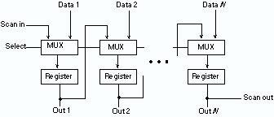
Scan Design
In test mode, all flip-flops functionally form one or more shift registers.
The inputs and outputs of these shift registers are connected to PI/Pos.
Using the test mode, all flip-flops can be set to any desired states.
The states of the flip-flops are observed by shifting the contents of the scan register out.

Slide 34
Scan Flip-Flop (SFF)
D
Master latch
Slave latch
TC
Logic
overhead
Q
MUX
SD
Q
CK
D flip-flop
CK
Master open
Slave open
t
TC
Normal mode, D selected
Scan mode, SD selected
t

Slide 35
Flip-flop for Partial Scan
Normal scan flip-flop (SFF) with multiplexer of the LSSD flip-flop is used.
Scan flip-flops require a separate clock control:
    Either use a separate clock pin
    Or use an alternative design for a single clock pin
D
Master
latch
Slave
latch
MUX
Q
SD
TC
CK
SFF
(Scan flip-flop)
TC
CK
Normal mode
Scan mode

Slide 36
Scan-Hold Flip-Flop (SHFF)
To SD of
next SHFF
D
Q
SD
SFF
TC
Q
CK
HOLD
The control input HOLD keeps the output steady at previous state of flip-flop.
In the normal mode, TC=HOLD=1. In the scan mode, TC=1 and HOLD=0. This isolates the combinational logic from the scan register activity.
The state inputs of combinational logic driven by the hold latch remain frozen at their pre-scan value
Power Savings

Slide 37
Random-Access Scan (RAS)
PI
PO
Combinational
logic
RAM
n_{ff}
bits
CK
TC
SCANIN
SCANOUT
SEL
Address decoder
ADDRESS
Address scan
register
log₂ n_{ff} bits
ACK

Slide 38
RAS Flip-Flop (RAM Cell)
D
Q
To comb.
logic
From comb. logic
SD
Scan flip-flop
(SFF)
SCANIN
CK
TC
SCANOUT
SEL

Slide 39
IEEE 1149.1 JTAG
Boundary Scan Standard
Motivation
Bed-of-nails tester
System view of boundary scan hardware
Elementary scan cell
Test Access Port (TAP) controller
Boundary scan instructions
Summary

Slide 40
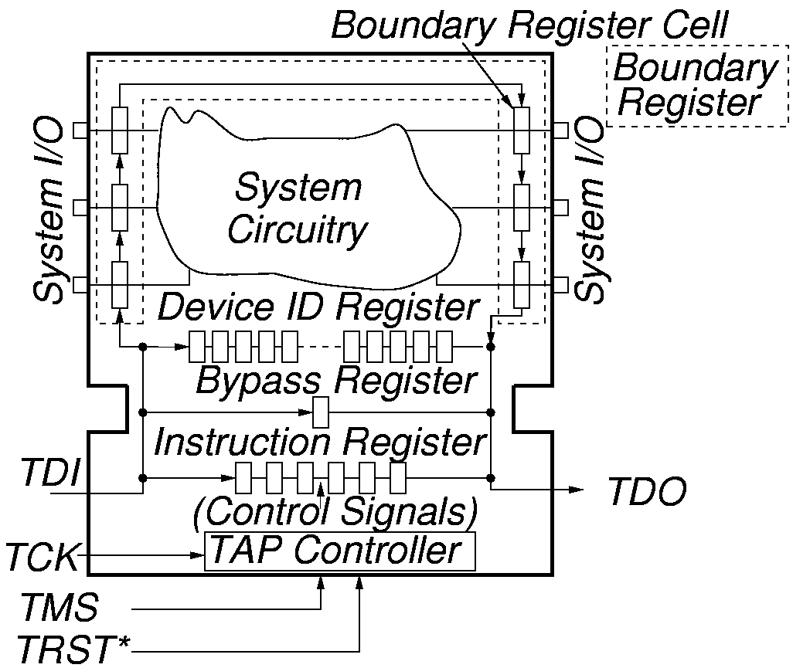
System Test Logic

Slide 41
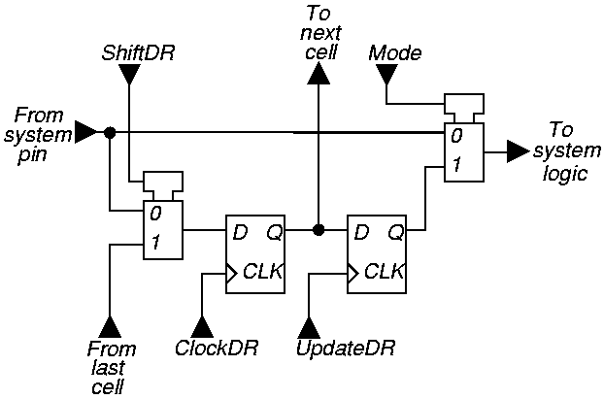
Elementary Boundary Scan Cell

Slide 42
Tap Controller Signals
Test Access Port (TAP) includes these signals:
  Test Clock Input (TCK) -- Clock for test logic
    Can run at different rate from system clock
  Test Mode Select (TMS) -- Switches system from functional to test mode
  Test Data Input (TDI) -- Accepts serial test data and instructions -- used to shift in vectors or one of many test instructions
  Test Data Output (TDO) -- Serially shifts out test results captured in boundary scan chain (or device ID or other internal registers)
  Test Reset (TRST) -- Optional asynchronous TAP controller reset

Slide 43
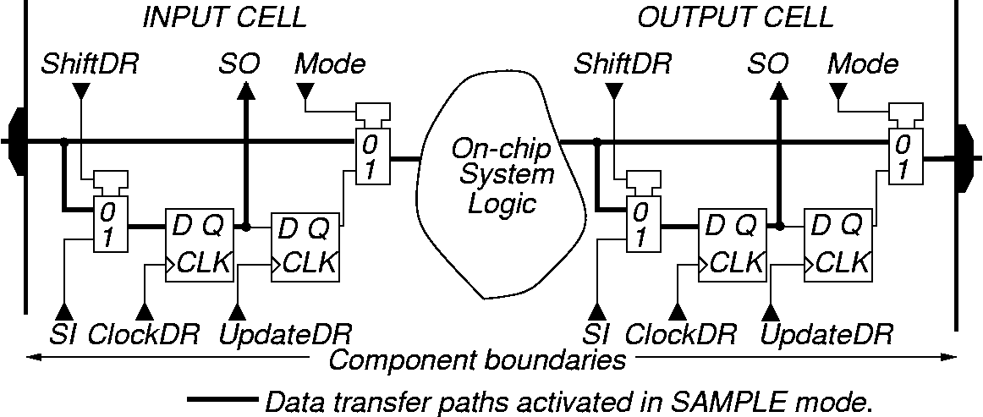
SAMPLE / PRELOAD Instruction -- SAMPLE
Purpose:
Get snapshot of normal chip input/output signals.
Put data on boundary scan chain before next instruction.

Slide 44
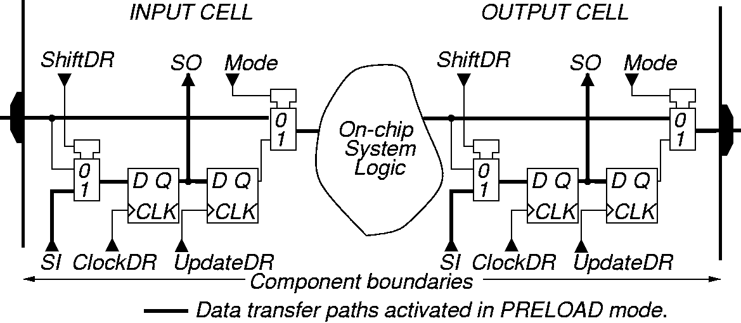
SAMPLE / PRELOAD Instruction -- PRELOAD

Slide 45
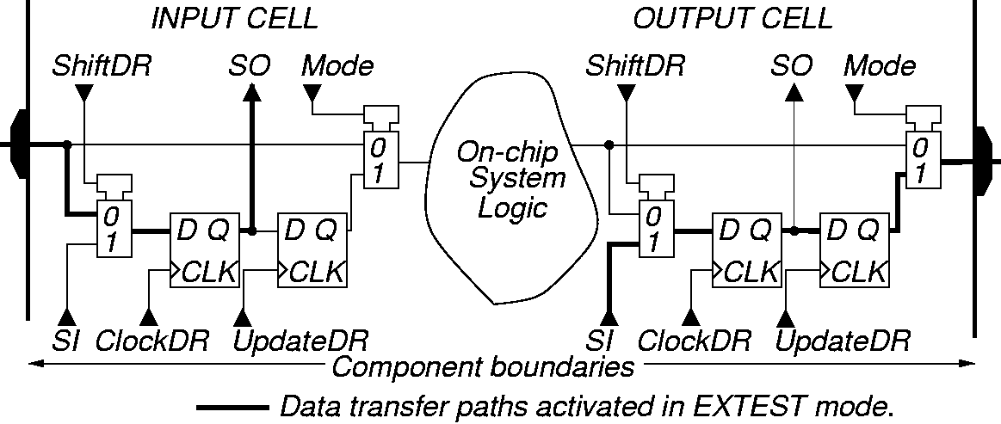
EXTEST Instruction
Purpose: Test off-chip circuits and board-level interconnections

Slide 46
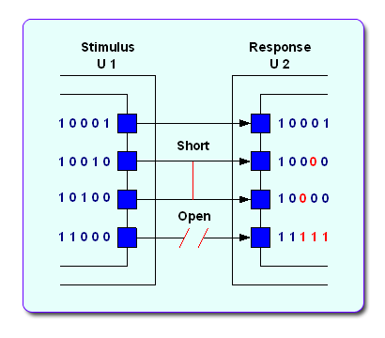
Interconnect Test

Slide 47
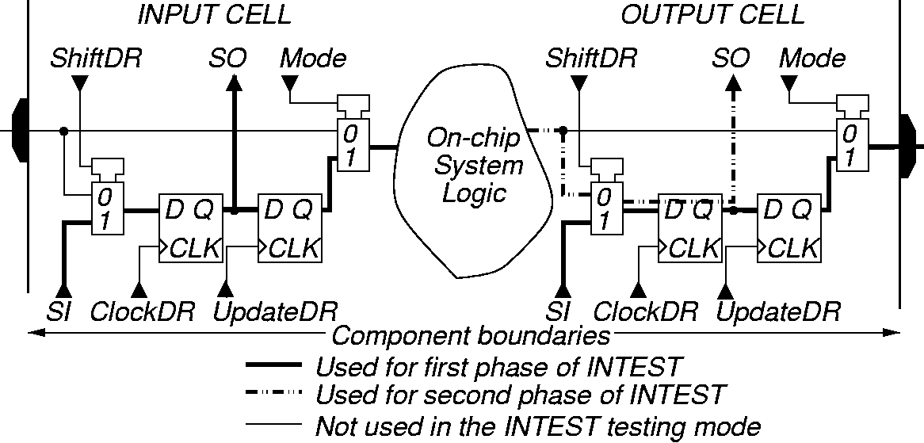
INTEST Instruction
Purpose:
  Shifts external test patterns onto component.
  External tester shifts component responses out.

Slide 48
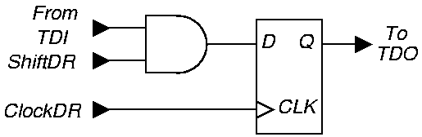
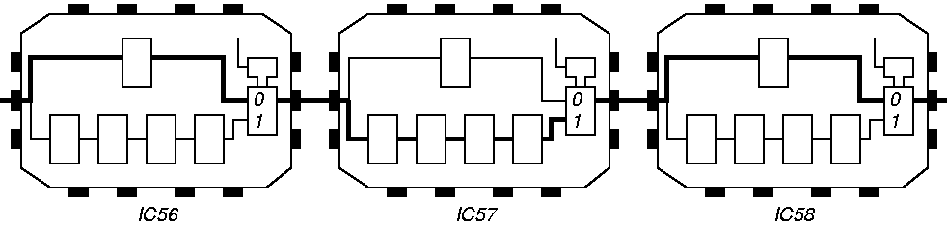
BYPASS Instruction
Purpose: Bypasses scan chain with 1-bit register

Slide 49
BIST Motivation
Useful for field test and diagnosis (less expensive than a local automatic test equipment)
Software tests for field test and diagnosis:
  Low hardware fault coverage
  Low diagnostic resolution
  Slow to operate
Hardware BIST benefits:
  Lower system test effort
  Improved system maintenance and repair
  Improved component repair
  Better diagnosis

Slide 50
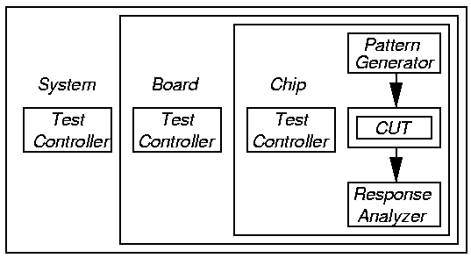
BIST Process
Test controller – Hardware that activates self-test simultaneously on all PCBs
Each board controller activates parallel chip BIST Diagnosis effective only if very high fault coverage

Slide 51
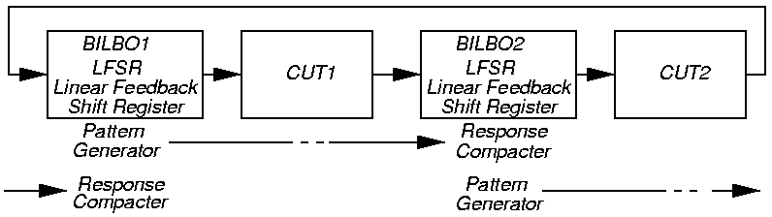
BILBO – Works as Both a PG and a RC
Built-in Logic Block Observer (BILBO) -- 4 modes:
  Flip-flop
  LFSR pattern generator
  LFSR response compacter
  Scan chain for flip-flops

Slide 52
Pattern Generation
Store in ROM – too expensive
Exhaustive
Pseudo-exhaustive
Pseudo-random (LFSR) – Preferred method
Binary counters – use more hardware than LFSR
Modified counters
Test pattern augmentation
  LFSR combined with a few patterns in ROM

Slide 53
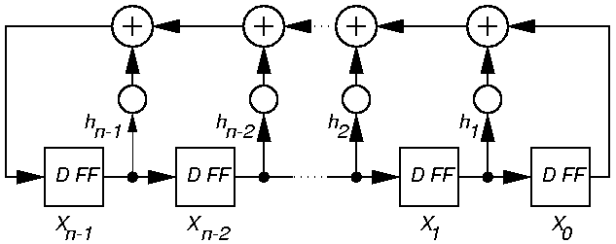
Pseudo-Random Pattern Generation
Standard Linear Feedback Shift Register (LFSR)
  Produces patterns algorithmically – repeatable
  Has most of desirable properties of random numbers
Need not cover all 2^{n} input combinations
Long sequences needed for good fault coverage

Slide 54
Matrix Equation for Standard LFSR
X₀ (t + 1)
X₁ (t + 1)
.
.
.
X_{n-3} (t + 1)
X_{n-2} (t + 1)
X_{n-1} (t + 1)
0
0
.
.
.
0
0
1
1
0
.
.
.
0
0
h₁
0
1
.
.
.
0
0
h₂
…
…
…
…
…
0
0
.
.
.
1
0
h_{n-2}
0
0
.
.
.
0
1
h_{n-1}
X₀ (t)
X₁ (t)
.
.
.
X_{n-3} (t)
X_{n-2} (t)
X_{n-1} (t)
=
X (t + 1) = T_{s} X (t) (T_{s} is companion matrix)

Slide 55
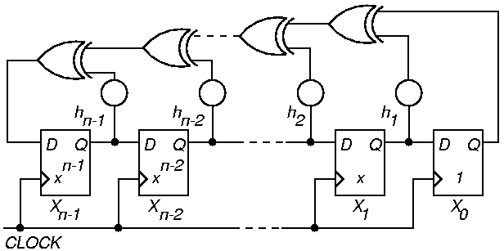
Standard n-Stage LFSR Implementation
Autocorrelation – any shifted sequence same as original in 2^{n-1} – 1 bits, differs in 2^{n-1} bits
If h_{i} = 0, that XOR gate is deleted

Slide 56
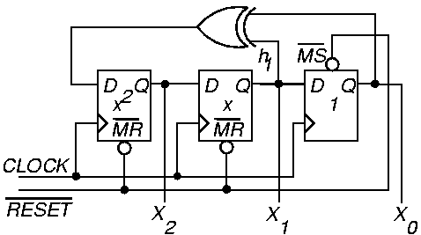
Example External XOR LFSR with Reset
Characteristic polynomial f (x) = 1 + x + x³
  (read taps from right to left)

Slide 57
External XOR LFSR
Pattern sequence for example LFSR (earlier):
Always have 1 and x^{n} terms in polynomial
Never repeat an LFSR pattern more than 1 time –Repeats same error vector, cancels fault effect
X₀
X₁
X₂
1
0
0
0
0
1
0
1
0
1
0
1
0
1
1
1
1
1
1
1
0
1
0
0
0
0
1
…
X₀ (t + 1)
X₁ (t + 1)
X₂ (t + 1)
0
0
1
1
0
1
0
1
0
X₀ (t)
X₁ (t)
X₂ (t)
=

Slide 58
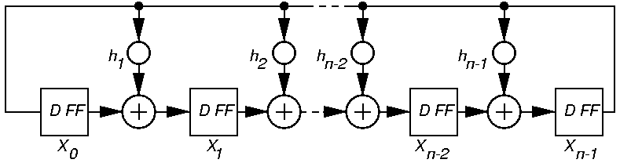
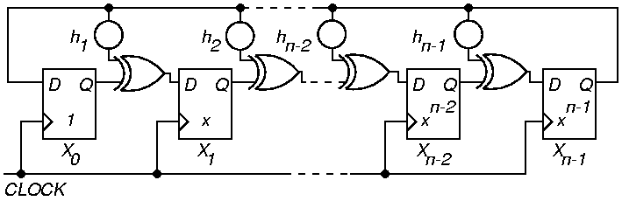
Generic Modular LFSR

Slide 59
Modular LFSR Matrix
X₀ (t + 1)
X₁ (t + 1)
X₂ (t + 1)
.
.
.
X_{n-3} (t + 1)
X_{n-2} (t + 1)
X_{n-1} (t + 1)
0
1
0
.
.
.
0
0
0
0
0
1
.
.
.
0
0
0
0
0
0
.
.
.
0
0
0
…
…
…
…
…
…
0
0
0
.
.
.
0
1
0
0
0
0
.
.
.
0
0
1
1
h₁
h₂
.
.
.
h_{n-3}
h_{n-2}
h_{n-1}
X₀ (t)
X₁ (t)
X₂ (t)
.
.
.
X_{n-3} (t)
X_{n-2} (t)
X_{n-1} (t)
=

Slide 60
Response Compaction
Large amounts of data in CUT response to LFSR patterns – example:
  Generate 5 million random patterns
  CUT has 200 outputs
  Leads to: 5 million x 200 = 1 billion bits response
Uneconomical to store and check all of these responses on chip
Responses must be compacted

Slide 61
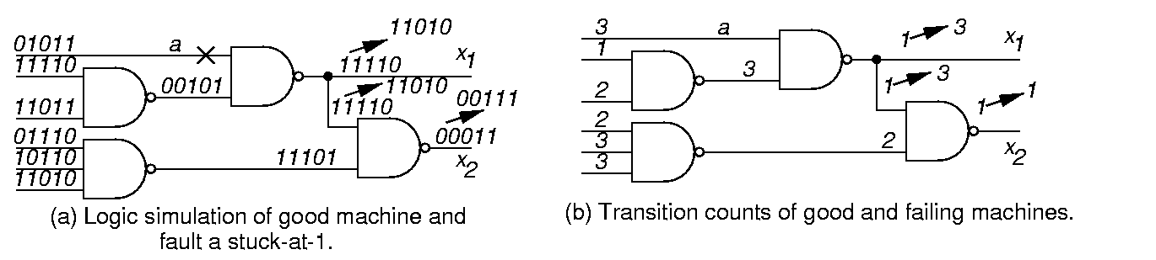
Transition Counting
Faulty machine response is shown above the good machine response
Aliasing

Slide 62
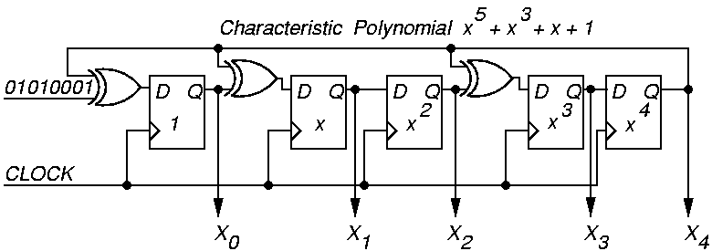
Example Modular LFSR Response Compacter
LFSR seed value is “00000”

Slide 63
Polynomial Division
Inputs
Initial State
1
0
0
0
1
0
1
0
X⁰
0
1
0
0
0
1
1
1
1
X¹
0
0
1
0
0
0
0
1
0
X²
0
0
0
1
0
0
0
0
1
X³
0
0
0
0
1
0
1
0
1
X⁴
0
0
0
0
0
1
0
1
0
Logic
Simulation:
Logic simulation: Remainder = 1 + x² + x³
0 1 0 1 0 0 0 1
0 x⁰ + 1x¹ + 0 x² + 1 x³ + 0 x⁴ + 0 x⁵ + 0 x⁶ + 1 x⁷

Slide 64
Symbolic Polynomial Division
x²
x⁷
x⁷
+ 1
+ x⁵
x⁵
x⁵
x⁵ + x³ + x + 1
+ x³
+ x³
+ x³
x³
+ x
+ x
+ x
+ x²
+ x²
+ x²
+ 1
+ 1
remainder
Remainder matches that from logic simulation
of the response compacter!

Slide 65
Multiple-Input Signature Register (MISR)
Problem with ordinary LFSR response compacter:
  Too much hardware if one of these is put on each primary output (PO)
Solution: MISR – compacts all outputs into one LFSR
  Works because LFSR is linear – obeys superposition principle
  Superimpose all responses in one LFSR – final remainder is XOR sum of remainders of polynomial divisions of each PO by the characteristic polynomial

Slide 66
MISR Matrix Equation
d_{i} (t) – output response on PO_{i} at time t
X₀ (t + 1)
X₁ (t + 1)
.
.
.
X_{n-3} (t + 1)
X_{n-2} (t + 1)
X_{n-1} (t + 1)
0
0
.
.
.
0
0
1
1
0
.
.
.
0
0
h₁
…
…
…
…
…
0
0
.
.
.
1
0
h_{n-2}
0
0
.
.
.
0
1
h_{n-1}
X₀ (t)
X₁ (t)
.
.
.
X_{n-3} (t)
X_{n-2} (t)
X_{n-1} (t)
d₀ (t)
d₁ (t)
.
.
.
d_{n-3} (t)
d_{n-2} (t)
d_{n-1} (t)
=
+

Slide 67
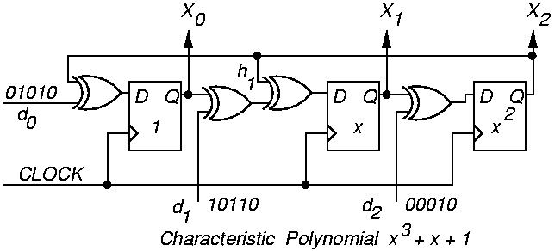
Modular MISR Example
X₀ (t + 1)
X₁ (t + 1)
X₂ (t + 1)
0
1
0
0
0
1
1
1
0
X₀ (t)
X₁ (t)
X₂ (t)
d₀ (t)
d₁ (t)
d₂ (t)
=
+

Slide 68
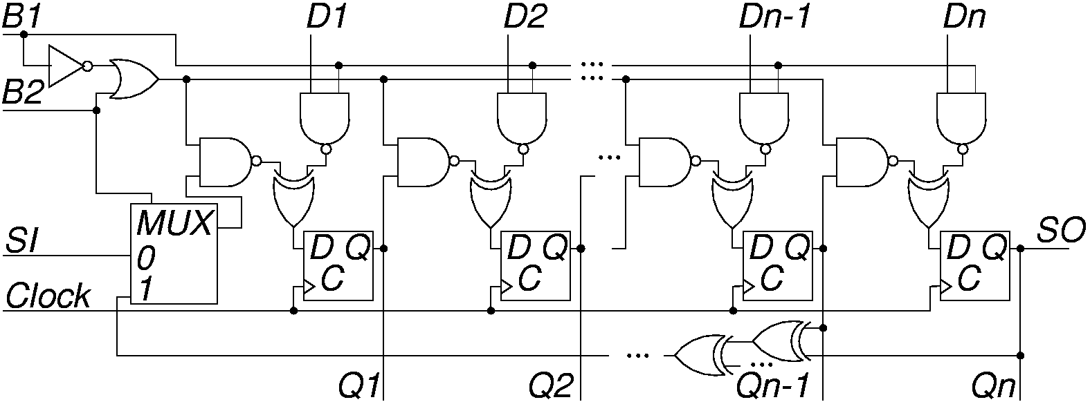
Built-in Logic Block Observer (BILBO)
Combined functionality of D flip-flop, pattern generator, response compacter and scan chain
  Reset all FFs to 0 by scanning in zeros

Slide 69
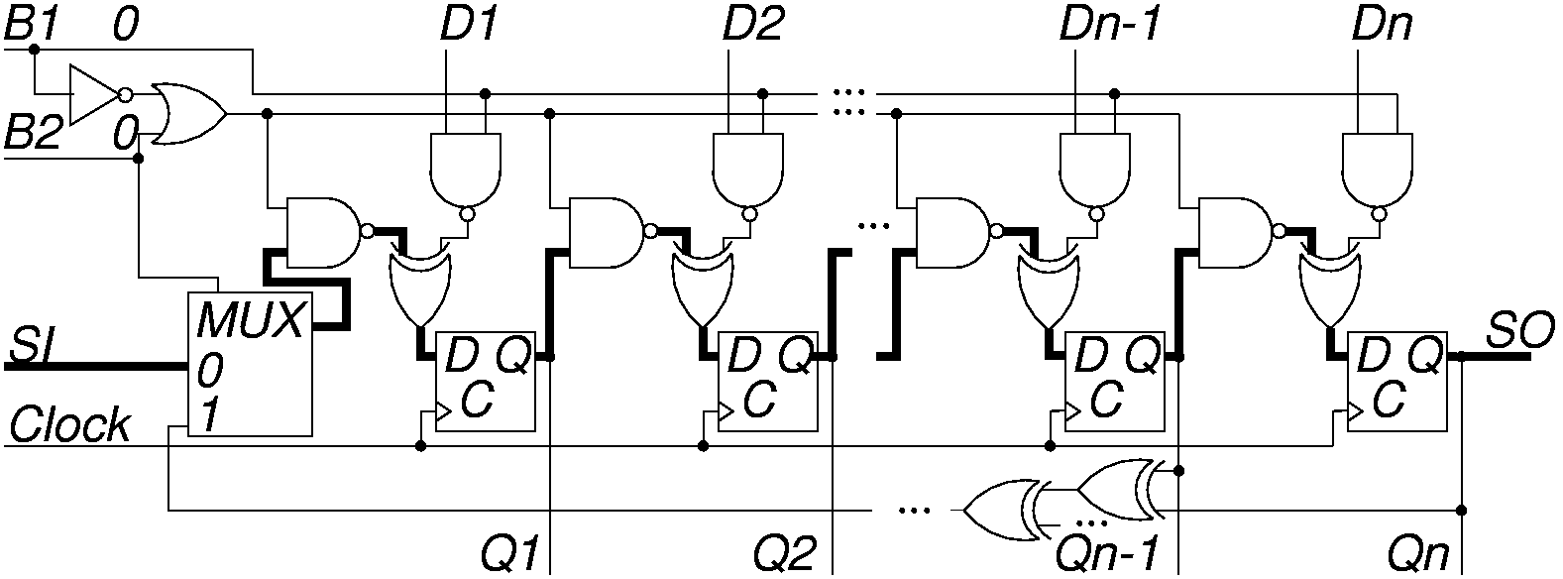
BILBO Serial Scan Mode
B1 B2 = “00”
Bold lines show enabled data paths

Slide 70
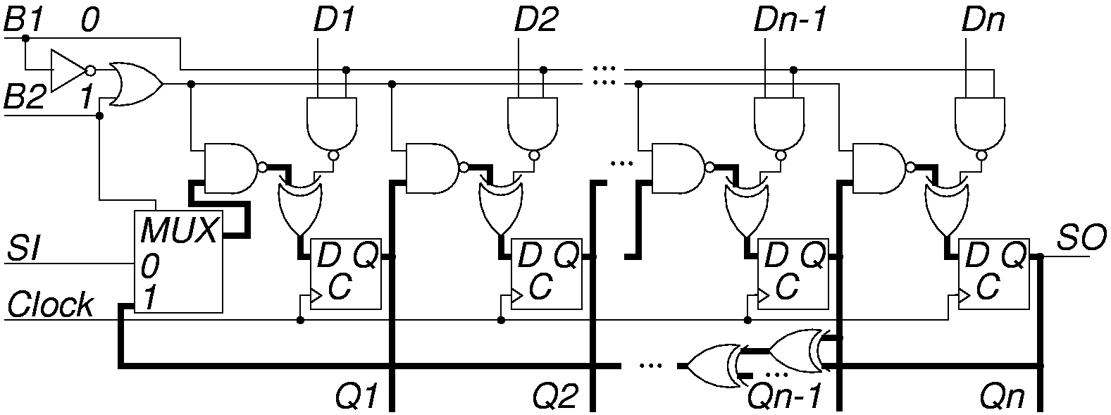
BILBO LFSR Pattern Generator Mode
B1 B2 = “01”

Slide 71
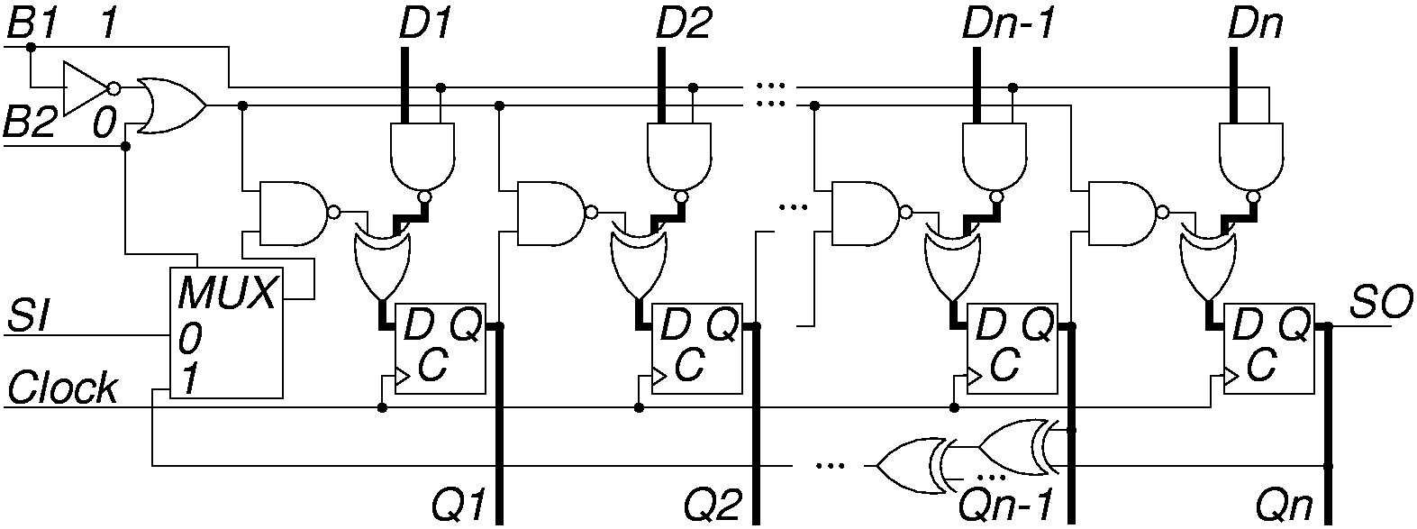
BILBO in DFF (Normal) Mode
B1 B2 = “10”

Slide 72
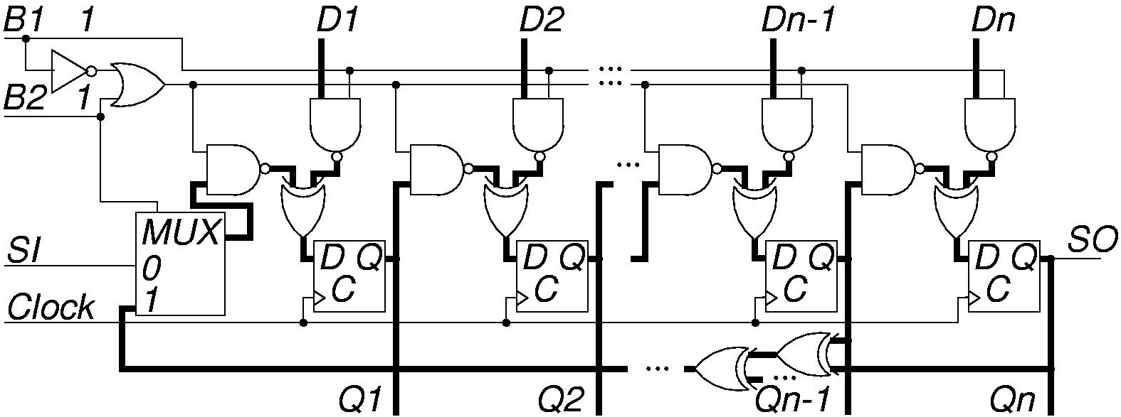
BILBO in MISR Mode
B1 B2 = “11”

Slide 73
A Conceptual Architecture for Core Test Access
Three separate elements in the embedded core test infrastructure
  Test pattern source and sink
  Test Access Mechanism
  Core test wrapper

Slide 74
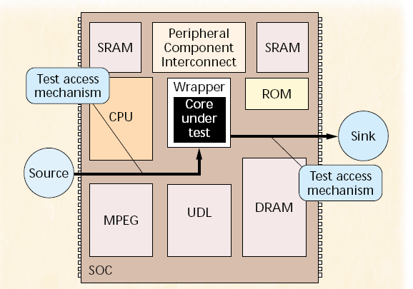
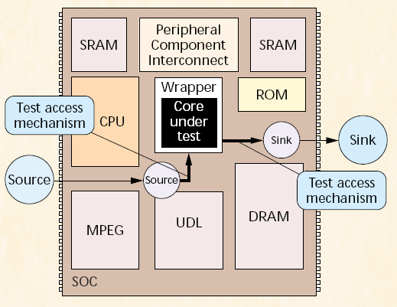
Source & Sink
The source generates the test stimuli and the sink compares the response to the expected response.
Source and sink of a core can be implemented either off-chip, on-chip or as a combination of both.

Slide 75
Test Access Mechanism
It takes care of on-chip test pattern transport.
The key components of any TAM are its width and length.
The width refers to the TAM’s transport capacity.
The length of a TAM is the physical distance it has to bridge between the source and core or core and sink.

Slide 76
Different ways of implementing a TAM
When implementing a TAM, we have the following options
  A TAM can either reuse existing functionality to transport test patterns or be formed by dedicated test access hardware.
  A TAM can either go through other modules on the IC or pass around those other modules.
  One can either have an independent access mechanism per core, or share an access mechanism with multiple cores.
  A test access mechanism can either be a plain signal transport medium, or may contain certain intelligent test control functions.

Slide 77
Test Rail
Combines the strength of both the test bus and boundary scan test approaches.
One or more test rails of varying width per IC – trade off between test time and silicon area.
Multiple cores can be daisy chained into one test rail.
Per core there is a test rail bypass-allows user to test each core sequentially or multiple cores in parallel – trade off between diagnostic resolution and test time.

Slide 78
Test Rail Architecture

Slide 79
Core Test Wrapper
Interface between the embedded core and its system chip environment.
It connects the core terminals both to the rest of the IC, as well as to the TAM.
It is implemented on chip.

Slide 80
P1500 Standard
IEEE standard
  http://grouper.ieee.org/groups/1500/index.html
It consists of two components
  Core Test Wrapper
  Core Test Language (CTL)

Slide 81
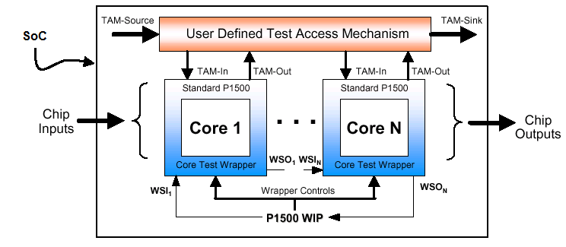
SoC with P1500 wrapped cores
TAM source/sink – chip I/O, test bus/rail, BIST, etc.
TAM in/out – 0 to n lines for parallel and/or serial test data, or test control
Wrapper Interface Port (WIP)

Slide 82
P1500 TAM Connection Example

Slide 83
P1500 wrapper configurations

Slide 84
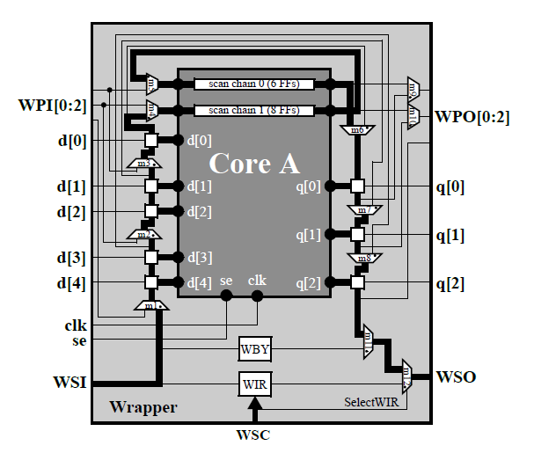
Example of application (serial intest)
cf. IEEE P1500 Standard

Slide 85
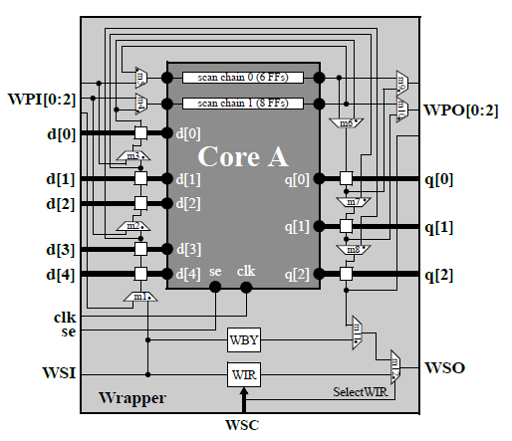
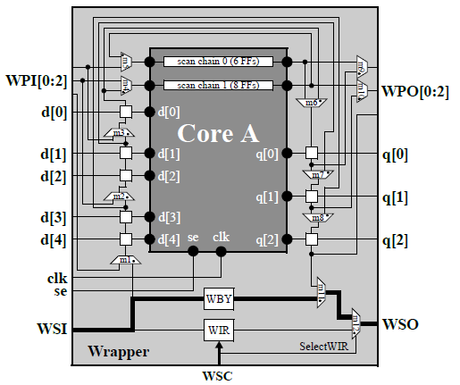
Example of application (bypass)
cf. IEEE P1500 Standard

Slide 86
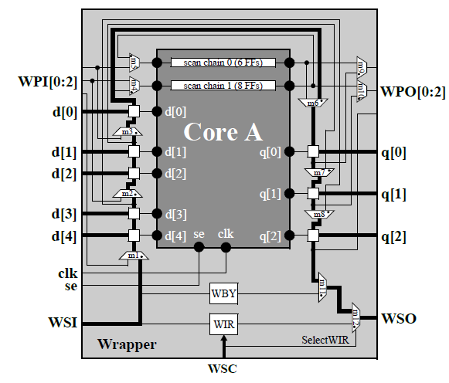
Example of application (serial extest)
cf. IEEE P1500 Standard

Slide 87
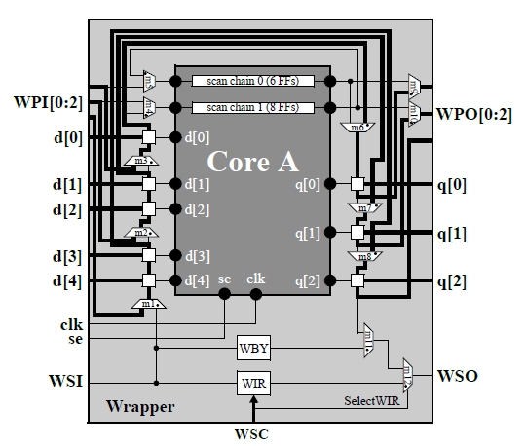
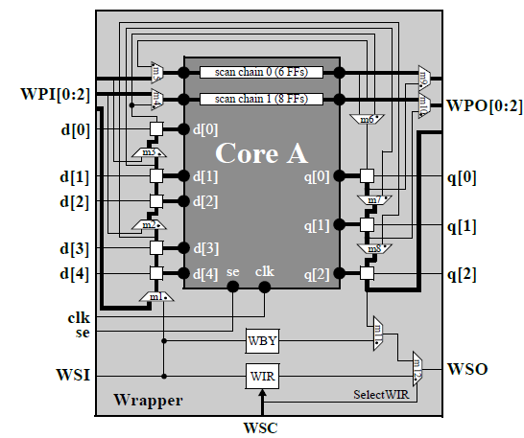
Example of application (parallel extest, intest)
cf. IEEE P1500 Standard

