Slide 1
EE434: ASIC and Digital Systems
Midterm 2 Review
Jacob Murray
School of EECS, WSU
jmurray@eecs.wsu.edu

Slide 2
Structure of the Exam
Three problems with multiple parts
All topics will be almost equally represented
Will look similar to layout of sample exam
What is fair game?
  Lecture 18 – Lecture 25

Slide 3
Overview
Verilog
Finite State Machines
Test Methodologies
Fault Modeling
Design for Test (DFT)

Slide 4
Verilog
You will NOT need to write any long complicated code
You should be able to write small pieces of Verilog
Understand common coding mistakes
Be able to detect limitations in a block of code

Slide 5
Verilog
Do you see any problem with the following Verilog code? Please explain.
always @ (posedge clk, posedge reset)
if (reset) q <= 0;
else q <= d;
always @ (set)
if (set) q <= 1;
endmodule

Slide 6
Verilog
When we tried to simulate the following code, sometimes we observed ‘x’ at the output. What is the reason behind such an observation? Explain.
module mux_2 (input [3:0] d0, d1,
input s,
output [3:0] y);
tristate t0 (d0, s, y);
tristate t1 (d1, s, y);
endmodule

Slide 7
Verilog
Following is the module declaration of a D flip-flop with an asynchronous active-low reset. Complete the description of the flip-flop using Verilog.
module flipflop (D, Clock, Resetn, Q);
input D, Clock, Resetn;
output Q;
reg Q;
always @ (…)
…
endmodule

Slide 8
Verilog
The following piece of Verilog code is to be used to model a Mux. When synthesized would it behave like a Mux? If not, what would it be? Explain.
module mux (input [3: 0] d_0, d_1,
input s, output reg [3: 0] y);
always @ (posedge s)
if (s) y <= d_1;
else y <= d_0;
endmodule

Slide 9
Finite State Machines
State transition graph
Reachability of states
Homing sequence
Equivalent states
State encoding

Slide 10
State transition graph
Each transition describes part of the next-state, output functions:
S2
S1
S3

Slide 11
“01” String Recognizer
Recognize 01 sequence in input string:
recognizer
0
0
0
0
1
1
1
0
0
0
1
1

Slide 12
Recognizer state transition graph
1/0
0/0
Bit 1
0/0
Bit 2
1/1

Slide 13
Reachability
State is reachable if there is a path from given state.
May be created by state encoding:
s0
s1
s2
s3

Slide 14
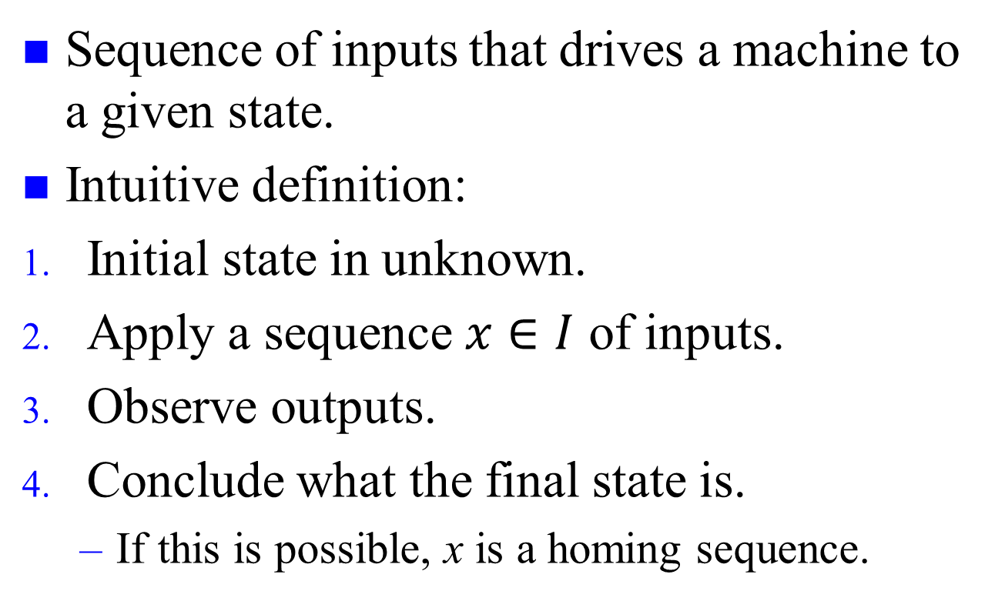
Homing sequence
Sequence of inputs that drives a machine to a given state.
Intuitive definition:
Initial state in unknown.
Apply a sequence $x∈I$ of inputs.
Observe outputs.
Conclude what the final state is.
  If this is possible, x is a homing sequence.
s0
s1
s2

Slide 15
Equivalent states
States are equivalent if they cannot be distinguished by any input sequence:
0/0
s1
s2
-/1
1/0
-/0
-/0
s3
s4
States s2 and s3 are equivalent

Slide 16
Test Methodologies
Defects and faults
Real tests
Testing types

Slide 17
Defect vs. Fault
To become a fault, the defect needs to connect two disjoint conductors or disconnect a continuous pattern

Slide 18
Real Tests
Based on analyzable fault models, which may not map on real defects.
Incomplete coverage of modeled faults due to high complexity.
Some good chips are rejected. The fraction (or percentage) of such chips is called the yield loss.
Some bad chips pass tests. The fraction (or percentage) of bad chips among all passing chips is called the defect level.

Slide 19
Testing as Filter Process
Good chips
Prob(pass test) = high
Mostly
good
chips
Prob (good) = y
Fabricated
chips
Prob(pass test) = low
Prob(fail test) = low
Defective chips
Mostly
bad
chips
Prob(bad) = 1- y
Prob(fail test) = high

Slide 20
Roles of Testing
Detection: Determination whether or not the device under test (DUT) has some fault.
Diagnosis: Identification of a specific fault that is present on DUT.
Device characterization: Determination and correction of errors in design and/or test procedure.
Failure mode analysis (FMA): Determination of manufacturing process errors that may have caused defects on the DUT.

Slide 21
Types of Testing
Verification testing, characterization testing, or design debug
  Verifies correctness of design and of test procedure – usually requires correction to design
Manufacturing testing
  Factory testing of all manufactured chips for parametric faults and for random defects
Acceptance testing (incoming inspection)
  User (customer) tests purchased parts to ensure quality

Slide 22
Fault Modeling
Definitions related to testing
Stuck-at fault model
  Single
  Multiple
Fault equivalence
Fault dominance
Test vectors needed to detect faults
Transistor Faults

Slide 23
Stuck-at Fault
The circuit is modeled as an interconnection of Boolean gates
Each connecting line can have two types of faults
  Stuck-at-1 (s-a-1) & Stuck-at-0 (s-a-0)
A circuit with n lines can have 3^{n}-1 possible stuck line combinations
  Each line can be in one of the three states:(s-a-1),(s-a-0), or fault free
An n-line circuit can have at most 2n single stuck-at faults

Slide 24
Single Stuck-at Fault
Three properties define a single stuck-at fault
    Only one line is faulty
    The faulty line is permanently set to 0 or 1
    The fault can be at an input or output of a gate
Example: XOR circuit has 12 fault sites ( ) and 24 single stuck-at faults
Faulty circuit value
Good circuit value
c
j
s-a-0
0(1)
a
d
g
1(0)
1
h
z
0
1
i
b
e
1
f
k
Test vector for h s-a-0 fault

Slide 25
Fault Equivalence
Number of fault sites in a Boolean gate circuit = #PI + #gates + #(fanout branches)
Fault equivalence: Two faults f1 and f2 are equivalent if all tests that detect f1 also detect f2.
If faults f1 and f2 are equivalent then the corresponding faulty functions are identical.
Fault collapsing: All single faults of a logic circuit can be divided into disjoint equivalence subsets, where all faults in a subset are mutually equivalent. A collapsed fault set contains one fault from each equivalence subset.

Slide 26
Equivalence Rules
sa0
sa0
sa1
sa1
sa0 sa1
sa0 sa1
WIRE
sa0 sa1
sa0 sa1
AND
OR
sa0 sa1
sa0 sa1
sa0
sa1
NOT
sa0
sa1
sa0 sa1
sa0 sa1
sa0 sa1
sa0 sa1
sa0
NAND
NOR
sa1
sa0 sa1
sa0
sa0 sa1
sa1
sa0
FANOUT
sa1

Slide 27
Equivalence Example
sa0 sa1
Faults removed by equivalence
collapsing
sa0 sa1
sa0 sa1
sa0 sa1
sa0 sa1
sa0 sa1
sa0 sa1
sa0 sa1
sa0 sa1
sa0 sa1
sa0 sa1
sa0 sa1
sa0 sa1
sa0 sa1
sa0 sa1
sa0 sa1
20
Collapse ratio = ----- = 0.625
32

Slide 28
Fault Dominance
If all tests of some fault F1 detect another fault F2, then F2 is said to dominate F1.
Dominance fault collapsing: If fault F2 dominates F1, then F2 is removed from the fault list.
When dominance fault collapsing is used, it is sufficient to consider only the input faults of Boolean gates. See the next example.
If two faults dominate each other then they are equivalent.

Slide 29
Dominance Example
All tests of F2
F1
s-a-1
001
110 010
000
101
100
F2
s-a-1
011
s-a-1
Only test of F1
s-a-1
s-a-1
s-a-0
A dominance collapsed fault set

Slide 30
Dominance Example
sa0 sa1
Faults
removed by
equivalence
collapsing
sa0 sa1
sa0 sa1
sa0 sa1
sa0 sa1
sa0 sa1
sa0 sa1
sa0 sa1
sa0 sa1
sa0 sa1
sa0 sa1
sa0 sa1
Faults
removed by
dominance
collapsing
sa0 sa1
sa0 sa1
sa0 sa1
sa0 sa1
15
Collapse ratio = ----- = 0.47
32

Slide 31
Dominance Fault Collapsing
An n-input Boolean gate requires (n+1) single stuck-at faults to be modeled.
To collapse faults of a gate, all faults from the output can be eliminated retaining one type (s-a-1 for AND and NAND; s-a-0 for OR and NOR) of fault on each input and the other type (s-a-0 for AND and NAND; s-a-1 for OR and NOR) on any one of the inputs
The output faults of the NOT gate, and the wire can be removed as long as both faults on the input are retained.

Slide 32
Multiple Stuck-at Faults
A multiple stuck-at fault means that any set of lines is stuck-at some combination of (0,1) values.
The total number of single and multiple stuck-at faults in a circuit with k single fault sites is 3^{k}-1.
A single fault test can fail to detect the target fault if another fault is also present, however, such masking of one fault by another is rare.
Statistically, single fault tests cover a very large number of multiple faults.

Slide 33
Transistor (Switch) Faults
MOS transistor is considered an ideal switch and two types of faults are modeled:
    Stuck-open -- a single transistor is permanently stuck in the open state.
    Stuck-short -- a single transistor is permanently shorted irrespective of its gate voltage.
Detection of a stuck-open fault requires two vectors.
Detection of a stuck-short fault requires the measurement of quiescent current (I_{DDQ}).

Slide 34
Stuck-Open Example
Vector 1: test for A s-a-0
(Initialization vector)
Vector 2 (test for A s-a-1)
pMOS
FETs
V_{DD}
Two-vector s-op test
can be constructed by
ordering two s-at tests
A
1
0
0
0
Stuck-
open
B
C
0
1(Z)
nMOS
FETs
Good circuit states
Faulty circuit states

Slide 35
Stuck-Short Example
Test vector for A s-a-0
pMOS
FETs
V_{DD}
I_{DDQ} path in
faulty circuit
A
1
0
Stuck-
short
B
Good circuit state
C
0 (X)
nMOS
FETs
Faulty circuit state

Slide 36
Design for Test
Full-Scan
Observability
Controllability
Scan Flip-Flop

Slide 37
Definition
Design for testability (DFT) refers to those design techniques that make test generation and test application cost-effective.
DFT methods for digital circuits:
  Ad-hoc methods
  Structured methods:
    Scan
    Partial Scan
    Built-in self-test (BIST)
    Boundary scan
DFT method for mixed-signal circuits:
    Analog test bus

Slide 38
Observability
The observability of a particular circuit node is the degree to which we can observe that node at the output of an integrated circuit.
Measure the output of a gate within a larger circuit to check whether it operates correctly.
Limited number of nodes can be directly observed.

Slide 39
Controllability
The controllability of an internal circuit node within a chip is a measure of the ease of setting the node to a 1 or 0 metric.
Degree of difficulty of testing a particular signal within a circuit
An easily controllable node would be directly settable via an input pad.

Slide 40
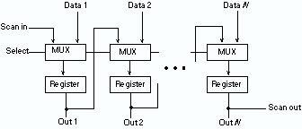
Scan Design
In test mode, all flip-flops functionally form one or more shift registers.
The inputs and outputs of these shift registers are connected to PI/Pos.
Using the test mode, all flip-flops can be set to any desired states.
The states of the flip-flops are observed by shifting the contents of the scan register out.

Slide 41
Scan Flip-Flop (SFF)
D
Master latch
Slave latch
TC
Logic
overhead
Q
MUX
SD
Q
CK
D flip-flop
CK
Master open
Slave open
t
TC
Normal mode, D selected
Scan mode, SD selected
t

