Slide 1
EE434
ASIC & Digital Systems
Jacob Murray
School of EECS
Washington State University
jmurray@eecs.wsu.edu

Slide 2
More on State Machines
(Lecture 21)
Adopted from FPGA-based System Design
Reference: Chapter 5 of the text book

Slide 3
Sequential machines
Use registers to make primary output values depend on state + primary inputs.
Varieties:
  Mealy—outputs function of present state, inputs;
  Moore—outputs depend only on state.

Slide 4
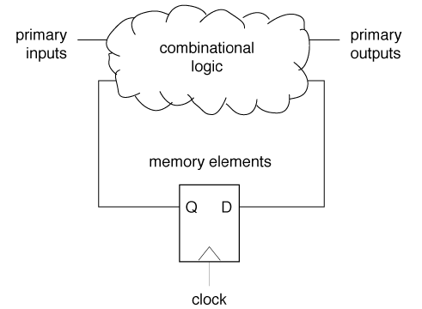
FSM structure

Slide 5
Synchronous design
Controlled by clock(s).
  State changes at time determined by the clock.
  Inputs to registers settle in time for state change.
  Primary inputs settle in time for combinational delay through logic.
Machine state is determined solely by registers.
  Don’t have to worry about timing constraints, events outside the registers.

Slide 6
Non-functional requirements and optimization
Performance:
  Clock period is determined by combinational logic delay.
Area:
  Combinational logic size usually dominates area.
Energy/power:
  Often dominated by combinational logic.
  May be improved by latching values.

Slide 7
Models of state machines
Register-transfer:
  Combinational equations for inputs to registers.
State transition graph/table:
  Next-state, output functions described piecewise.

Slide 8
State transition graph
Each transition describes part of the next-state, output functions:
S2
S1
S3

Slide 9
Register-transfer structure
Registers fed by combinational logic:
Combinational
logic
D
Q
D
Q
D
Q
D
Q
D
Q
D
Q

Slide 10
Block diagram
Combination of register-transfer machines
Purely structural description:
B1
A
B2

Slide 11
Symbolic values
A sequential machine description may use symbolic, not binary values.
  Symbolic values must be encoded during implementation.
Encoding may optimize implementation characteristics:
  Area.
  Performance.
  Energy.

Slide 12
STG vs. register-transfer
Each representation is easier for some types of machines.
Example: counter vs. string recognizer.

Slide 13
Counter state transition graph
Cyclic structure:
1/1
1/2
1/7
0
1
6
7
…
1/0

Slide 14
Counter register-transfer function
Specify using addition:
  Next_count = count + 1.
Regular structure of logic.

Slide 15
“01” String Recognizer
Recognize 01 sequence in input string:
recognizer
0
0
0
0
1
1
1
0
0
0
1
1

Slide 16
Recognizer state transition graph
1/0
0/0
Bit 1
0/0
Bit 2
1/1

Slide 17
Mealy vs. Moore machine
Moore machine:
  Output a function of state.
Mealy machine:
  Output a function of primary inputs + state.

Slide 18
Reachability
State is reachable if there is a path from given state.
May be created by state encoding:
s0
s1
s2
s3

Slide 19
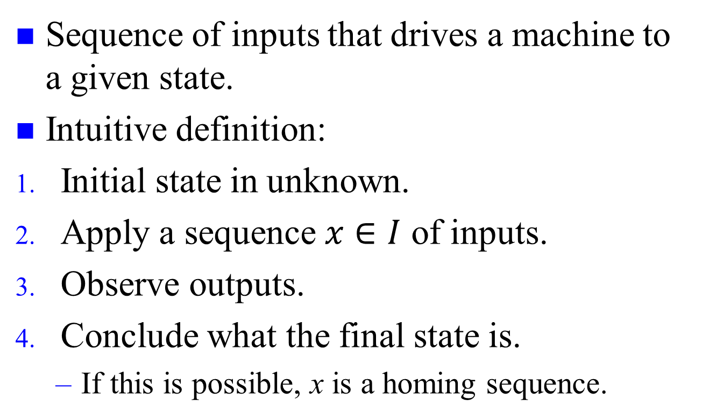
Homing sequence
Sequence of inputs that drives a machine to a given state.
Intuitive definition:
Initial state in unknown.
Apply a sequence $x∈I$ of inputs.
Observe outputs.
Conclude what the final state is.
  If this is possible, x is a homing sequence.
s0
s1
s2

Slide 20
Equivalent states
States are equivalent if they cannot be distinguished by any input sequence:
0/0
s1
s2
-/1
1/0
-/0
-/0
s3
s4
States s2 and s3 are equivalent

Slide 21
Networks of FSMs
Functions can be built up from interconnected FSMs:
I1
x
I2
M1
M2
O1
y
O2
Internal connections
External connections

Slide 22
Illegal composition of Mealy machines
Combinational
logic
Combinational
logic
D
Q
D
Q

Slide 23
State assignment
Find a binary code for symbolic values in machine.
  Optimize area, performance.
  May be done on inputs, outputs as well.

Slide 24
Optimizing state assignments
Codes affect the next-state, output logic.
  Compute conditions based on state.
Best code depends on the input, output logic and its interaction with state computations.

Slide 25
Encoding a shift register
Symbolic state transition table for shift register:
0 | S00 | S00 | 0
1 | S00 | S10 | 0
0 | S01 | S00 | 1
1 | S01 | S10 | 1
0 | S10 | S01 | 0
1 | S10 | S11 | 0
0 | S11 | S01 | 1
1 | S11 | S11 | 1

Slide 26
Bad encoding
Let S00 = 00, S01 = 01, S10 = 11, S11 = 10.
Logic:
  Output = S1 S0’ + S1’ S0

Slide 27
Good encoding
Let S00 = 00, S01 = 01, S10 = 10, S11 = 11.
Logic:
  Output = S0

Slide 28
One-hot code
N-state machine has n-bit encoding.
i^{th} bit is 1 if machine is in state i.
Comparison:
  Easy to tell what state the machine is in.
  Easy to get the machine into an illegal state (0000, 1111, etc.).
  Uses a lot of registers.

Slide 29
State codes in n-space
1
s2 code = 110
s1 code = 111
0
1
1

Slide 30
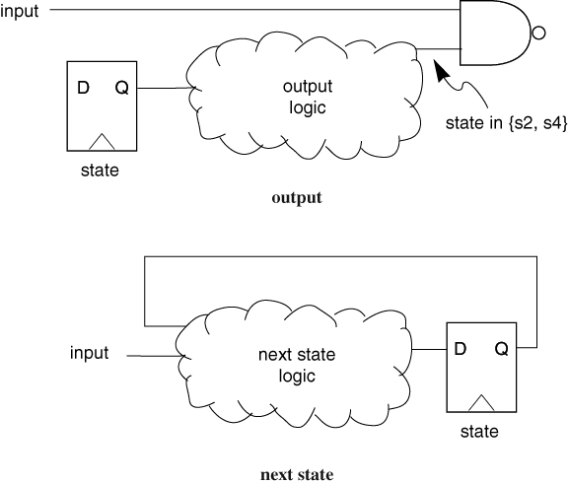
State codes and delay

Slide 31
Traffic light controller
Intersection of two roads:
  highway (busy);
  farm (not busy).
Want to give green light to highway as much as possible.
Want to give green to farm when needed.
Must always have at least one red light.

Slide 32
Traffic light system
traffic light (red, yellow, green)
farm road
highway
sensor (cars)

Slide 33
System operation
Sensor on farm road indicates when cars on farm road are waiting for green light.
Must obey required lengths for green, yellow lights.

Slide 34
Traffic light machine
Build controller out of two machines:
  sequencer which sets colors of lights, etc.
  timer which is used to control durations of lights.
Separate counter isolates logical design from clock period.
Separate counter greatly reduces number of states in sequencer.

Slide 35
Sequencer state transition graph
(cars & long)’ / 0 green red
hwy-
green
short/ 1 red yellow
cars & long / 1 green red
short’ /
0 red yellow
farm-
yellow
hwy-
yellow
short’ /
0 yellow red
short / 1 yellow red
cars’ + long / 1 red green
farm-
green
cars & long’ / 0 red green

