Slide 1

Dynamic Branch Prediction

Slide 2
Static Branch Prediction
Code around delayed branch
To reorder code around branches, need to predict branch statically when compile
Simplest scheme is to predict a branch as taken
Average misprediction = untaken branch frequency = 34% SPEC
More accurate scheme predicts branches using profile information collected from earlier runs, and modify prediction based on last run:
Integer
Floating Point

Slide 3
Dynamic Branch Prediction
Why does prediction work?
Underlying algorithm has regularities
Data that is being operated on has regularities
Instruction sequence has redundancies that are artifacts of way that humans/compilers think about problems
Is dynamic branch prediction better than static branch prediction?
There are a small number of important branches in programs which have dynamic behavior

Slide 4
Dynamic Branch Prediction
Performance = ƒ(accuracy, cost of misprediction)
Branch History Table (BHT) is simplest
Lower bits of PC address index table of 1-bit values
Says whether or not branch taken last time
No address check
Problem: in a loop, 1-bit BHT will cause two mispredictions (avg is 9 iterations before exit):
End of loop case, when it exits instead of looping as before
First time through loop on next time through code, when it predicts exit instead of looping

Slide 5
Branch History Table (Branch Target Buffer)
PC Target PC Prediction
3320
3340
3340
4460
1(T)
4520
3320
1(T)
4460
4520

Slide 6
Dynamic Branch Prediction
Solution: 2-bit scheme where change prediction only if get misprediction twice
Red: stop, not taken
Green: go, taken
Taken
Not taken
Predicted Taken (11)
Predicted Taken (10)
Taken
Taken
Not taken
Not taken
Predicted (01) not Taken
Predicted (00) not Taken
Taken
Not taken

Slide 7
Dynamic Branch Prediction
PC
Target
Prediction
Taken
Not taken
Predicted Taken
Predicted Taken
Taken
Taken
Not taken
Not taken
Predicted not Taken
Predicted not Taken
Taken
Not taken
BHT

Slide 8
BHT Accuracy
Mispredict, reasons:
Wrong guess for that branch
Got branch history of wrong branch when index the table
4096 entry table programs vary from 1% misprediction (nasa7, tomcatv) to 18% (eqntott), with spice at 9% and gcc at 12%
4096 about as good as infinite table (in Alpha 211164)

Slide 9
Example
if ( d = =0 ) b1
d = 1
if ( d = = 1) b2

Slide 10
Possible sequence
if ( d = =0 ) b1
d = 1
if ( d = = 1) b2

Slide 11
1-bit predictor
d
b1 prediction
b1 action
New b1 prediction
b2 prediction
b2 action
New b2 prediction
2
NT
T
T
NT
T
T
0
T
NT
NT
T
NT
NT
2
NT
T
T
NT
T
T
0
T
NT
NT
T
NT
NT

Slide 12
Correlating Branches
Hypothesis: recent branches are correlated;
that is, behavior of recently executed branches affects prediction of current branch
Idea: record m most recently executed branches as taken or not taken, and use that pattern to select the proper branch history table
In general, (m,n) predictor means record last m branches to select between 2^{m} history tables each with n-bit counters
Our old 2-bit BHT is then a (0,2) predictor

Slide 13
(1,1)
NT T
Last branch
d
b1 prediction
b1 action
New b1 prediction
b2 prediction
b2 action
New b2 prediction
2
NT/NT
T
T/NT
NT/NT
T
NT/T
0
T/NT
NT
T/NT
NT/T
NT
NT/T
2
T/NT
T
T/NT
NT/T
T
NT/T
0
T/NT
NT
T/NT
NT/T
NT
NT/T

Slide 14
Correlating Branches
(2,2) predictor
The behavior of recent branches selects between four predictions of next branch, and
updating just that prediction
Branch address
2-bits per branch predictors
NT
T
← last branch
Prediction
NT T
NT T
Previous to last branch
i-1 branch: Not Taken
i-2 branch: Taken

Slide 15
Correlating Branches
(2,2) predictor
– Behavior of recent branches selects between four predictions of next branch, updating just that prediction
Branch address
4
2-bits per branch predictor
Prediction
2-bit global branch history

Slide 16
Accuracy of Different Schemes
4096 Entries 2-bit BHT
Unlimited Entries 2-bit BHT
1024 Entries (2,2) BHT
Frequency of Mispredictions

Slide 17
Re-evaluating Correlation
Several of the SPEC benchmarks have less than a dozen branches responsible for 90% of taken branches:
program branch % static # = 90%
compress 14% 236 13
eqntott 25% 494 5
gcc 15% 9531 2020
mpeg 10% 5598 532
real gcc 13% 17361 3214
Real programs + OS more like gcc
Small benefits beyond benchmarks for correlation?

Slide 18
Need Address at Same Time as Prediction
Branch Target Buffer (BTB): Address of branch index to get prediction AND branch address (if taken)
Note: must check for branch match now, since can’t use wrong branch address ()
Return instruction addresses predicted with stack

Slide 19
Branch Target Buffer (Section 2.9 textbook)
PC of instruction to fetch
Predicted PC
T/NT prediction
Number of entries in BTB
=
No
Instruction is not predicted to be a branch.
Yes
Instruction is a branch and predicted

Slide 20
Instruction Fetch (stage)
Send PC to
Instruction Memory and
Branch Target Buffer (BTB)
No
Entry found in BTB ?
Yes

Slide 21
Address is not in BTB
No
Entry found in BTB ?
Yes
IF
No
Is instruction a
taken branch?
Yes
ID
Normal Instruction execution
Enter branch address and next PC into BTB
EX

Slide 22
Address is in BTB
No
Entry found in BTB ?
Yes
IF
Send out predicted PC
No
Yes
taken branch?
ID
Mispredicted branch
Kill fetch; restart fetch; delete entry from BTB
NO STALLS
EX

Slide 23
Tournament Predictors
Motivation for correlating branch predictors is 2-bit predictor failed on important branches; by adding global information, performance improved
Tournament predictors: use 2 predictors,
1 based on global information and
1 based on local information, and
combine with a selector
Hopes to select right predictor for right branch (or right context of branch)

Slide 24
Tournament Predictor in Alpha 21264
4K 2-bit counters to choose from among a global predictor and a local predictor
Global predictor also has 4K entries and is indexed by the history of the last 12 branches; each entry in the global predictor is a standard 2-bit predictor
12-bit pattern: ith bit 0 => ith prior branch not taken;
ith bit 1 => ith prior branch taken.
1
4K × 2 bits
2
3
.
.
.
12
Address

Slide 25
Tournament Predictor in Alpha 21264
Local predictor consists of a 2-level predictor:
Top level a local history table consisting of 1024 10-bit entries; each 10-bit entry corresponds to the most recent 10 branch outcomes for the entry. 10-bit history allows patterns 10 branches to be discovered and predicted.
Next level Selected entry from the local history table is used to index a table of 1K entries consisting a 3-bit saturating counters, which provide the local prediction
Total size: 4K*2 + 4K*2 + 1K*10 + 1K*3 = 29K bits!
(~180,000 transistors)
1K × 10 bits
1K × 3 bits

Slide 26
% of predictions from local predictor in Tournament Prediction Scheme

Slide 27
Accuracy v. Size (SPEC89)

Slide 28
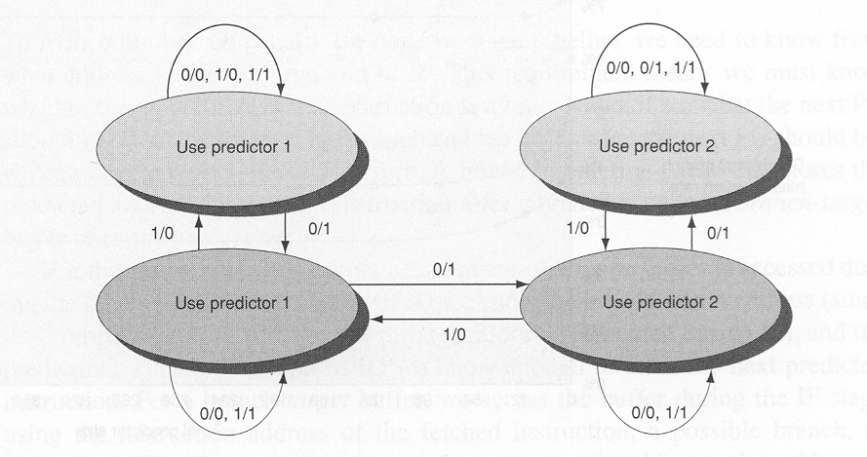
2-bit counter predictor selector
Predictor 2
Predictor 1

Slide 29
Selective History Predictor
8096 x 2 bits
1
0
Taken/Not Taken
11
10
01
00
Choose Non-correlator
Branch Addr
Choose Correlator
2
Global
History
00
01
8K x 2 bit
Selector
10
11
11 Taken
10
01 Not Taken
00
2048 x 4 x 2 bits

Slide 30
Taken
Not taken
Predicted Taken (11)
Predicted Taken (10)
Taken
Taken
Not taken
Not taken
8096 x 2 bits
Predicted (01) not Taken
Predicted (00) not Taken
1
0
Taken
Taken/Not Taken
Not taken
11
10
01
00
Choose Non-correlator
Branch Addr
Choose Correlator
2
Global
History
00
01
8K x 2 bit
Selector
10
00
11
11
11 Taken
10
01 Not Taken
00
2048 x 4 x 2 bits
01
10

Slide 31
Dynamic Branch Prediction Summary
Branch History Table: 2 bits for loop accuracy
Correlation: Recently executed branches correlated with next branch
Branch Target Buffer: include branch address & prediction
Predicated Execution can reduce number of branches, number of mispredicted branches

Slide 32
Gselect and Gshare predictors
Keep a global register (GR) with outcome of k branches
Use that in conjunction with PC to index into a table containing 2-bit predictor
Gselect – concatenate
Gshare – XOR (better)
(PHT) Pattern History Table

Slide 33
Predicated Execution
Avoid branch prediction by turning branches into conditionally executed instructions:
if (x) then A = B op C else NOP
If false, then neither store result nor cause interference
Expanded ISA of Alpha, MIPS, PowerPC, SPARC have conditional move; PA-RISC can annul any following instruction
Drawbacks to conditional instructions
Still takes a clock even if “annulled”
Stall if condition evaluated late: Complex conditions reduce effectiveness since condition becomes known late in pipeline
x
A = B op C

Slide 34
Types of Branches

Slide 35
Special Case: Return Addresses
Register Indirect branch - hard to predict address
SPEC89 85% such branches for procedure return
Since stack discipline for procedures, save return address in small buffer that acts like a stack: 8 to 16 entries has small miss rate, return address stack (RAS)

