Slide 1
Execution of Multiple Instructions per cycle

Slide 2
Getting CPI < 1: Issuing Multiple Instructions/Cycle
Two variations
Superscalar: varying number of instructions/cycle (1 to 8), scheduled by compiler or by HW (Tomasulo)
IBM PowerPC, Sun UltraSparc, DEC Alpha, HP 8000
(Very) Long Instruction Words (V)LIW: fixed number of instructions (4-16) scheduled by the compiler; put ops into wide templates
Joint HP/Intel agreement in 1999/2000
Intel Architecture-64 (IA-64) 64-bit address
Style: “Explicitly Parallel Instruction Computer (EPIC)”
Anticipated success lead to use of Instructions Per Clock cycle (IPC) vs. CPI

Slide 3
Getting CPI < 1: Issuing Multiple Instructions/Cycle
Superscalar DLX: 2 instructions, 1 FP & 1 anything else
– Fetch 64-bits/clock cycle; Int on left, FP on right
– Can only issue 2nd instruction if 1st instruction issues
– More ports for FP registers to do FP load & FP op in a pair
Type Pipe Stages
Int. instruction IF ID EX MEM WB
FP instruction IF ID EX MEM WB
Int. instruction IF ID EX MEM WB
FP instruction IF ID EX MEM WB
Int. instruction IF ID EX MEM WB
FP instruction IF ID EX MEM WB
1 cycle load delay expands to 3 instructions in SS
instruction in right half can’t use it, nor instructions in next slot

Slide 4
Superscalar
IF
IF
ID
ID
IF
IF
EX
EX
ID
ID
IF
IF
M
M
EX
EX
ID
ID
IF
IF
WB
WB
M
M
EX
EX
ID
ID
IF
IF
WB
WB
M
M
EX
EX
ID
ID
WB
WB
M
M
EX
EX
WB
WB
M
M
WB
WB

Slide 5
Multiple Issue Challenges
Integer/FP split is simple for HW, get CPI of 0.5 only for programs /w:
Exactly 50% FP operations
No hazards
If more instructions issue at same time, greater difficulty of decode and issue
Even 2-scalar => examine 2 opcodes, 6 register specifiers, & decide if 1 or 2 instructions can issue
VLIW: tradeoff instruction space for simple decoding
The very long instruction word (VLIW) has room for many operations
By definition, all the operations the compiler puts in the long instruction word are independent → they can be executed in parallel
E.g., 2 integer operations, 2 FP ops, 2 Memory refs, 1 branch
16 to 24 bits per field => 7*16 or 112 bits to 7*24 or 168 bits wide
Need compiling technique that schedules across several branches

Slide 6
VLIW
Mem. ref. 1 Mem. ref. 2 FP op. 1 FP op. 2 inst branch

Slide 7
Loop Unrolling in VLIW
Memory Memory FP FP Int. op/ Clock reference 1 reference 2 operation 1 op. 2 branch
LD F0,0(R1) LD F6,-8(R1) 1
LD F10,-16(R1) LD F14,-24(R1) 2
LD F18,-32(R1) LD F22,-40(R1) ADDD F4,F0,F2 ADDD F8,F6,F2 3
LD F26,-48(R1) ADDD F12,F10,F2 ADDD F16,F14,F2 4
ADDD F20,F18,F2 ADDD F24,F22,F2 5
SD 0(R1),F4 SD -8(R1),F8 ADDD F28,F26,F2 6
SD -16(R1),F12 SD -24(R1),F16 7
SD -32(R1),F20 SD -40(R1),F24 SUBI R1,R1,#48 8
SD -0(R1),F28 BNEZ R1,LOOP 9
Unrolled 7 times to avoid delays
7 results in 9 clocks, or 1.3 clocks per iteration (1.8X)
Average: 2.5 ops per clock, 50% efficiency
Note: Need more registers in VLIW (15 vs. 6 in SS)

Slide 8
HW support for More ILP
Speculation: allow an instruction to issue that is dependent on branch predicted to be taken without any consequences (including exceptions) if branch is not actually taken (“HW undo”); called “boosting”
Combine branch prediction with dynamic scheduling to execute before branches resolved
Separate speculative bypassing of results from real bypassing of results
When instruction no longer speculative, write boosted results (instruction commit) or discard boosted results
execute out-of-order but commit in-order to prevent irrevocable action (update state or exception) until instruction commits

Slide 9
HW support for More ILP
Need HW buffer for results of uncommitted instructions: reorder buffer
3 fields: instr, destination, value.
Reorder buffer can be operand source → more registers like RS.
Use reorder buffer number instead of reservation station when execution completes.
Supplies operands between execution complete & commit.
Once operand commits, result is put into register.
Instructions commit in order.
As a result, its easy to undo speculated instructions on mispredicted branches or on exceptions.
Reorder
Buffer
FP
Op
Queue
FP Regs
Res Stations
Res Stations
FP Adder
FP Mult

Slide 10
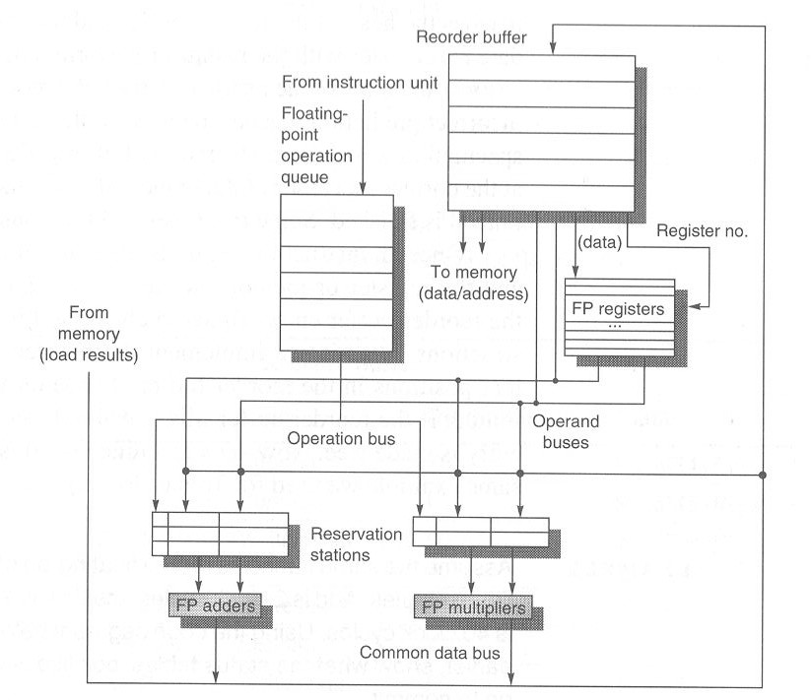
Load unit

Slide 11
Four Steps of Speculative Tomasulo Algorithm
1. Issue—get instruction from FP Op Queue
If reservation station and reorder buffer slot free, issue instr & send operands & reorder buffer no. for destination (this stage sometimes called “dispatch”)
2. Execution—operate on operands (EX)
When both operands ready then execute; if not ready, watch CDB for result; when both in reservation station, execute; checks RAW (sometimes called “issue”)
3. Write result—finish execution (WB)
Write on Common Data Bus to all awaiting FUs & reorder buffer; mark reservation station available.
4. Commit—update register with reorder result
When instr. at head of reorder buffer & result present, update register with result (or store to memory) and remove instr from reorder buffer. Mispredicted branch flushes reorder buffer (sometimes called “graduation”)

Slide 12
Branch correction
Reorder buffer information
Fetch Unit
Dispatch unit
w/ 8-entry
instruction queue
Completion
unit w/
reorder
buffer
Instruction
Cache
Instruction dispatch buses
Register nos.
Register
nos.
Instruction Operation buses
Register nos.
Register nos.
GP operand buses
FP operand buses
Reservation Stations
XSU0
XSU1
MCFXU
LSU
FPU
BPU
GP result buses
FP result buses
Result status buses
Data
Cache

Slide 13
Tomasulo With Reorder buffer:
Done?
FP Op
Queue
ROB7
ROB6
ROB5
ROB4
ROB3
ROB2
ROB1
Newest
Reorder Buffer
Oldest
F0
LD F0,10(R2)
N
Registers
To
Memory
Dest
Dest
from
Memory
Dest
Reservation
Stations
1 10+R2
FP adders
FP multipliers
Notes:
Resolve RAW memory conflict? (address in memory buffers)
Integer unit executes in parallel

Slide 14
Tomasulo With Reorder buffer:
Done?
FP Op
Queue
ROB7
ROB6
ROB5
ROB4
ROB3
ROB2
ROB1
Newest
Reorder Buffer
F10
ADDD F10,F4,F0
N
Oldest
F0
LD F0,10(R2)
N
Registers
To
Memory
Dest
Dest
from
Memory
2 ADDD R(F4),ROB1
Dest
Reservation
Stations
1 10+R2
FP adders
FP multipliers
Notes:
Resolve RAW memory conflict? (address in memory buffers)
Integer unit executes in parallel

Slide 15
Tomasulo With Reorder buffer:
Done?
FP Op
Queue
ROB7
ROB6
ROB5
ROB4
ROB3
ROB2
ROB1
Newest
Reorder Buffer
F2
DIVD F2,F10,F6
N
F10
ADDD F10,F4,F0
N
Oldest
F0
LD F0,10(R2)
N
Registers
To
Memory
Dest
Dest
from
Memory
2 ADDD R(F4),ROB1
3 DIVD ROB2,R(F6)
Dest
Reservation
Stations
1 10+R2
FP adders
FP multipliers
Notes:
Resolve RAW memory conflict? (address in memory buffers)
Integer unit executes in parallel

Slide 16
Tomasulo With Reorder buffer:
Done?
FP Op
Queue
ROB7
ROB6
ROB5
ROB4
ROB3
ROB2
ROB1
Newest
F0
ADDD F0,F4,F6
N
F4
LD F4,0(R3)
N
Reorder Buffer
--
BNE F2,<…>
N
F2
DIVD F2,F10,F6
N
F10
ADDD F10,F4,F0
N
Oldest
F0
LD F0,10(R2)
N
Registers
To
Memory
Dest
Dest
from
Memory
2 ADDD R(F4),ROB1
6 ADDD ROB5, R(F6)
3 DIVD ROB2,R(F6)
Dest
Reservation
Stations
1 10+R2
5 0+R3
FP adders
FP multipliers
Notes:
Resolve RAW memory conflict? (address in memory buffers)
Integer unit executes in parallel

Slide 17
Tomasulo With Reorder buffer:
Done?
FP Op
Queue
--
ROB5
ST 0(R3),F4
N
ROB7
ROB6
ROB5
ROB4
ROB3
ROB2
ROB1
Newest
F0
ADDD F0,F4,F6
N
F4
LD F4,0(R3)
N
Reorder Buffer
--
BNE F2,<…>
N
F2
DIVD F2,F10,F6
N
F10
ADDD F10,F4,F0
N
Oldest
F0
LD F0,10(R2)
N
Registers
To
Memory
Dest
Dest
from
Memory
2 ADDD R(F4),ROB1
6 ADDD ROB5, R(F6)
3 DIVD ROB2,R(F6)
Dest
Reservation
Stations
1 10+R2
5 0+R3
FP adders
FP multipliers
Notes:
Resolve RAW memory conflict? (address in memory buffers)
Integer unit executes in parallel

Slide 18
Tomasulo With Reorder buffer:
Done?
FP Op
Queue
--
M[10]
ST 0(R3),F4
Y
ROB7
ROB6
ROB5
ROB4
ROB3
ROB2
ROB1
Newest
F0
ADDD F0,F4,F6
N
F4
M[10]
LD F4,0(R3)
Y
Reorder Buffer
--
BNE F2,<…>
N
F2
DIVD F2,F10,F6
N
F10
ADDD F10,F4,F0
N
Oldest
F0
LD F0,10(R2)
N
Registers
To
Memory
Dest
Dest
from
Memory
2 ADDD R(F4),ROB1
6 ADDD M[10],R(F6)
3 DIVD ROB2,R(F6)
Dest
Reservation
Stations
1 10+R2
FP adders
FP multipliers
Notes:
Resolve RAW memory conflict? (address in memory buffers)
Integer unit executes in parallel

Slide 19
Tomasulo With Reorder buffer:
Done?
FP Op
Queue
--
M[10]
ST 0(R3),F4
Y
ROB7
ROB6
ROB5
ROB4
ROB3
ROB2
ROB1
Newest
F0
<val2>
ADDD F0,F4,F6
Ex
F4
M[10]
LD F4,0(R3)
Y
Reorder Buffer
--
BNE F2,<…>
N
F2
DIVD F2,F10,F6
N
F10
ADDD F10,F4,F0
N
Oldest
F0
LD F0,10(R2)
N
Registers
To
Memory
Dest
Dest
from
Memory
2 ADDD R(F4),ROB1
3 DIVD ROB2,R(F6)
Dest
Reservation
Stations
1 10+R2
FP adders
FP multipliers
Notes:
Resolve RAW memory conflict? (address in memory buffers)
Integer unit executes in parallel

Slide 20
Tomasulo With Reorder buffer:
Done?
FP Op
Queue
--
M[10]
ST 0(R3),F4
Y
ROB7
ROB6
ROB5
ROB4
ROB3
ROB2
ROB1
Newest
F0
<val2>
ADDD F0,F4,F6
Ex
F4
M[10]
LD F4,0(R3)
Y
Reorder Buffer
--
BNE F2,<…>
N
F2
DIVD F2,F10,F6
N
F10
ADDD F10,F4,F0
N
Oldest
What about memory
hazards???
F0
LD F0,10(R2)
N
Registers
To
Memory
Dest
Dest
from
Memory
2 ADDD R(F4),ROB1
3 DIVD ROB2,R(F6)
Dest
Reservation
Stations
1 10+R2
FP adders
FP multipliers
Notes:
Resolve RAW memory conflict? (address in memory buffers)
Integer unit executes in parallel

