Slide 1
EE 261, Spring 2025, Lecture 1
Goals/Topics:
Course information, structure, & ground rules
General comments about electrical circuits
Best viewed in
presentation mode
in PowerPoint.
Announcements:
Homework 0 posted (nothing to submit but things to do).
Suggested readings posted in Assignments at Canvas (different
readings on different days even if they appear with same heading).

Slide 2




Instructor: John B. Schneider, Office: EME 221
Phone: 509 335 6457, email: john_schneider@wsu.edu
TA (ugrad): Kaung Myat Lwin, Dana 149
email: kaungmyat.lwin@wsu.edu
TA (ugrad): Atticus Prim, Dana 149
email: atticus.prim@wsu.edu
Note: Zoom available on request.
Send email to request meeting.
TA (ugrad): Joseph Porter, Dana 149
email: joseph.porter@wsu.edu
TA (ugrad): Henry Shaw, Dana 149
email: henry.shaw@wsu.edu

Slide 3
Meeting Time and Place
Note: EE 262 (the lab) is a separate
course with a separate instructor.
Lecture: Sec. 01 (SLN 02502)
Mon., Wed., Fri. 1:10 p.m.–2:00 p.m., Cleveland, Rm. 30
Midterm Exams: Evenings in Spark G45 (see posted schedule)
Office Hours:
John: Mon., Wed., Fri. 4:00–5:00 p.m., EME 221
Kaung Myat: Tue. 2:00 p.m.–3:00 p.m., Dana 149
Atticus: Fri. 3:00 p.m.–4:00 p.m., Dana 149
Joseph: Thu. 2:00 p.m.–4:00 p.m., Dana 149
Henry: Wed. 4:30 p.m.–5:30 p.m., Dana 149
{
Starting
next
week.
Tutors for circuits also available in VCEA Tutoring Center.
(See: https://vcea.wsu.edu/student-success/tutoring/)

Slide 4
“Additional” course webpage: eecs.wsu.edu/~schneidj/ee261
Duplicates much, but not all, of what is available via Canvas.
Useful if/when Canvas unavailable.
Provides some material not available at Canvas, e.g., “actual”
schedule (what was covered in the past) and
“pre-lecture” slides.
Post-lecture slides will be available both at course webpage and
at Canvas (see Modules > Week N). Posted shortly after lecture.
Post-lecture slides will be available both at course webpage and
at Canvas (see Modules > Week N). Posted shortly after lecture.
View slides by downloading and using presentation mode. Slides
always start nearly empty but may end up rather full. (Often
won’t display properly if viewed directly within Canvas.)
View slides by downloading and using presentation mode. Slides
always start nearly empty but may end up rather full. (Often
won’t display properly if viewed directly within Canvas.)
View slides by downloading and using presentation mode. Slides
always start nearly empty but may end up rather full. (Often
won’t display properly if viewed directly within Canvas.)
Note test dates! Dates are not subject to change.
Evening exams
in Spark G45.

Slide 5
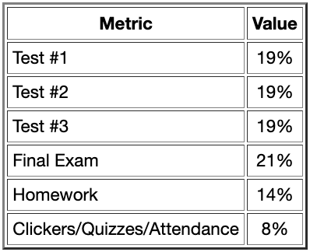
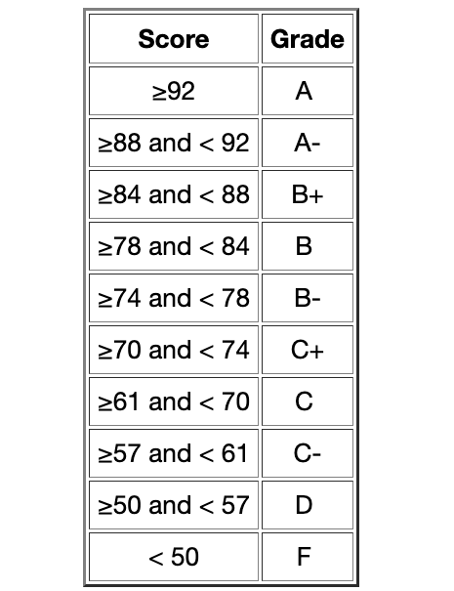
Grading
{
More than 3/4.
{
Less than 1/4.
But important!
Scores calculated to one decimal place
(and not rounded beyond that).
No extra credit available.
(But, some additional optional assessments may be
offered to entire class that may benefit one’s grade.)

Slide 6



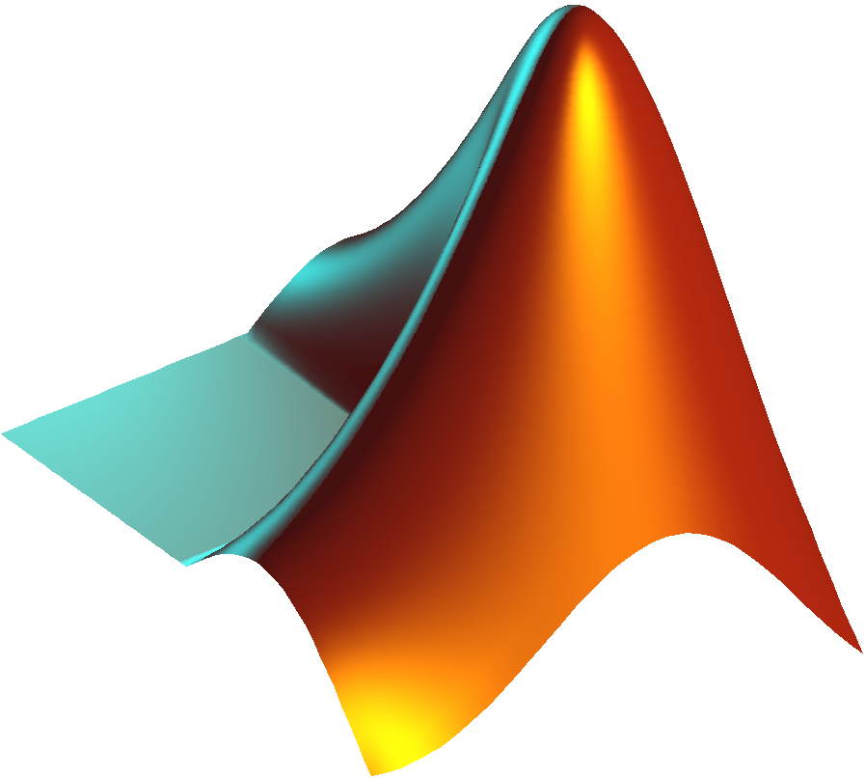
Textbook/Technologies
Required: Electric Circuits, 12th ed., J. W. Nilsson &
S. A. Riedel, Pearson, 2022, ISBN 9780137648375.
Access through Pearson “Mastering” Website.
E-text included in tuition/course fees. Don’t buy!
(But, reduced-price hardcopy available.)
Required: iClicker Student subscription or
physical remote.
Will use iClicker Cloud.
See “Homework 0” for details.
Recommended: MATLAB. Free for WSU students.
Go to:
https://www.mathworks.com/academia/tah-portal/washington-state-university-40714885.html

Slide 7
Homework
Assignments consist of two parts: online work (Pearson Mastering)
and “handwritten” work (submitted via Canvas).
Two lowest Mastering assignments scores dropped.
Two lowest handwritten assignments scores dropped.
Late work is not accepted. (Solution posted shortly after due.)
If you do the homework, you shouldn’t have any trouble with
the exams (which largely determine your grade). You will do well
in this class.
If you do the homework, you shouldn’t have any trouble with
the exams (which largely determine your grade). You will do well
in this class.
If you do not do the homework, it will be a challenge to pass this class.

Slide 8

iClicker
Can respond via physical remote, browser, or via iClicker Student app.
You respond to “polls” (multiple choice or numeric).
Attendance is half of score.
Correctness of answers determines the other half of score.
Three lowest scores dropped.
15% added to obtain final score.
(Responding to a clicker poll while not being in attendance is cheating
and will, at minimum, result in an overall clicker score of zero.)
Clicker questions are invariably “simple” but do require thought.
You will likely answer several clicker questions incorrectly.
That’s okay!
Learn from these (low-stakes) mistakes.

Slide 9
iClicker Demo
What is your major?
  Electrical or Computer Engineering.
  Mechanical Engineering.
  Bioengineering.
  Material Science and Engineering (MSE).
  Other.

Slide 10
HW “0” Posted: Due Sunday, Jan. 12
Find in “Assignments” section of Canvas (or course website).
Nothing to submit (answers to Mastering questions notwithstanding).
No activities in Week 1 will be counted in final grade (that
includes iClicker polling/attendance).
Things start to count in the second week, so best to get
everything sorted out now.
You are asked to read syllabus: Please do that!

Slide 11
Some Keys to Success
Engage with the material and don’t fall behind.
  Honestly work through the homework (even if/when frustrating)
  Read the suggested reading material (textbook is thorough; awkward start)
Collaborate or seek help to enhance learning.
Resources: Classmates, TAs, Tutors, Instructor.
At its core, nothing about this course is very advanced/challenging:
  Scale one number to get another (Ohm’s law)
  Sum of numbers has to be zero (Kirchhoff’s voltage and current laws)
  Consistently apply a few rules (e.g., passive sign convention)
Build your understanding to point where you recognize the simplicity
of the material.
A few “advanced” concepts will show up later (differential equations;
harmonic signals represented by complex numbers).
Keep the easy things easy so the hard things are possible.

Slide 12
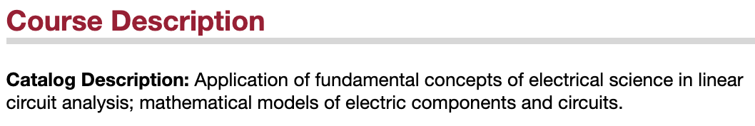
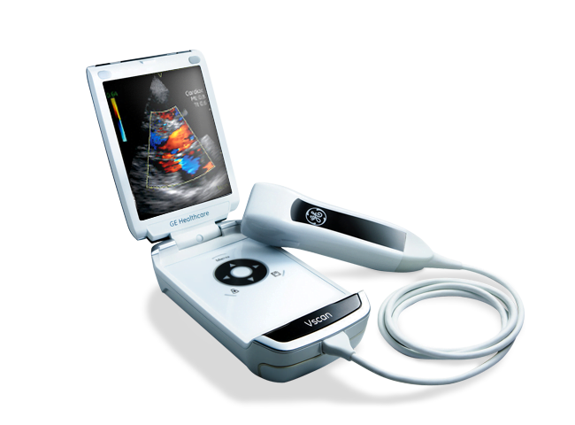
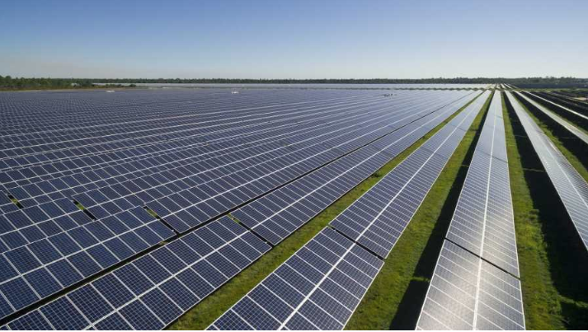
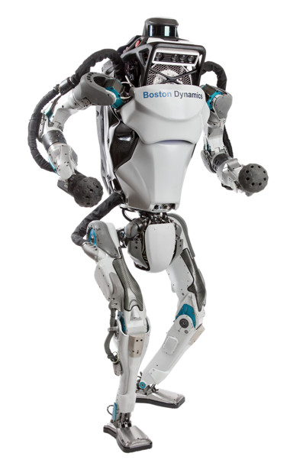
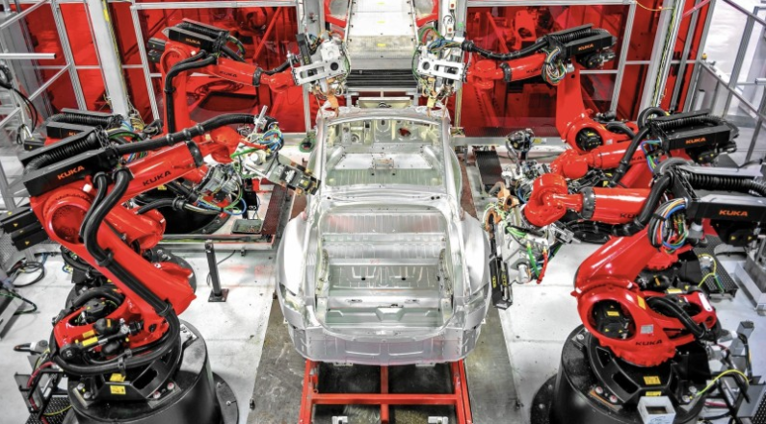
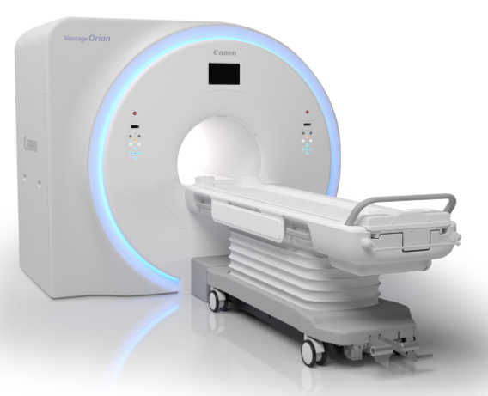
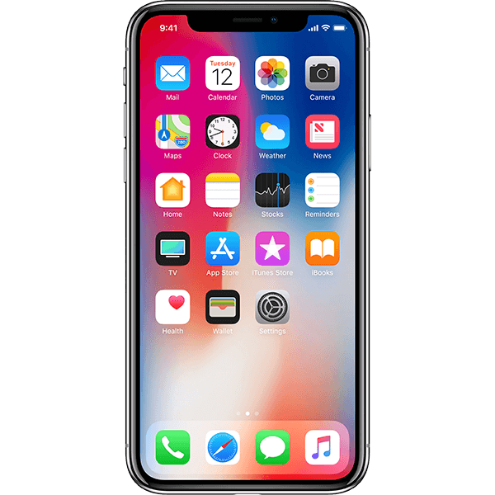
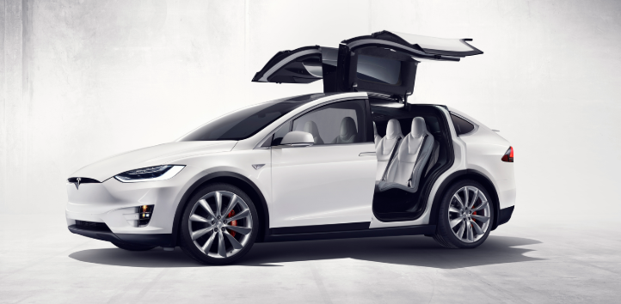
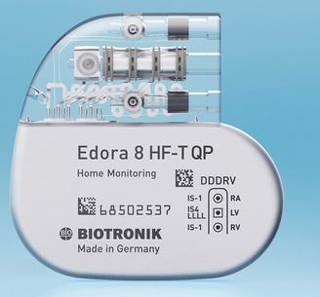
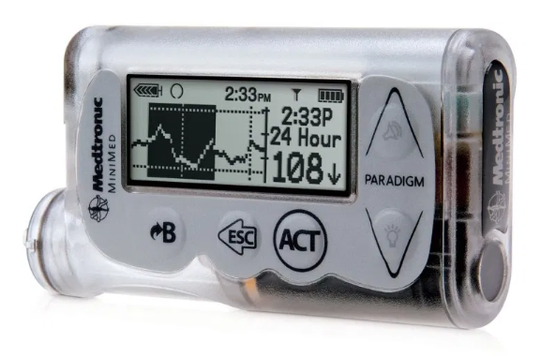
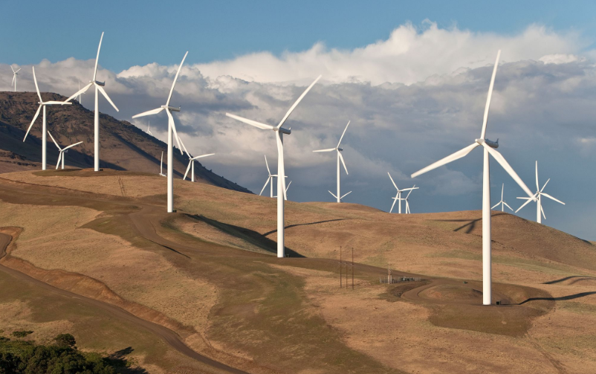

Slide 13


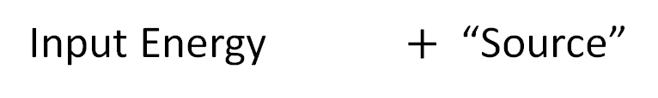





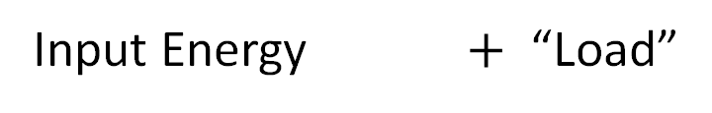


Electricity is a form of energy.
Energy can perform work.
Input Energy $+$ “Source”
Output Energy
Energy source
representations:
Nuclear
$$+$$
Nuclear reactor
Electrical
Optical (EM)
$$+$$
Solar panel
Electrical
Chemical
$$+$$
Battery
Electrical
Mechanical
$$+$$
Wind turbine
Electrical
Acoustic
$$+$$
Microphone
Electrical
Radio waves (EM)
$$+$$
Antenna
Electrical
Input Energy $+$ “Load”
Output Energy
Load
representations:
Electrical
$$+$$
Electric motor
Mechanical
Electrical
$$+$$
Loudspeaker
Acoustic
and
Electrical
$$+$$
Battery charger
Chemical
Electrical
$$+$$
Light bulb
Optical (EM)
“Sources”
may
act as loads.
Electrical
$$+$$
Antenna
Radio waves (EM)
Electrical
$$+$$
Space heater
Thermal

Slide 14
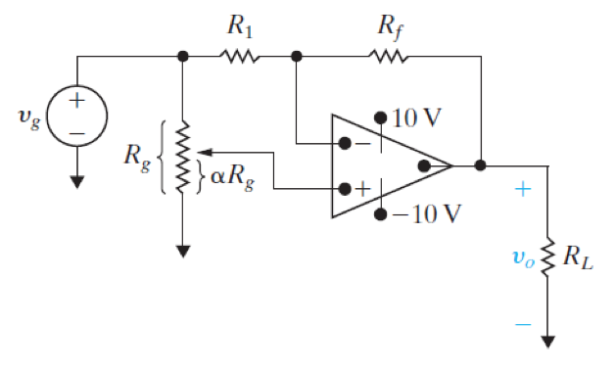
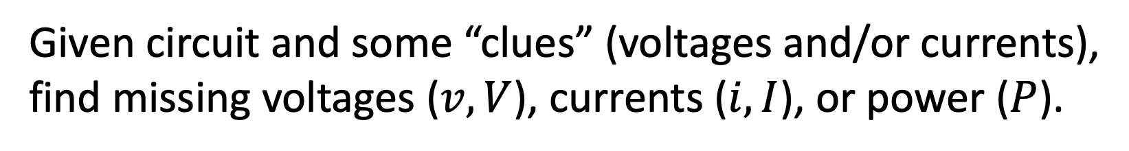
Problems: Analysis initially will feel like puzzle solving.
Given circuit and some “clues” (voltages and/or currents),
find missing voltages ($v, V$), currents ($i, I$), or power ($P$).
Huge practical applications
(although not always obvious).
Solution obtained by applying
laws.
There are rigorous approaches
for solution/analysis!
Instead of puzzles to work out,
will have “recipes” to follow.
Will rarely be concerned with design/synthesis
(i.e., given desired output, create appropriate circuit).

