Slide 1
EE 261, Spring 2025, Lecture 4
Goals/Topics:
More on resistors and Ohm’s Law
Comment on power and sources
Distinction between series and parallel elements
More on “allowable” circuits
Best viewed in
presentation mode
in PowerPoint.
Announcements: Homework 1 due Wednesday (by 11:59 p.m.).
Problem-solving videos posted (see Canvas > Modules > Week 2).

Slide 2
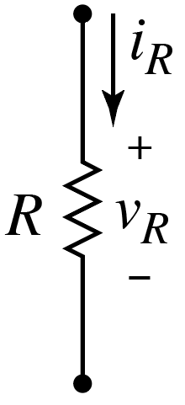
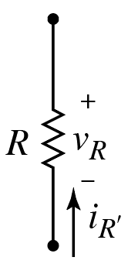
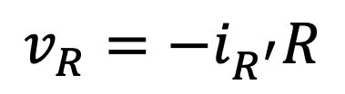
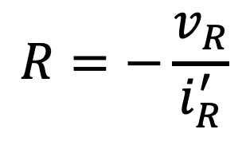
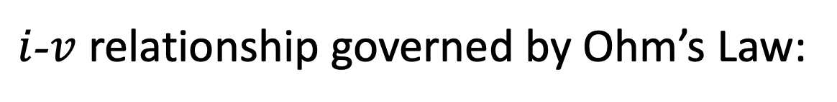
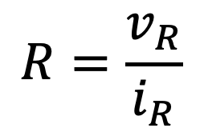

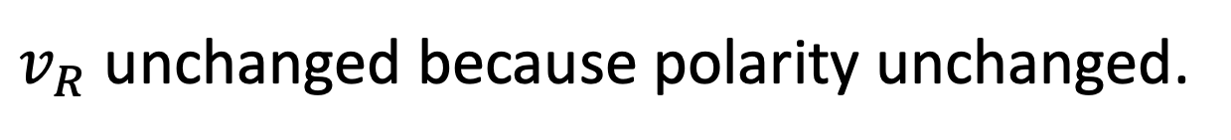
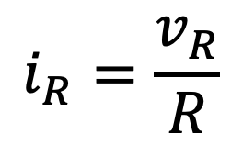
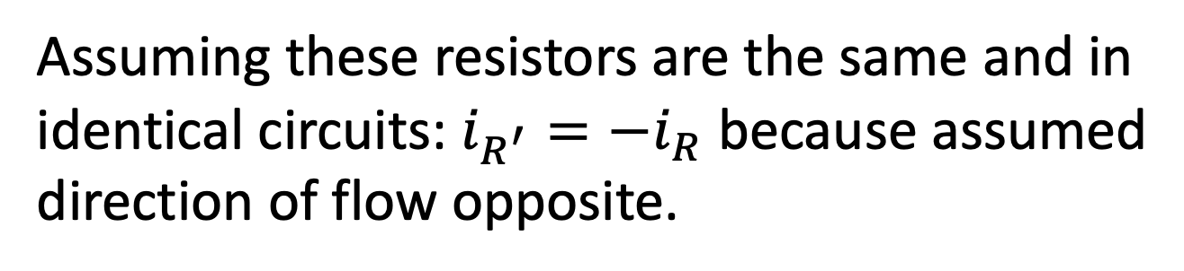
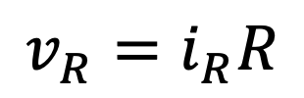
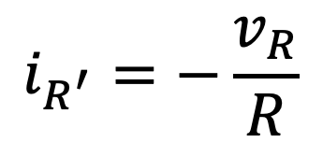
Recall: Resistors
$i$-$v$ relationship governed by Ohm’s Law:
$$i_{R}=\frac{v_{R}}{R}$$
$$R=\frac{v_{R}}{i_{R}}$$
$$v_{R}=i_{R}R$$
or
or
Resistance has units of ohms, Ω.
But, Passive Sign Convention always factors
into any $i$-$v$ relationship.
Include negative sign if current flowing
into negative terminal.
$$v_{R}=−i_{R^{′}}R$$
Assuming these resistors are the same and in
identical circuits: $i_{R^{′}}=−i_{R}$ because assumed
direction of flow opposite.
$$i_{R^{′}}=−\frac{v_{R}}{R}$$
or
$$R=−\frac{v_{R}}{i_{R}^{′}}$$
or
$v_{R}$ unchanged because polarity unchanged.

Slide 3



An aside: A practice numeric iClicker question.
What is $5−7.5$? (numeric poll)
Hint: The answer is $−2.5$.
Send!
Should be easy to enter on iClicker Student app.
iClicker 2 physical remotes take a little practice.
Use up/down keys to selected desired digit
(0–9) or symbol (.–E^).
Toggle to numeric mode once poll open.
Position cursor (entry) using left/right keys.

Slide 4
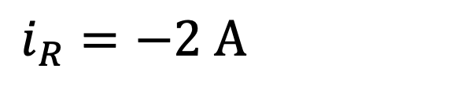
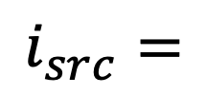
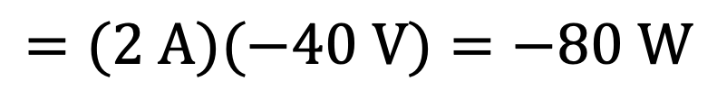
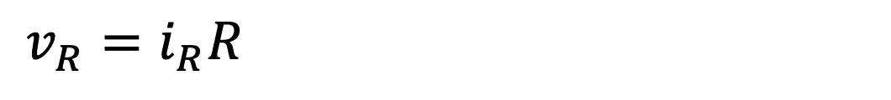

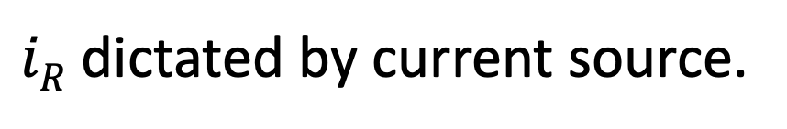
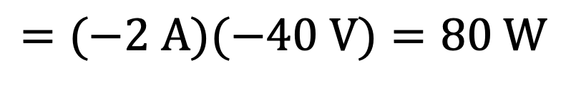
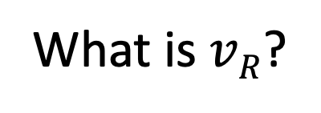
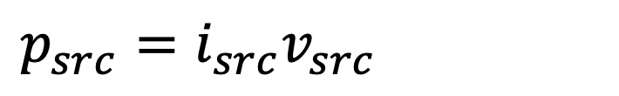

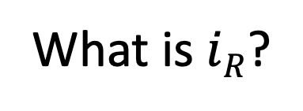

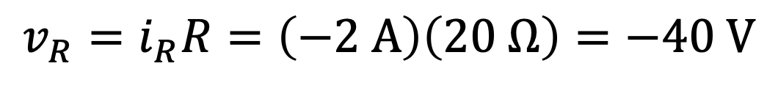
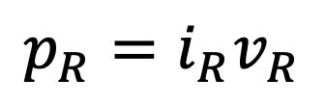
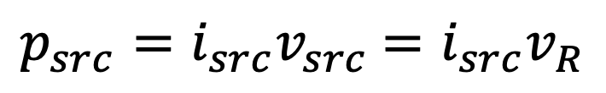

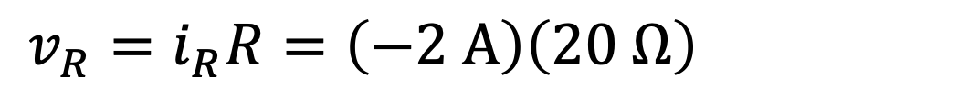
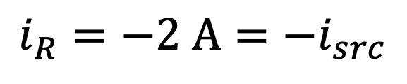

Application of Ohm’s Law:
Flows in
clockwise
direction.
What is $iR$?
(numeric poll;
units of amps understood)
$v_{src}$ $=v_{R}$
$iR$ dictated by current source.
$$i_{src}$$
$$i_{R}=−2 A=−i_{src}$$
$$i_{src}=$$
$$+$$
$$i_{R}=−2 A=−i_{src}$$
$$v_{src}$$
What is $vR$?
(numeric poll;
units of volts understood)
$$−$$
Flows in
counter-
clockwise
direction.
$$v_{R}=i_{R}R=\left(−2 A\right)\left(20 Ω\right)=−40 V$$
$$v_{R}=i_{R}R=\left(−2 A\right)\left(20 Ω\right)=−40 V$$
$$v_{R}=i_{R}R=\left(−2 A\right)\left(20 Ω\right)=−40 V$$
Resistor is consuming power. Current source is delivering power.
Resistor is consuming power. Current source is delivering power.
$p_{src}=i_{src}v_{src}$ $=i_{src}v_{R}$
$$p_{R}=i_{R}v_{R}$$
$p_{src}=i_{src}v_{src}$ $=i_{src}v_{R}$
$$=(−2 A)(−40 V)=80 W$$
$$=(2 A)(−40 V)=−80 W$$

Slide 5
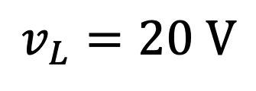
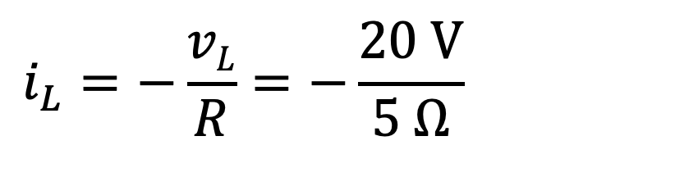
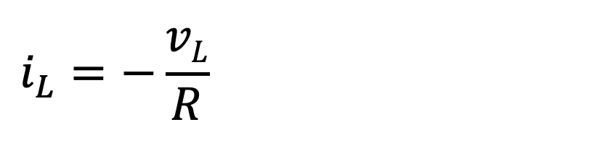
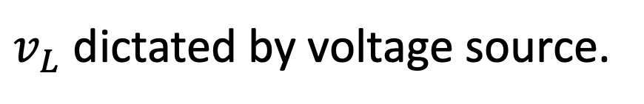
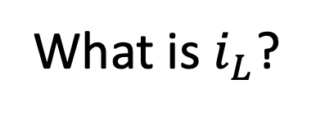
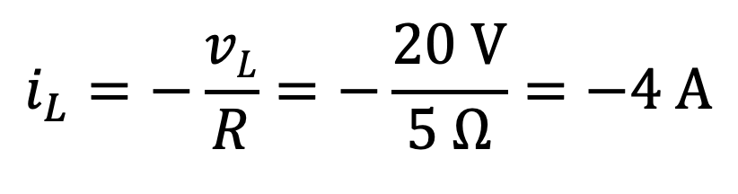
Consider (variant of previous lecture’s examples):
What is $i_{L}$?
(numeric poll;
units of amperes understood)
$v_{L}$ dictated by voltage source.
$$v_{L}=20 V$$
$$i_{L}=−\frac{vL}{R}=−\frac{20 V}{5 Ω}=−4 A$$
$$i_{L}=−\frac{vL}{R}=−\frac{20 V}{5 Ω}=−4 A$$
$$i_{L}=−\frac{vL}{R}=−\frac{20 V}{5 Ω}=−4 A$$
Terms dictated by Ohm’s Law.
Sign dictated by passive sign convention.
Terms dictated by Ohm’s Law.
Sign dictated by Passive Sign Convention.

Slide 6
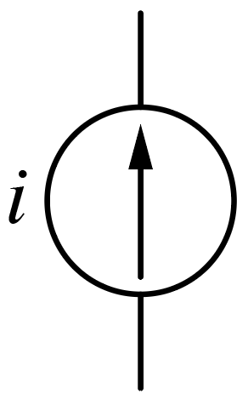
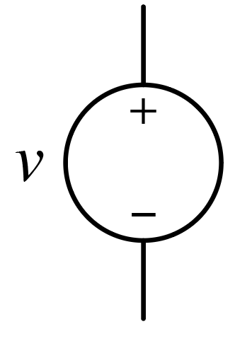
Aside: What’s the difference between a voltage source,
a current source, and a “power supply?”
Aside:
Current that flows through voltage source
dictated by rest of circuit.
i
+
v
–
Voltage that exists across current source
dictated by rest of circuit.
These are power supplies.
(Or how we represent power supplies. In a given circuit they might be consuming power.)
(Independent) Voltage Source
(Independent) Current Source
A “power supply” cannot simultaneously control voltage and current.
A power supply dictates either the voltage or the current.
(Similar to fact a pump cannot simultaneously control pressure and
flow rate.)
A “250 W supply” is saying max power source can deliver.

Slide 7
Voltage and current sources may deliver power (negative power),
or they may consume power (positive power).
Voltage and current sources may deliver power (negative power)
Behavior dictated by entire circuit in which source operates.
But, three things are always true about power in a circuit:
Magnitudes of total power delivered and consumed must be equal.
Resistors always consume power.
Power consumed or delivered by an element is independent
of assumed direction of current flows and assumed polarity of
voltages.

Slide 8



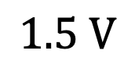
Don’t do this at home!
Imagine people as resistors (because they are).
Imagine three people holding onto two wires at different potential.
Aslan
Blaze
Chantal
$$1.5 V$$

Slide 9

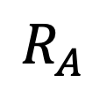
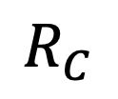
Don’t do this at home!
Imagine people as resistors (because they are).
Imagine three people holding onto two wires at different potential.
$$R_{A}$$
Aslan
$$R_{B}$$
Blaze
$$R_{C}$$
Chantal
$$1.5 V$$

Slide 10
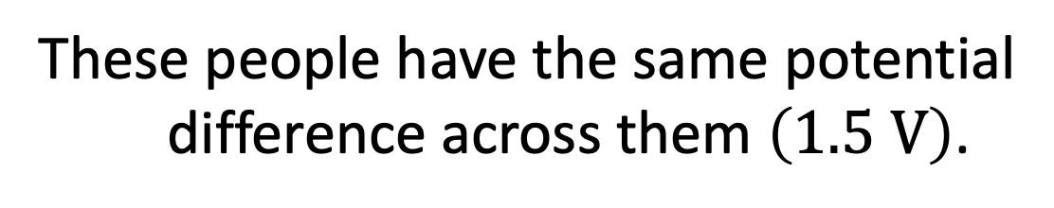
Don’t do this at home!
Imagine people as resistors (because they are).
Imagine three people holding onto two wires at different potential.
These people have the same potential
difference across them $\left(1.5 V\right)$.
Aslan
They are said to be in parallel.
These people are also in
parallel with the source.
Elements that span
(touch) the exact same two
electrical potentials (wires) in
a circuit are in parallel.
Blaze
Chantal
$$1.5 V$$
Could replace voltage source with a current source. People and source are still in parallel.
Could replace voltage source with a current source. People and source are still in parallel.

Slide 11
Don’t do this at home!
Imagine people as resistors (because they are).
Imagine four people arranging themselves in a circuit like so…
Aslan
Blaze
Chantal
$$1.5 V$$

Slide 12

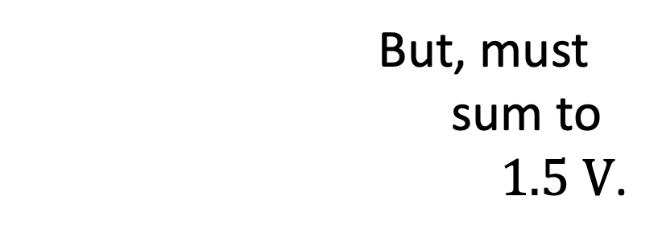
Don’t do this at home!
Imagine people as resistors (because they are).
Imagine four people arranging themselves in a circuit like so…
Blaze and Chantal are still in parallel with
each other and with the source.
Aslan
There is a voltage drop across Darius
and Aslan.
Insufficient information to
determine what those
voltage drops are.
Darius
Blaze
(In series — see next slide.)
Individually, Aslan and Darius
are not in parallel with anything.
But, must
sum to
$1.5 V$.
Chantal
$$1.5 V$$

Slide 13


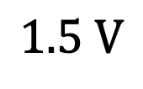


Now imagine Aslan, Blaze, and Chantal arranging themselves like so…
There is only one path for current to flow so they would all have the
same current through them.
They are said to be in series.
Aslan
Blaze
Chantal
$$I$$
$$I$$
$$I$$
$$1.5 V$$
$$I$$
Elements with the same current through them are said to be in series.

Slide 14
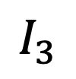
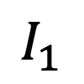
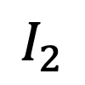
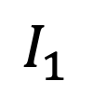

Imagine Darius now inserts himself like so…
The current through Aslan, Blaze, and the source are the same.
They are still in series.
(But this current would be different from before.)
Aslan
Blaze
Chantal
$$I_{3}$$
$$I_{2}$$
$$I_{1}$$
$$I_{1}$$
$$1.5 V$$
Darius
In general, an element may be neither
in series nor parallel with another element.
$$I_{1}$$
In parallel.
Darius and Chantal are now in parallel.
But, individually, they are not in series with anything.

Slide 15
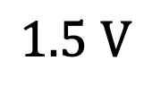
Summary
(leads)
Imagine elements have two hands with which they attach to circuit.
If two elements are holding onto the same wire and no other
elements are holding onto that wire, those elements are in series.
(Sufficient
condition.)
If two elements are, with their two hands, each holding onto the
same two wires, those elements are in parallel.
Series
$$1.5 V$$
Parallel

Slide 16
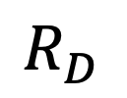
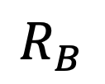
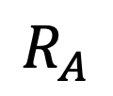
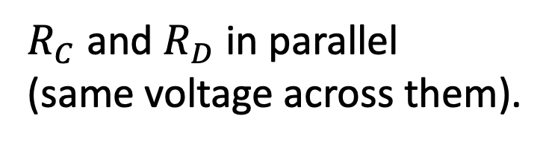
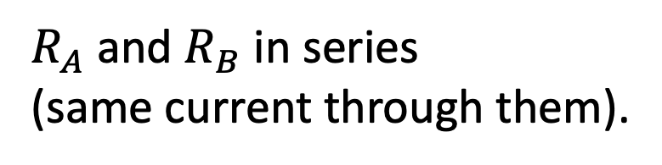

Summary
Imagine elements have two hands with which they attach to circuit.
If two elements are holding onto the same wire and no other
elements are holding onto that wire, those elements are in series.
(Sufficient
condition.)
If two elements are, with their two hands, each holding onto the
same two wires, those elements are in parallel.
$$R_{A}$$
$$R_{B}$$
$$R_{C}$$
Series
$R_{A}$ and $R_{B}$ in series
(same current through them).
$$1.5 V$$
$$R_{D}$$
Parallel
$R_{C}$ and $R_{D}$ in parallel
(same voltage across them).

Slide 17





Series components have exact same current through them.
In this circuit, all
components are in series.
All have current $I_{a}$.
In this circuit, all
components are in series.
All have current $I_{a}$.
If two, and only two, elements are touching the same wire, those
elements are in series. (Sufficient condition.)
If two, and only two, elements are touching the same wire, those
elements are in series. (Sufficient condition.)
Also, if $A$ is in series with $B$, and $B$ is in series with $C$,
then $A$ is also in series with $C.$
Thus, $V_{a}$ is in series with $R_{2}$.

Slide 18




Which elements are in series?
Voltage source not in series
with anything. (Nor is it in
parallel with any single resistor.)
Voltage source not in series
with anything. (Nor is it in
parallel with any single resistor.)
$R_{1}$, $R_{2}$, and $R_{3}$ are in series.
Current $I_{b}$ flows through them.
$R_{4}$ and $R_{5}$ are in series (but only with each other).
Current $I_{c}$ flows through them.

Slide 19




Which elements are in series?
Only $R_{1}$ and $R_{2}$ in series.
Current $I_{b}$ flows through
them.
Note: All current directions
are “guesses.” Nothing special
about them. Any or all currents may be negative (indicating current
[positive charge] actually flows in opposite direction).
Note: All current directions
are “guesses.” Nothing special
about them.

Slide 20



Parallel elements have the exact same voltage across them.
or touch
(They go between the same two “potentials”/wires in the circuit.)
These components are all in parallel.
All elements have same potential
across them.
All elements have voltage $V_{1}$
across them.
Parallel elements span the same two
wires (or same two collections of wires).
If a ground isn’t specified in a circuit, we’re free to identify one
wherever we want.
Don’t hesitate to add a ground if it aids your
understanding of the circuit.

Slide 21






Parallel elements have the exact same voltage across them.
or touch
(They go between the same two “potentials”/wires in the circuit.)
$$+ V_{1}−$$
Being in series or parallel is a matter
of topology, not labels.
All these elements are in parallel.
$$+$$
$$V_{a}$$
$$−$$
$$−$$
$$V_{2}$$
$$+$$
Note that, as labeled:
$$V_{a}=V_{1}=−V_{2}$$
$$V_{a}=V_{1}=−V_{2}$$
Despite having $V_{1}=V_{a}≠V_{2}$,
these components are considered in parallel because they connect
(go between or touch) the same two “points.”
Points in the electrical sense of potentials.

Slide 22







Thinking in terms of individual elements,
which resistor is, or which resistors are,
parallel with $R_{2}$?
$$V_{a}$$
$$V_{b}$$
A) Only $R_{1}$
B) Only $R_{3}$
C) Only $R_{4}$
D) All
E) None
$$+ V_{1}−$$
$$+ \\ V_{3} \\ −$$
$R_{1}$ not in parallel with anything
(voltage drop across it is $V_{1}=V_{a}−V_{b}$).
$R_{3}$ not in parallel with anything (voltage drop across it is ${V_{3}=V}_{b}−0=V_{b}$).
$I_{a}$, $R_{2}$, and $R_{4}$ are in parallel with each other (all with voltage drop $V_{a}$).
$I_{a}$, $R_{2}$, and $R_{4}$ are in parallel with series combination of $R_{1}$ and $R_{3}$.

Slide 23





Can redraw circuit in any way you want provided you maintain same connections.
$$V_{a}$$
Circuit on right is identical
to previous circuit.
$$V_{b}$$
Previous:
$$V_{a}$$
$$V_{b}$$

Slide 24





Is the circuit shown below a valid circuit?
Yes.
No.
Add voltages moving from
one source to the next.
$$10 V+30 V=40 V=v_{R}$$
$$10 V+30 V=40 V=v_{R}$$
$$10 V+30 V=40 V=v_{R}$$
Similar to having batteries in series.
All elements are in series:
They have the same current flowing through them.

