Slide 1
EE 261, Spring 2025, Lecture 5
Goals/Topics:
More on valid (and invalid) circuits
Kirchhoff’s Current Law (KCL)
Kirchhoff’s Voltage Law (KVL)
Resistor power
Best viewed in
presentation mode
in PowerPoint.
Announcements:
Homework 1 due tonight.
Homework 2 posted (Mastering & handwritten). Due Wed., Jan. 22.

Slide 2
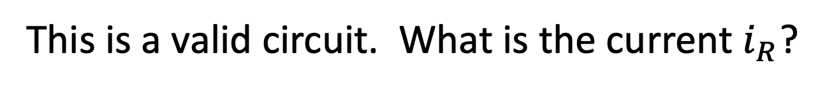
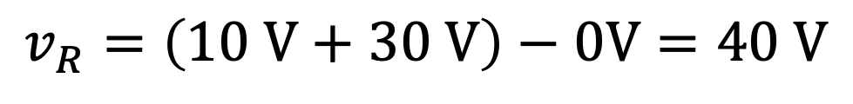
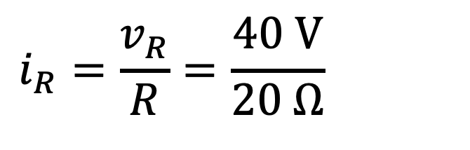
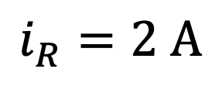
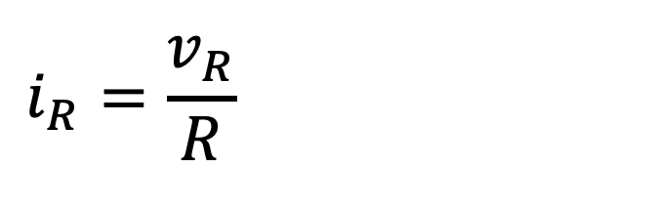

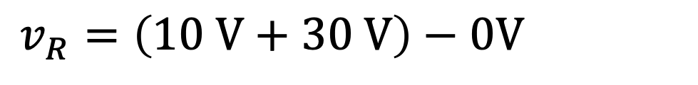
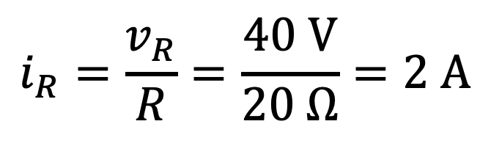
This is a valid circuit. What is the current $i_{R}$?
This is a valid circuit. What is the current $i_{R}$?
$$v_{R}=\left(10 V+30 V\right)−0V=40 V$$
$$v_{R}=\left(10 V+30 V\right)−0V=40 V$$
Ohm’s Law:
$$i_{R}=\frac{v_{R}}{R}=\frac{40 V}{20 Ω}=2 A$$
$$i_{R}=\frac{v_{R}}{R}=\frac{40 V}{20 Ω}=2 A$$
$$i_{R}=\frac{v_{R}}{R}=\frac{40 V}{20 Ω}=2 A$$
$$i_{R}=2 A$$

Slide 3
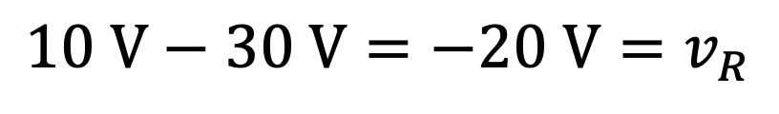
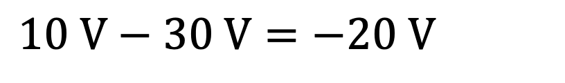
Is this a valid circuit?
Yes.
No.
Add a ground.
Account for changes in voltage
moving from bottom to the top.
Add a ground.
Account for changes in voltage
moving from bottom to the top.
$$10 V−30 V=−20 V=v_{R}$$
$$10 V−30 V=−20 V=v_{R}$$

Slide 4
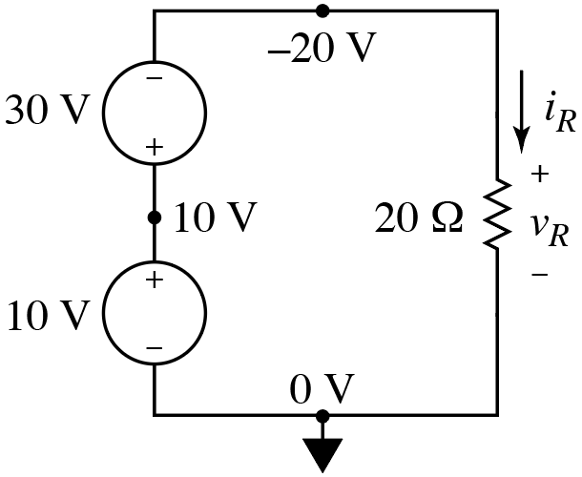
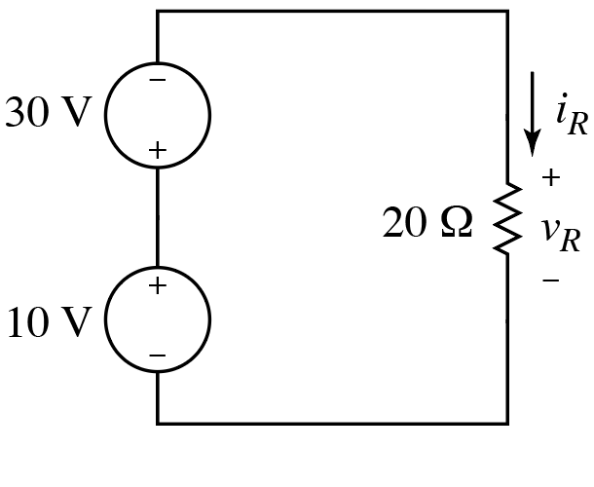
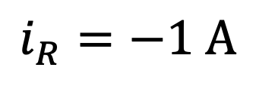
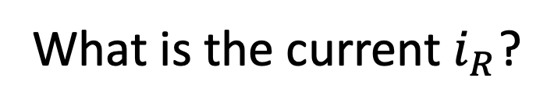
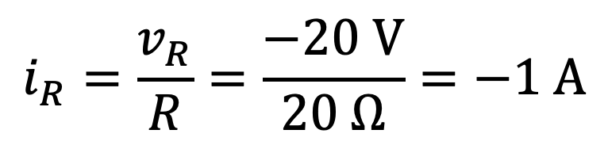
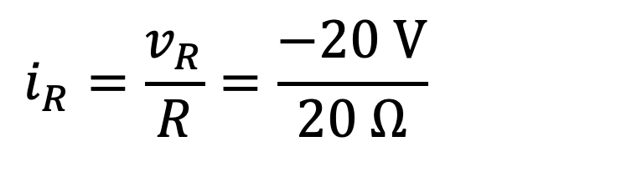
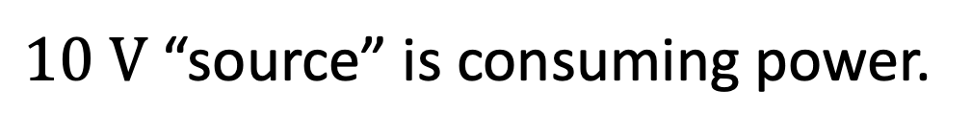
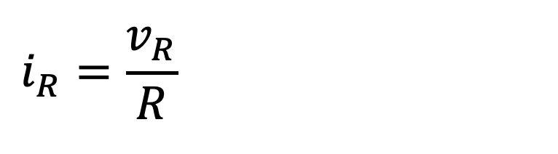
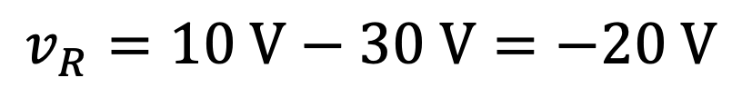
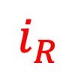
What is the current $i_{R}$?
$$v_{R}=10 V−30 V=−20 V$$
Ohm’s Law:
$$i_{R}=\frac{v_{R}}{R}=\frac{−20 V}{20 Ω}=−1 A$$
$$i_{R}=\frac{v_{R}}{R}=\frac{−20 V}{20 Ω}=−1 A$$
$$i_{R}=\frac{v_{R}}{R}=\frac{−20 V}{20 Ω}=−1 A$$
$$i_{R}=−1 A$$
$$i_{R}$$
$10 V$ “source” is consuming power.
$$p_{10V}=−i_{R}\left(10 V\right)=−\left(−1 A\right)\left(10 V\right)=10 W$$
$$p_{10V}=−i_{R}\left(10 V\right)=−\left(−1 A\right)\left(10 V\right)=10 W$$
$$p_{10V}=−i_{R}\left(10 V\right)=−\left(−1 A\right)\left(10 V\right)=10 W$$
Positive power is consumed power.

Slide 5




Is the circuit shown below a valid circuit?
All points on a wire
have the same voltage.
Yes.
No.
$$20 V$$
$$20 V≠40 V$$
$$40 V$$
$$0 V$$
Sources are in conflict about difference in potential
from bottom to top. Something must/will break.
Sources are in conflict about difference in potential
from bottom to top. Something must/will break.
This would be valid if the voltage sources had the exact same voltage.
Or, this would be valid if a resistor was between the voltage sources.
This would be valid if the voltage sources were replaced by current
sources (then they can have different values [see next slide]).
This would be valid if the voltage sources were replaced by current
sources (then they can have different values [see next slide]).

Slide 6
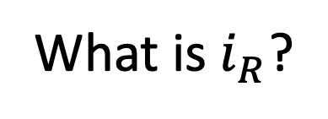
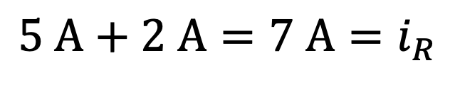
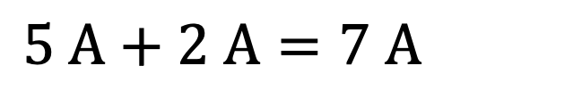
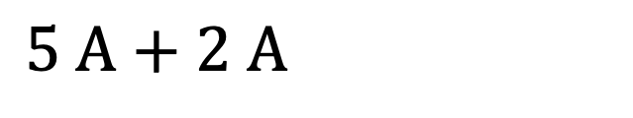
What flows into the top must flow out.
This is perfectly fine:
What is $i_{R}$?
Current sources dictate that it must be:
$$5 A+2 A=7 A=i_{R}$$
$$5 A+2 A=7 A=i_{R}$$
$$5 A+2 A=7 A=i_{R}$$
Which brings us to…

Slide 7
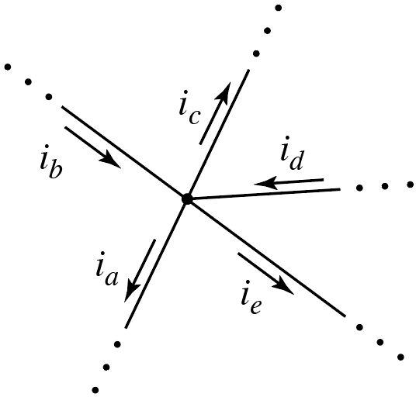
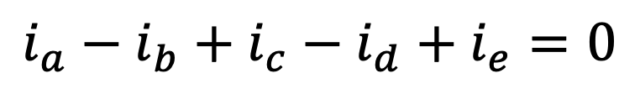
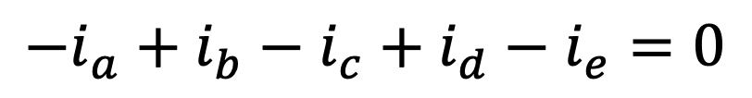
Because charge does not accumulate…
Kirchhoff’s Current Law (KCL): The sum of all currents at a node (wire) is zero.
Associate plus sign with current out of node and negative sign with current into node.
Associate plus sign with current out of node and negative sign with current into node. (Or vice versa! Just be consistent.)
$$i_{a}−i_{b}+i_{c}−i_{d}+i_{e}=0$$
(out positive; in negative)
or
$$−i_{a}+i_{b}−i_{c}+i_{d}−i_{e}=0$$
(in positive; out negative)

Slide 8
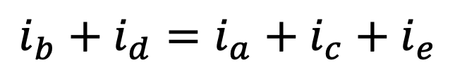
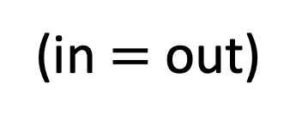
Equivalently: Sum of currents into a node equals sum of currents out.
$$i_{b}+i_{d}=i_{a}+i_{c}+i_{e}$$
(in $=$ out)

Slide 9
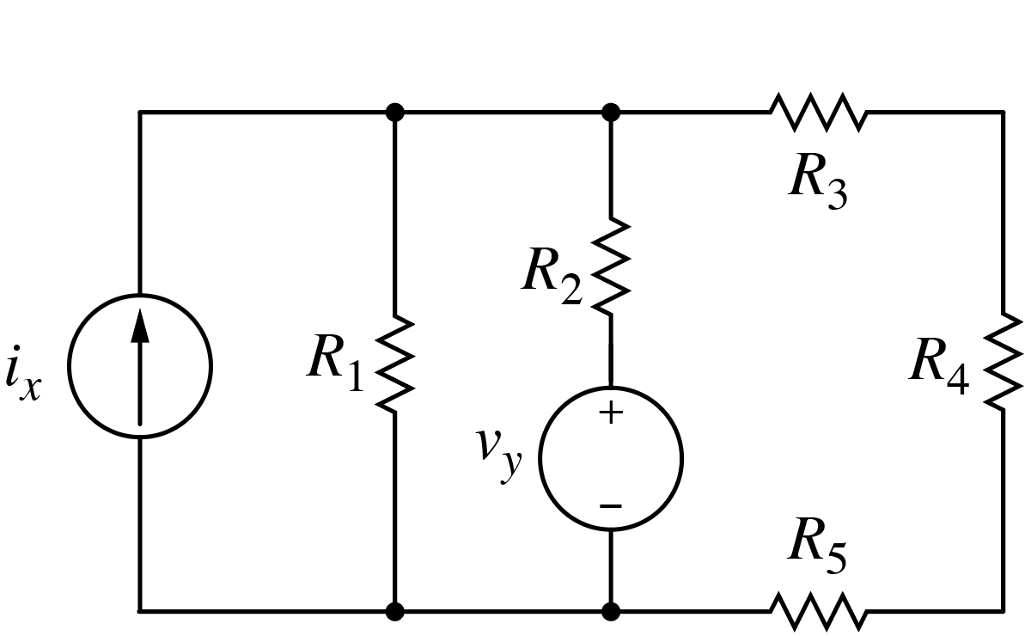
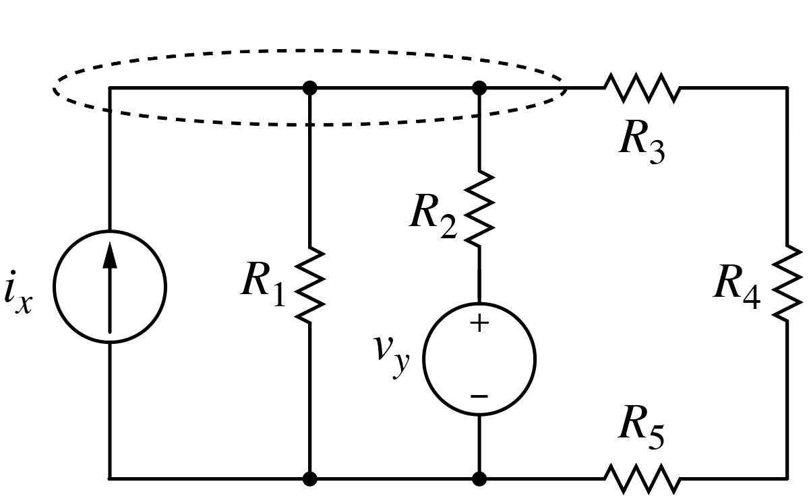
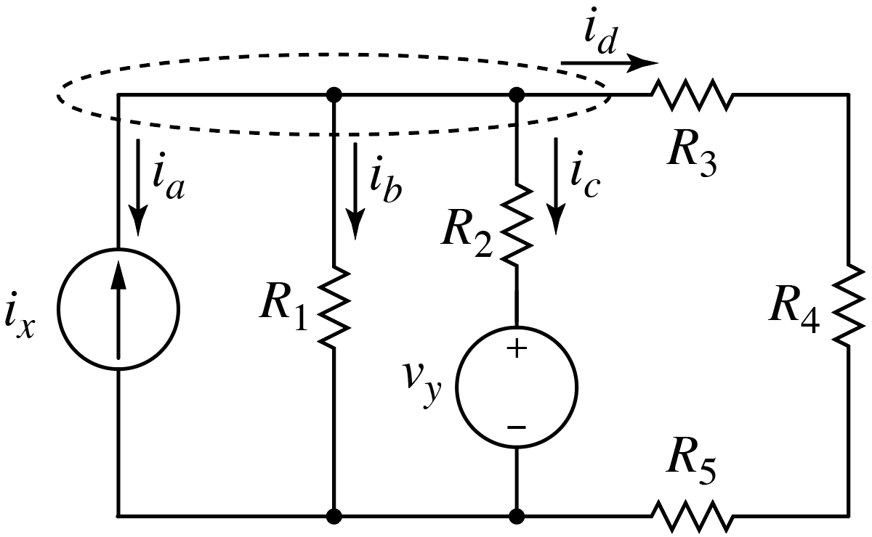
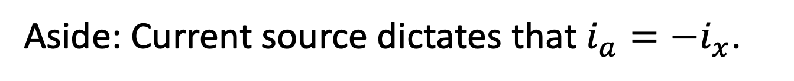
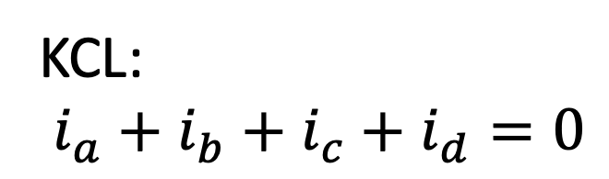
Perfectly fine to have all currents flowing into or out of a node (wire).
(We will do this routinely when
we get to node-voltage analysis.)
(assumed direction of)
Consider KCL at upper-
left “node.”
Label currents.
KCL:
$i_{a}+i_{b}+$ $i_{c}+$ $i_{d}=0$
Assuming currents aren’t
all zero, at least one must
be positive and at least
one must be negative.
Aside: Current source dictates that $i_{a}={−i}_{x}$.

Slide 10
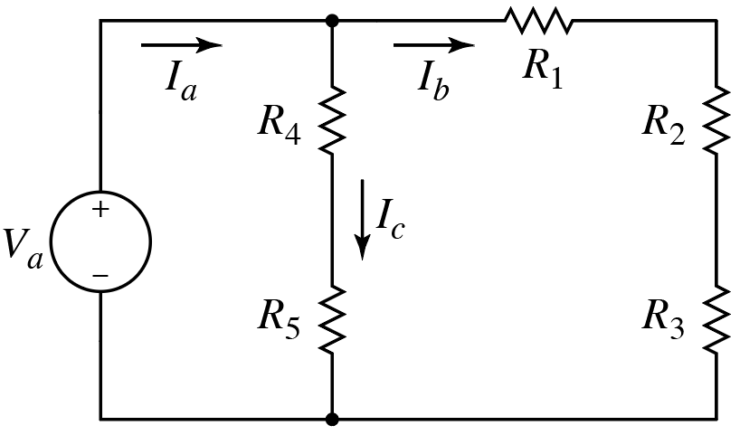
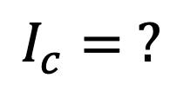
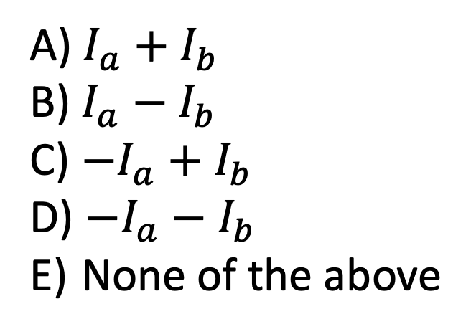

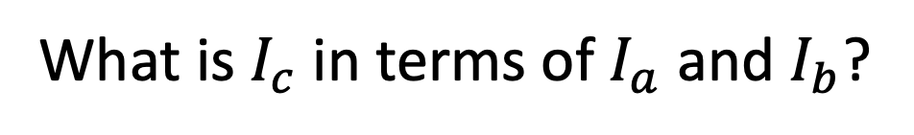
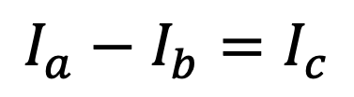


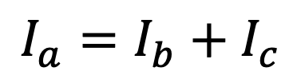

What is $I_{c}$ in terms of $I_{a}$ and $I_{b}$?
$$I_{c}= ?$$
$I_{a}+I_{b}$
$I_{a}−I_{b}$
${−I}_{a}+I_{b}$
$−I_{a}−I_{b}$
None of the above
$$I_{c}$$
$$I_{a}$$
$$I_{b}$$
current in $=$ current out
$$I_{a}=I_{b}+I_{c}$$
$$I_{a}−I_{b}=I_{c}$$
Could have considered this
node instead. Yields same result.

Slide 11
Because energy is conserved…
Kirchhoff’s Voltage Law (KVL): The sum of voltages around any closed path is zero.
If you traverse a circuit and return to the same physical point, you must be back at the starting potential.
No net change in potential.
Standard procedure for adding voltages around a loop (first,
ensure each element has an indicated voltage polarity):
Move around loop in clockwise direction.
If you encounter plus sign first, use plus for element’s voltage.
If you encounter negative sign first, use negative of voltage.
Thus, in KVL equations, indicated voltage drops are positive and
voltage gains are negative.
Thus, in KVL equations, indicated voltage drops are positive and
voltage gains are negative.
May seem backward at first, but simple to
follow and will be used throughout this class.

Slide 12
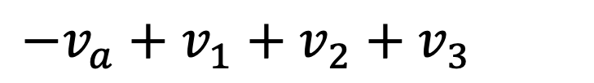
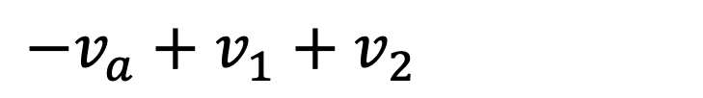
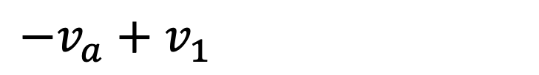

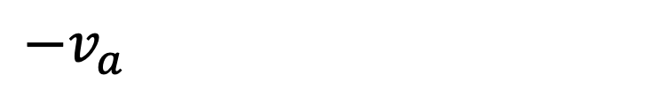

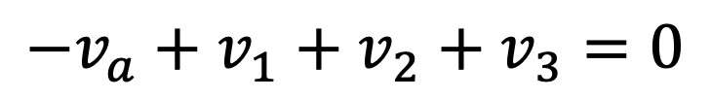
KVL for this circuit is?
Assume voltage $v_{a}$ and resistances are known.
What is $i_{a}$ in terms of $v_{a}$and resistors?
For KVL, start at bottom and
sum voltages around loop.
$$−v_{a}+v_{1}+v_{2}+v_{3}=0$$
$$−v_{a}+v_{1}+v_{2}+v_{3}=0$$
$$−v_{a}+v_{1}+v_{2}+v_{3}=0$$
$$−v_{a}+v_{1}+v_{2}+v_{3}=0$$
$$−v_{a}+v_{1}+v_{2}+v_{3}=0$$
Move
clockwise.
Indicated voltage drop
(positive).
Start here.
Indicated voltage gain
(negative).

Slide 13
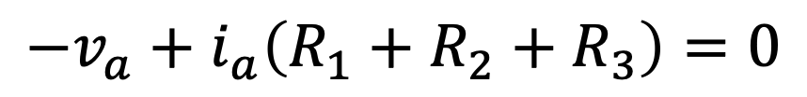
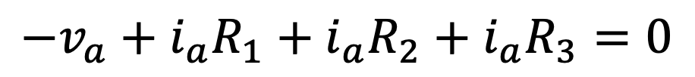


KVL for this circuit is?
Assume voltage $v_{a}$ and resistances are known.
What is $i_{a}$ in terms of $v_{a}$and resistors?
For KVL, start at bottom and
sum voltages around loop.
$$−v_{a}+v_{1}+v_{2}+v_{3}=0$$
Move
clockwise.
Using Ohm’s Law $\left(v=iR\right)$
for resistor voltages yields:
$$−v_{a}+i_{a}R_{1}+i_{a}R_{2}+i_{a}R_{3}=0$$
Start here.
$$−v_{a}+i_{a}\left(R_{1}+R_{2}+R_{3}\right)=0$$
$$i_{a}=\frac{v_{a}}{R_{1}+R_{2}+R_{3}}$$
(Series resistors add, but we’ll
return to that fact later.)

Slide 14

KVL for this circuit yields which equation? (Using standard procedure.)
A) $−v_{a}+v_{1}+v_{2}+v_{3}=0$
B) $−v_{a}+v_{1}−v_{2}+v_{3}=0$
C) $−v_{a}−v_{1}+v_{2}−v_{3}=0$
D) $v_{a}−v_{1}+v_{2}−v_{3}=0$
E) None of the above
B and D are equivalent equations,
hence D is technically correct.
However, D does not adhere to “standard procedure.”
For KVL, stick to having indicated voltage drops as positive and
voltage gains as negative (and sum moving in clockwise direction).

Slide 15






Applying Ohm’s Law yields which equation?
$$i_{a}$$
A) $−v_{a}+i_{a}R_{1}+i_{a}R_{2}+i_{a}R_{3}=0$
B) $−v_{a}+i_{a}R_{1}−i_{a}R_{2}+i_{a}R_{3}=0$
C) None of the above
Circuit hasn’t changed!
Actual voltages & currents don’t
change because of change of labels.
Still must have:
$$i_{a}R_{1}$$
$$i_{a}R_{3}$$
$$i_{a}={v_{a}}/{\left(R_{1}+R_{2}+R_{3}\right)}$$
From KVL: $−v_{a}+v_{1}−v_{2}+v_{3}=0$
Passive sign convention & Ohm’s law: $v_{2}=−i_{a}R_{2}$

Slide 16










Power Consumed by a Resistor
For current into positive terminal: $p=iv$ and $v=iR$
$$pR=iRvR=iR\left(iRR\right)=i_{R}^{2}R$$
$$pR=iRvR=iR\left(iRR\right)=i_{R}^{2}R$$
$$v_{R}=i_{R}R$$
$$pR=iRvR=iR\left(iRR\right)=i_{R}^{2}R$$
Ohm’s law
$$pR=iRvR=\left(vR/R\right)vR=v_{R}^{2}/R$$
$$pR=iRvR=\left(vR/R\right)vR=v_{R}^{2}/R$$
$$i_{R}={v_{R}}/R$$
$$pR=iRvR=\left(vR/R\right)vR=v_{R}^{2}/R$$
Ohm’s law
Aside: Ohm’s
law wheel
Can express $P$, $V$, $I$, or $R$
in terms of two of these values.
https://electriciandenver.com/

Slide 17










Power Consumed by a Resistor
For current into negative terminal: $p=−iv$ and $v=−iR$
Ohm’s law
$$pR=−iRvR=−iR\left(−iRR\right)=i_{R}^{2}R$$
$$pR=−iRvR=−iR\left(−iRR\right)=i_{R}^{2}R$$
$$v_{R}=−i_{R}R$$
$$pR=−iRvR=−iR\left(−iRR\right)=i_{R}^{2}R$$
Same as before!
$$pR=−iRvR=−\left(−vR/R\right)vR=v_{R}^{2}/R$$
$$pR=−iRvR=−\left(−vR/R\right)vR=v_{R}^{2}/R$$
$$i_{R}=−{v_{R}}/R$$
$$pR=−iRvR=−\left(−vR/R\right)vR=v_{R}^{2}/R$$
Ohm’s law
Because $R>0$, resistors
only consume power.
Bottom line: $pR=i_{R}^{2}R=v_{R}^{2}/R$

