Slide 1
EE 261, Spring 2025, Lecture 6
Goals/Topics:
Dependent sources
Even more on valid and invalid circuits
Various applications of Ohm’s law, KVL, and KCL
Best viewed in
presentation mode
in PowerPoint.
Announcements:
Homework 2 due Wednesday, January 22nd.
More problem-solving videos posted in Module > Week 3 at Canvas.

Slide 2
Dependent Sources
Voltage or current depends on voltage or current elsewhere.
(fixed) Resistors
???
Independent
voltage source
Variable
resistor

Slide 3
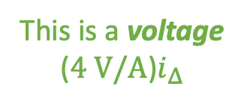
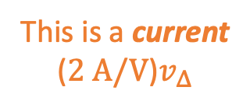


Dependent Sources
Voltage or current depends on voltage or current elsewhere.
The controlling
current
The controlling
voltage
This is a voltage
($4 V/A$)$i_Δ$
This is a voltage
($4 V/A$)$i_{Δ}$
Voltage controlled
current source
Dependent
sources
Current controlled
voltage source
This is a current
($2 A/V$)$v_Δ$
This is a current
($2 A/V$)$v_{Δ}$

Slide 4

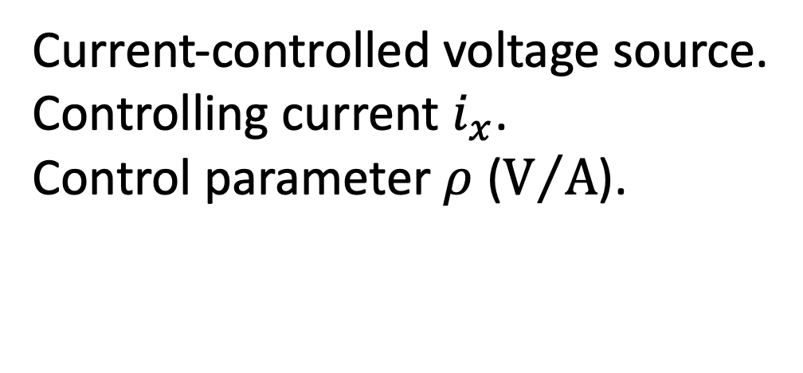
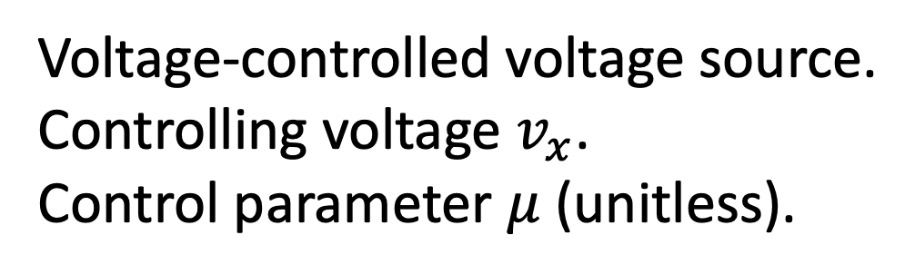
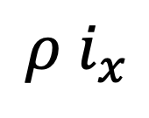

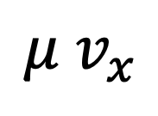

Dependent Sources
Voltage or current depends on voltage or current elsewhere.
Dependent voltage source:
{
Voltage-controlled voltage source.
Controlling voltage $v_{x}$.
Control parameter $μ$ (unitless).
$$μ v_{x}$$
$$v_{s}$$
$$=$$
or
Current-controlled voltage source.
Controlling current $i_{x}$.
Control parameter $ρ$ ($V/A$).
$$ρ i_{x}$$
Don’t let an “$i_{x}$” (i.e., a current) next to a voltage source fool you!
If there is a “$+$” and “$−$” in the diamond, it is a voltage source.

Slide 5

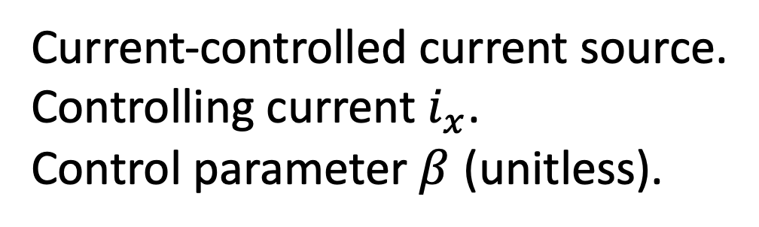
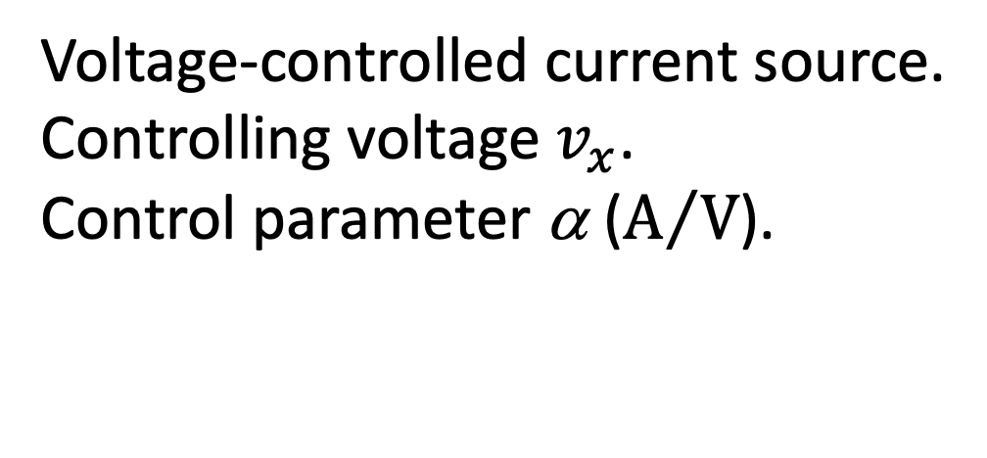
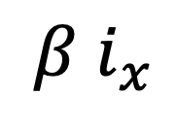
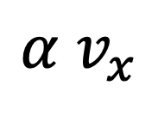


Dependent current source:
{
Voltage-controlled current source.
Controlling voltage $v_{x}$.
Control parameter α ($A/V$).
$$α v_{x}$$
$$i_{s}$$
$$=$$
or
Current-controlled current source.
Controlling current $i_{x}$.
Control parameter $β$ (unitless).
$$β i_{x}$$
Don’t let a “$v_{x}$” (i.e., a voltage) next to a current source fool you!
If there is an arrow in the diamond, it is a current source.

Slide 6
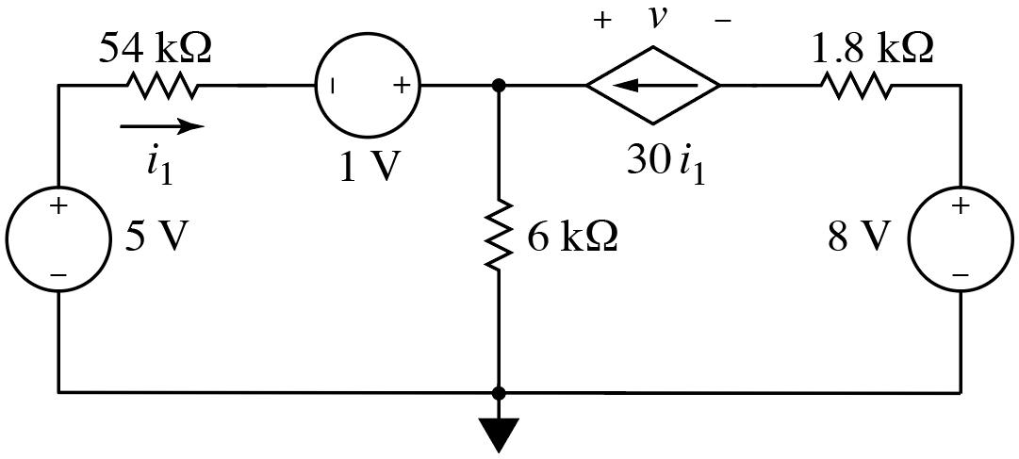
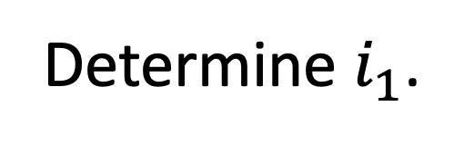
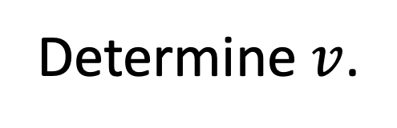
Consider:
Current controlled
current source.
Determine $i_{1}$.
Determine $v$.

Slide 7
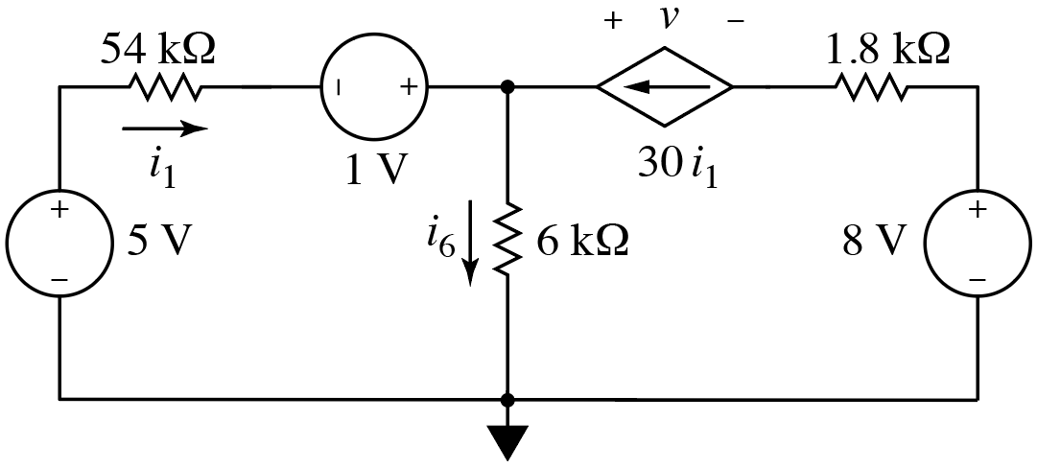

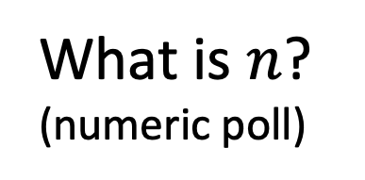
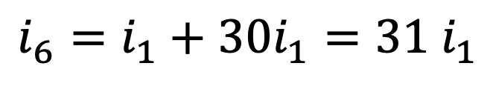

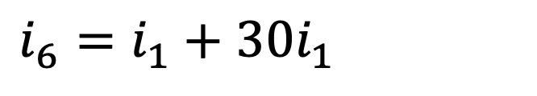
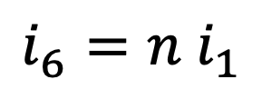
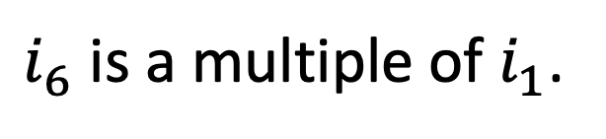
Consider:
What is expression for $i_{6}$?
Apply KCL to upper node.
At top node,
current out $=$ current in
$$i_{6}=n i_{1}$$
What is $n$?
(numeric poll)
$$i_{6}=i_{1}+30i_{1}=31 i_{1}$$
$$i_{6}=i_{1}+30i_{1}=31 i_{1}$$
$i_{6}$ is a multiple of $i_{1}$.

Slide 8
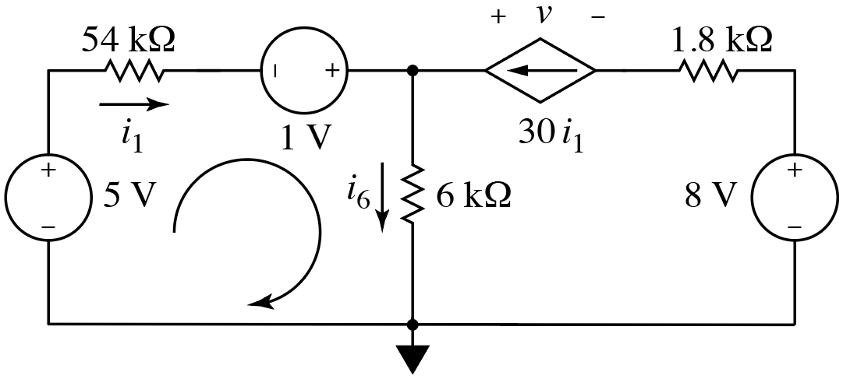
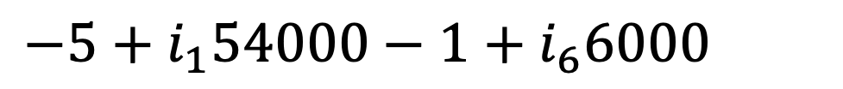
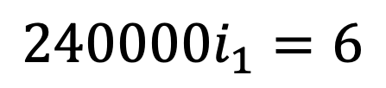
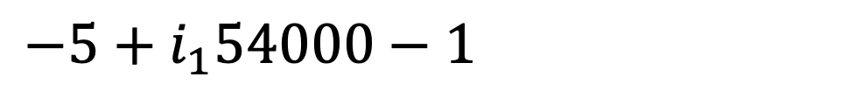
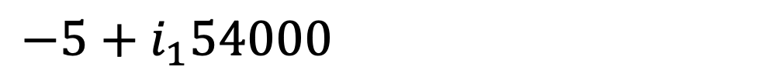
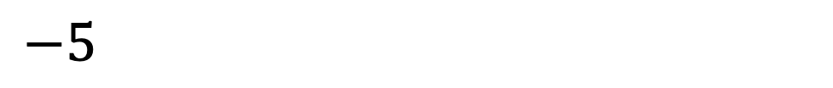
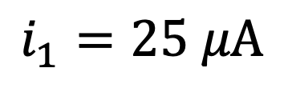
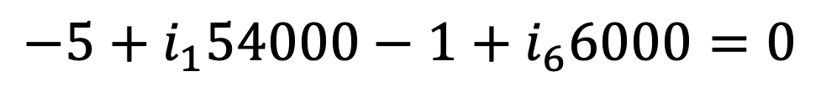
Consider:
+ –
✓
+
–
Start here.
Apply KVL to left loop:
$$−5+i_{1}54000−1+i_{6}6000=0$$
$$−5+i_{1}54000−1+i_{6}6000=0$$
$$−5+i_{1}54000−1+i_{6}6000=0$$
$$−5+i_{1}54000−1+i_{6}6000=0$$
$$−5+i_{1}54000−1+i_{6}6000=0$$
$$240000i_{1}=6$$
$$−5+i_{1}54000−1+\left(31i_{1}\right)6000=0$$
$$i_{1}=25 μA$$
(one equation; one unknown)

Slide 9
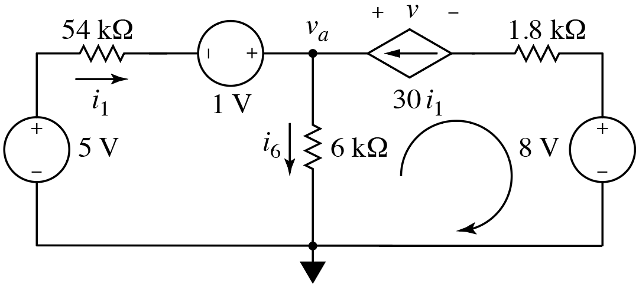
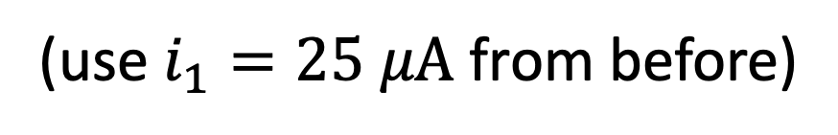
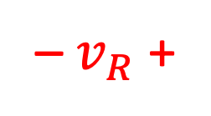
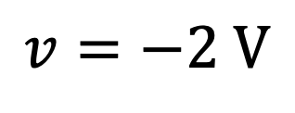
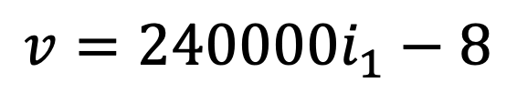
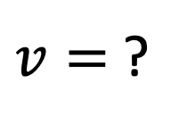
Consider:
– $v_{R}$ +
✓
+
–
Start here.
$v=$ ?
Apply KVL to right loop:
$$−\left(31i_{1}\right)6000+v−\left(30i_{1}\right)1800+8=0$$
$$−\left(31i_{1}\right)6000+v−\left(30i_{1}\right)1800+8=0$$
$$−\left(31i_{1}\right)6000+v−\left(30i_{1}\right)1800+8=0$$
$$−\left(31i_{1}\right)6000+v−\left(30i_{1}\right)1800+8=0$$
$$−\left(31i_{1}\right)6000+v−\left(30i_{1}\right)1800+8=0$$
$$v=240000i_{1}−8$$
(use $i_{1}=25 μA$ from before)
$$v=−2 V$$

Slide 10
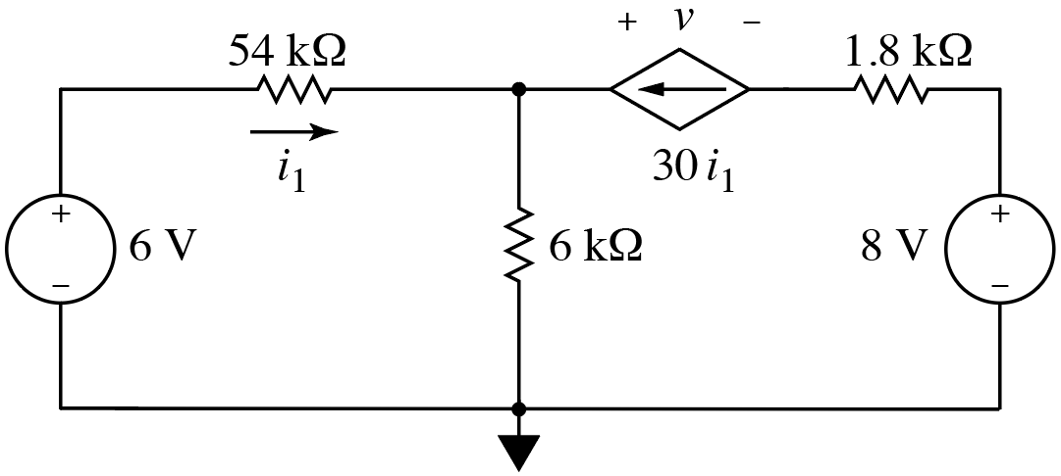
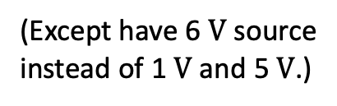
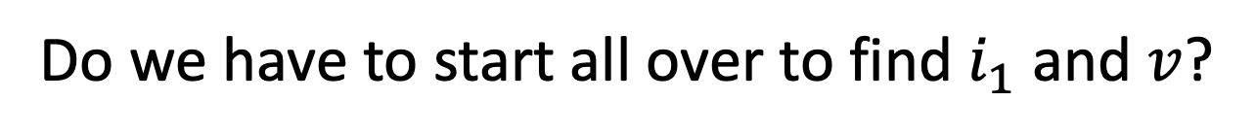

Previous circuits had
$1 V$ and $5 V$ sources.
Same currents.
Same element
voltages.
KVL
loop
(Except have 6 $V$ source
instead of 1 $V$ and 5 $V$.)
Nothing changed
over here.
Same element
powers.
Is this same as previous circuit?
Yes!
(Mostly.)
Do we have to start all over to find $i_{1}$ and $v$?
No!

Slide 11
















Original:
Modified:
$$+ −$$
$$+ −$$
$$i_{6}$$
$$+$$
$$−$$
$$i_{6}$$
$$+$$
$$−$$
KVL
loop
KVL
loop
Start here.
Start here.
$$−6+54000i_{1}+6000i_{6}=0$$
$$−6+54000i_{1}+6000i_{6}=0$$
$$−6+54000i_{1}+6000i_{6}=0$$
$$−5+54000i_{1}−1+6000i_{6}=0$$
$$−6+54000i_{1}+6000i_{6}=0$$
$$−5+54000i_{1}−1+6000i_{6}=0$$
$$−5+54000i_{1}−1+6000i_{6}=0$$
$$−5+54000i_{1}−1+6000i_{6}=0$$
$$−5+54000i_{1}−1+6000i_{6}=0$$
$$−6+54000i_{1}+6000i_{6}=0$$
Same!
No changes with right half of circuit, so KVL there is also the same.
Because equations same, currents and voltages must be same.
Order of placement of series elements unimportant.
(Addition is
commutative.)

Slide 12


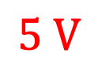

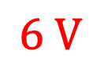





$$5−54k i_{1}$$
$$5 V$$
$$+ −$$
But something(s) must
be different, right?
$$6−54k i_{1}$$
Yes, but trivial:
node voltages relative
to ground may differ.
Original
$$0 V$$
$i_{1}$ same in both circuits.
Same voltage at top node
relative to ground.
Same voltage drop across $54 kΩ$ resistor.
$$6 V$$
$$+ −$$
$$6−54k i_{1}$$
Modified
$$0 V$$

Slide 13
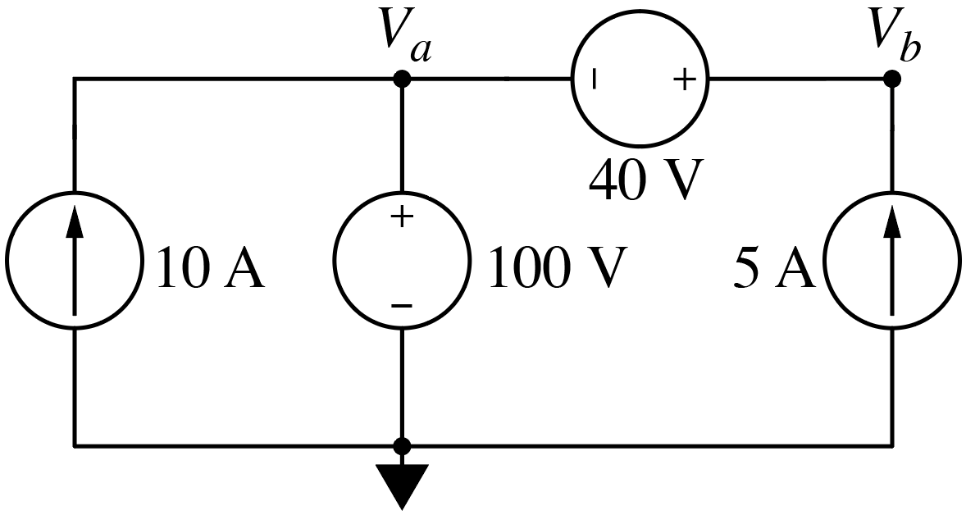
Consider collection of “sources”:
Sources in
series.
Sources in
parallel.
(Are either KVL or KCL violated?
If not, then it’s valid.)
Sources are not in conflict.
Is this a valid circuit?
(No apparent violation of KVL or KCL.)
A) Yes.
B) No.
Okay for current source to dictate current through a voltage source.
Okay for voltage source to dictate voltage across a current source.

Slide 14

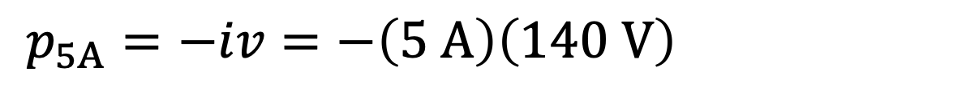

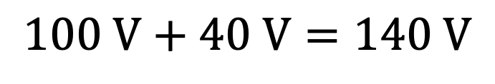
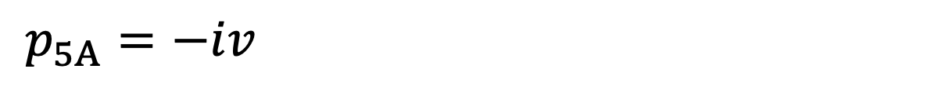
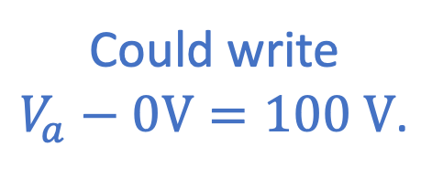

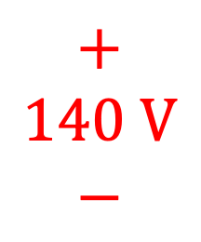
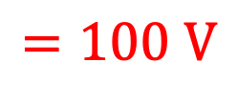

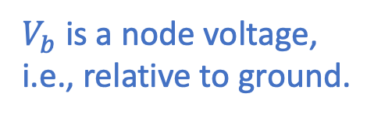




Could write $V_{b}−V_{a}=40 V$.
$$0 V+100 V=$$
$$=100 V$$
$$=V_{a}+40 V$$
$V_{b}$ is a node voltage,
i.e., relative to ground.
$$+$$
$$140 V$$
$$−$$
Could write
$V_{a}−0V=100 V$.
$$0 V$$
Passive sign
convention.
What is $V_{b}$? (numeric poll)
What is power for $5 A$ source? (numeric poll)
$$p_{5A}=−iv=−\left(5 A\right)\left(140 V\right)=−700 W$$
$$p_{5A}=−iv=−\left(5 A\right)\left(140 V\right)=−700 W$$
$$100 V+40 V=140 V$$
$$p_{5A}=−iv=−\left(5 A\right)\left(140 V\right)=−700 W$$
$$100 V+40 V=140 V$$
Delivered power.

Slide 15









Power for each element?
$$15 A$$
$$5 A$$
$$+$$
$$−$$
$$+$$
$$−$$
$$100 V$$
$$140 V$$
Indicate assumed
polarities and
current directions.
}
$$p_{5A}=−iv=−\left(5 A\right)\left(140 V\right)=−700 W$$
$$p_{10A}=−iv=−\left(10 A\right)\left(100 V\right)=−1000 W$$
$$p_{10A}=−iv=−\left(10 A\right)\left(100 V\right)=−1000 W$$
$$p_{10A}=−iv=−\left(10 A\right)\left(100 V\right)=−1000 W$$
Power delivered =
Power consumed
$$p_{40V}=iv=\left(5 A\right)\left(40 V\right)=200 W$$
$$p_{40V}=iv=\left(5 A\right)\left(40 V\right)=200 W$$
$$p_{40V}=iv=\left(5 A\right)\left(40 V\right)=200 W$$
$$p_{100V}=iv=\left(5 A+10 A\right)\left(100 V\right)=1500 W$$
$$p_{100V}=iv=\left(5 A+10 A\right)\left(100 V\right)=1500 W$$
$$p_{100V}=iv=\left(5 A+10 A\right)\left(100 V\right)=1500 W$$
From KCL.

Slide 16
Previously said you can control voltage or you can control current
but you cannot control them both.
But wait!

Slide 17







Previously said you can control voltage or you can control current
but you cannot control them both.
But wait!
What about this!?
$$10 A$$
$i_{2}=$ ?
Can’t you hook this up to things
and wouldn’t you always get
$10 A$ and $100 V$ from it?
$i_{1}=$ ?
Nope!
The only thing that’s guaranteed
is that there will be $100 V$across
the terminals.
Where the $10 A$flows is dictated by the entire circuit. Some (or all) may
flow out the terminals, some (or all) may flow into the voltage source.
Where the $10 A$flows is dictated by the entire circuit. Some (or all) may
flow out the terminals, some (or all) may flow into the voltage source.
Consider load of $100 Ω$ ($i_{2}=1 A$) vs. load of $1 Ω$ ($i_{2}=100 A$).
Consider load of $100 Ω$ ($i_{2}=1 A$) vs. load of $1 Ω$ ($i_{2}=100 A$).

