Slide 1
EE 261, Spring 2025, Lecture 8
Goals/Topics:
Series resistors
Parallel resistor
“Isolated” circuits with a common ground
Parallel resistors and conductances
More on series and parallel resistors
Best viewed in
presentation mode
in PowerPoint.
Announcements:
Homework 3 posted. Due Wednesday, Jan. 29th.
Test 1 next Friday, January 31st, at 7:00 p.m. in Spark G45.
Lecture that day will be an optional review.

Slide 2
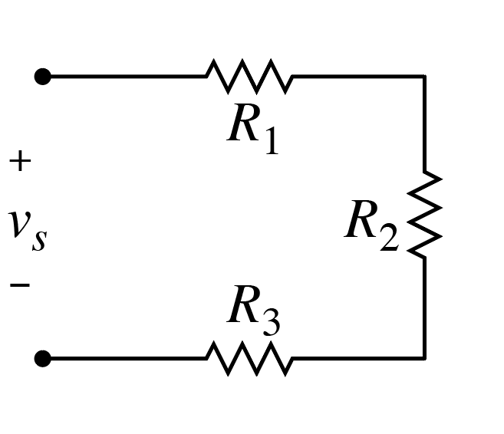
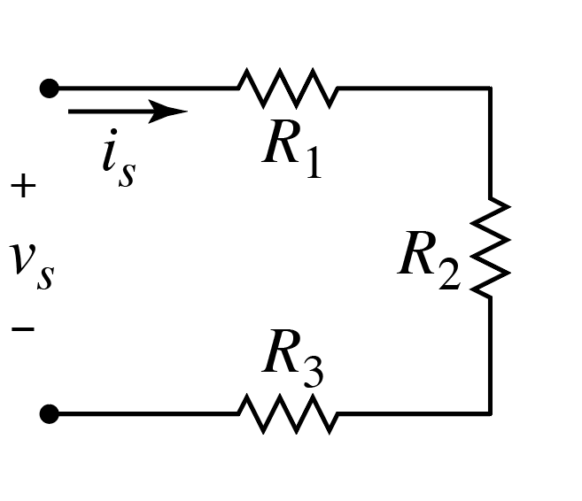
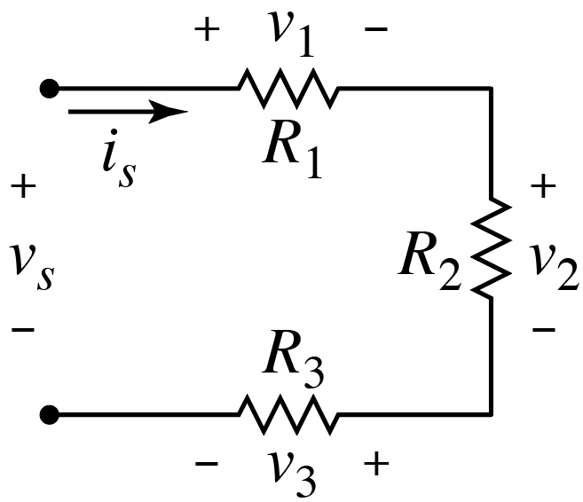
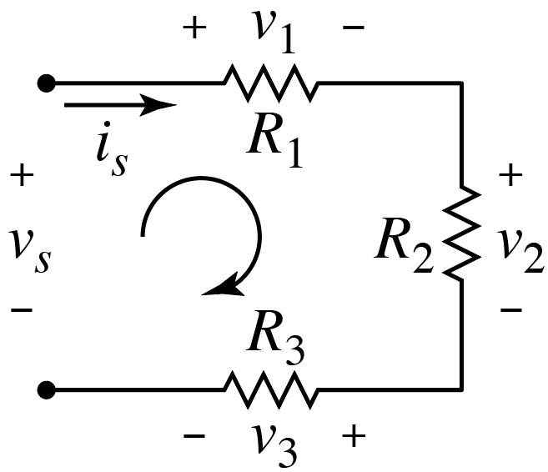
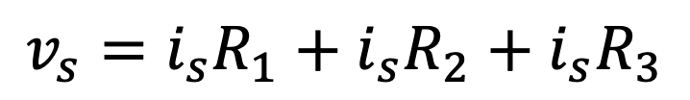
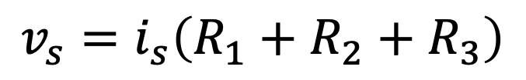
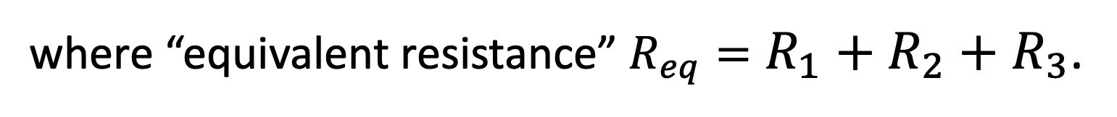
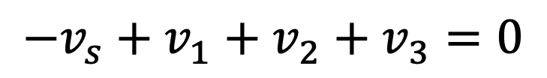
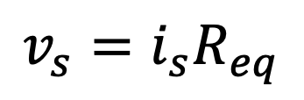
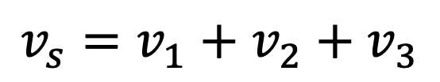
Series Resistors
KVL:
$$−v_{s}+v_{1}+v_{2}+v_{3}=0$$
$$v_{s}=v_{1}+v_{2}+v_{3}$$
Apply Ohm’s Law:
$$v_{s}=i_{s}R_{1}+i_{s}R_{2}+i_{s}R_{3}$$
$$v_{s}=i_{s}\left(R_{1}+R_{2}+R_{3}\right)$$
$$v_{s}=i_{s}R_{eq}$$
where “equivalent resistance” $R_{eq}=R_{1}+R_{2}+R_{3}$.
Long version: Series resistors are equivalent to
a single resistor whose resistance equals the sum
of the resistances of the resistors that are in series.
Series resistances add.

Slide 3
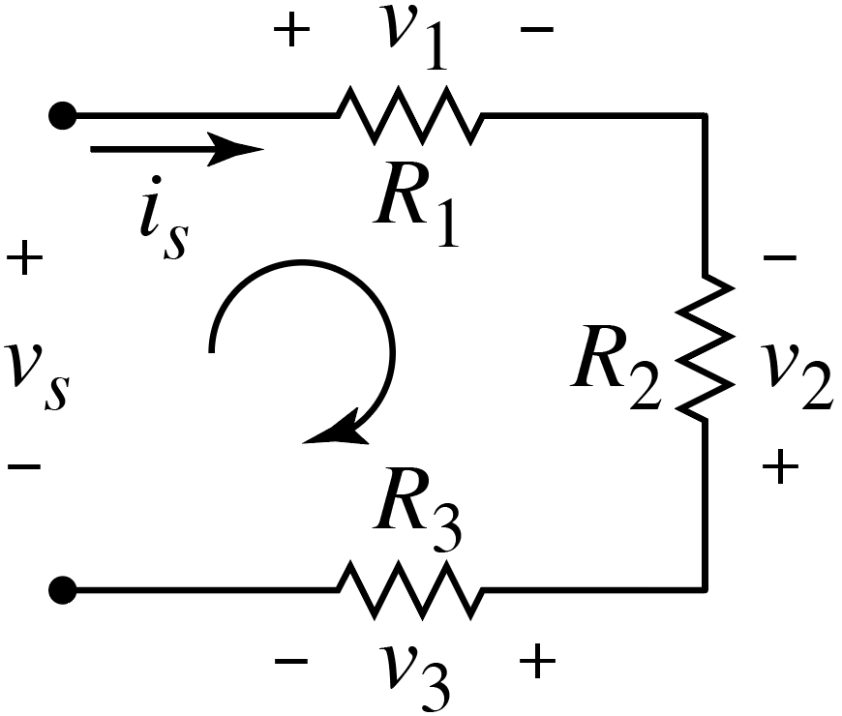
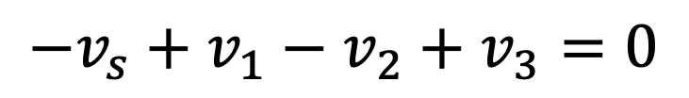
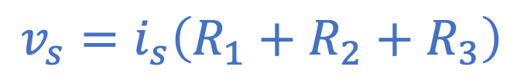
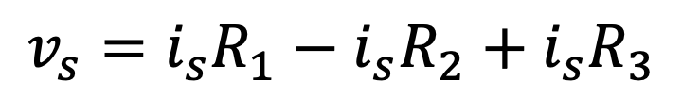
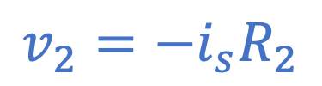
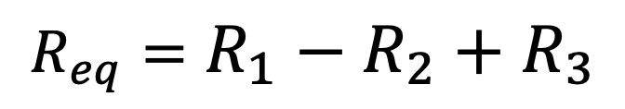
Consider:
Does KVL yield the following?
$$−v_{s}+v_{1}−v_{2}+v_{3}=0$$
A) Yes. B) No.
Does application of Ohm’s Law yield
the following?
$$v_{s}=i_{s}R_{1}−i_{s}R_{2}+i_{s}R_{3}$$
passive sign
convention
A) Yes. B) No.
$$v_{2}=−i_{s}R_{2}$$
Minus signs cancel!
$$v_{s}=i_{s}\left(R_{1}+R_{2}+R_{3}\right)$$
Is equivalent resistance the following?
Series resistances add.
$$R_{eq}=R_{1}−R_{2}+R_{3}$$
A) Yes. B) No.
(Regardless of any labels.)

Slide 4
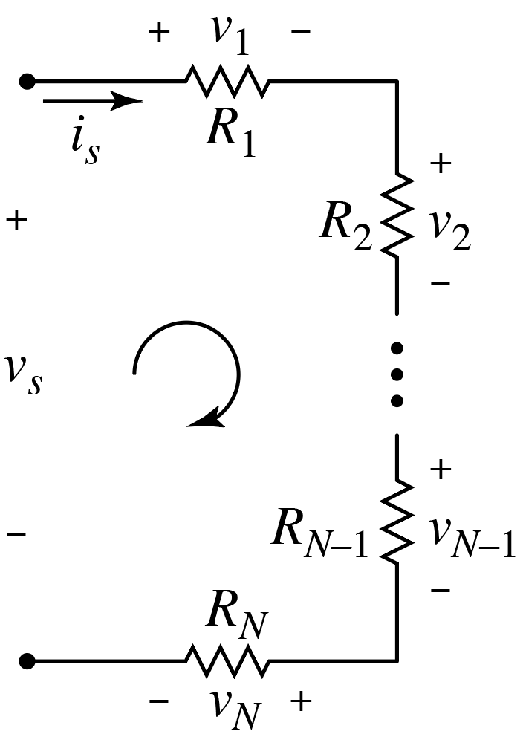
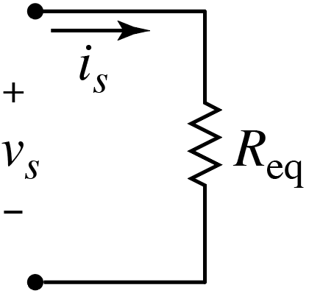
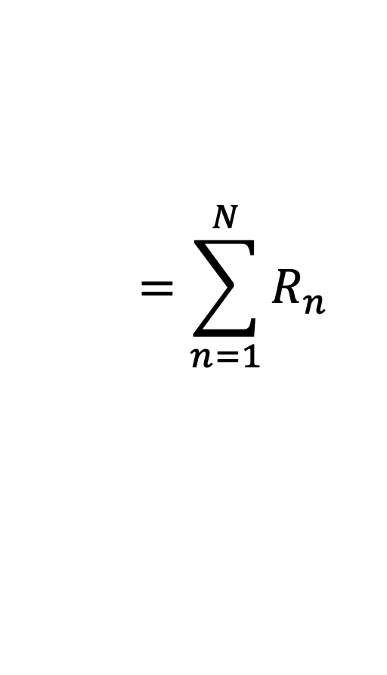
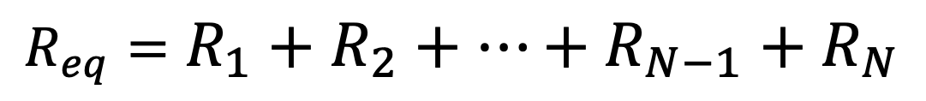
Arbitrary Number of Series Resistors
where:
$$R_{eq}=R_{1}+R_{2}+⋯+R_{N−1}+R_{N}$$
$$=\sum_{n=1}^{N}{R_{n}}$$
Order of resistors
does not matter.
Again: Order of series elements does not matter.

Slide 5

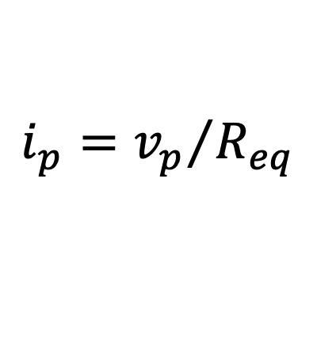
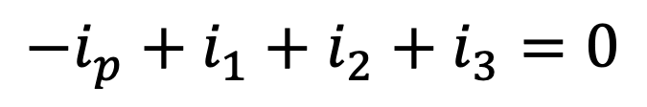
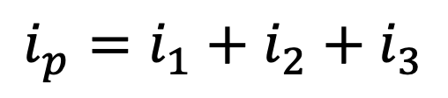
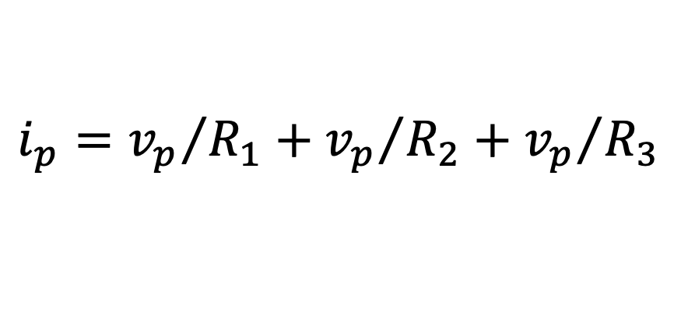
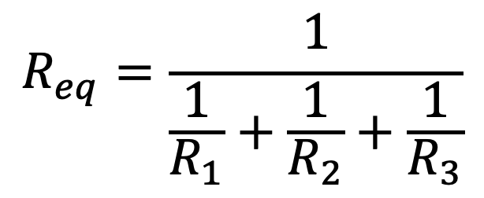
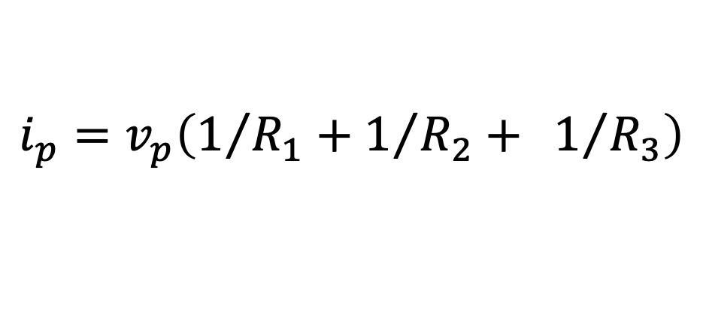
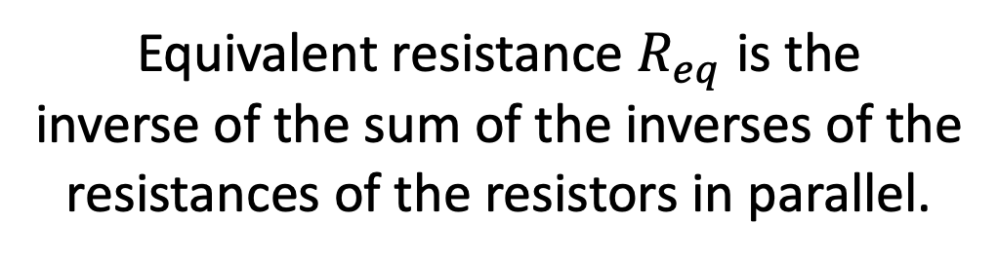
KCL:
Parallel Resistors
$$−i_{p}+i_{1}+i_{2}+i_{3}=0$$
$$i_{p}=i_{1}+i_{2}+i_{3}$$
Apply Ohm’s Law.
Parallel element have
same voltage across them.
$i_{p}={v_{p}}/{R_{1}}+{v_{p}}/{R_{2}}+$ ${v_{p}}/{R_{3}}$
Equivalent resistance $R_{eq}$ is the
inverse of the sum of the inverses of the
resistances of the resistors in parallel.
$$i_{p}=v_{p}\left(1/{R_{1}}+1/{R_{2}}+ 1/{R_{3}}\right)$$
$$i_{p}={v_{p}}/{R_{eq}}$$
$$R_{eq}=\frac{1}{\frac{1}{R_{1}}+\frac{1}{R_{2}}+\frac{1}{R_{3}}}$$
where $1/{R_{eq}}=1/{R_{1}}+1/{R_{2}}+1/{R_{3}}$
(Order of resistors does not matter.)

Slide 6
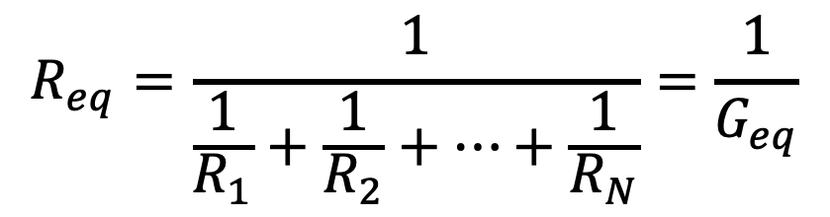
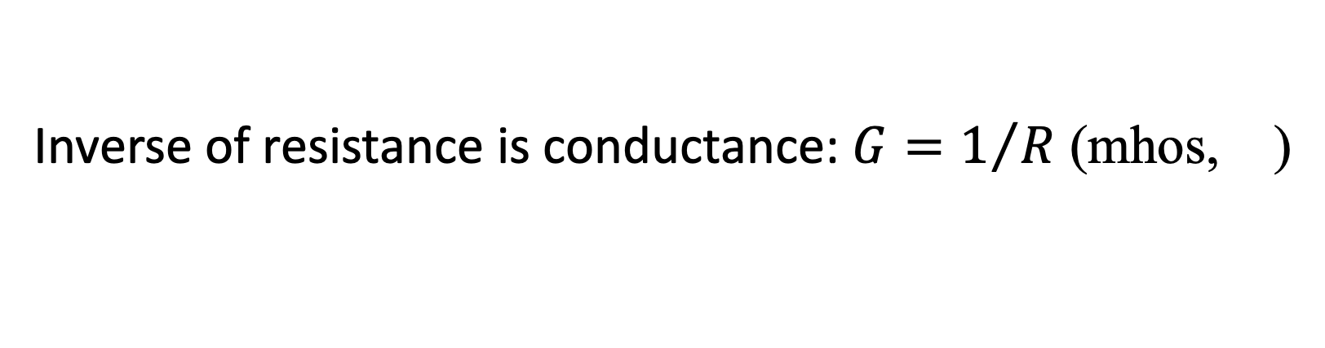
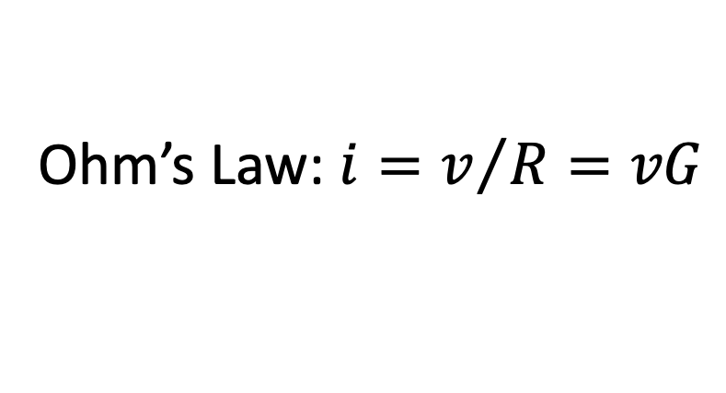
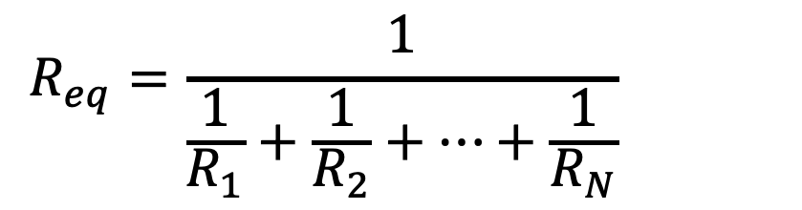
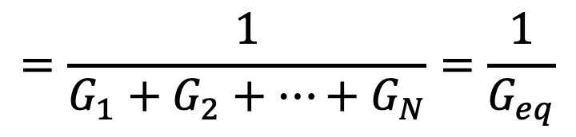
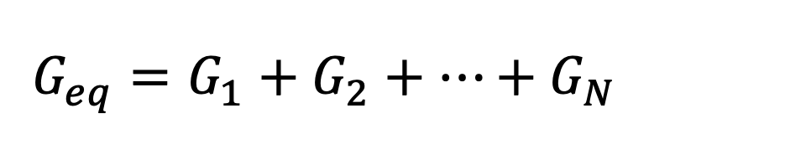
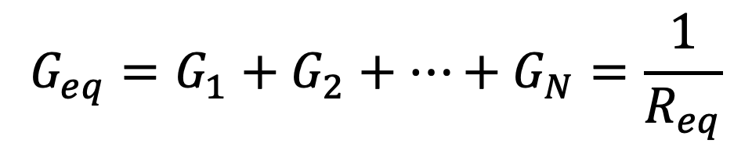
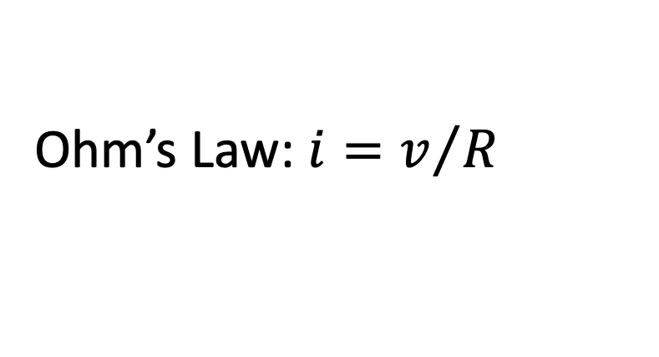
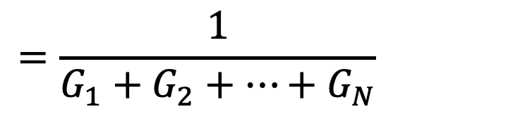
Arbitrary Number of Parallel Resistors (Parallel Conductances)
Inverse of resistance is conductance: $G=1/R$ (mhos, )
Ω
Ohm’s Law: $i=v/R=vG$
Ohm’s Law: $i=v/R=vG$
$$R_{eq}=\frac{1}{\frac{1}{R_{1}}+\frac{1}{R_{2}}+⋯+\frac{1}{R_{N}}}=\frac{1}{G_{eq}}$$
Equate denominators.
$$R_{eq}=\frac{1}{\frac{1}{R_{1}}+\frac{1}{R_{2}}+⋯+\frac{1}{R_{N}}}=\frac{1}{G_{eq}}$$
$$G_{eq}=G_{1}+G_{2}+⋯+G_{N}=\frac{1}{R_{eq}}$$
$$G_{eq}=G_{1}+G_{2}+⋯+G_{N}=\frac{1}{R_{eq}}$$
$$=\frac{1}{G_{1}+G_{2}+⋯+G_{N}}=\frac{1}{G_{eq}}$$
$$=\frac{1}{G_{1}+G_{2}+⋯+G_{N}}=\frac{1}{G_{eq}}$$
Parallel conductances add.

Slide 7
Arbitrary Number of Parallel Resistors (Parallel Conductances)
Inverse of resistance is conductance: $G=1/R$ (mhos, )
Ω
Ohm’s Law: $i=v/R=vG$
Ohm’s Law: $i=v/R=vG$
For a given voltage…
the larger resistance becomes, the smaller the current that flows.
the larger resistance becomes, the smaller conductance becomes.
the smaller conductance becomes, the smaller the current that flows.
the smaller resistance becomes, the larger the current that flows.
the smaller resistance becomes, the large conductance becomes.
the larger conductance becomes, the larger the current that flows.

Slide 8
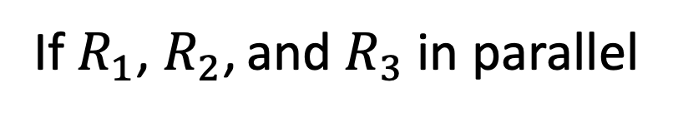
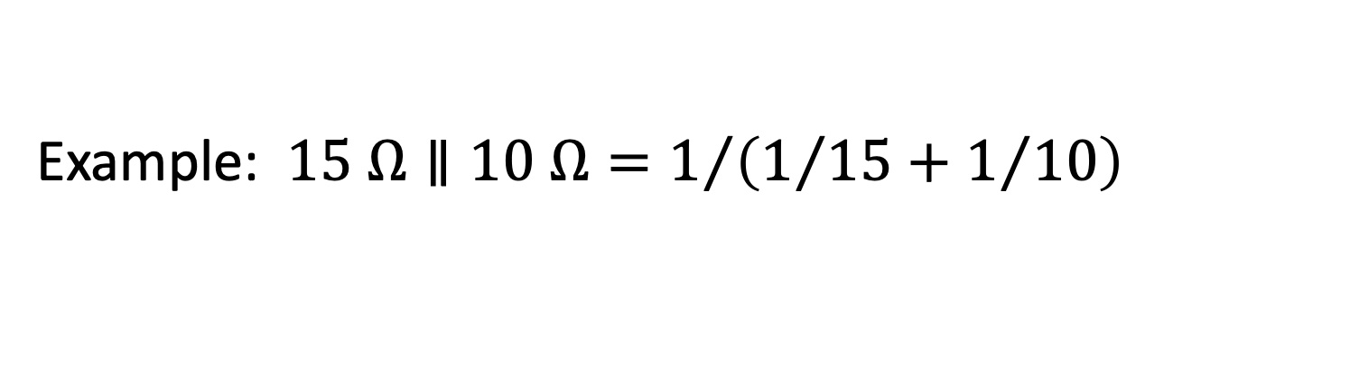
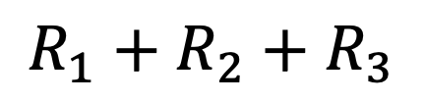
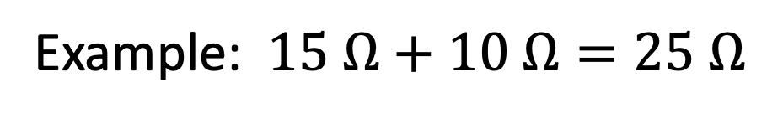
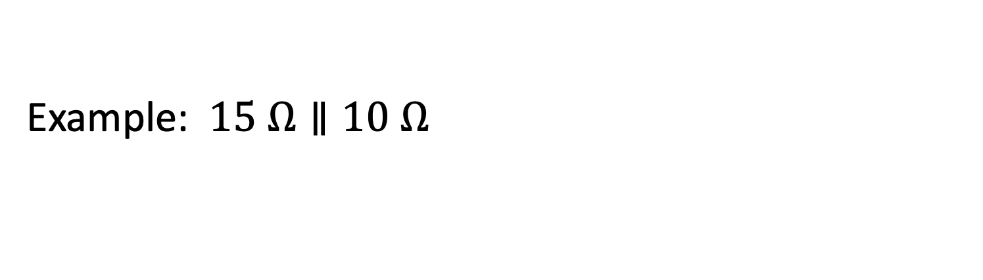
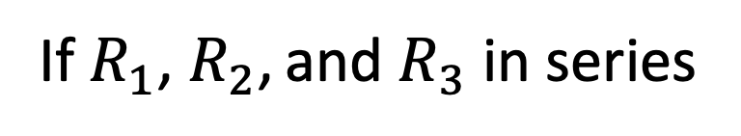

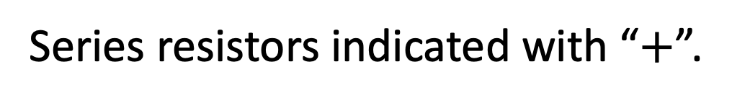

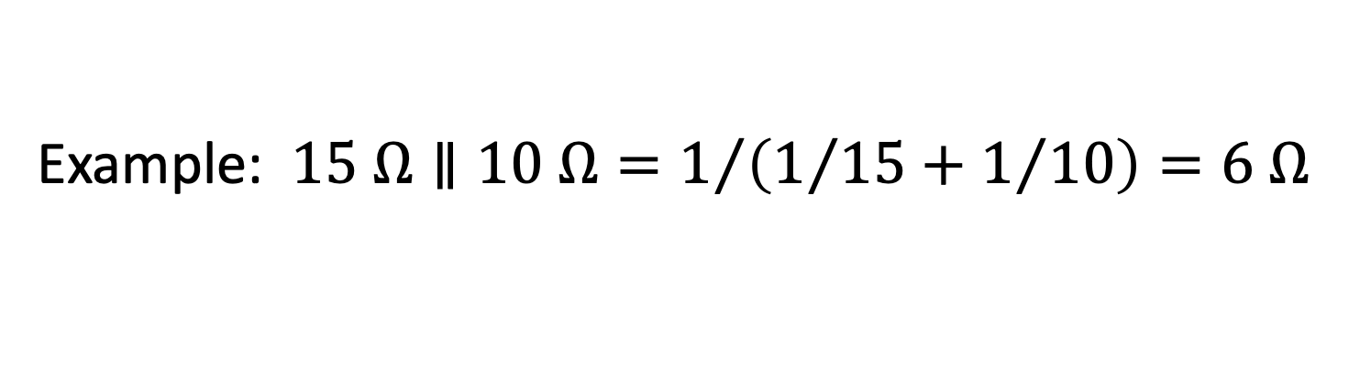
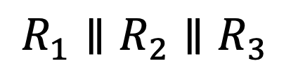
Common notation related to circuit topology:
Series resistors indicated with “$+$”.
Parallel resistor indicated with “$∥$”.
If $R_{1}$, $R_{2}$, and $R_{3}$ in series
$$R_{1}+R_{2}+R_{3}$$
If $R_{1}$, $R_{2}$, and $R_{3}$in parallel
$$R_{1}∥R_{2}∥R_{3}$$
Example: $15 Ω+10 Ω=25 Ω$
Example: $15 Ω+10 Ω=25 Ω$
Bigger than biggest resistor!
Important reality checks!
Smaller than smallest resistor!
Example: $15 Ω∥10 Ω=1/{\left(1/{15}+1/{10}\right)}=6 Ω$
Example: $15 Ω∥10 Ω=1/{\left(1/{15}+1/{10}\right)}=6 Ω$
Example: $15 Ω∥10 Ω=1/{\left(1/{15}+1/{10}\right)}=6 Ω$

Slide 9
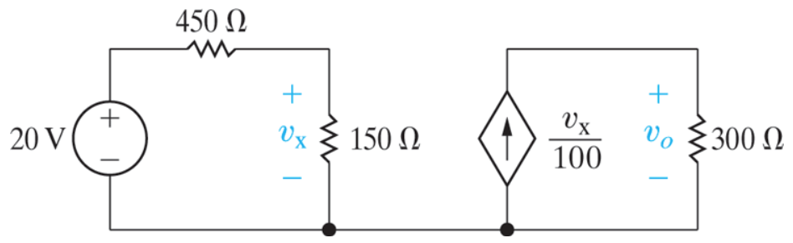

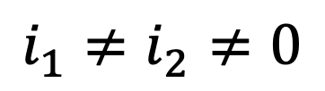
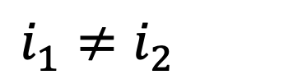
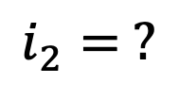

Charge does not accumulate in any portion of circuit.
What flows in flows out. Thus:
HW related:
$$i_{1}≠i_{2}≠0$$
$$i_{1}≠i_{2}≠0$$
Bottom wire(s) all
at same potential.
$$i_{1}= ?$$
$$i=0$$
$$i_{2}= ?$$
(Common ground.)

Slide 10


Consider:
Are any elements in series?
A) Yes. B) No.
Are any elements in parallel?
A) Yes. B) No.
How to solve for voltages or currents?
One approach: Wye-to-delta or delta-to-wye transformation.
Next lecture…

Slide 11





Consider:
Equivalent resistance $R_{ab}$?
Is $10 Ω$ in series with
another resistor?
A) Yes. B) No.
Is $10 Ω$ in parallel with
another resistor?
Can an element that is in series with
another element ever be in parallel
with yet another element?
A) Yes. B) No.
If circuit consists of only two elements,
they are simultaneously in series & in parallel.
A) Yes. B) No.
Recall elements need not be in series or parallel with any other elements!
E.g. $6 Ω$ above.

Slide 12













Consider:
Equivalent resistance $R_{ab}$?
$10 Ω$ in series with $26 Ω$:
$$10+26=36 Ω$$
$$10+26=36 Ω$$
$18 Ω$ in parallel with this
combination:
$$18∥\left(10+26\right)=12 Ω$$
$36 Ω$ in parallel with this
combination:
$$18∥\left(10+26\right)=12 Ω$$
$6 Ω$ in series with this
combination:
$$36∥\left(6+18∥\left(10+26\right)\right)=12 Ω$$
$$36∥\left(6+18∥\left(10+26\right)\right)=12 Ω$$
$$6+18∥\left(10+26\right)=18 Ω$$
$$6+18∥\left(10+26\right)=18 Ω$$
$$R_{ab}=12 Ω$$

Slide 13















Consider:
Equivalent resistance $R_{ab}$?
$$15∥60=12 Ω$$
$$45∥30=18 Ω$$
$$18+12+20=50 Ω$$
$$50∥50=25 Ω$$
Note:
$$R∥R=R/2$$
$$25+25+10=60 Ω$$
$$R∥R∥R=R/3$$
$$R∥R∥⋯∥R∥R=R/N$$
$$R_{ab}=60 Ω$$
$N$equal resistors in parallel

Slide 14


Consider:
Equivalent resistance $R_{ab}$?
$$15∥60=12 Ω$$
$$45∥30=18 Ω$$
$$18+12+20=50 Ω$$
$$50∥50=25 Ω$$
Note: $10 Ω$ and $25Ω$ resistors “ended up”
in series, but they were always in series.
Note: $10 Ω$ and $25Ω$ resistors “ended up”
in series, but they were always in series.
$$25+25+10=60 Ω$$
They must have the same current passing
through them. Hence, they’re in series.
$$R_{ab}=60 Ω$$
They must have the same current passing
through them. Hence, they’re in series.

Slide 15


Recall:
Series: $R_{eq}=R_{1}+R_{2}+⋯+R_{N}$
Parallel: $1/{R_{eq}}=1/{R_{1}}+1/{R_{2}}+⋯+1/{R_{N}}$
Assuming no resistor is zero or infinite,
equivalent resistance of series resistors is always
greater than resistance of any single resistor.
Assuming no resistor is zero or infinite,
equivalent resistance of parallel resistors is
always less than resistance of any single resistor.

Slide 16





Is the following true or false?
$$\frac{1}{a+b}=\frac{1}{a}+\frac{1}{b}$$
True
False
$$\frac{1}{2+3}=\frac{1}{5}≠\frac{1}{2}+\frac{1}{3}=\frac{5}{6}$$
$$\frac{1}{2+3}=\frac{1}{5}≠\frac{1}{2}+\frac{1}{3}=\frac{5}{6}$$
$$\frac{1}{2+3}=\frac{1}{5}≠\frac{1}{2}+\frac{1}{3}=\frac{5}{6}$$
$$\frac{1}{2+3}=\frac{1}{5}≠\frac{1}{2}+\frac{1}{3}=\frac{5}{6}$$

Slide 17







Is the following true or false?
$$\frac{1}{\frac{1}{a}+\frac{1}{b}}=a+b$$
True
False
$$\frac{1}{\frac{1}{2}+\frac{1}{3}}=\frac{1}{5/6}=\frac{6}{5}≠2+3=5$$
$$\frac{1}{\frac{1}{2}+\frac{1}{3}}=\frac{1}{5/6}=\frac{6}{5}≠2+3=5$$
$$\frac{1}{\frac{1}{2}+\frac{1}{3}}=\frac{1}{5/6}=\frac{6}{5}≠2+3=5$$
$$\frac{1}{\frac{1}{2}+\frac{1}{3}}=\frac{1}{5/6}=\frac{6}{5}≠2+3=5$$
$$\frac{1}{\frac{1}{2}+\frac{1}{3}}=\frac{1}{5/6}=\frac{6}{5}≠2+3=5$$
$$\frac{1}{1/a}=a$$
This is true.

Slide 18





Is the following true or false?
$$\frac{1}{\frac{1}{a}+\frac{1}{b}}=\frac{ab}{a+b}$$
True
False
$$\frac{ab}{ab}\left(\frac{1}{\frac{1}{a}+\frac{1}{b}}\right)=\frac{ab}{\frac{ab}{a}+\frac{ab}{b}}=\frac{ab}{b+a}$$
$$\frac{ab}{ab}\left(\frac{1}{\frac{1}{a}+\frac{1}{b}}\right)=\frac{ab}{\frac{ab}{a}+\frac{ab}{b}}=\frac{ab}{b+a}$$
$$\frac{ab}{ab}\left(\frac{1}{\frac{1}{a}+\frac{1}{b}}\right)=\frac{ab}{\frac{ab}{a}+\frac{ab}{b}}=\frac{ab}{b+a}$$
$$\frac{ab}{ab}\left(\frac{1}{\frac{1}{a}+\frac{1}{b}}\right)=\frac{ab}{\frac{ab}{a}+\frac{ab}{b}}=\frac{ab}{b+a}$$
Product over
the sum.

Slide 19





Is the following true or false?
$$\frac{1}{\frac{1}{a}+\frac{1}{b}+\frac{1}{c}}=\frac{abc}{a+b+c}$$
True
False
$$\frac{abc}{abc}\left(\frac{1}{\frac{1}{a}+\frac{1}{b}+\frac{1}{c}}\right)=\frac{abc}{\frac{abc}{a}+\frac{abc}{b}+\frac{abc}{c}}=\frac{abc}{cb+ac+ab}$$
$$\frac{abc}{abc}\left(\frac{1}{\frac{1}{a}+\frac{1}{b}+\frac{1}{c}}\right)=\frac{abc}{\frac{abc}{a}+\frac{abc}{b}+\frac{abc}{c}}=\frac{abc}{cb+ac+ab}$$
$$\frac{abc}{abc}\left(\frac{1}{\frac{1}{a}+\frac{1}{b}+\frac{1}{c}}\right)=\frac{abc}{\frac{abc}{a}+\frac{abc}{b}+\frac{abc}{c}}=\frac{abc}{cb+ac+ab}$$
$$\frac{abc}{abc}\left(\frac{1}{\frac{1}{a}+\frac{1}{b}+\frac{1}{c}}\right)=\frac{abc}{\frac{abc}{a}+\frac{abc}{b}+\frac{abc}{c}}=\frac{abc}{cb+ac+ab}$$

Slide 20



Given:
$$R_{12}=\frac{1}{\frac{1}{R_{1}}+\frac{1}{R_{2}}}=\frac{R_{1}R_{2}}{R_{1}+R_{2}}$$
$$R_{12}=\frac{1}{\frac{1}{R_{1}}+\frac{1}{R_{2}}}=\frac{R_{1}R_{2}}{R_{1}+R_{2}}$$
Is the following true or false?
$$\frac{1}{\frac{1}{R_{1}}+\frac{1}{R_{2}}+\frac{1}{R_{3}}}=\frac{1}{\frac{1}{R_{12}}+\frac{1}{R_{3}}}$$
True
False
Equal.
Can “replace” pairs of parallel resistors with their equivalents
(even while they are in parallel with other resistors).
Can “replace” pairs of parallel resistors with their equivalents
$$R_{1}∥R_{2}∥R_{3}=\left(R_{1}∥R_{2}\right)∥R_{3}=R_{1}∥\left(R_{2}∥R_{3}\right)$$
$$R_{1}∥R_{2}∥R_{3}=\left(R_{1}∥R_{2}\right)∥R_{3}=R_{1}∥\left(R_{2}∥R_{3}\right)$$
$$R_{1}∥R_{2}∥R_{3}=\left(R_{1}∥R_{2}\right)∥R_{3}=R_{1}∥\left(R_{2}∥R_{3}\right)$$

Slide 21





DMM being used as an ohmmeter.
DUT$=$ Device Under Test
DMM
Digital Multimeter (DMM)
DUT
Can measure voltage,
current, and resistance
(act as an ohmmeter).
But it has its limits…
Attempt to measure $1 GΩ$ resistor.
$$I=0$$
No current
through voltmeter.
Redraw circuit.
Combine parallel
resistors.
Parallel

Slide 22










$$I=0$$
$$100 nA$$
DMM
Voltmeter, not a voltage source.
Assume DMM reports resistance at terminals as:
Multiply numerator and
denominator by $R_{1}$.
Ohm’s Law.
$$\frac{V}{100 nA}=\frac{R_{eq}\left(100 nA\right)}{100 nA}=R_{eq}=\frac{1}{\frac{1}{R_{1}}+\frac{1}{200×{10}^{6}}}=R_{1}\left(\frac{1}{1+\frac{R_{1}}{200×{10}^{6}}}\right)$$
$$\frac{V}{100 nA}=\frac{R_{eq}\left(100 nA\right)}{100 nA}=R_{eq}=\frac{1}{\frac{1}{R_{1}}+\frac{1}{200×{10}^{6}}}=R_{1}\left(\frac{1}{1+\frac{R_{1}}{200×{10}^{6}}}\right)$$
$$\frac{V}{100 nA}=\frac{R_{eq}\left(100 nA\right)}{100 nA}=R_{eq}=\frac{1}{\frac{1}{R_{1}}+\frac{1}{200×{10}^{6}}}=R_{1}\left(\frac{1}{1+\frac{R_{1}}{200×{10}^{6}}}\right)$$
$$\frac{V}{100 nA}=\frac{R_{eq}\left(100 nA\right)}{100 nA}=R_{eq}=\frac{1}{\frac{1}{R_{1}}+\frac{1}{200×{10}^{6}}}=R_{1}\left(\frac{1}{1+\frac{R_{1}}{200×{10}^{6}}}\right)$$
$$\frac{V}{100 nA}=\frac{R_{eq}\left(100 nA\right)}{100 nA}=R_{eq}=\frac{1}{\frac{1}{R_{1}}+\frac{1}{200×{10}^{6}}}=R_{1}\left(\frac{1}{1+\frac{R_{1}}{200×{10}^{6}}}\right)$$
$$\frac{measured voltage}{test current}$$
Ideally DMM would report just this.
Deviation from $1.0$ is an error.

Slide 23













$$R_{eq}=R_{1}\left(\frac{1}{1+\frac{R_{1}}{200×{10}^{6}}}\right)=R_{calculated}=R_{measured}=R_{reported}$$
$$R_{eq}=R_{1}\left(\frac{1}{1+\frac{R_{1}}{200×{10}^{6}}}\right)=R_{calculated}=R_{measured}=R_{reported}$$
$$R_{eq}=R_{1}\left(\frac{1}{1+\frac{R_{1}}{200×{10}^{6}}}\right)=R_{calculated}=R_{measured}=R_{reported}$$
$$R_{eq}=R_{1}\left(\frac{1}{1+\frac{R_{1}}{200×{10}^{6}}}\right)=R_{calculated}=R_{measured}=R_{reported}$$
Ideally,
just this.
Deviation from
one is an error.
If $R_{1}=200 MΩ$
$$R_{reported}=100 MΩ$$
Ugh! Not good.
Way off!
$R_{measured}$ can never be
larger than $200 MΩ$!
If $R_{1}=1 GΩ$
$$R_{reported}=166.7 MΩ$$
Excellent!
Almost no error.
If $R_{1}=10 Ω$
$$R_{reported}=9.9999995 Ω$$
If $R_{1}=1 MΩ$
$$R_{reported}=0.9950 MΩ$$
Tolerable error?

