Slide 1
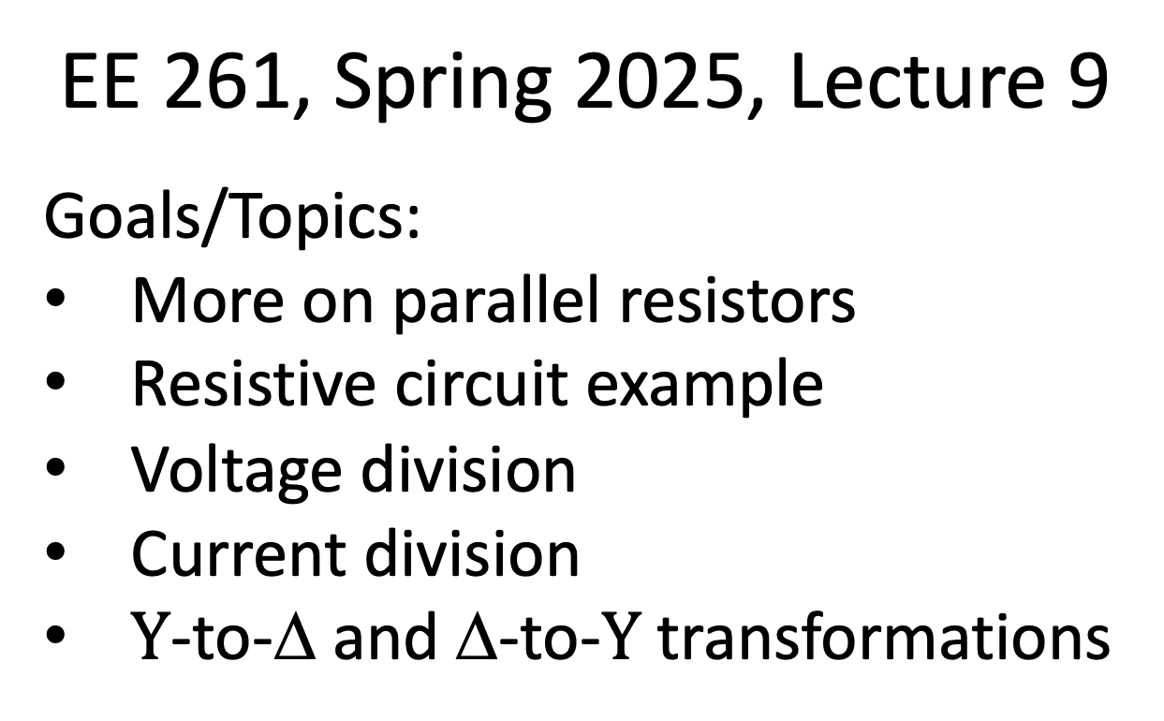
EE 261, Spring 2025, Lecture 9
Goals/Topics:
More on parallel resistors
Resistive circuit example
Voltage division
Current division
$Y$-to-Δ and Δ-to-$Y$ transformations
Best viewed in
presentation mode
in PowerPoint.

Slide 2
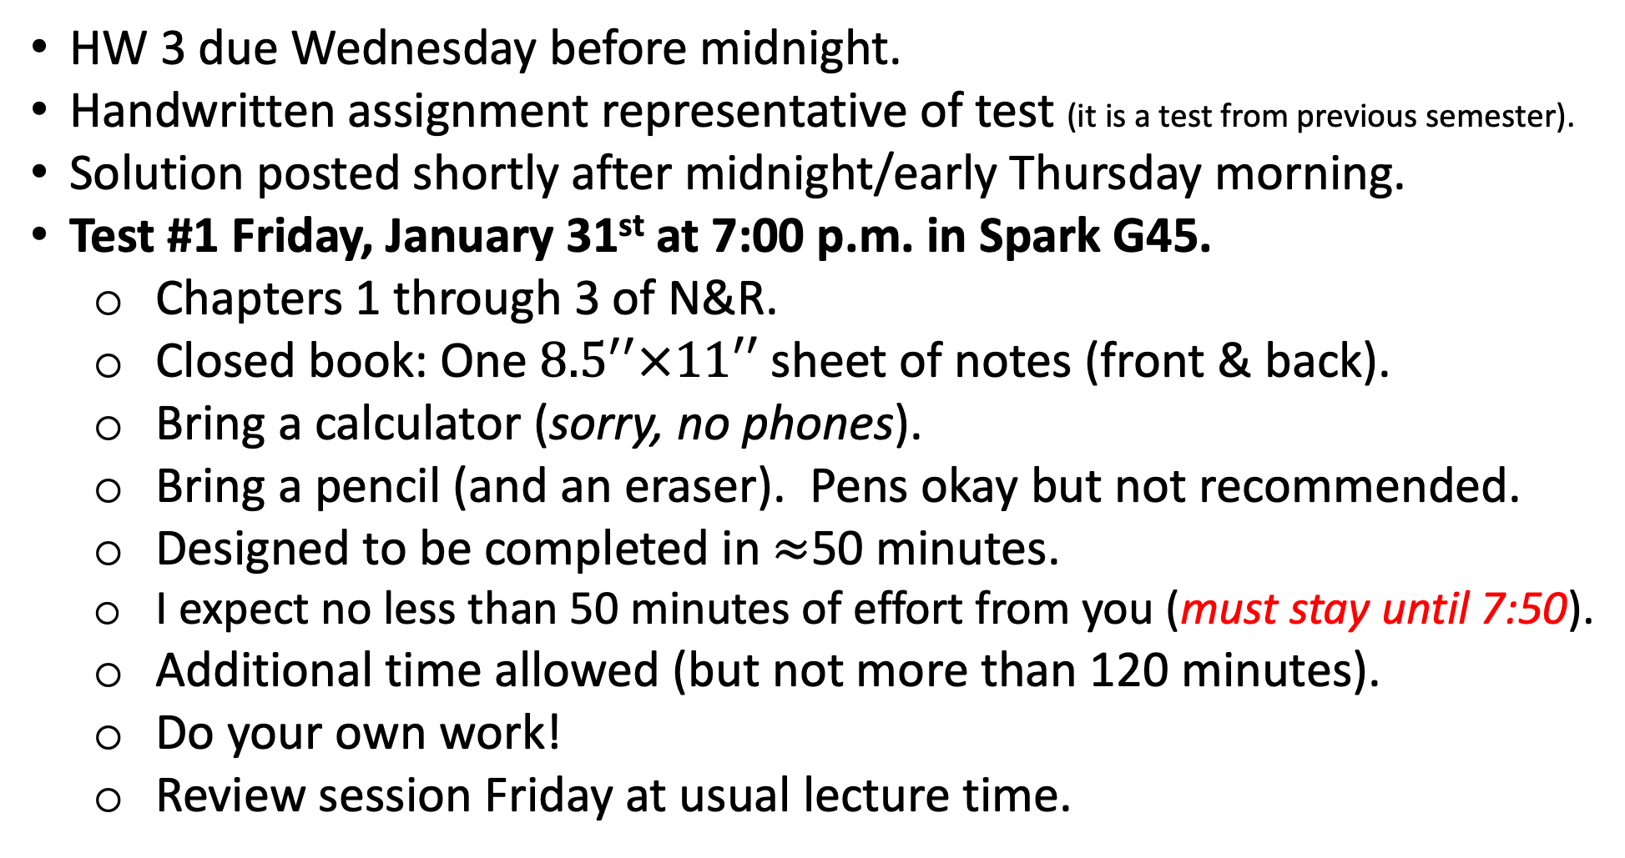
Announcements:
HW 3 due Wednesday before midnight.
Handwritten assignment representative of test (it is a test from previous semester).
Solution posted shortly after midnight/early Thursday morning.
Test #1 Friday, January 31st at 7:00 p.m. in Spark G45.
  Chapters 1 through 3 of N&R.
  Closed book: One ${8.5}^{′′}×11′′$ sheet of notes (front & back).
  Bring a calculator (sorry, no phones).
  Bring a pencil (and an eraser). Pens okay but not recommended.
  Designed to be completed in $≈$50 minutes.
  I expect no less than 50 minutes of effort from you (must stay until 7:50).
  Additional time allowed (but not more than 120 minutes).
  Do your own work!
  Review session Friday at usual lecture time.
But…

Slide 3
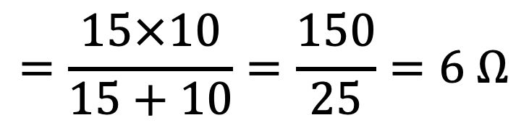
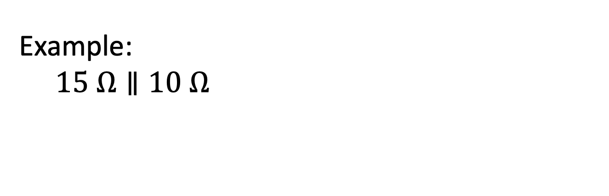
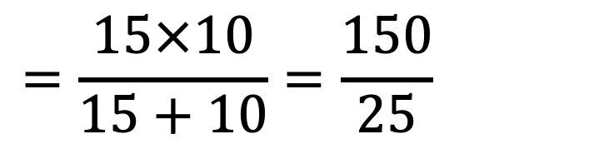
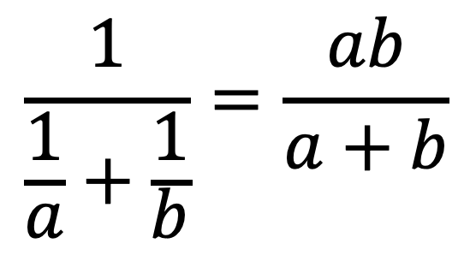
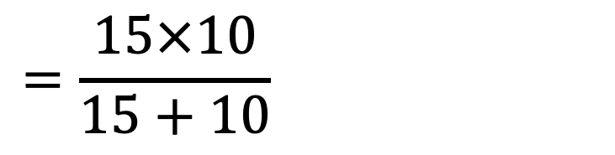
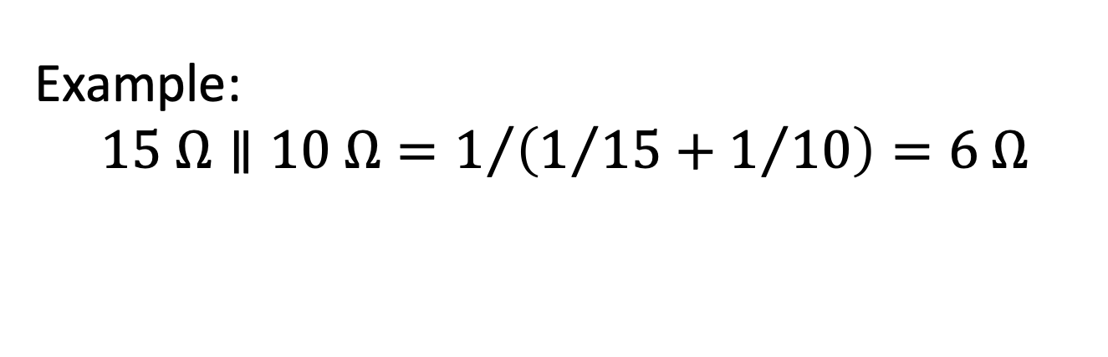
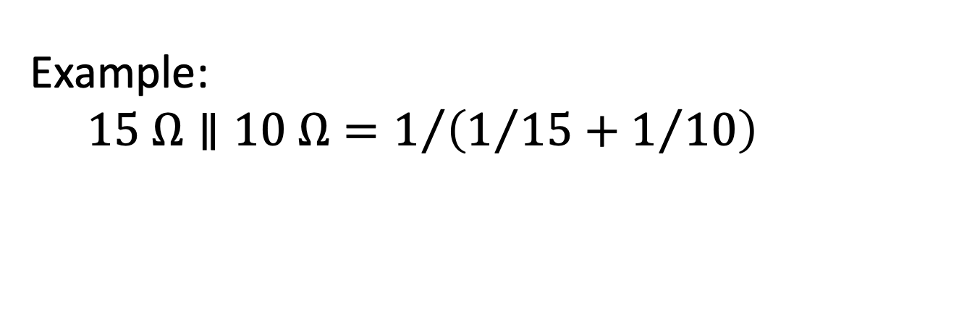
From last time, this is true:
$$\frac{1}{\frac{1}{a}+\frac{1}{b}}=\frac{ab}{a+b}$$
“Product over the sum” is convenient shortcut for finding
equivalent resistance of two (and only two!) parallel resistors.
Example:
$$15 Ω∥10 Ω=1/{\left(1/{15}+1/{10}\right)}=6 Ω$$
Example:
$$15 Ω∥10 Ω=1/{\left(1/{15}+1/{10}\right)}=6 Ω$$
Example:
$$15 Ω∥10 Ω=1/{\left(1/{15}+1/{10}\right)}=6 Ω$$
(messy-ish)
$$=\frac{15×10}{15+10}=\frac{150}{25}=6 Ω$$
$$=\frac{15×10}{15+10}=\frac{150}{25}=6 Ω$$
$$=\frac{15×10}{15+10}=\frac{150}{25}=6 Ω$$
(easy-ish)

Slide 4
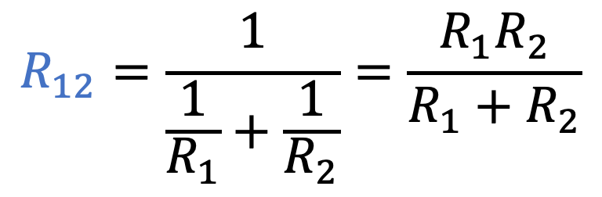
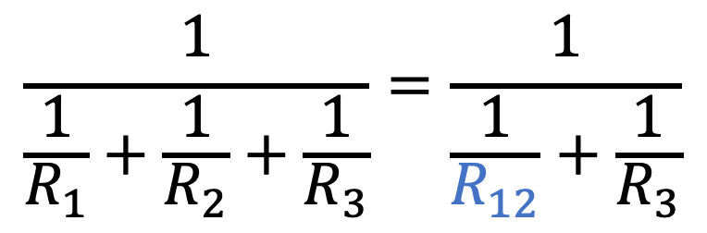
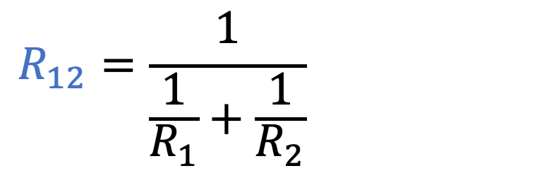
Given:
$$R_{12}=\frac{1}{\frac{1}{R_{1}}+\frac{1}{R_{2}}}=\frac{R_{1}R_{2}}{R_{1}+R_{2}}$$
$$R_{12}=\frac{1}{\frac{1}{R_{1}}+\frac{1}{R_{2}}}=\frac{R_{1}R_{2}}{R_{1}+R_{2}}$$
Is the following true or false?
$$\frac{1}{\frac{1}{R_{1}}+\frac{1}{R_{2}}+\frac{1}{R_{3}}}=\frac{1}{\frac{1}{R_{12}}+\frac{1}{R_{3}}}$$
True
False
Equal.
Can “replace” pairs of parallel resistors with their equivalents
(even while they are in parallel with other resistors).
Can “replace” pairs of parallel resistors with their equivalents
$$R_{1}∥R_{2}∥R_{3}=\left(R_{1}∥R_{2}\right)∥R_{3}=R_{1}∥\left(R_{2}∥R_{3}\right)$$
$$R_{1}∥R_{2}∥R_{3}=\left(R_{1}∥R_{2}\right)∥R_{3}=R_{1}∥\left(R_{2}∥R_{3}\right)$$
$$R_{1}∥R_{2}∥R_{3}=\left(R_{1}∥R_{2}\right)∥R_{3}=R_{1}∥\left(R_{2}∥R_{3}\right)$$

Slide 5
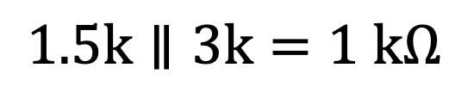

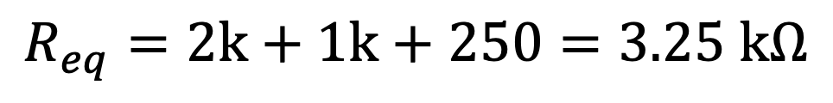
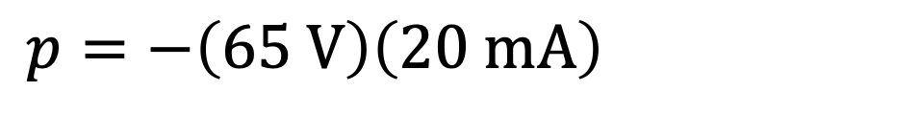

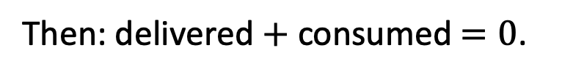
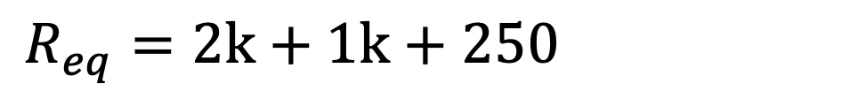
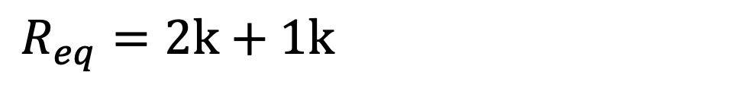
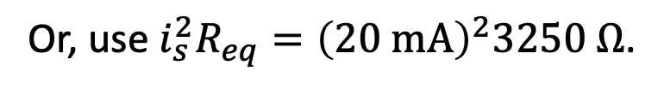
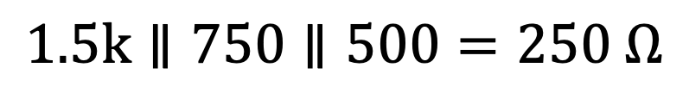
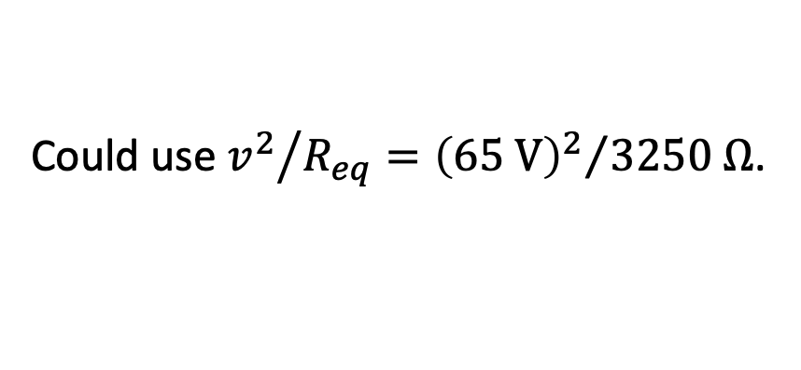
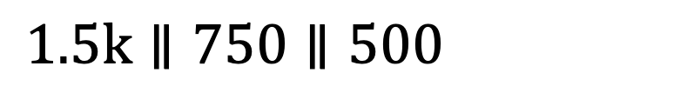
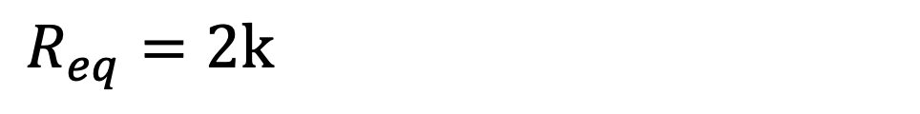
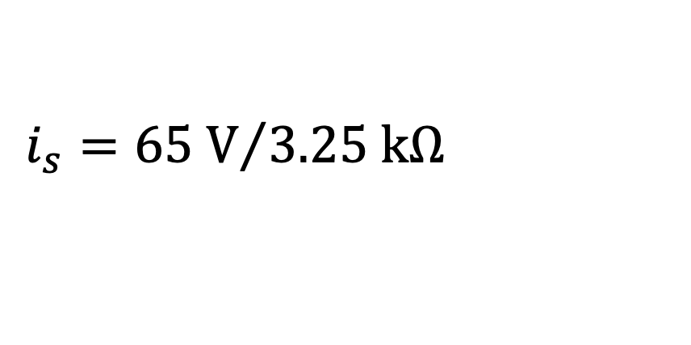
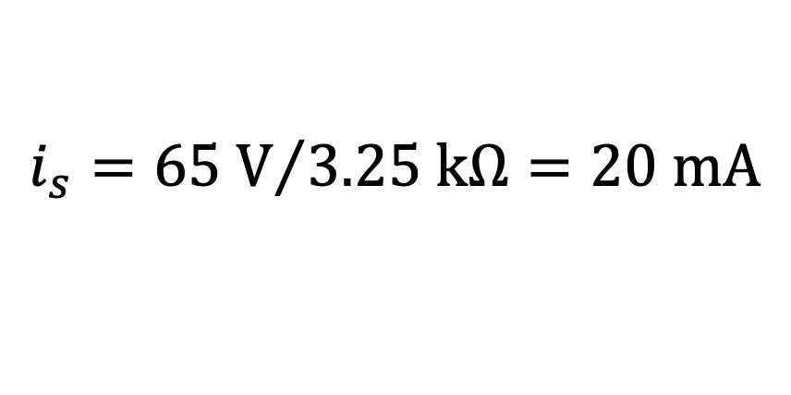
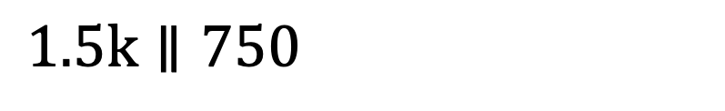
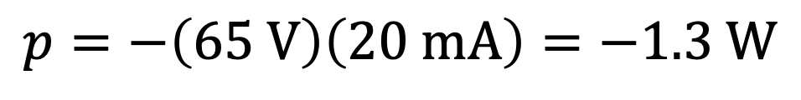

Power delivered?
Current from source?
Resistance across source?
$$1 kΩ$$
z
Series
Parallel
Parallel
i_{s}
Parallel
$$250 Ω$$
$$900+600=1.5 kΩ$$
$$1.5k∥3k=1 kΩ$$
(well, equivalent resistances)
$$1.5k∥750∥500=250 Ω$$
$$1.5k∥750∥500=250 Ω$$
$$1.5k∥750∥500=250 Ω$$
Now only have series resistors!
$$i_{s}={65 V}/{3.25 kΩ}=20 mA$$
$$R_{eq}=2k+1k+250=3.25 kΩ$$
$$i_{s}={65 V}/{3.25 kΩ}=20 mA$$
$$R_{eq}=2k+1k+250=3.25 kΩ$$
$$R_{eq}=2k+1k+250=3.25 kΩ$$
$$R_{eq}=2k+1k+250=3.25 kΩ$$
Could use ${v^{2}}/{R_{eq}}={{\left(65 V\right)}^{2}}/{3250 Ω}$.
$$p=−\left(65 V\right)\left(20 mA\right)=−1.3 W$$
$$p=−\left(65 V\right)\left(20 mA\right)=−1.3 W$$
Or, use $i_{s}^{2}R_{eq}={\left(20 mA\right)}^{2}3250 Ω$.
Then: delivered $+$ consumed $=0$.

Slide 6
Power delivered?
Current from source?
Resistance across source?
With practice, should be able to quickly write:
$$R_{eq}=2k+\left(1.5k∥3k\right)+500∥750∥\left(900+600\right)$$
$$R_{eq}=2k+\left(1.5k∥3k\right)+500∥750∥\left(900+600\right)$$
$$R_{eq}=2k+\left(1.5k∥3k\right)+500∥750∥\left(900+600\right)$$
And, with this, should also be able to quickly calculate this resistance.
Don't forget your calculator for the exam!

Slide 7
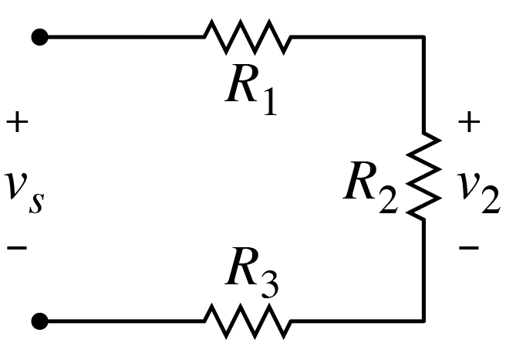
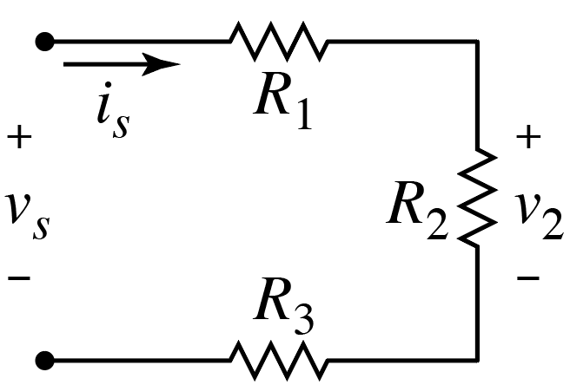
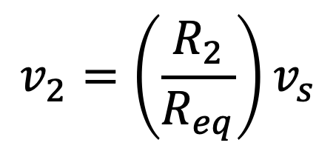
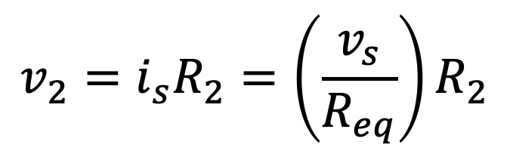

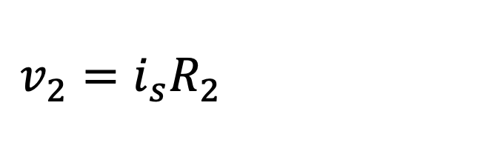
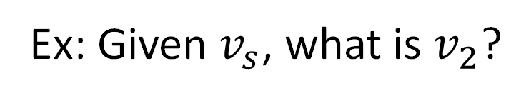
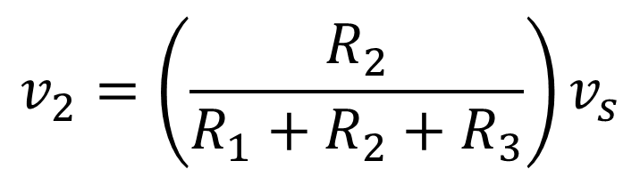
Voltage Division: A shortcut to find voltage across a series element
Voltage Division: A shortcut to find voltage across a series resistor.
Given voltage across series resistors, what is voltage across
a specific individual resistor?
Ex: Given $v_{s}$, what is $v_{2}$?
Without calculating
current.
$$v_{2}=i_{s}R_{2}=\left(\frac{v_{s}}{R_{eq}}\right)R_{2}$$
$$v_{2}=i_{s}R_{2}=\left(\frac{v_{s}}{R_{eq}}\right)R_{2}$$
$$i_{s}$$
$$v_{2}=\left(\frac{R_{2}}{R_{eq}}\right)v_{s}$$
$$v_{2}=\left(\frac{R_{2}}{R_{1}+R_{2}+R_{3}}\right)v_{s}$$
unitless

Slide 8
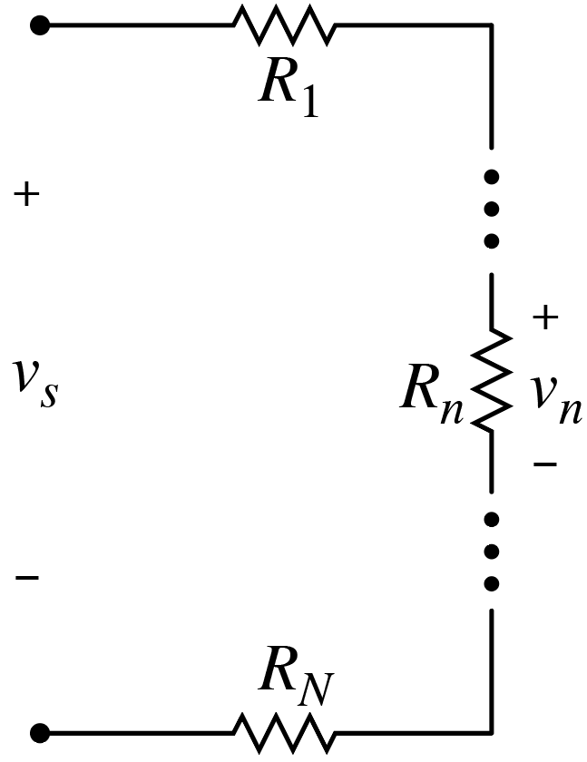
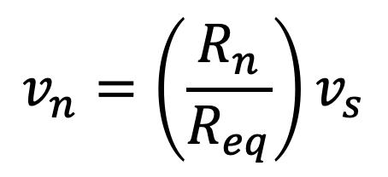

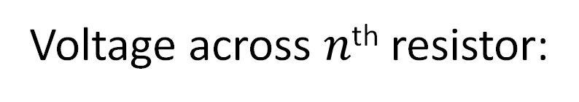
Voltage Division: General Case
Voltage across $n$^{th} resistor:
$$v_{n}=\left(\frac{R_{n}}{R_{eq}}\right)v_{s}$$
Voltage across individual resistors never
larger than voltage across all resistors.
$$v_{n}<v_{s}$$

Slide 9
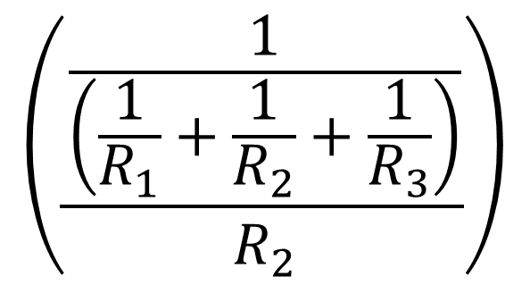
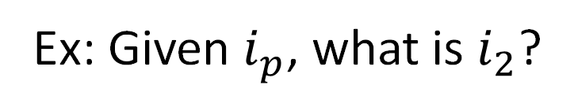

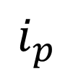

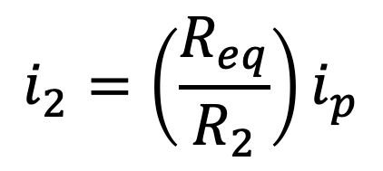
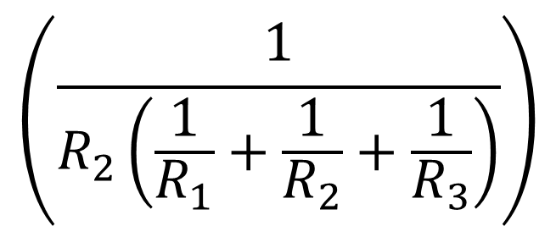

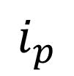
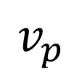

Current Division: A shortcut to find current through a parallel element
Current Division: A shortcut to find current through a parallel resistor.
Given total current into parallel resistors, what is current through
a specific individual resistor?
Ex: Given $i_{p}$, what is $i_{2}$?
Without calculating
voltage.
$$i_{2}=\frac{v_{p}}{R_{2}}=\frac{\left(i_{p}R_{eq}\right)}{R_{2}}$$
$$i_{2}=\frac{v_{p}}{R_{2}}=\frac{\left(i_{p}R_{eq}\right)}{R_{2}}$$
$$v_{p}$$
$$i_{2}=\left(\frac{R_{eq}}{R_{2}}\right)i_{p}$$
unitless
$$\left(\frac{\frac{1}{\left(\frac{1}{R_{1}}+\frac{1}{R_{2}}+\frac{1}{R_{3}}\right)}}{R_{2}}\right)$$
$$\left(\frac{1}{R_{2}\left(\frac{1}{R_{1}}+\frac{1}{R_{2}}+\frac{1}{R_{3}}\right)}\right)$$
$$i_{2}=$$
$$i_{p}$$
$$=$$
$$i_{p}$$

Slide 10
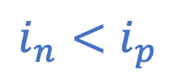

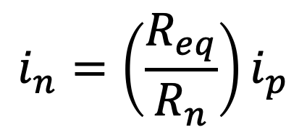
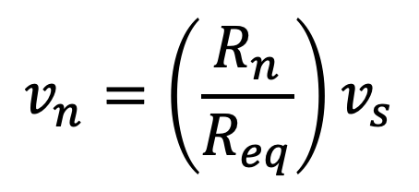
Current Division: General Case
Voltage Division: General Case
Current through $n$^{th} resistor:
$$i_{n}=\left(\frac{R_{eq}}{R_{n}}\right)i_{p}$$
Current through individual resistors never
larger than current through all resistors.
$$v_{n}=\left(\frac{R_{n}}{R_{eq}}\right)v_{s}$$
$$i_{n}<i_{p}$$
Current division only pertains to
parallel resistors.
Voltage division only pertains to
series resistors.

Slide 11
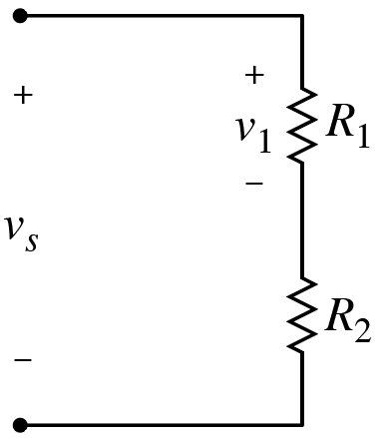









Following can lead to confusion! Consider ignoring. But, useful reality check emerges.
Following can lead to confusion! Consider ignoring. But, useful reality check emerges.
Following can lead to confusion! Consider ignoring. But, useful reality check emphasized.
Voltage division for two resistors.
Current division for two resistors.
Largest voltage
appears across
largest resistor.
$$+ \\ v_{2} \\ −$$
Largest current flows through smallest resistor.
$$i_{1}=\left(\frac{R_{eq}}{R_{1}}\right)i_{p}=\left(\frac{\left(\frac{R_{1}R_{2}}{R_{1}+R_{2}}\right)}{R_{1}}\right)i_{p}$$
$$i_{1}=\left(\frac{R_{eq}}{R_{1}}\right)i_{p}=\left(\frac{\left(\frac{R_{1}R_{2}}{R_{1}+R_{2}}\right)}{R_{1}}\right)i_{p}$$
$$i_{1}=\left(\frac{R_{eq}}{R_{1}}\right)i_{p}=\left(\frac{\left(\frac{R_{1}R_{2}}{R_{1}+R_{2}}\right)}{R_{1}}\right)i_{p}$$
Good to keep in mind!
$$v_{1}=\left(\frac{R_{1}}{R_{eq}}\right)v_{s}$$
If $R_{1}>R_{2}$,
then $v_{1}>v_{2}$.
If $R_{2}>R_{1}$,
then $i_{1}>i_{2}$.
This approach only holds for two resistors.
Convenient, but
potentially confusing!
$$v_{1}=\left(\frac{R_{1}}{R_{1}+R_{2}}\right)v_{s}$$
$$i_{1}=\left(\frac{R_{2}}{R_{1}+R_{2}}\right)i_{p}$$
(Individual terms
meaningful.)
(Individual terms
not meaningful.)

Slide 12













Current
Division
$$i_{n}=\left(\frac{R_{eq}}{R_{n}}\right)i_{p}$$
Voltage
Division
$$v_{n}=\left(\frac{R_{n}}{R_{eq}}\right)v_{s}$$
Consider:
Result independent of this resistor!
(Source power not
independent of this
resistor.)
What is $i_{1}$?
$1 A$
$2 A$
$3 A$
$4 A$
$6 A$
$$8 A$$
Know more than half of
the current goes through
smaller resistor.
$$R_{eq}=\frac{\left(1k\right)\left(3k\right)}{1k+3k}=\frac{3k^{2}}{4k}=\frac{3}{4}k=750 Ω$$
$$R_{eq}=\frac{\left(1k\right)\left(3k\right)}{1k+3k}=\frac{3k^{2}}{4k}=\frac{3}{4}k=750 Ω$$
$$R_{eq}=\frac{\left(1k\right)\left(3k\right)}{1k+3k}=\frac{3k^{2}}{4k}=\frac{3}{4}k=750 Ω$$
$$R_{eq}=\frac{\left(1k\right)\left(3k\right)}{1k+3k}=\frac{3k^{2}}{4k}=\frac{3}{4}k=750 Ω$$
More rigorously:
$$i_{1}=\left(\frac{750 Ω}{1 kΩ}\right) 8 A=\left(\frac{3}{4}\right)8 A=6 A$$
$$i_{1}=\left(\frac{750 Ω}{1 kΩ}\right) 8 A=\left(\frac{3}{4}\right)8 A=6 A$$
$$i_{1}=\left(\frac{750 Ω}{1 kΩ}\right) 8 A=\left(\frac{3}{4}\right)8 A=6 A$$
Current division:

Slide 13











Current
Division
$$i_{n}=\left(\frac{R_{eq}}{R_{n}}\right)i_{p}$$
Voltage
Division
$$v_{n}=\left(\frac{R_{n}}{R_{eq}}\right)v_{s}$$
Consider:
Result
independent
of this resistor!
$$+$$
What is $v_{2}$?
$40 V$
$30 V$
$20 V$
$15 V$
$10 V$
Know more than half
the voltage appears
across larger resistor.
$$60 V$$
(Source power not
independent of this
resistor.)
$$−$$
More rigorously:
$$R_{eq}=10+5=15 Ω$$
$$v_{2}=\left(\frac{10 Ω}{15 Ω}\right)60 V=\left(\frac{2}{3}\right)60 V=40 V$$
$$v_{2}=\left(\frac{10 Ω}{15 Ω}\right)60 V=\left(\frac{2}{3}\right)60 V=40 V$$
$$v_{2}=\left(\frac{10 Ω}{15 Ω}\right)60 V=\left(\frac{2}{3}\right)60 V=40 V$$
Voltage division:

Slide 14

Consider:
Three connections to an
arbitrary collection of
resistors.
Why three? One reason:
relevant to how power
delivered.
Why three? One reason:
relevant to how power
delivered.

Slide 15
Consider:
Three connections to an
arbitrary collection of
resistors.
Interior isn’t unknown,
necessarily, but can be
any collection of resistors.
Regardless of interior,
can always model as
just three resistors
between connections.

Slide 16



Can attach test voltage and measure
resulting current to determine resistance
between nodes $α$ and $β$:
$$R_{αβ}={v_{t}}/{i_{t}}$$

Slide 17



Can attach test voltage and measure
resulting current to determine resistance
between nodes $α$ and $γ$:
$$R_{αγ}={v_{t}}/{i_{t}}$$

Slide 18



Can attach test voltage and measure
resulting current to determine resistance
between nodes $β$ and $γ$:
$$R_{βγ}={v_{t}}/{i_{t}}$$

Slide 19










Three connections to arbitrary collection of resistors.
Two resistors per $a$, $b$, $c$ node.
Can model interior using as few as three resistors.
Two choices:
$Δ$ (Delta)
or $Y$ (wye).
$$\left(R_{a},R_{b},R_{c}\right)$$
$$≠$$
$$(R_{1},R_{2},R_{3})$$
$R_{αβ}$, $R_{αγ}$, and $R_{βγ}$ same regardless of chosen
interior model. Not interested in conversion of
arbitrary collection to $Δ$ or $Y$. Instead, interested
in converting from $Δ$ to $Y$, or vice versa.
$R_{αβ}$, $R_{αγ}$, and $R_{βγ}$ same regardless of chosen
interior model. Not interested in conversion of
arbitrary collection to $Δ$ or $Y$. Instead, interested
in converting from $Δ$ to $Y$, or vice versa.
$R_{αβ}$, $R_{αγ}$, and $R_{βγ}$ same regardless of chosen
interior model. Not interested in conversion of
arbitrary collection to $Δ$ or $Y$. Instead, interested
in converting from $Δ$ to $Y$, or vice versa.
One resistors per $a$, $b$, $c$ node; three at center node.

