Slide 1
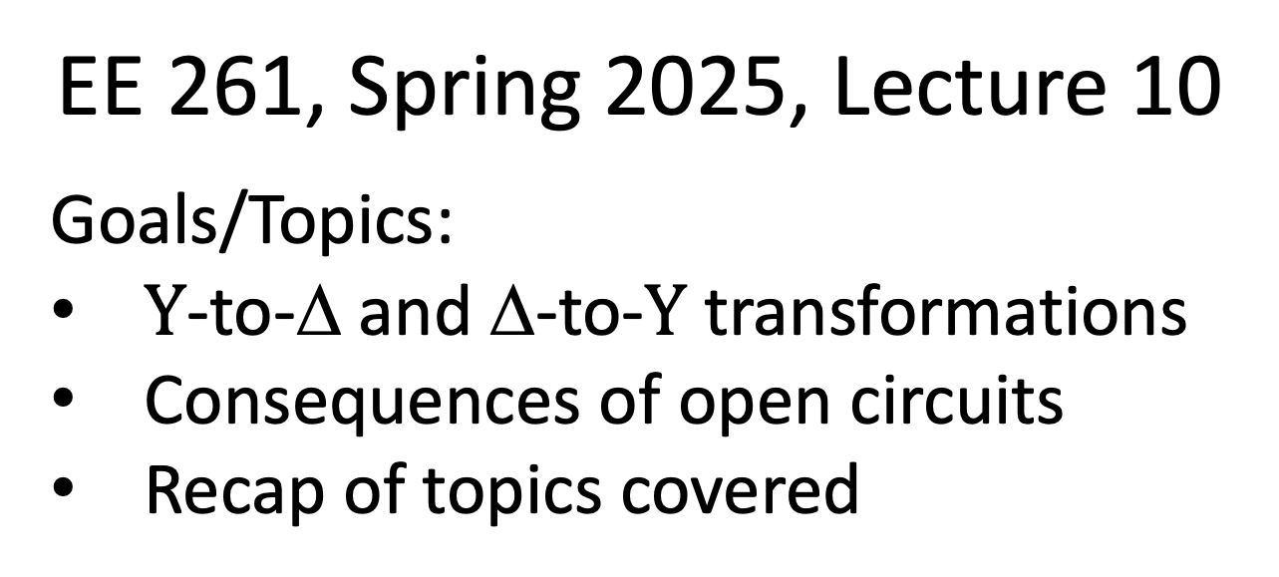
EE 261, Spring 2025, Lecture 10
Goals/Topics:
$Y$-to-Δ and Δ-to-$Y$ transformations
Consequences of open circuits
Recap of topics covered
Best viewed in
presentation mode
in PowerPoint.
Announcements:
Homework 3 due by midnight today.
Test 1 this Friday, Jan. 31 at 7:00 p.m. in Spark G45.
(Optional) Review session Friday at usual lecture time.

Slide 2
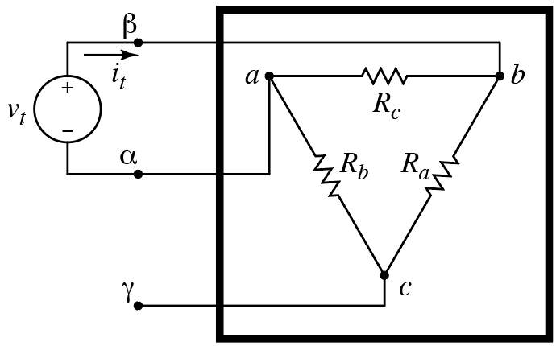
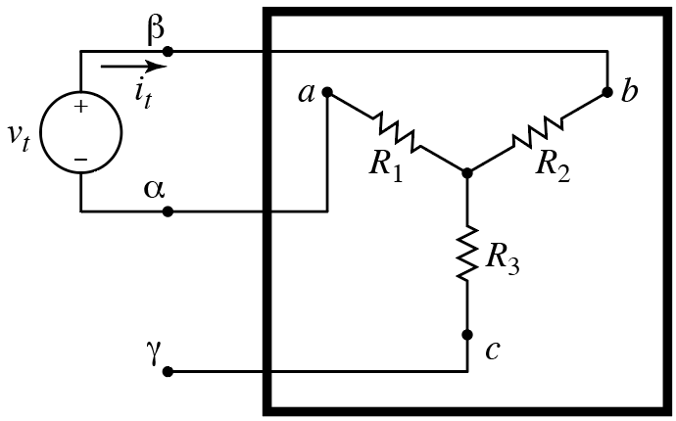
Consider $R_{αβ}$:
Resistance between terminals is the same.
doesn’t
matter (yet)
no current
through $R_{3}$
$Δ$ configuration
$Y$ configuration
$$R_{αβ}=R_{c}∥\left(R_{a}+R_{b}\right)=\frac{R_{c}\left(R_{a}+R_{b}\right)}{R_{a}+R_{b}+R_{c}}$$
$$R_{αβ}=R_{c}∥\left(R_{a}+R_{b}\right)=\frac{R_{c}\left(R_{a}+R_{b}\right)}{R_{a}+R_{b}+R_{c}}$$
$$R_{αβ}=R_{1}+R_{2}$$
Equate expressions
for resistance:
$$R_{αβ}=\frac{R_{c}\left(R_{a}+R_{b}\right)}{R_{a}+R_{b}+R_{c}}=R_{1}+R_{2}$$
One equation relating two
sets of three variables.

Slide 3

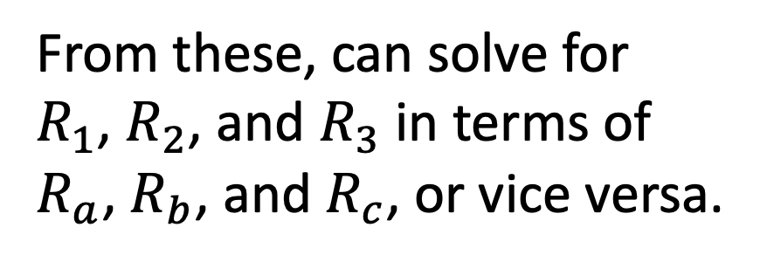

From previous slide:
$$R_{αβ}=\frac{R_{c}\left(R_{a}+R_{b}\right)}{R_{a}+R_{b}+R_{c}}=R_{1}+R_{2}$$
Three equations relating
two sets of three variables.
Similarly for other pairs of nodes:
From these, can solve for
$R_{1}$, $R_{2}$, and $R_{3}$ in terms of
$R_{a}$, $R_{b}$, and $R_{c}$, or vice versa.
$$R_{βγ}=\frac{R_{a}\left(R_{b}+R_{c}\right)}{R_{a}+R_{b}+R_{c}}=R_{2}+R_{3}$$
$$R_{αγ}=\frac{R_{b}\left(R_{a}+R_{c}\right)}{R_{a}+R_{b}+R_{c}}=R_{1}+R_{3}$$
(The algebra is left to you if
you’re interested.)
$Δ$ configuration
$Y$ configuration

Slide 4
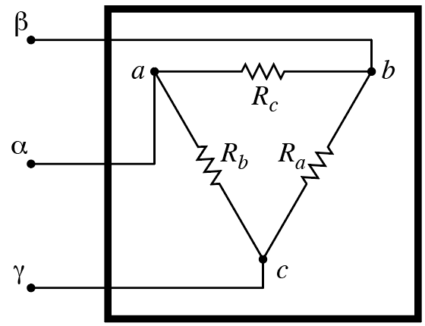
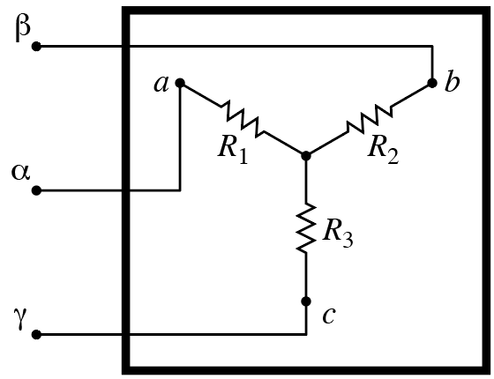
Convert from Δ ($R_{a}$, $R_{b}$, $R_{c}$) to $Y$ ($R_{1}$, $R_{2}$, $R_{3}$):
$Δ$ known.
$$R_{1}=\frac{R_{b}R_{c}}{R_{a}+R_{b}+R_{c}}$$
$$R_{2}=\frac{R_{a}R_{c}}{R_{a}+R_{b}+R_{c}}$$
Want $Y$.
$$R_{3}=\frac{R_{a}R_{b}}{R_{a}+R_{b}+R_{c}}$$
This conversion may allow us to solve a
circuit more easily than we could otherwise.

Slide 5
Convert from $Y$ ($R_{1}$, $R_{2}$, $R_{3}$) to Δ ($R_{a}$, $R_{b}$, $R_{c}$):
$Y$ known.
$$R_{a}=\frac{R_{1}R_{2}+R_{2}R_{3}+R_{1}R_{3}}{R_{1}}$$
$$R_{b}=\frac{R_{1}R_{2}+R_{2}R_{3}+R_{1}R_{3}}{R_{2}}$$
Want $Δ$.
$$R_{c}=\frac{R_{1}R_{2}+R_{2}R_{3}+R_{1}R_{3}}{R_{3}}$$
This conversion may allow us to solve a
circuit more easily than we could otherwise.

Slide 6
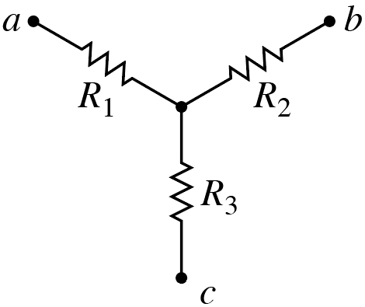
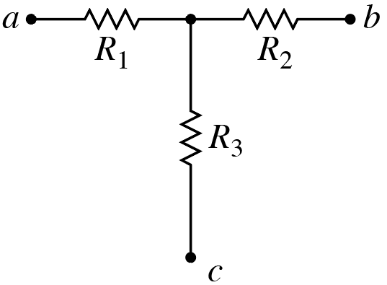
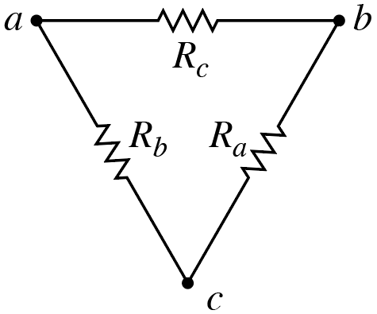
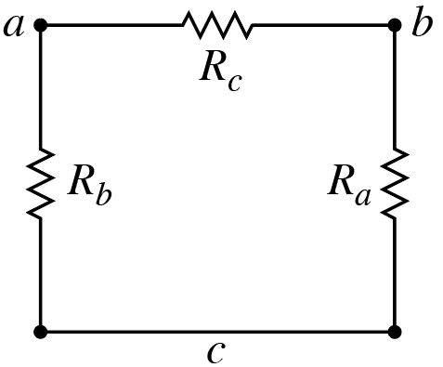
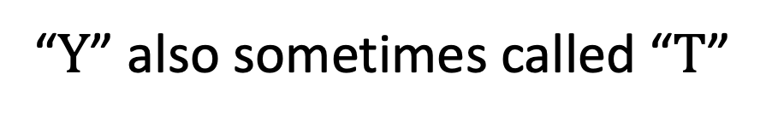
“$Y$” also sometimes called “$T$”
Same
“Δ” also sometimes called “Π” (pi)
Same

Slide 7
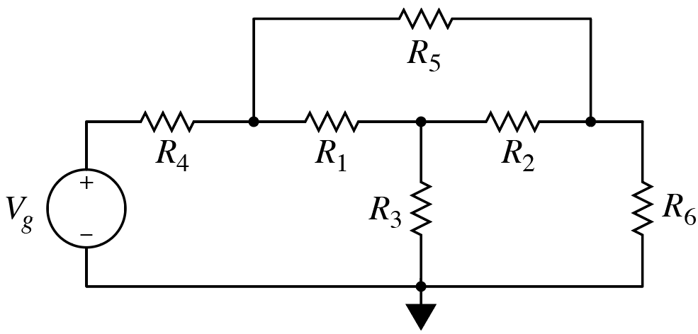
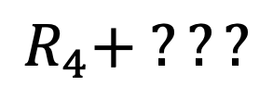
Consider:
Any resistors in series?
A) Yes B) No
Any resistors in parallel?
A) Yes B) No
Resistance seen by voltage source?
Uhm…
$$R_{4}+ ???$$

Slide 8
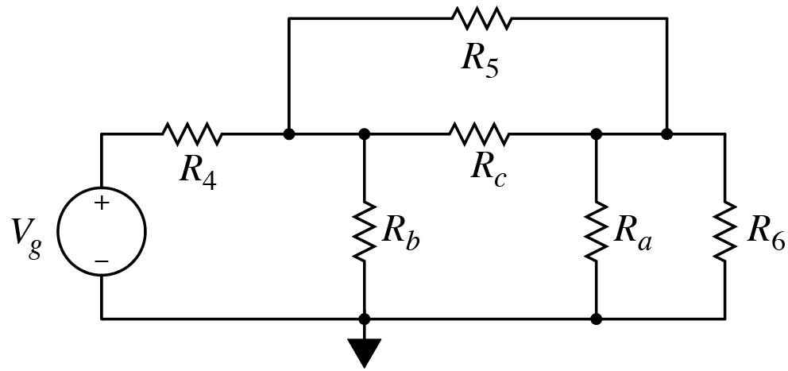
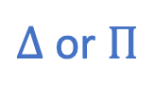

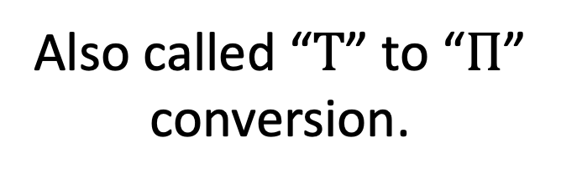
Consider: Convert from Y ($R_{1}$, $R_{2}$, $R_{3}$) to Δ ($R_{a}$, $R_{b}$, $R_{c}$):
Consider: Convert from $Y$ ($R_{1}$, $R_{2}$, $R_{3}$) to Δ ($R_{a}$, $R_{b}$, $R_{c}$):
$Y$ or $T$
Also called “$T$” to “$Π$”
conversion.
$Δ$ or $Π$
Electrically the same
(except for converted
resistors)

Slide 9

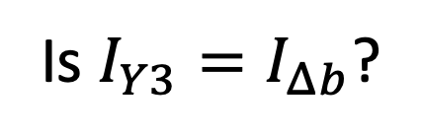


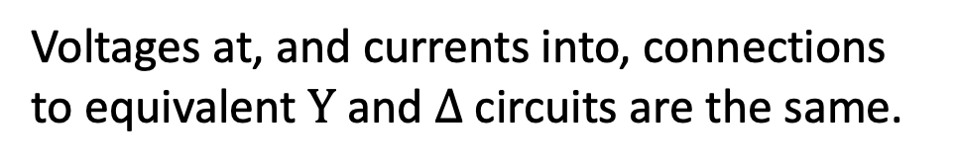


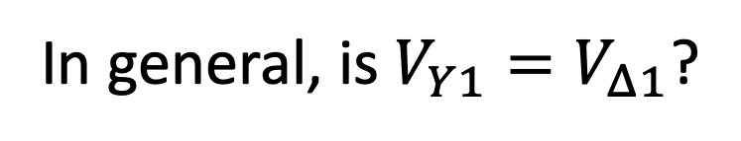
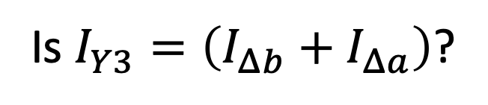
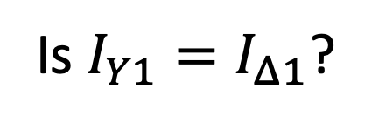
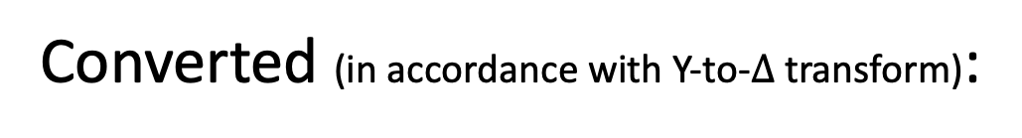


Original:
In general, is $V_{Y1}=V_{Δ1}$?
$$I_{Y1}$$
A) Yes B) No
$$V_{Y1}$$
$$I_{Y3}$$
Is $I_{Y1}=I_{Δ1}$?
A) Yes B) No
Is $I_{Y3}=I_{Δb}$?
Converted (in accordance with Y-to-$Δ$ transform):
A) Yes B) No
$$I_{Δ1}$$
Is $I_{Y3}=\left(I_{Δb}+I_{Δa}\right)$?
$$V_{Δ1}$$
$$I_{Δb}$$
$$I_{Δa}$$
A) Yes B) No
Voltages at, and currents into, connections
to equivalent $Y$ and $Δ$ circuits are the same.
Total current flow at “bottom” is same.

Slide 10
Original:
Any resistors in series?
A) Yes B) No
Any resistors in parallel?
A) Yes B) No
Converted:
Any resistors in series?
A) Yes B) No
Any resistors in parallel?
A) Yes B) No

Slide 11





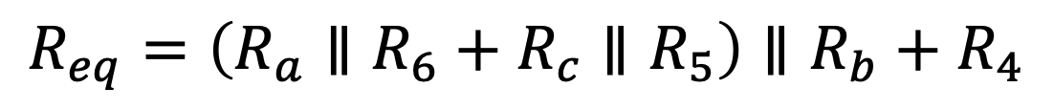
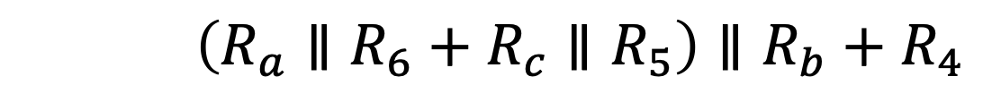
Converted:
Equivalents of these parallel
resistances are in series.
With parallel resistors, now “easy” to obtain $R_{eq}$ seen by source:
These parentheses required.
$$R_{eq}=\left(R_{a}∥R_{6}+R_{c}∥R_{5}\right)∥R_{b}+R_{4}$$
$$R_{eq}=\left(R_{a}∥R_{6}+R_{c}∥R_{5}\right)∥R_{b}+R_{4}$$
$$R_{eq}=\left(R_{a}∥R_{6}+R_{c}∥R_{5}\right)∥R_{b}+R_{4}$$
$$R_{eq}=\left(R_{a}∥R_{6}+R_{c}∥R_{5}\right)∥R_{b}+R_{4}$$
$$R_{eq}=\left(R_{a}∥R_{6}+R_{c}∥R_{5}\right)∥R_{b}+R_{4}$$
$$R_{eq}=\left(R_{a}∥R_{6}+R_{c}∥R_{5}\right)∥R_{b}+R_{4}$$
Note: “$∥$” has higher precedence than “$+$”.
Feel free to use parentheses as
needed to added clarity to expressions.
$$R_{a}∥R_{6}+R_{c}∥R_{5}=\left(R_{a}∥R_{6}\right)+\left(R_{c}∥R_{5}\right)≠R_{a}∥\left(R_{6}+R_{c}\right)∥R_{5}$$
$$R_{a}∥R_{6}+R_{c}∥R_{5}=\left(R_{a}∥R_{6}\right)+\left(R_{c}∥R_{5}\right)≠R_{a}∥\left(R_{6}+R_{c}\right)∥R_{5}$$

Slide 12


Consider:
$Y$ here
$Y$ here
Δ here
More ways to solve this circuit
based on transformations!
(See posted video in Week 3 Module
for further details.)
Δ here
Electrically the same
(except for converted
resistors)

Slide 13
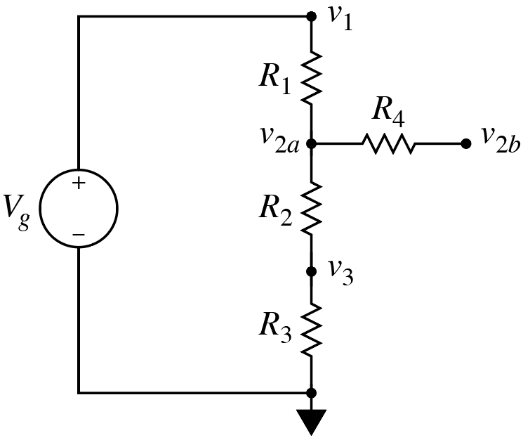

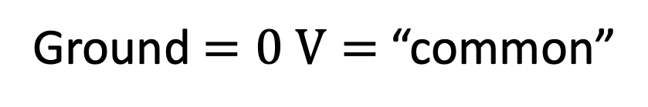

Consider:
Ground $=0 V=$ “common”
Ground $=0 V=$ “common”
Ground $=0 V=$ “common”

Slide 14
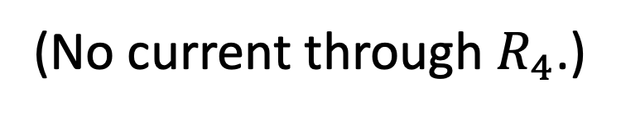
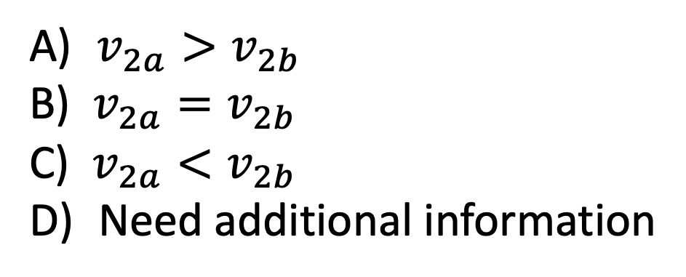

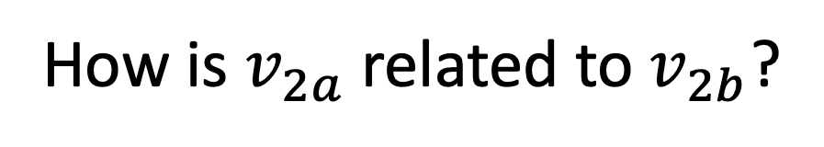
Consider:
Can get voltage across $R_{1}$, $R_{2}$, and $R_{3}$ using voltage division.
Right side of $R_{4}$ not attached to anything.
(No current through $R_{4}$.)
How is $v_{2a}$ related to $v_{2b}$?
A) $v_{2a}>v_{2b}$
B) $v_{2a}=v_{2b}$
C) $v_{2a}<v_{2b}$
D) Need additional information

Slide 15
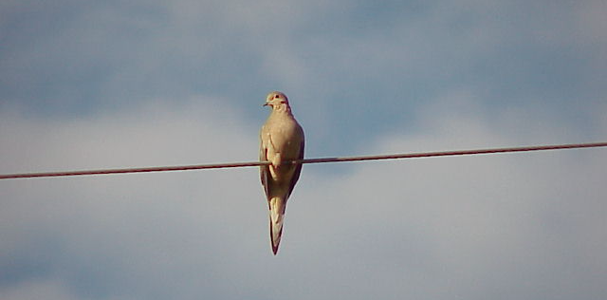
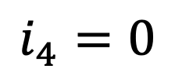
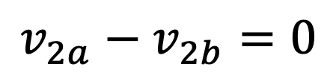
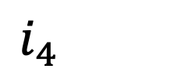
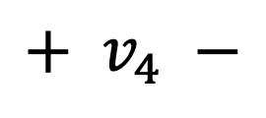
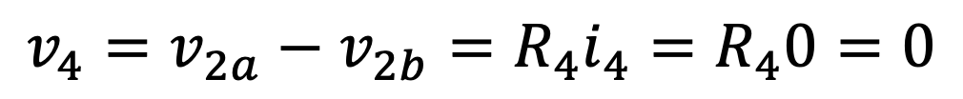
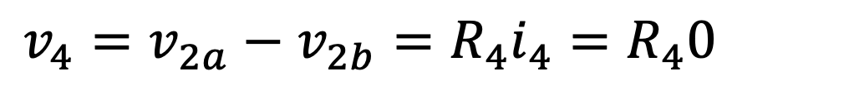
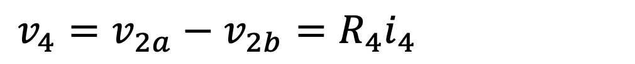
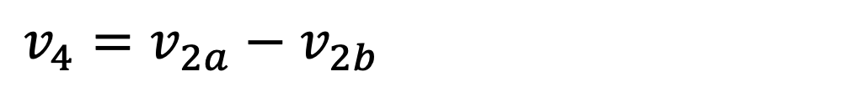
Consider:
Can get voltage across $R_{1}$, $R_{2}$, and $R_{3}$ using voltage division.
Right side of $R_{4}$ not attached to anything.
(No current through $R_{4}$.)
$$i_{4}=0$$
$$i_{4}=0$$
$$v_{2a}−v_{2b}=0$$
$$v_{4}=v_{2a}−v_{2b}={R_{4}i}_{4}=R_{4}0=0$$
$$v_{4}=v_{2a}−v_{2b}={R_{4}i}_{4}=R_{4}0=0$$
$$v_{4}=v_{2a}−v_{2b}={R_{4}i}_{4}=R_{4}0=0$$
$$+ v_{4} −$$
$$v_{4}=v_{2a}−v_{2b}={R_{4}i}_{4}=R_{4}0=0$$
How is $v_{2a}$ related to $v_{2b}$?
A) $v_{2a}>v_{2b}$
B) $v_{2a}=v_{2b}$
C) $v_{2a}<v_{2b}$
D) Need additional information
Current cannot flow through $R_{4}$, so no voltage drop across it.

Slide 16
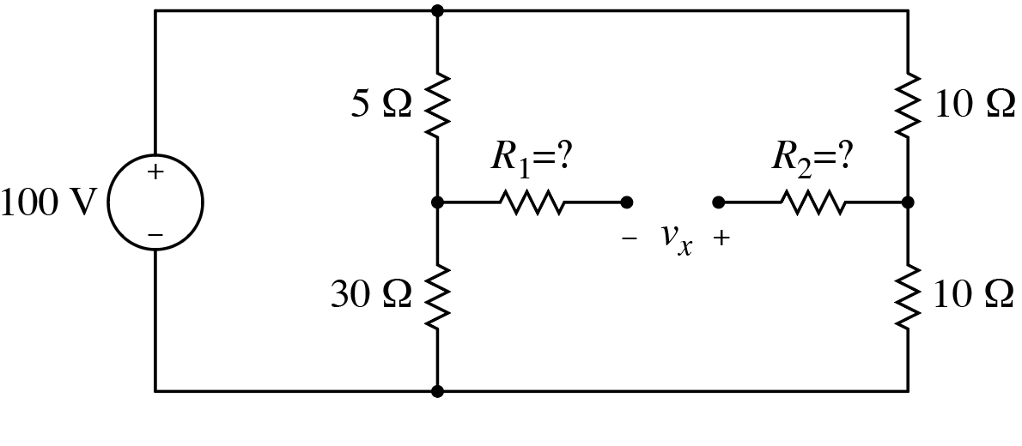
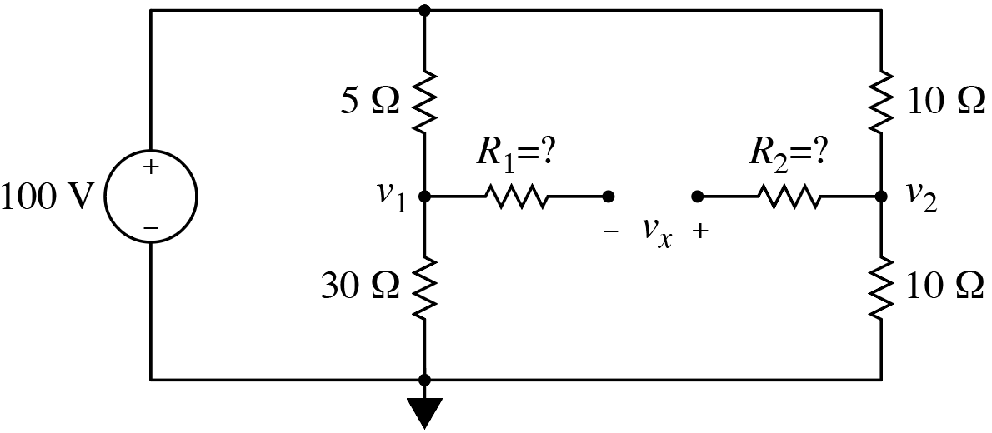
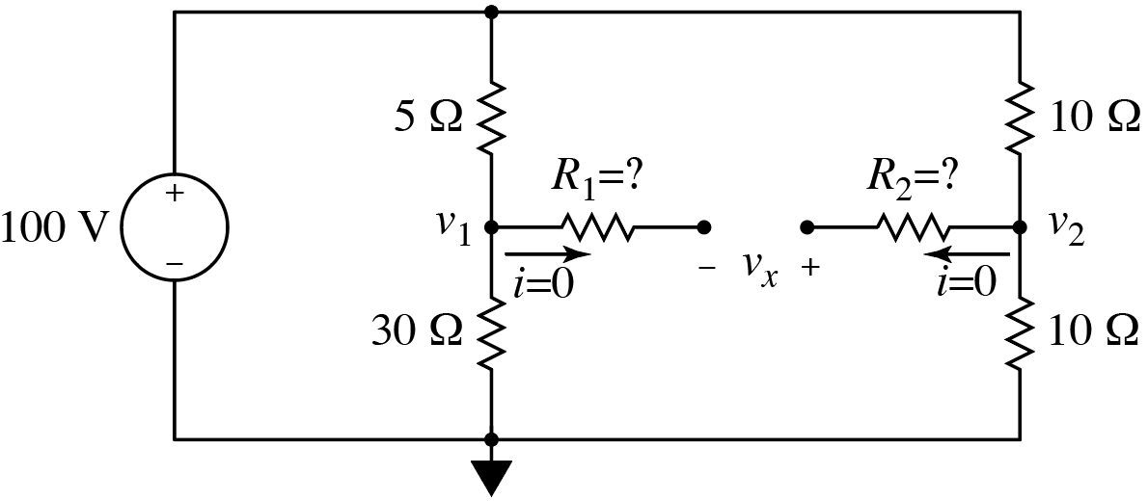
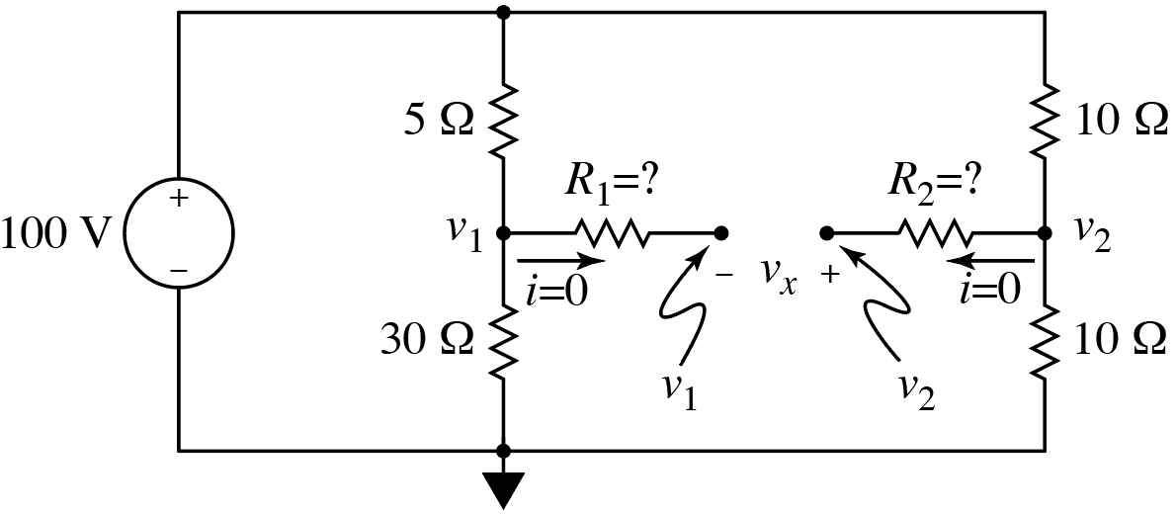
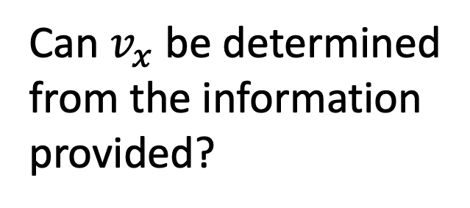
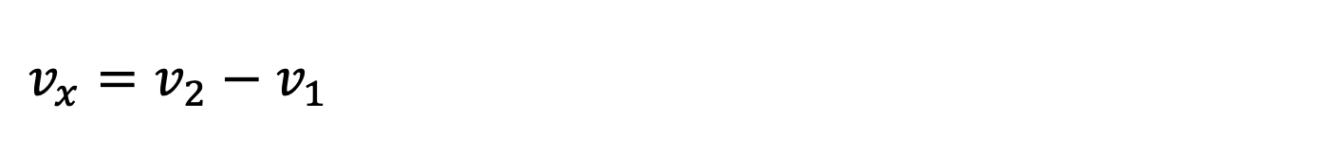
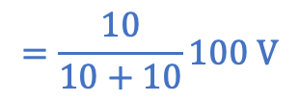
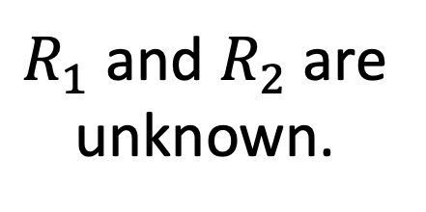
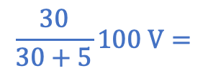
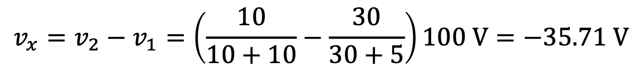

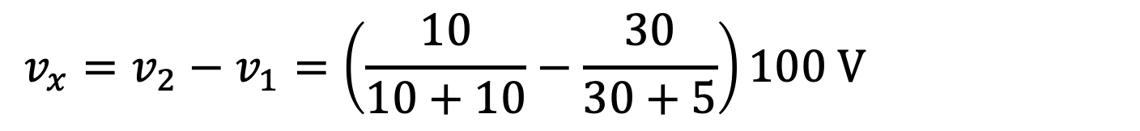
Consider:
$R_{1}$ and $R_{2}$are
unknown.
$$\frac{30}{30+5}100 V=$$
$$=\frac{10}{10+10}100 V$$
Can $v_{x}$ be determined
from the information
provided?
Add voltage labels.
Yes
No
No path for current to flow through resistors $R_{1}$ and $R_{2}$.
Voltages at both ends of $R_{1}$ and $R_{2}$must be the same.
Can determine $v_{1}$ and $v_{2}$using voltage division.
$$v_{x}=v_{2}−v_{1}=\left(\frac{10}{10+10}−\frac{30}{30+5}\right)100 V=−35.71 V$$
$$v_{x}=v_{2}−v_{1}=\left(\frac{10}{10+10}−\frac{30}{30+5}\right)100 V=−35.71 V$$
$$v_{x}=v_{2}−v_{1}=\left(\frac{10}{10+10}−\frac{30}{30+5}\right)100 V=−35.71 V$$

Slide 17

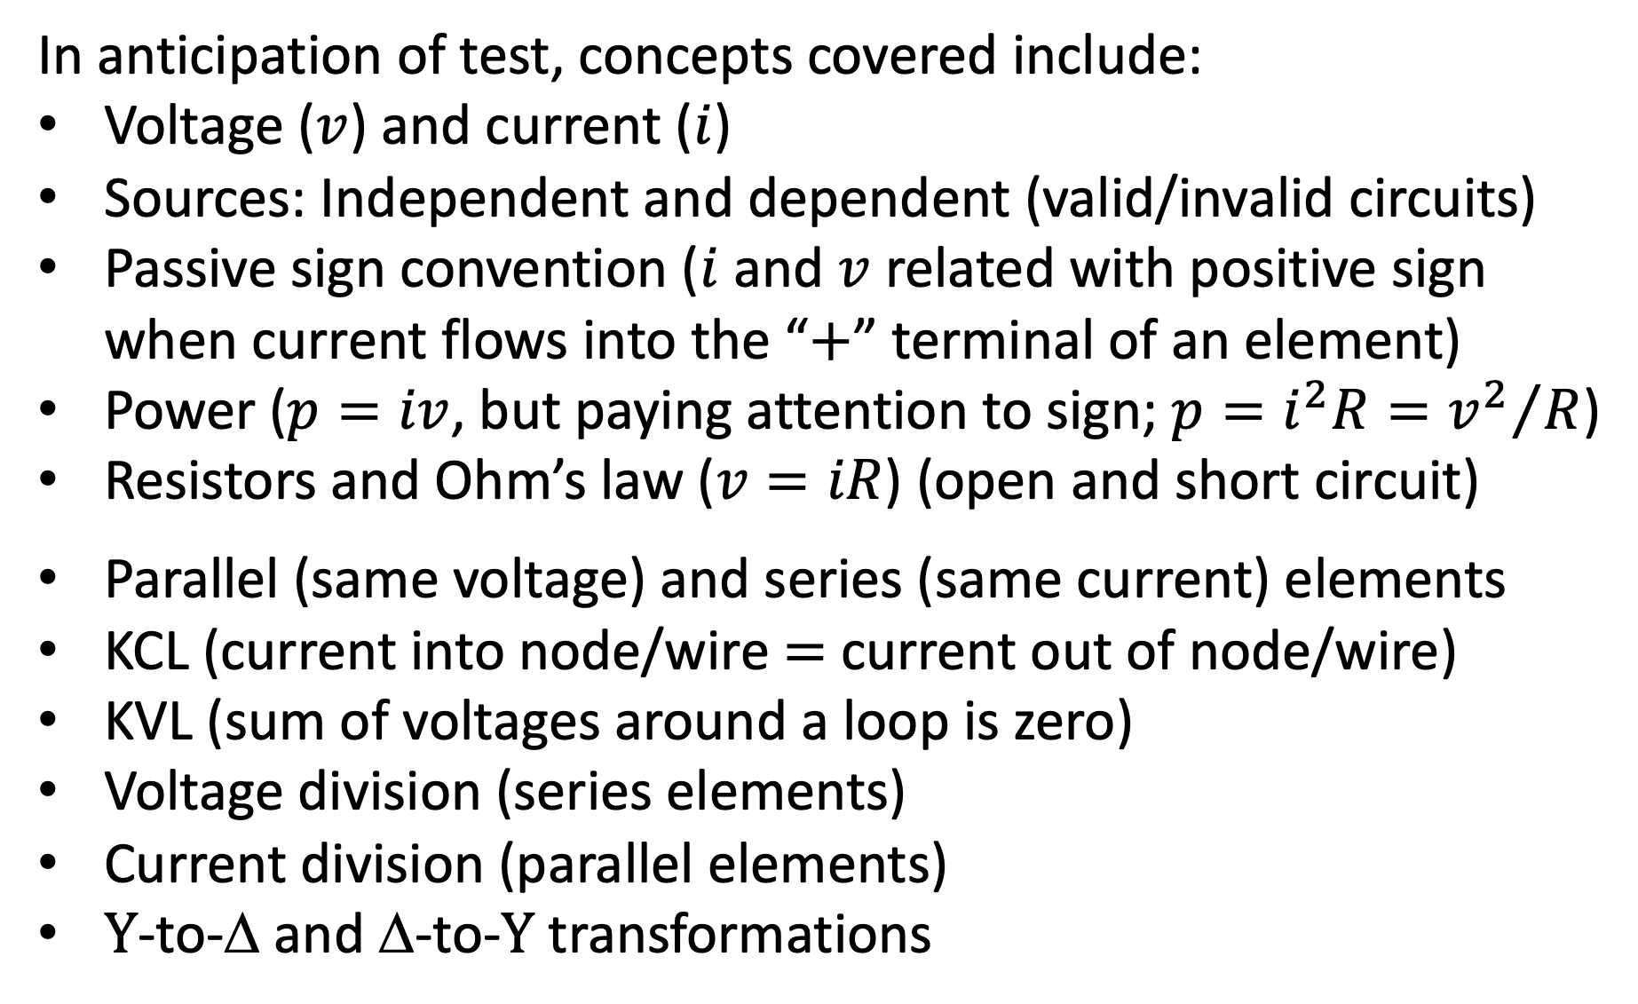

In anticipation of test, concepts covered include:
Voltage ($v$) and current ($i$)
Sources: Independent and dependent (valid/invalid circuits)
Passive sign convention ($i$ and $v$ related with positive sign
when current flows into the “$+$” terminal of an element)
Power ($p=iv$, but paying attention to sign; $p=i^{2}R={v^{2}}/R$)
Resistors and Ohm’s law ($v=iR$) (open and short circuit)
Parallel (same voltage) and series (same current) elements
KCL (current into node/wire $=$ current out of node/wire)
KVL (sum of voltages around a loop is zero)
Voltage division (series elements)
Current division (parallel elements)
$Y$-to-Δ and Δ-to-$Y$ transformations
$$R_{oc}=∞$$
$R_{sc}=0=$ wire

